Slide 1
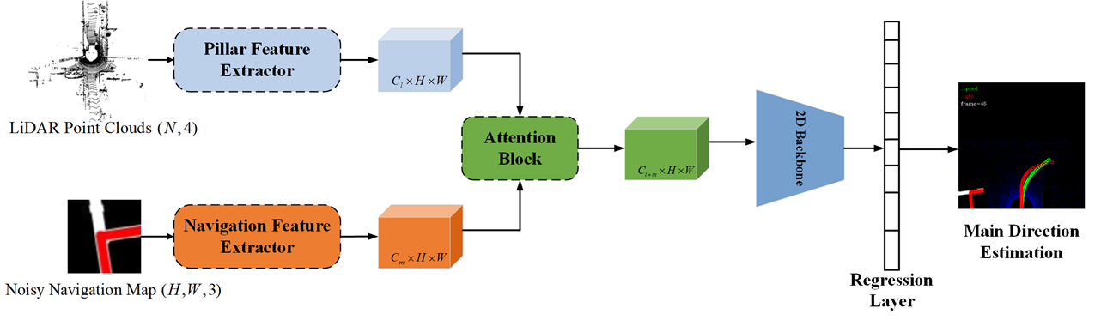
DirectionNet: Road Main Direction Estimation for Autonomous Vehicles from LiDAR Point Clouds
Wancheng Shen, Meiping Shi and Tao Wu
The College of Intelligence Science and Technology,
National University of Defense Technology, China
Inspired by the human's driving style
Road main direction representation with spatial-sampling method
Utilizing the channel attention mechanism and the spatial attention mechanism to enhance generalization ability
An intermediate way transiting from traditional methods to end-to-end autonomous driving methods
Overview of the DirectionNet

