Slide 1
DirectionNet:Road Main Direction Estimation for Autonomous Vehicles from LiDAR Point Clouds
Wancheng Shen¹, Meiping Shi¹ and Tao Wu¹
¹College of Intelligence Science and Technology
National University of Defense Technology
ARM 2022

Slide 2
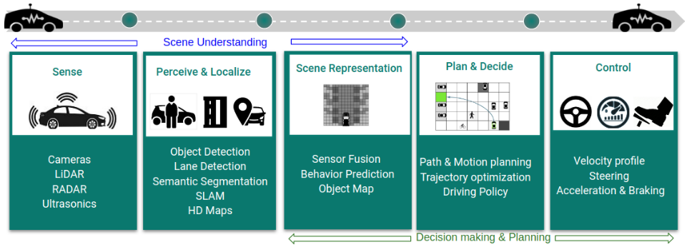
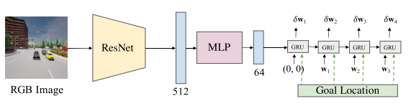
Introduction
Autonomous Driving
traditional methods
end-to-end methods

Slide 3
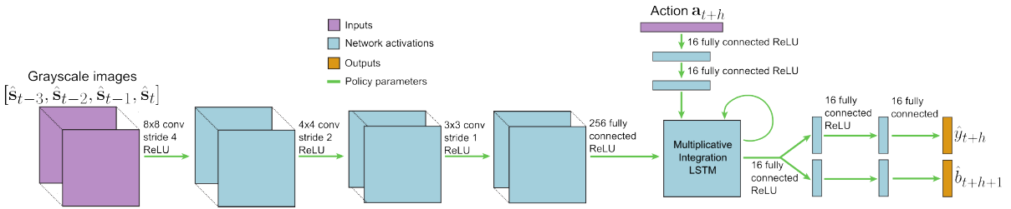
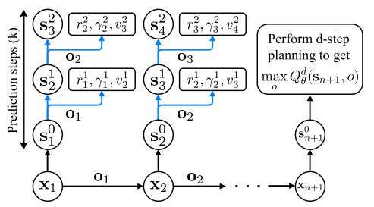
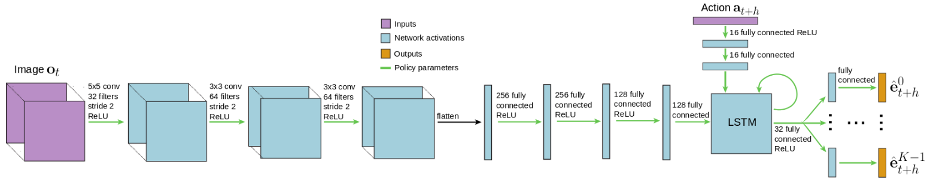
Existing Approaches
Reinforcement Learning
GCGS
VPN
BADGR

Slide 4
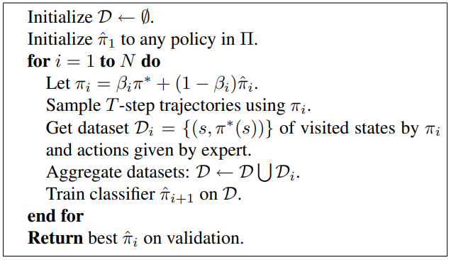
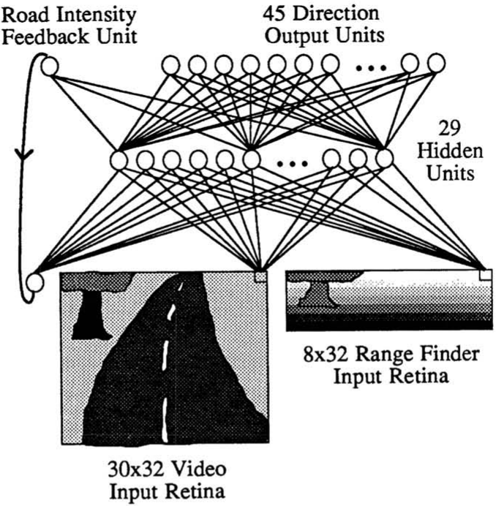
Existing Approaches
Imitation Learning
ALVINN
DAgger

Slide 5
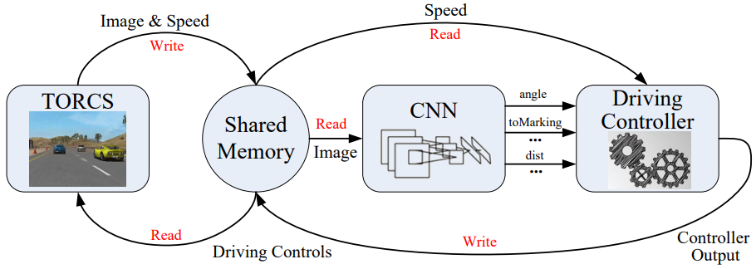
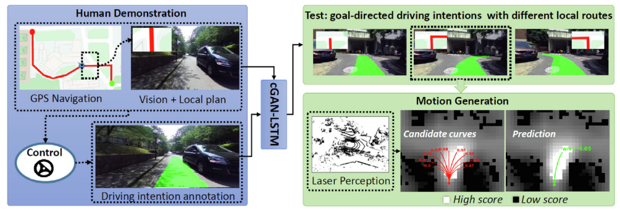
Existing Approaches
Direct Perception Approach
DeepDriving
DeepGoal

Slide 6

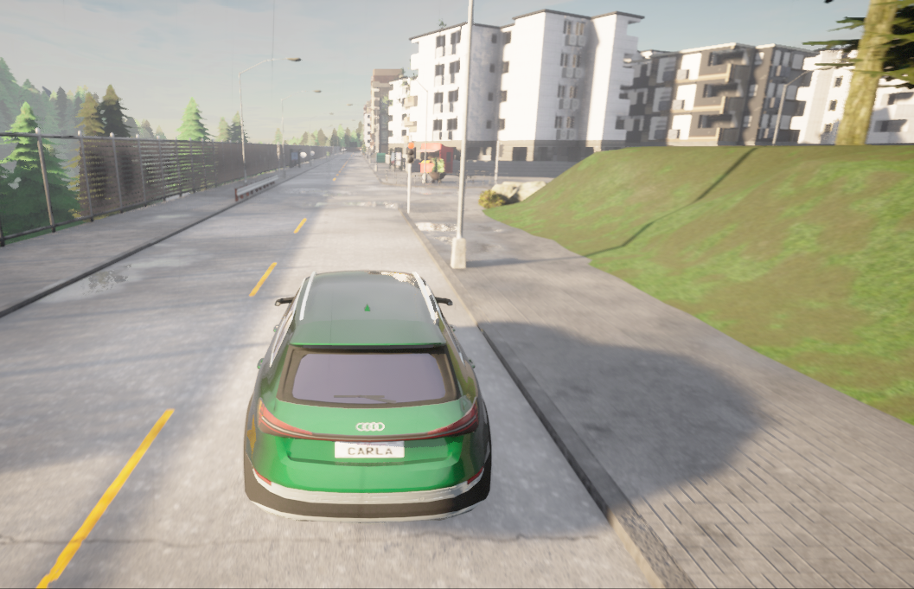
Motivation
human's driving style
simple navigation map
road structure

Slide 7
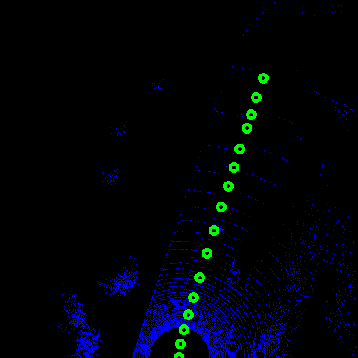
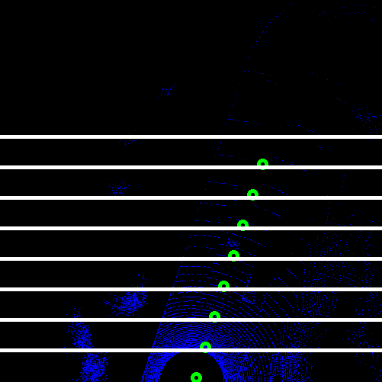

Methods
Road Main Direction Representation
time-sampling method
spatial-sampling method

Slide 8
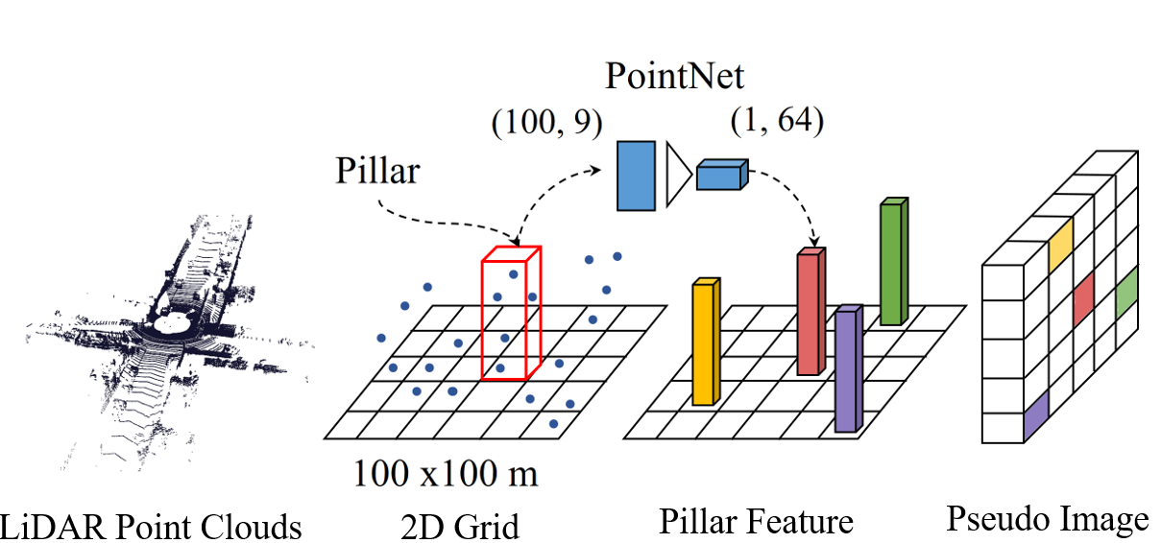
Methods
Point Clouds Feature Extraction

Slide 9
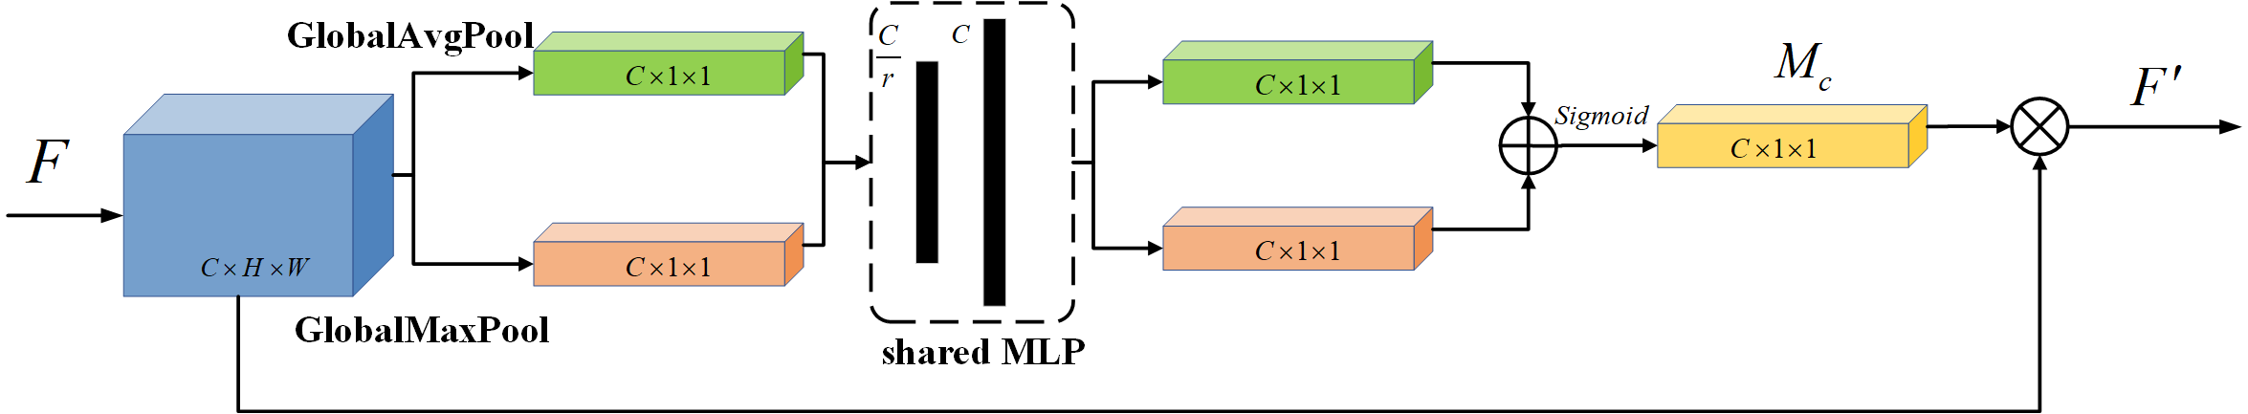
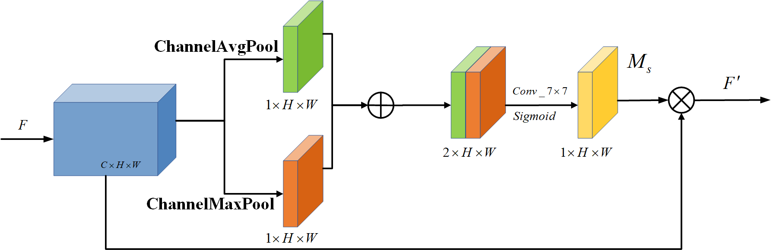
Methods
Attention Mechanism
Channel Attention Block
Spatial Attention Block

Slide 10
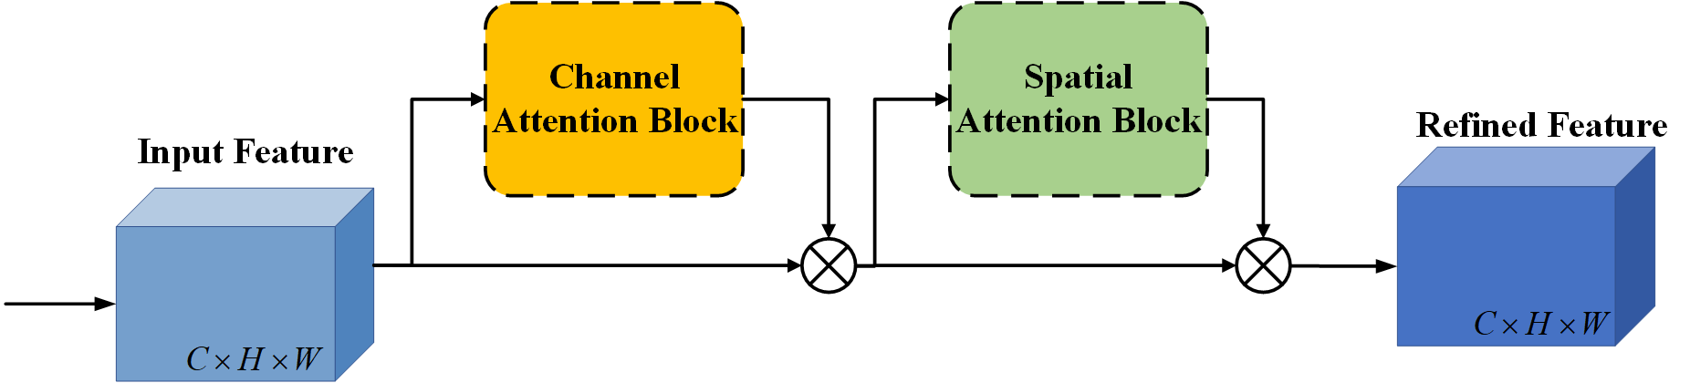
Methods
Attention Mechanism
Connect CAB and SAB in series

Slide 11
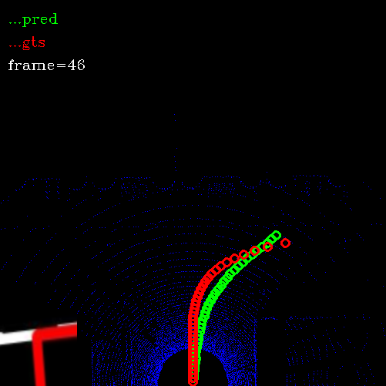
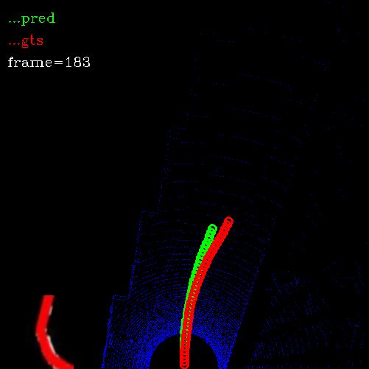
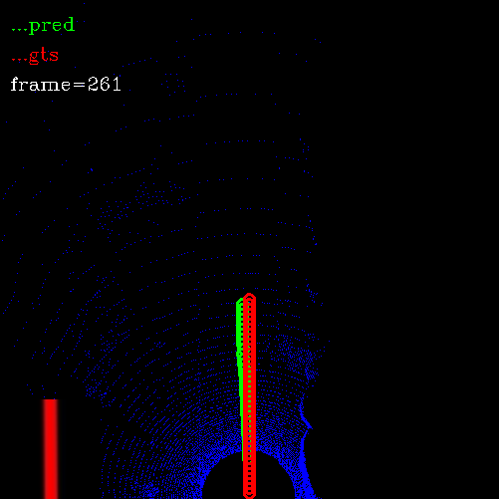
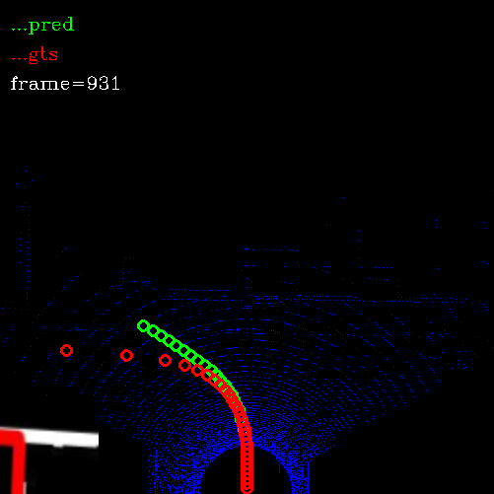
Experiment Results
Performance on CARLA

Slide 12
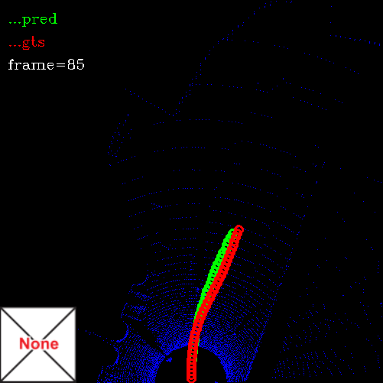
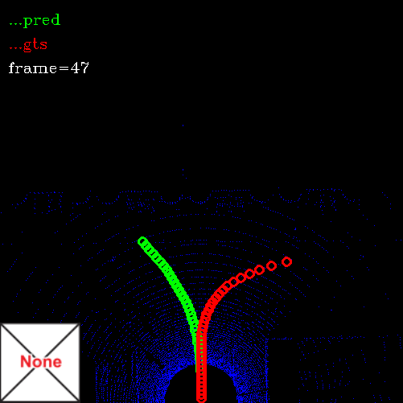
Experiment Results
Ablation Experiment 1
w/ & w/o map

Slide 13
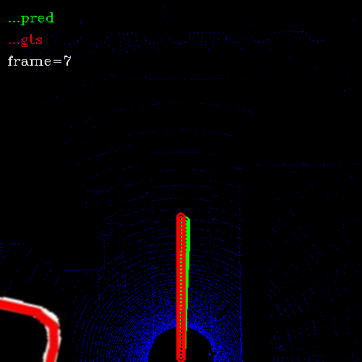
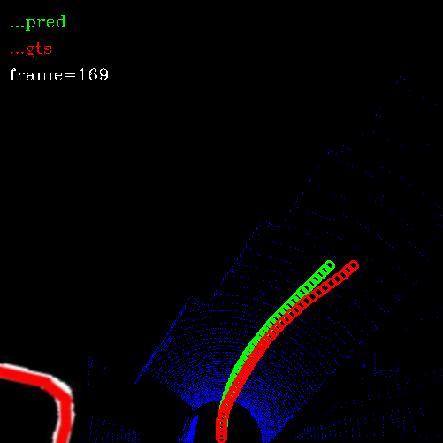
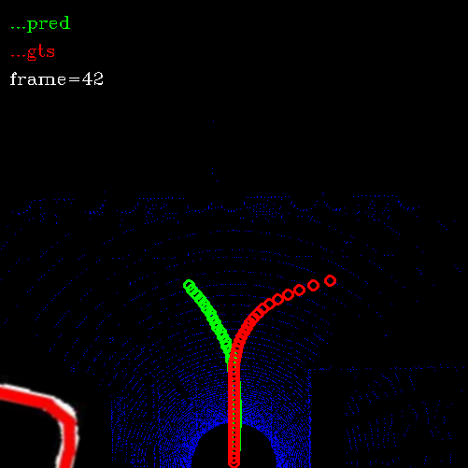
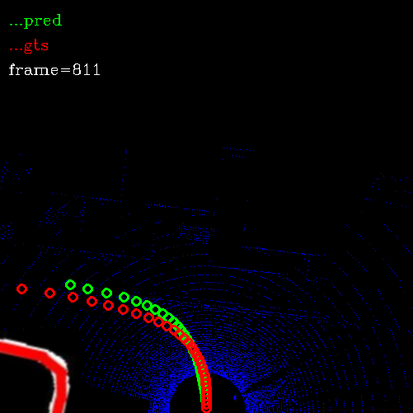
Experiment Results
Ablation Experiment 2
set map

Slide 14
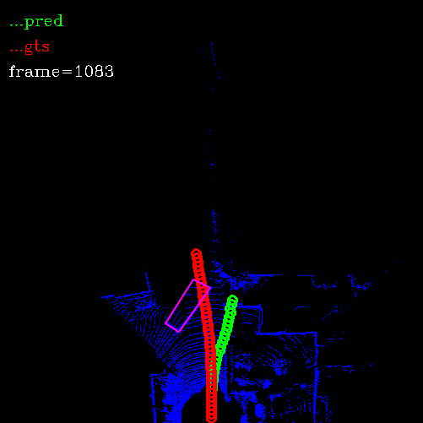
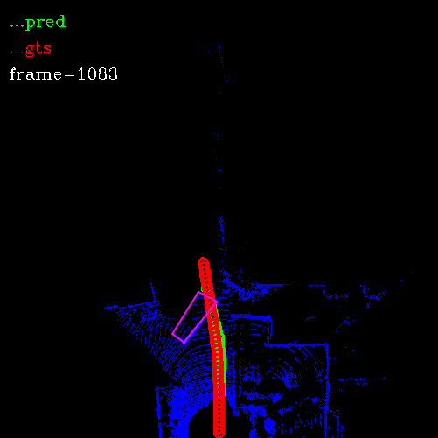
Experiment Results
Ablation Experiment 3
w/o spatial attention
w/ spatial attention

Slide 15
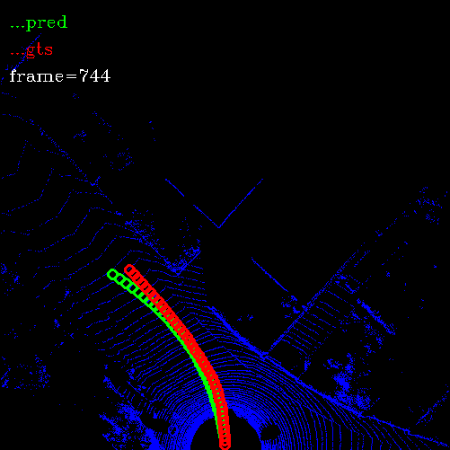
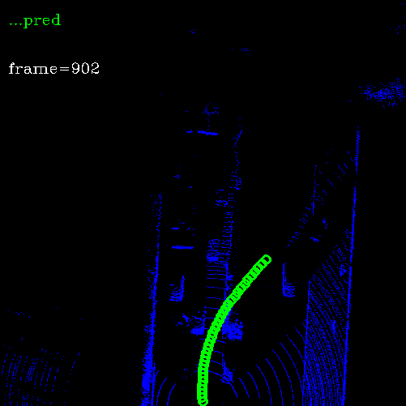
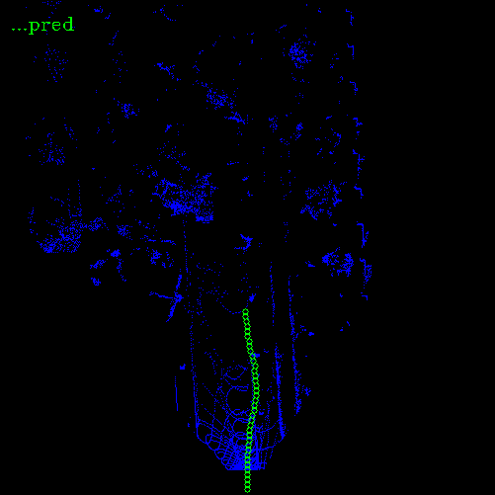
Experiment Results
Generalization Experiments
KITTI-64 Lidar
128 Lidar
Livox Lidar

Slide 16
Conclusions
An intermediate way transitting from traditional autonomous driving methods to end-to-end autonomous driving methods
The generalization ability of our method is not suitable for LiDARs with different scanning patterns
Utilizing domain adaptation technology to enhance the generalization ability of our method

