Slide 1
Semantic Web Services
SS 2016
Linked Services
Anna Fensel
06.06.2016

Slide 2
Where are we?
# | Title
1 | Introduction
2 | Web Science + TourPack project (separate slideset)
3 | Service Science
4 | Web services
5 | Web2.0 services
6 | Semantic Web + ONLIM APIs (separate slideset)
7 | Semantic Web Service Stack (WSMO, WSML, WSMX)
8 | OWL-S and the others
9 | Semantic Services as a Part of the Future Internet and Big Data Technology
10 | Lightweight Annotations
11 | Linked Services
12 | Applications
13 | Mobile Services

Slide 3
Outline
Motivation
Minimal Service Model (MSM)
Linked Services
USDL and LinkedUSDL
Summary
References

Slide 4
MOTIVATION

Slide 5
Motivation for Linked Services
Availability of Linked Data enabled its practical application in service modeling
“Data as a service” trend
More advanced and flexible interlinking of services
Step beyond WSMO, OWL-S, etc. solutions, towards simplification
…actively developed starting ca. 2010 till current days.

Slide 6
MINIMAL SERVICE MODEL (MSM)

Slide 7
MSM – What is it
The most well-known approaches to annotating services semantically are OWL-S, WSMO, SAWSDL, WSMO-Lite when it comes to WSDL services, and MicroWSMO, and SA-REST for Web APIs.
In order to cater for interoperability, iServe uses what can essentially be considered the maximum common denominator between these formalisms which we refer to as the Minimal Service Model (MSM).
The MSM, ﬁrst introduced together with hRESTS and WSMO-Lite, is thus a simple RDF(S) ontology able to capture (part of ) the semantics of both Web services and Web APIs in a common model supporting the common publishing and search of services while it allows speciﬁc extensions to beneﬁt from the added expressivity of other formalisms should tools and applications require it.
Text taken from & see also: http://iserve.kmi.open.ac.uk/wiki/IServe_vocabulary

Slide 8
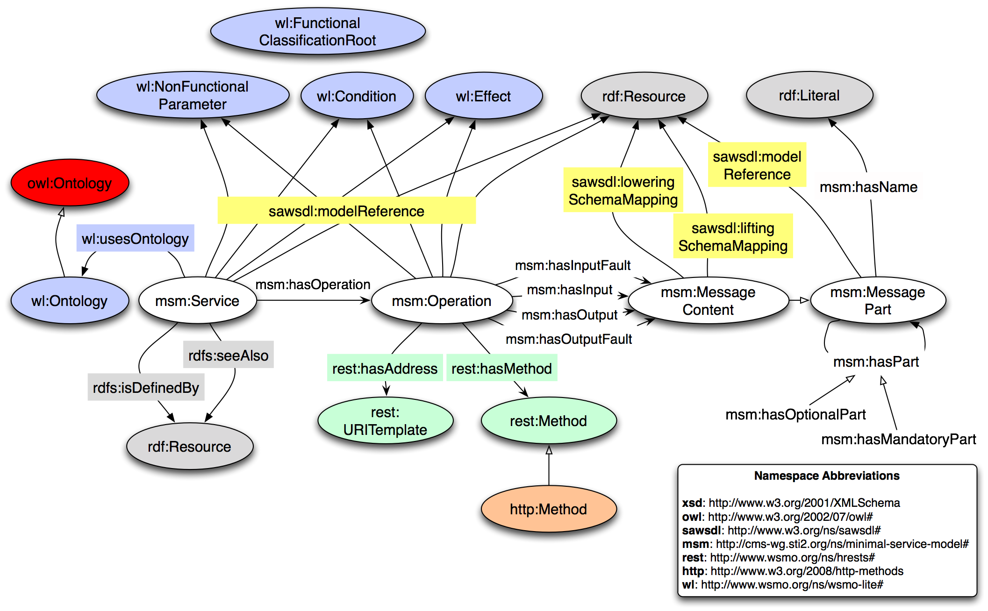
MSM – Ontology depiction
Source: http://iserve.kmi.open.ac.uk/wiki/IServe_vocabulary

Slide 9
MSM explanation
MSM characterises Services as being composed of a number of Operations, which in turn have input, output and fault MessageContent descriptions. MessageContent may be composed of mandatory or optional MessageParts.
The model is complemented by the WSMO-Lite vocabulary, which denes classes for describing the four core aspects of service semantics identified by previous research on service semantics, namely, functional semantics, nonfunctional semantics, behavioural semantics, and an information model. These types of service semantics are relevant for advanced discovery, selection and composition, among other tasks.
The main classes of WSMO-Lite are Condition, Effect, and FunctionalClassicationRoot, used for capturing functional and behavioral semantics, and NonfunctionalParameter for nonfunctional semantics.
To attach the semantics to the service model, we use the RDF mapping of SAWSDL, which denes three properties, namely modelReference, liftingSchemaMapping and loweringSchemaMapping.

Slide 10
LINKED SERVICES
FOR THIS PART, FOLLOW PRESENTATION OF J. DOMINGUE & C. PEDRINACI: “LINKED SERVICES: CONNECTING SERVICES TO THE WEB OF DATA”, HTTP://WWW.SLIDESHARE.NET/JOHNDOMINGUE/LINKED-SERVICES-CONNECTING-SERVICES-TO-THE-WEB-OF-DATA

Slide 11
USDL & LINKED USDL

Slide 12
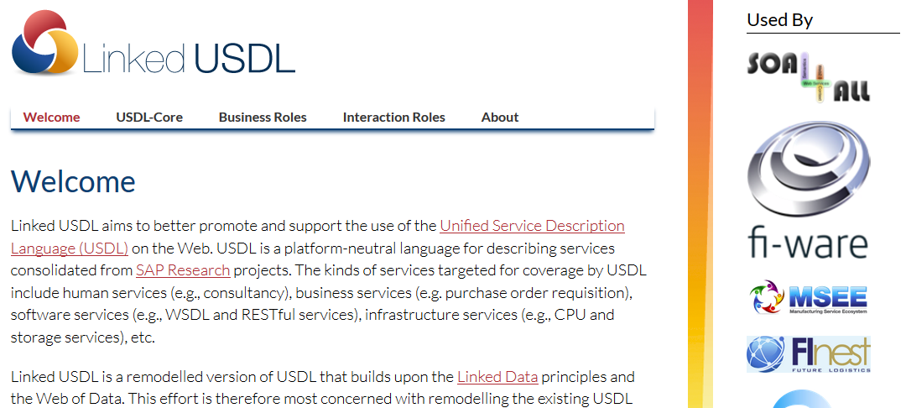
USDL and LinkedUSDL – What it is
See also: http://linked-usdl.org

Slide 13
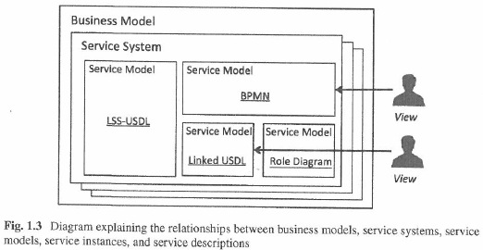
General positioning of USDl and Linked USDL
Source: Cardoso, J., Lopes, R., Poels, G. “Service Systems”, Springer, 2014. ISBN 978-3-319-10813-1.

Slide 14
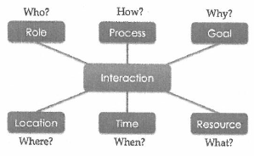
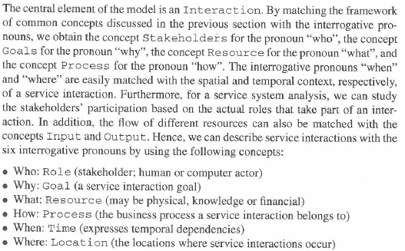
Linked Service System (LSS) Model Structure
Source: Cardoso, J., Lopes, R., Poels, G. “Service Systems”, Springer, 2014. ISBN 978-3-319-10813-1.

Slide 15
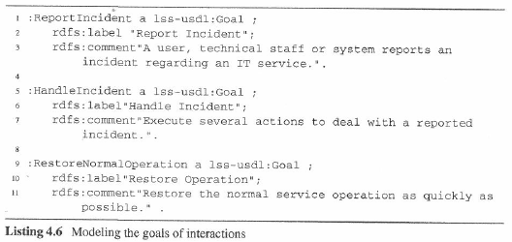
LSS Implementation Example - Goals
Source: Cardoso, J., Lopes, R., Poels, G. “Service Systems”, Springer, 2014. ISBN 978-3-319-10813-1.

Slide 16
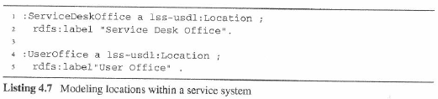
LSS Implementation Example - Locations
Source: Cardoso, J., Lopes, R., Poels, G. “Service Systems”, Springer, 2014. ISBN 978-3-319-10813-1.

Slide 17
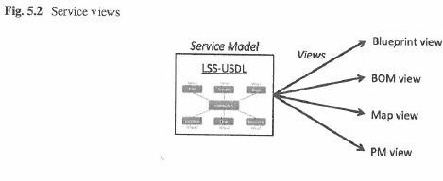
LSS – Service views
Commonly applied, also in tools e.g. graphical editors:
interactions, internal interactions
bill of materials, resources
map, location, geo
project management view
e.g. people’s involvement
Source: Cardoso, J., Lopes, R., Poels, G. “Service Systems”, Springer, 2014. ISBN 978-3-319-10813-1.

Slide 18
USDL and LinkedUSDL - Overview
For introduction and overview to USDL and LinkedUSDL, follow presentation of J. Cardoso: “Linked-USDL”, http://www.slideshare.net/JorgeCardoso4/l07-linkedusdl

Slide 19
SUMMARY

Slide 20
Conclusions
MSM aims to simplify and minimalise the service models developed by now, and provides a minimalistic ontology.
Linked Services are connecting (linked) data with services; iServe is one of its main implementations.
USDL is a language for modeling services from a business point perspective;
LinkedUSDL is an instance of USDL employing linked data & having a semantic representation.

Slide 21
REFERENCES

Slide 22
References
Jacek Kopecký, Karthik Gomadam, Tomas Vitvar: hRESTS: an HTML Microformat for Describing RESTful Web Services. In Proceedings of the 2008 IEEE/WIC/ACM International Conference on Web Intelligence (WI-08), December 2008, Sydney, Australia.
Pedrinaci, C., Kopecký, J., Maleshkova, M., Liu, D., Li, N., & Domingue, J. (2011). Unified lightweight semantic descriptions of web apis and web services.
Cardoso, J., Lopes, R., Poels, G. “Service Systems”, Springer, 2014. ISBN 978-3-319-10813-1.

Slide 23
Next Lecture
# | Title
1 | Introduction
2 | Web Science + TourPack project (separate slideset)
3 | Service Science
4 | Web services
5 | Web2.0 services
6 | Semantic Web + ONLIM APIs (separate slideset)
7 | Semantic Web Service Stack (WSMO, WSML, WSMX)
8 | OWL-S and the others
9 | Semantic Services as a Part of the Future Internet and Big Data Technology
10 | Lightweight Annotations
11 | Linked Services
12 | Applications
13 | Mobile Services

Slide 24

Questions?

