Slide 1
Extension on an Predefined Ontology for Smart Building
Du Sicong

Slide 2
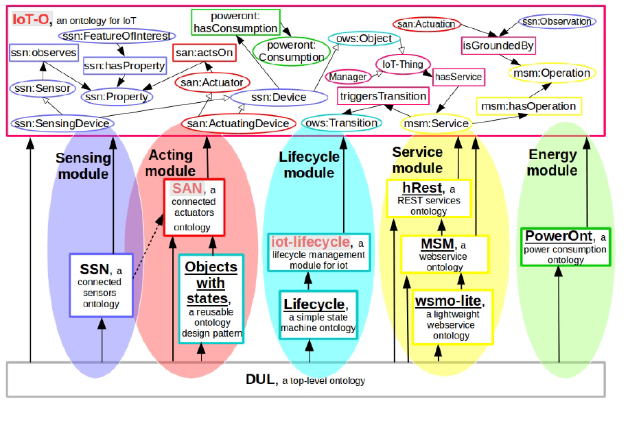

Slide 3
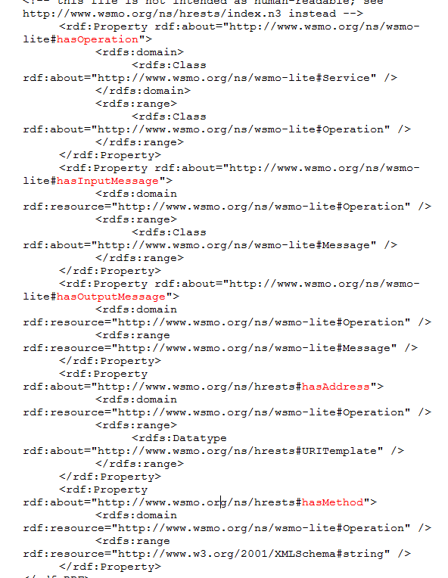

Slide 4
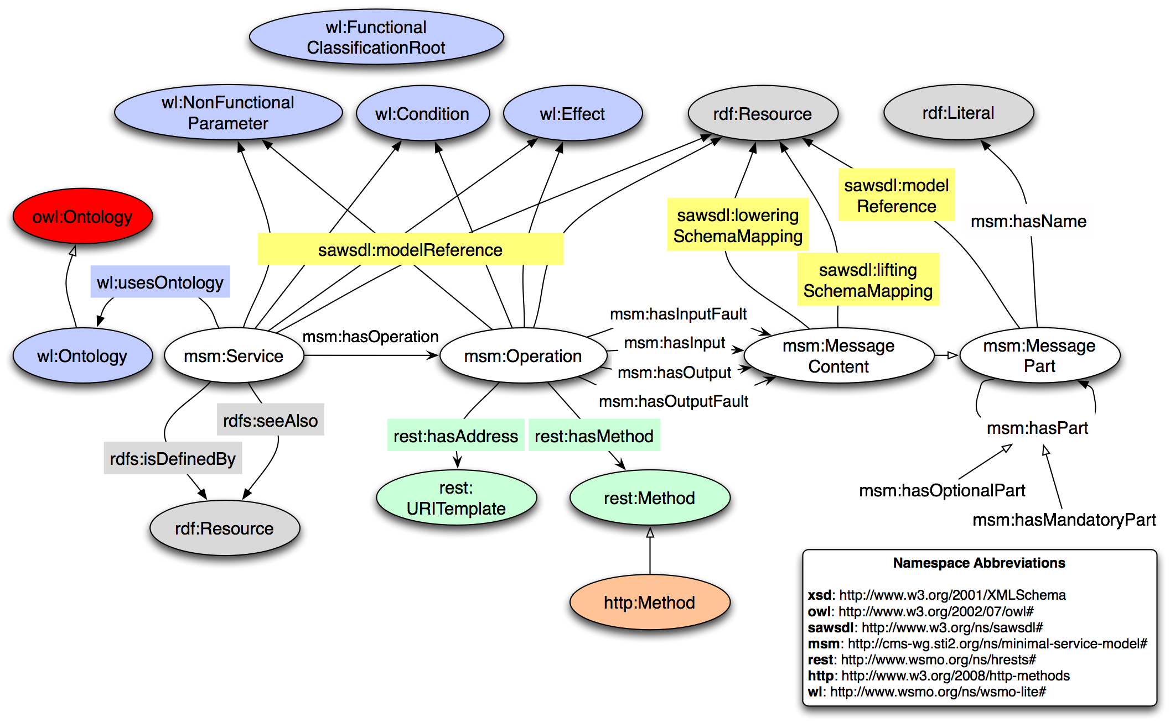
MSM – Ontology depiction

