Slide 1

Semi-automatic Metadata Annotation of Web of Things with Knowledge Base
Yunong Yang*, Zhenyu Wu, Xinning Zhu
Beijing University of Posts and Telecommunications
yangyunong@bupt.edu.cn
Sep. 2016
IC-NIDC’ 16, Beijing, China
Notes:
Hello everyone, my name is Yang yunong. I am honored to have the chance to introduce my research to you on this special occasion. The topic of my paper is Semi-automatic Metadata Annotation of Web of Things with Knowledge Base.

Slide 2
Outline
Background & Motivation
Linking for Structured WoT Metadata
Reference Implementation & Evaluation
Conclusion and Future Work
Notes:
My presentation is divided into four parts. And first I will introduce some background knowledge of entity linking with a knowledge base in WoT domain.

Slide 3
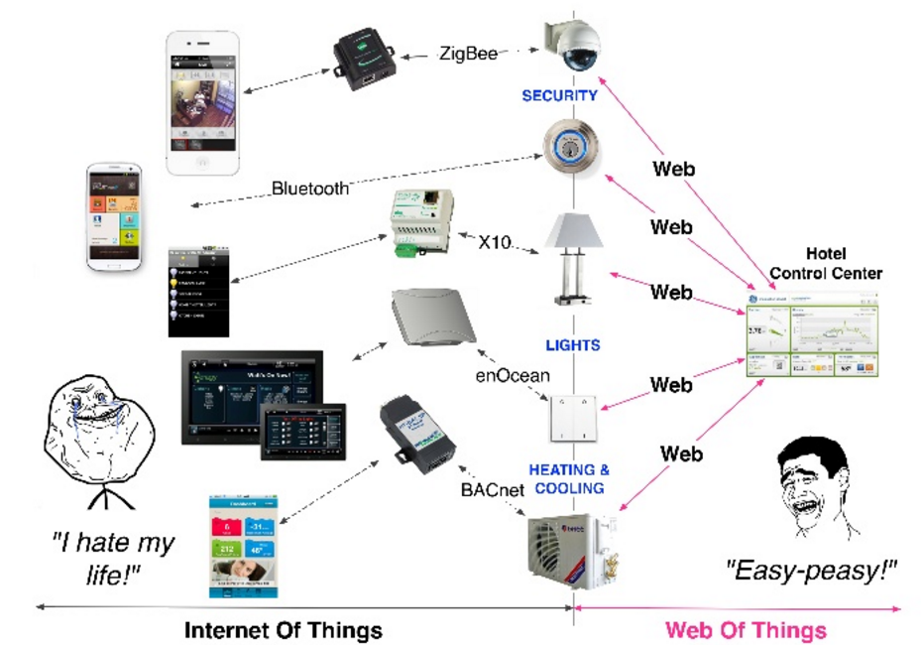
Background (1/2) Web of Things and Linked Sensor Data
From IoT to WoT: Interconnectivity and Interoperability
Unsolved Issues:
Semantic Interoperability
Link of Physical Data
REST Architectural Style: Leveraging Web architecture, Standard and Techniques
URI as the global resource identifier
HTTP as application layer protocolXML/HTML/JSON/RDF as the resource representations
Notes:
WoT lower down the barrier of interconnecting and interoperating between devices. This picture shows the evolution from traditional IoT to WoT. In IoT , each device may support different communication protocol, such as Bluetooth, zigbee and wifi. In a simple smart home scene, we have to use different terminal to control devices. And each device is separated from others. But in WoT, it is all different, all device can be reached and controlled through web. That means all you need to control your home is a smart phone. And communications can be established between different devices. In WoT, all devices can be defined as web resource which use URI as its global identifier, use Http as application layer protocol, and uses XML/HTML/JSON/RDF as a representation. Although WoT provides a flexible structure, there are still some unsolved issues:
(敲击屏幕)
First: Different Platform has their own schema to describe things. How to increase the semantic interoperability among platforms?
Second: Physical Data representing in the form of JSON/XML/HTML means nothing but string to the machine, how to link a physical string to a real world object.
The semantic technique is the key solution to these issues.

Slide 4
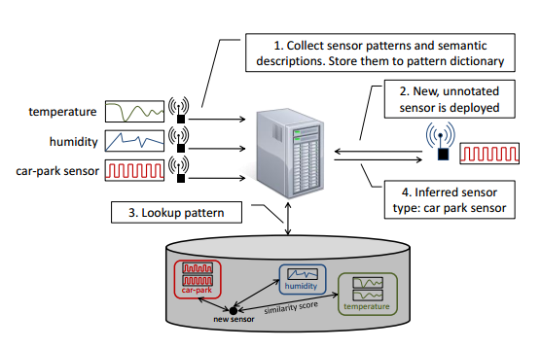
Background (2/2) Web of Things and Linked Sensor Data
Mining semantics from streaming senor data
State of the Arts: Linking Sensor Data with Semantics
Knowledge Engineering Method (Top-down)
Upper Ontology: W3C SSN
Domain-specific Ontology: SWEET, SAREF, QUDT, etc,.
[A. Sheth, 2008], [A. Gyrard, 2014] , [Payam Barnaghi, 2010] , [D. Pfisterer, 2011]
Machine Learning Method (Bottom-up)
Mining semantics from streaming senor data
Pattern Clustering + Rule-based annotation + Domain-specific Ontology
[Peng. W, 2011], [Ganz F, 2014], [Martin Langkvist, 2014]
Commonsense Knowledge Graph Construction from Web Pages (Candidate)
Entity Linking for unstructured and tabular data
[Girija Limaye, 2010], [Mulwad V, 2013], [Shen W, 2015], [Bhagavatula, 2015]
Notes:
The Semantic Web of Things integrate semantic technique with WoT. Two ways are popular in linking sensor data with semantics
One is a knowledge engineering method: that means a certain upper ontology is proposed by domain expert, and all device should be defined follow this rules.
The other is a Machine Learning Method, such as Mining semantics from streaming sensor data. It’s shown in the picture, it combines pattern Clustering and Rule-based annotation with Domain-specific Ontology to establish a pattern dictionary. Then linking a new device by classify it to an existing pattern in dictionary. Another approach is commonsense knowledge graph construction from web pages. Each mention in a Web Page may have corresponding entity in background knowledge base like DBpedia. We could use context constraint to identify which entity a mention should link to.

Slide 5
Objectives & Motivations
Challenges & Motivations
Objectives
1. Construct WoT KG as linkable as possible to enable AI applications
2. A hybrid KG with both domain-specific and commonsense knowledge
3. Lower the barrier of constructing the KG with both manual and automatic methods
Current ontologies for IoT is too heavy and complex
SSN is complex and only for sensors (only sensor, we also need actuator)
A few of main classes and properties are enough for common IoT scene
Reusing existing common vocabularies as many as possible
Lack of commonsense knowledge and facts
DBpedia, YAGO, Wikidata mainly extracted facts from the web which result in the lack of sensor network facts.
(Semi-) Automatic semantic annotation is needed as a complement for manual method
Notes:
Both ways have their limits in knowledge graph construction, Current ontologies for IoT are too heavy and complex, and it still miss some concept like Actuator. We hope to define only a few of main classes and properties for common IoT scene by reusing existing common vocabularies as many as possible. Moreover, current open knowledge base like Dbpedia YAGO and Wikidata almost extracted facts from the web which result in the lack of commonsense sensor network facts. Thus, we expect a combination of both way and developing a semi-Automatic annotation system.
(点击一下)
Our system aims at:
Construct WoT Knowledge Graph as linkable as possible to enable AI applications
Construct a hybrid Knowledge Graph with both domain-specific and commonsense knowledge
Lower the barrier of constructing the Knowledge Graph with both manual and automatic methods

Slide 6
Outline
Background & Motivation
Linking for Structured WoT Metadata
Reference Implementation & Evaluation
Conclusion and Future Work
Notes:
After talking about expects and goals, let’s move on to our solution in this paper.

Slide 7
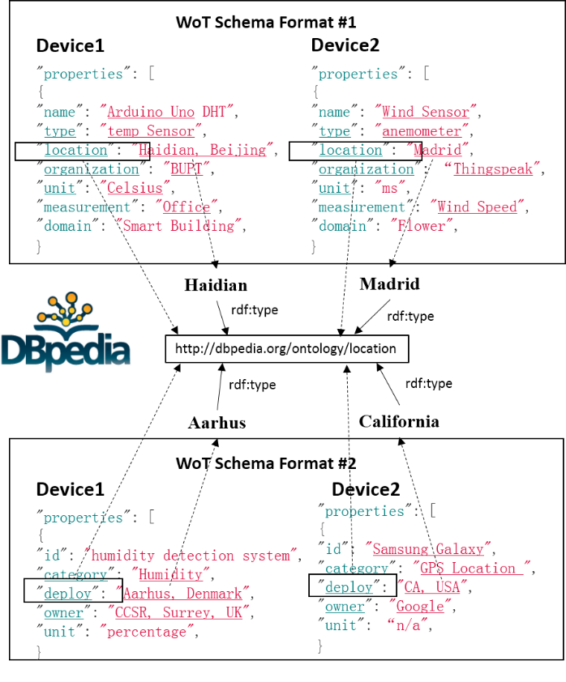
Semi-automatic Annotation via Entity Linking Method
Link string mention in the metadata to the entities in the DBPedia
INPUT: Structured WoT metadata with AVP strings
Approach
Transform Attribute-Value-Pairs (AVP) to tabular data
Model the tabular structure as a PGM (Probabilistic Graph Model)
Inference based on Massage Passing
STEP1: Candidate generation from DBpedia
STEP2: Disambiguation by Re-rank
STEP3: Joint Iterative Inference to refine
entity mapping by message passing algorithm
OUTPUT: Link string mention in the metadata to the entities in the DBPedia
Notes:
As current thing representation could be freely defined by Attribute-Value-Pairs, such as XML, JSON and HTML Table, that means values belong to an attribute(or key) in the same schema are refer to the same concept.
For example, in this picture, key “location” in WoT schema one and key “deploy”in WoT schema two actually refer to the same commonsense concept “location”in DBpedia.
Moreover, it forms a constraint between values under the same key. We could take advantage of this constraint and entity linking technique to linking different WoT metadata to one public knowledge base, which means mapping the keys to appropriate classes or types, while mapping corresponding values to entities and identify relation between keys.
The linking module takes structured WoT metadata with AVP strings as input. Then, it takes three steps, that is, Transform AVP to tabular data, Model the tabular structure as a Probabilistic Graph Model and inference based on massage passing algorithm. And three sub-steps in Message Passing are required to link string mention to the entities in the DBPedia, those are Candidate generation, Re-rank and Joint Iterative Inference. And these links are output of the linking module.
I will make a detailed introduction of these approaches next.

Slide 8


Modeling the WoT Metadata as Factor Graph
Column nodes
type
location
organization
…..
Device1
“properties” : {
“name”: “Arduino Uno DHT”,
“type”: “temperature”,
“location”:”BUPT, Beijing”,
“organization”:”BUPT”,
“unit”:”Celsius”,
“measurement”:”Office”,
“domain”:”Smart Building” }
Device2
“properties” :{
“name”: “Wind Sensor”,
“type”: “anemometer”,
“location”:”Madrid”,
“organization”:”Thingspeak”,
“unit”:”m/s”,
“measurement”:”Wind Speed”,
“domain”:”Flower growing”
}
temperature
BUPT, Beijing
BUPT
Entity nodes
anemometer
Madrid
Thingspeak
…..
Factor Node
(relation)
Factor Node
(Column)
Key is mapped to column header, and value is mapped to cell text in a table
Column
Type
Name | Type | Location | Organization | Unit | measurement | domain
Arduino Uno DHT | temperature | BUPT, BeiJing | BUPT | Celsius | Office | Smart Building
Wind Sensor | anemometer | Madrid | Thingspeak | m/s | Wind Speed | Flower growing
……
Row Cell
Text
Row Cell
Text
Notes:
First, linking module will modeling the WoT metadata as a factor graph. It takes raw WoT metadata keys as the column type and values as the row cell text in a tabulation. Then mapping column headers in tabulation to column variable node and mapping each row cell text to entity variable node in Factor Graph. Factor nodes in factor graph represent functions. They take variable nodes as input and output. In this factor graph, there are two kind of factor nodes, fai 1 is called column constraint and fai 2 is called relation constraint. All variable nodes in one column can be linked to factor node fai 1 and all cell nodes in different two columns can be linked to factor node fai2. Factor nodes could provide agreement functions on selecting a best assignment to each variable node according to the joint constraints.

Slide 9
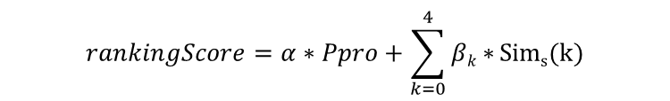
Candidate Generation and Ranking
Candidate Generation and Re-rank for Cell Text
Several candidates can be retrieved from DBpedia by a fuzzy sparql query. The more precision the candidate are, the less iterations are took in disambiguation. Thus, re-ranking metric is developed to score each candidates of a mention.
Prior probability  Define the popularity of an entity based on the link count information from DBpedia
String similarity  In contrast to popularity, string similarity provides a syntactic comparison between cell text and candidate entities. e.g. Levenshtein Distance, Dice Score, String length, whether fully contained or eaqual.
SVM Ranking Classifier
Ranking Score for a candidate of a mention
Prior probability
String similarity
Type Generation for Column Type
Type candidate is generated by each cell candidates' class (rdf:type) of which they belonged to in one column
Input: sparql statement
PREFIX rdf:<http://www.w3.org/1999/02/22-rdf-syntax-ns#>
SELECT DISTINCT ?type
WHERE {
<Current candidate> rdf:type ?type.
}
Output: All matching types under rdf:type from KB
Notes:
In inference module, candidate generation and re-rank sub-steps can be seen as a data pre-processing. Several candidates can be retrieved from DBpedia endpoint by a fuzzy sparql query. The more precision the candidate are, the less iterations are took in disambiguation. Thus, we develop a re-ranking metric to score each candidates of a mention.
We use svm ranking classifier to score each candidate from fuzzy query. Two kinds of features are extracted from the candidates, one is Prior probability which represent how frequently a candidate is referenced by others. The other is string similarity, we combine classical Levenshtein Distance, Dice Score with other metric like string length to collectively measure similarity between mention-candidate pairs.
Moreover, linking module also need all classes of each cell candidate and all relations between each candidate pairs in two columns. We could use sparql query to get them from dbpedia too.

Slide 10
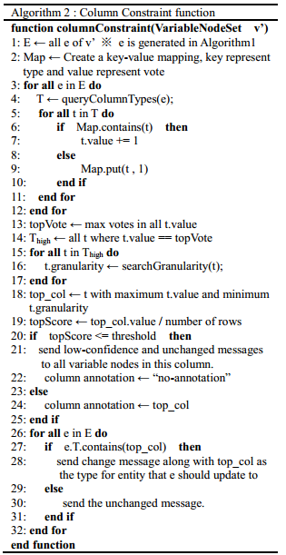
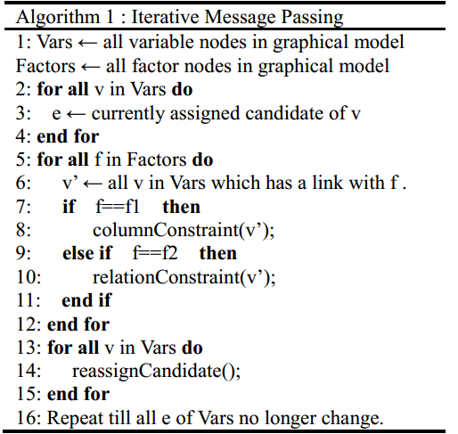
Joint Inference Model
Iterative Messaging Passing Algorithm based on semantic constraints
Joint inference:
Pick the type which has the maximum votes and minimum granularity as the type of the column. It can be called as constraint of this column either.
Iterative substitution:
Iteratively refine the mapping entity to improve its linking quality
Notes:
After data pre-processing, we move on to the most important part in linking module- The joint Inference model. Here we propose an Iterative Message Passing Algorithm based on semantic constraints between the contextual nodes. The main principle of this algorithm is iterative feedback and re-assign. In feedback step, both constraint functions act on a candidate of an entity node and send it a message which contains whether it should change its current assignment or not. Then in re-assign step, linking module will determine whether change the current assignment after computing all messages with their credible weight.
As steps in both constraint functions are similar. I just introduce column constraint here. In column constraint, each candidate gives every father type a vote. Then a type with maximum votes and minimum granularity is elected as the constraint of this column. If the current assignment of an entity node doesn’t comply with this constraint, a change message will be sent to the entity node. It indicates a new candidate should be assigned here.
The algorithm will make iterative substitution until all assignments in entity nodes no longer change or reach the iteration limits.

Slide 11
Outline
Background & Motivation
Linking for Structured WoT Metadata
Reference Implementation & Evaluation
Conclusion and Future Work
Notes:
Next, I want to show you a demo implementation of our knowledge graph construction system and make an evaluation of the annotation result.

Slide 12
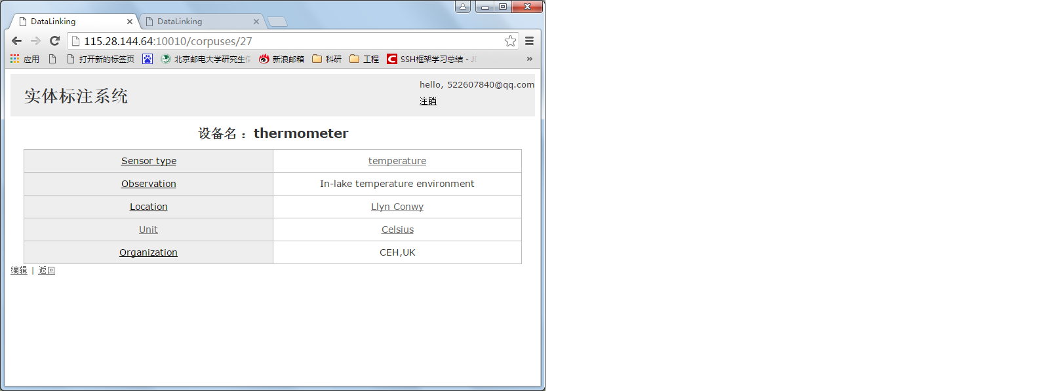
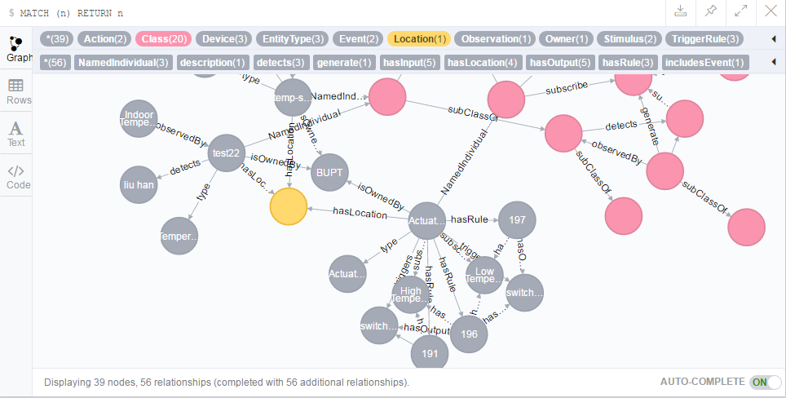

Reference Implementation
Graph Database
Notes:
The left is the structure of our system. We use DBpedia as our background Knowledge Base and get candidate entities by querying DBpedia open endpoint. We then choose an open source SVM ranking classifier to re-rank the initial list from DBpeida and develop an online semi-automatic WoT device description tools by using Spring Data Neo4j framework. Finally, the annotation results are persisted in Neo4j, a NoSQL Graph Database. To show which mention has been linked to the DBpedia, we add a hyperlink to those mentions in output web page. And we name a reference field for each node in Neo4j to store their linking entity in Dbpedia. This graph shows the persistence of WoT facts in Neo4j.

Slide 13
Evaluation
Evaluation on semi-automatic annotation process
Table I Accuracy for re-rank
Dataset | condition | Ground truth rank in top 10 | Ground truth rank in top 1
Fixed WebTable | initial rank | 90.3% | 57.9%
 | re-ranked | 94.7% | 71.8%
Application generated | initial rank | 84.3% | 58.4%
 | re-ranked | 94.4% | 83.1%
Target entity is ranked higher in both top 10 and top 1 by SVM ranking classifier, compared with initial rank
Table II The accuracy of entity annotations
Dataset | IMP only | IMP + re-rank
Application generated | 57.2% | 74.2%
IMP+Re-ranking improve the accuracy of mapping entity to the cell text
Notes:
We select two test datasets to verify the accuracy of re-rank step. The fixed Webtable is a public dataset which extracts Wikipedia table and manually annotated with DBpedia entities. The application generated dataset is generated by WoT AVP through our system according to other IoT platform like Thingspeak and we have manually annotated them with DBpedia entities too. We determine to take only the top 10 query results as our candidate entities. It is a balance between accuracy and time consuming. Table one shows when ground truth exist, the re-rank step can raise the rank of a ground truth in the candidate rank list.
Another table shows the accuracy of entity annotations with Application generated dataset. It shows IMP with Re-ranking improve the accuracy of mapping entity to the cell text. The low accuracy is mainly because of the missing of ground truth in DBpedia. Some WoT concept like observation is not a commonsense knowledge but fuzzy query may return irrelevent candidates back. It may result in a wrong link.

Slide 14
Outline
Background & Motivation
Linking for Structured WoT Metadata
Reference Implementation & Evaluation
Conclusion and Future Work
Notes:
At the end of my presentation, I want to state the pros and cons in our research.

Slide 15
Lesson Learned & Future Work
Pros
Cons
Linking domain knowledge to commonsense knowledge
Recognizing entities which WoT metadata values refer to
EL-based method for good scalability
Commonsense knowledge in DBpedia could not cover most of the concepts and relations in IoT domain
Alignment between domain knowledge and commonsense knowledge is missing
Remote call from DBpedia endpoint for querying candidate entities consumes too much time.
Future Work
Semantic WoT Applications
Finding and Interacting with things with NL(QA?)
Automatic interaction between things by semantic search and reasoning
Notes:
The semi-automatic annotation system can link domain knowledge to commonsense knowledge. It increases the semantic interoperability among platforms. We also propose an entity linking based method to recognizing entities which WoT metadata values refer to, which has a good scalability.
But there still many problems unsolved. Commonsense knowledge in DBpedia could not cover most of the concepts and relations in IoT domain. It directly results in the missing link between domain knowledge and commonsense knowledge. Moreover, the remote call from DBpedia endpoint for querying candidate entities consumes too much time. It decreases the efficiency in linking module.
We are going to develop some Semantic WoT Applications based on the domain knowledge base. We would use semantic reasoning to interact things with Nature Language, like question answering system. Semantic search and reasoning also can be used in automatic interaction between things. Those are what we interested in, and concentrate on in the future.

Slide 16
Thank you for you attentions!
Q&A
Notes:
That’s all of my presentation. Thank you for your attention.

