Slide 1

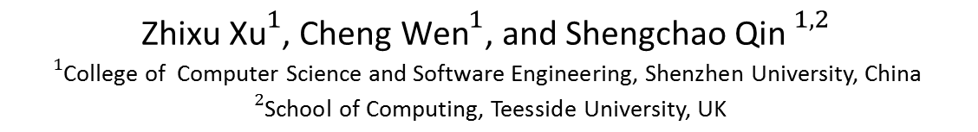
Learning Types for Binaries
${\text{Zhixu} \text{Xu}}^{1}$, ${\text{Cheng} \text{Wen}}^{1}$, and ${\text{Shengchao} \text{Qin} }^{1,2}$
$${}_{}^{1}{\text{College} \text{of} \text{Computer} \text{Science} \text{and} \text{Software} \text{Engineering}\text{, }\text{Shenzhen} \text{University}\text{, }\text{China} }$$
$${}_{}^{2}{\text{School} \text{of} \text{Computing}\text{, }\text{Teesside} \text{University}\text{, }\text{UK}}$$
Notes:
Hello everyone, this is Cheng Wen from Shenzhen University. I am very honor to have this opportunity to present our approach. Our topic is “Learning Types for Binaries”

Slide 2

Outline
Introduction
Motivating Examples
Approach
Experiments
Conclusion
Notes:
This is the outline of this talk. Firstly I will give a brief Introduction about type inference on binary code and illustrate some motivating examples. Then I will spend most of the time to present our approach, followed by the experiments. At last, I will conclude the talk.

Slide 3
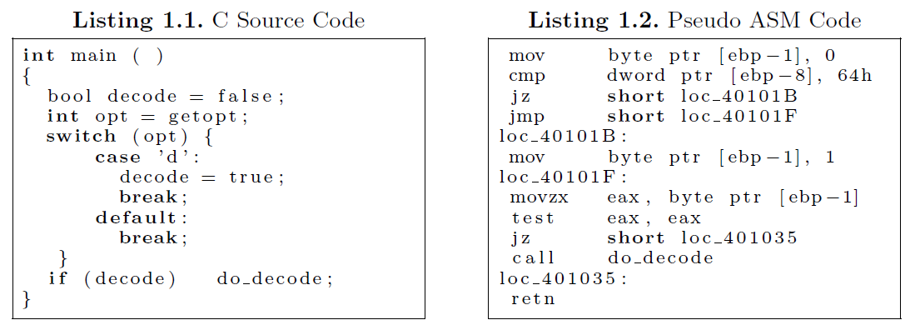
Introduction
Binary code type inference
Decompilation
Binary code rewriting
Vulnerability detection and analysis
Binary code reuse
……
Protocol reverse engineering
Virtual machine introspection
Game hacking
Malware analysis
Binary code type inference aims to infer a high-level typed variables from executables.
Name？
Type?
Notes:
Binary code type inference aims to infer a high-level typed variables from executables, which is required for, or significantly benefits, many applications such as decompilation, binary code rewriting, vulnerability detection and analysis and so on.
However, unlike high-level source codes, binary code type inference is challenging because, during compilation, much program information is lost, particularly, the variables that store the data, and their types.

Slide 4
Introduction
A significant amount of research:
TIE [Lee et al. 2011]
HOWARD [Slowinska et al. 2011]
SMARTDEC [Fokin et al. 2011]
RECALL [Dewey and Giffin 2012]
POINTERSCOPE [Zhang et al. 2012]
ARTISTE [Caballero et al. 2012b]
UNDANGLE [Caballero et al. 2012a]
SECONDWRITE [ElWazeer et al. 2013]
RHK [Tobbins et al. 2013]
MEMPICK [Haller et al. 2013]
TOP [Zeng et al. 2013]
YM [Yan and McCamant]
OBJDIGGER [Jin et al. 2014]
LEGO [Srinivasan and Rep 2014]
YB [Yoo and Barua 2014]
VFGUARD [Prakash et al. 2015]
VTINT [Zhang et al. 2015]
KE [Kate et al. 2016]
Most of them resort to program analysis techniques.
Over-conservative
Heavy-weight
Notes:
A significant amount of research has been carried out on binary code type inference.
Most of them resort to program analysis techniques, which are often too conservative to infer types with high accuracy.
And some of them are too heavy-weight to use in practice.
For example, in the sense that they may generate too many constraints to solve for large-scale programs.

Slide 5
Motivation
Snippet Code from base64.c
Hex-rays Decompiler: | char (incorrect)
SmartDec Decompiler: | byte_t (over-conservative)
Notes:
Next, I will illustrate some examples that are not easy to recover the precise types by existing methods.
The first example comes from a program base64.c form coreutils. The program uses a variable decode with type Boolean. But after compiling, the variable decode is simply represented as a byte in stack and the type Boolean is lost. Due to the conservative program analysis they adopt, most existing tools, such as SmartDec and Hex-Rays, recover for the variable decode the type character or byte_t data, which is clearly either incorrect or over-conservative.

Slide 6
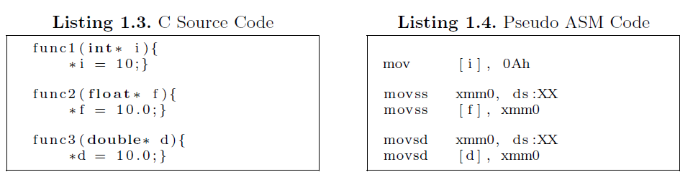
Motivation
Assignments of different types
func1: int i
Hex-rays Decompiler: Dword*
SmartDec Decompiler: int_32
func2: float f
Hex-rays Decompiler: Dword*
SmartDec Decompiler: int_32
func3: double d
Hex-rays Decompiler: Qword*
SmartDec Decompiler: int_32
Notes:
Another example, programs with fewer instructions are more difficult to recover types correctly. Let us consider three simple assignments for three variables with different types. SmartDec recovers the same type integer for all these three variables, while Hex-Rays infers the type of different pointer. Again, most of the results are either incorrect or over-conservative, even not a definite type in program languages.
These are the assembly code of these 3 function. One may note that the variables of different types are compiled with different instructions, that is, mov, movss and movsd.
Hence, a simple solution is to enhance the program analysis techniques with three new rules to infer these three different types.
However, it is pity that the instruction mov is not only used for integer. Even if it works, there are too many instructions and types to figure out the reasonable rules.
That is the motivation for why we want to use machine learning method to predict the most possible types for target variables.

Slide 7
Approach
Approach | Learning types for binaries leverage a machine learning method to type inference
Idea | Duck typing
byte ptr
mov _ , 0
mov _ , 1
movzx eax, _
most likely to be a feature
bool
Notes:
In this paper, we propose a new approach to learning types for binaries. Our approach first learns a classifier from existing binaries with debug information and then uses this classifier to predict types for new, unseen binaries.
Let us consider this program snippets again. The related instruction of variable decode are mov , 0 ; mov , 1; movzx eax, which is most likely to be a feature of Boolean type.
Generally, the set of the related instructions of a variable reflects how the variable is stored, manipulated, and interpreted. So our solution is to take the related instruction as feature indicator, and then to learn the most possible type from the feature.
This is motivated by “duck typing", where the type of a variable is determined by its features and properties instead of being explicitly defined.

Slide 8
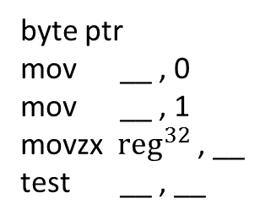
bool？
byte ptr
mov __ , 0
mov __ , 1
movzx ${reg}^{32}$ , __
test __ , __
提取信息
判定类型
Type

Slide 9
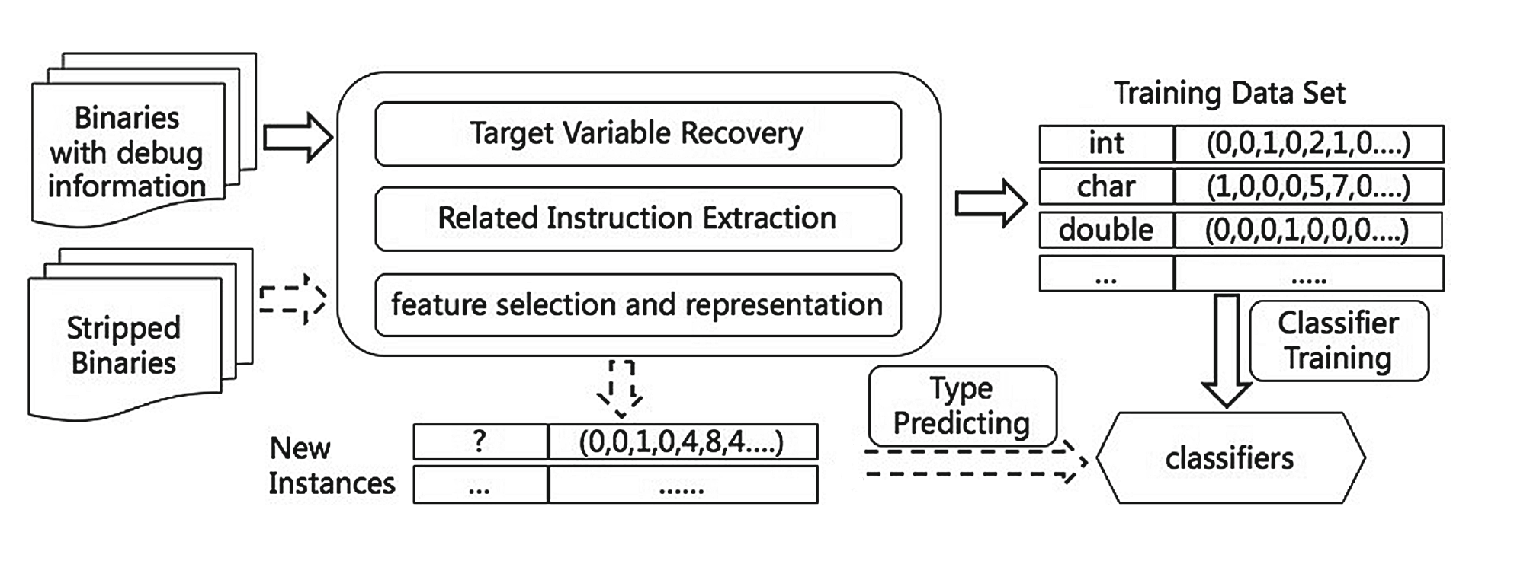
Approach
Binary Analysis
organize
Result
Notes:
This picture shows the main idea of our approach.
Our approach first learns a classier from existing binaries with debug information and then uses this classier to predict types for new, unseen binaries.
In detail, our approach consists of the following steps: (1) target variable recovery; (2) related instruction extraction; (3) feature selection and representation; (4) classier training; (5) type predicting.
In the following, we describe each of them.

Slide 10
Approach
Target Variable Recovery
Abstractions of memory blocks
Address expressions
Direct access
Absolute address
Indirect access
[base + index * scale + offset]
Notes:
During compilation, variables of the source program and their type information are not included in the resulting binary. So the first step is to identify the target variables.
Indeed, variables are abstractions of memory blocks, which are accessed by absolute address directly or indirectly through expressions of the form “base address add offset".
In the following, we use another program from C runtime Library as an illustrated example.

Slide 11
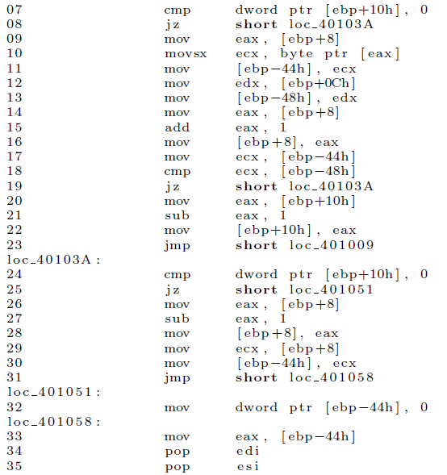
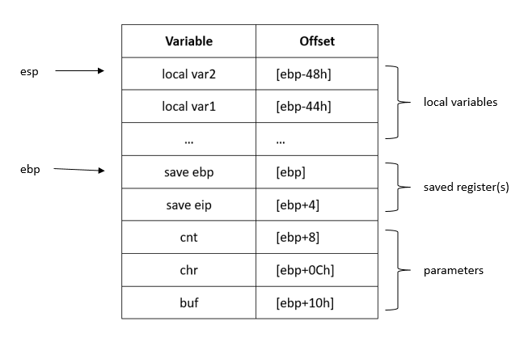
Approach
\\Snippet Source Code of memchr
char memchr ( char buf , int chr , int cnt ) {
while ( cnt && buf++ != chr )
cnt--;
return ( cnt ? --buf : NULL) ;
}
Runtime Stack
…
…
Local variable
[ebp-offset]
…
Save ebp
Save eip
buf
chr
Paremeter
[ebp+offset]
cnt
Notes:
The picture on the left is source code. And the picture on the right is the corresponding assembly code.
In the beginning, the parameters need to be push into stack. Then the original value of the stack pointer needs to be saved. Finally, the local variables are push into the stack.
The variables in the stack is accessed by the base address and the offset. In this example, [ebp+offset] for parameters and [ebp-offset] for local variables.
So the variables we recovered in stack are shown in this figure. There are three parameters, which conform to the declarations in the Source code. Due to the low-level instructions, there are two more local variables, which are used respectively to store the Intermediate value.

Slide 12
Approach
Related Instruction Extraction
[ebp+8]
[ebp+8]
mov eax, [ebp+8]
mov eax, [ebp+8]
mov [ebp+8], eax
mov eax, [ebp+8]
mov [ebp+8], eax
mov ecx, [ebp+8]
[ebp+8]
No interesting information?
Notes:
Next, we want to extract the related instructions for the target variables, which reflect how the variables are used and will be used as a feature to learn the types.
Take [ebp+8] as an example, the instructions using a variable directly are extracted. There seems to be no interesting information.
However, an instruction of a variable in high-level codes may be compiled into several instructions in low-level codes, some of which may not use the corresponding variable directly.
When the variable is “mov” into the register, It created a use-defined chain.

Slide 13
Approach
Related Instruction Extraction
[ebp+8]
mov eax, [ebp+8] //def of eax by [ebp+8]
movsx ecx, byte ptr [eax] //use of eax
mov eax, [ebp+8] //def of eax by [ebp+8]
add eax, 1 //use of eax
mov [ebp+8], eax
mov eax, [ebp+8] //def of eax by [ebp+8]
sub eax, 1 //use of eax
mov [ebp+8], eax
mov ecx, [ebp+8] //def of ecx by [ebp+8]
Mov [ebp-44h], ecx //use of ecx
Use-defined Chains
If a data register is defined by a variable, then all the uses of the register are considered as the uses of the variable as well.
Notes:
Therefore, we make use of use-defined chains on the data registers to extract the indirect instructions: If a data register is defined by a variable, then all the uses of the register are considered as the uses of the variable as well.
After that we can get more interesting information. These are the related instruction of [ebp+8].

Slide 14
Approach
Feature Selection
mov __ , reg32
mov reg32 , __
mov __ , reg16
mov reg16 , __
mov __ , reg8
mov reg8 , __
mov __ , addr
mov addr , __
mov __ , 0
mov __ , 1
mov __ , imm
add __ , reg32
add reg32 , __
add __ , imm
sub __ , reg32
sub reg32 , __
sub __ , imm
……
We select the N most frequently used and representative instructions as the feature indicators.
TF-IDF algorithm
Notes:
According to the official document, different instructions have different usages.
So we perform some pre-processing on these instructions based on their usages.
Moreover, not all the instructions are widely used or representative. For that we do a statistical analysis on our dataset, which consists of real-world programs and source codes from some course books, using the well-known scheme Term Frequency and Inverse Document Frequency (TF-IDF) algorithm. Based on the result, we select the N most frequently used and representative instructions as the feature indicators. In theory, the more instructions, the better. While in practice, we found 100 instructions are enough.

Slide 15

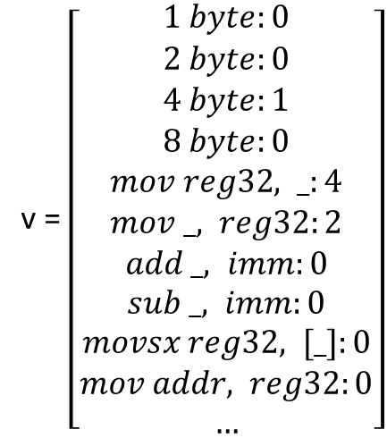
Approach
Feature Representation
$$v=\left[\begin{matrix}f1 :t1, & f2 :t2, & … & fn :tn\end{matrix}\right]$$
where $f_{i}$ is a feature term, $t_{i}$ is the value of feature $f_{i}$, and $\text{n}$ is the number of features.
[ebp+8]
mov eax, [ebp+8]
movsx ecx, byte ptr [eax]
mov eax, [ebp+8]
add eax, 1
mov [ebp+8], eax
mov eax, [ebp+8]
sub eax, 1
mov [ebp+8], eax
mov eax, [ebp+8]
mov [ebp-44h], eax
v = $\left[\begin{aligned}1 byte:0 \\ 2 byte:0 \\ 4 byte:1 \\ 8 byte:0 \\ mov reg32, _:4 \\ mov _, reg32:2 \\ add _, imm:0 \\ sub _, imm:0 \\ movsx reg32, [_]:0 \\ mov addr, reg32:0 \\ …\end{aligned}\right]$
Size info
Vector representation
Selected
instruction
Notes:
Next, we represent the selected features of variables using vector space model.
We only concern that how many times an interesting instruction are performed on a variable, leaving the order out of consideration. Formally, a variable is represented as the following vector v:
where $f_{i}$ is a feature term, $t_{i}$ is the value of feature $f_{i}$, and $\text{n}$ is the number of features.
Let ‘s consider this variable again. The vector representation of [ebp+8] can be shown in the following:
It is a 4 byte data. And the value of the instruction feature term are the frequency.

Slide 16
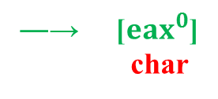
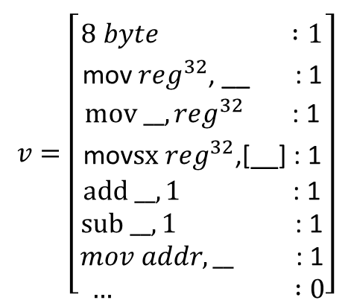
$$v=\left[\begin{aligned} \\ 8 byte :1 \\ \text{mov} {reg}^{32}\text{, __ } \text{: 1} \\ mov __{,reg}^{32} \text{: 1} \\ \text{mov} sx {reg}^{32}\text{,[__] : 1} \\ add __,1 \text{: 1} \\ sub __,1 \text{:}\text{ 1} \\ mov addr,__ \text{: 1} \\ … :0\end{aligned}\right]$$
%% [ebp+8]
*
[ebp+8]
char*
―→ [${eax}^{0}$]
char

Slide 17
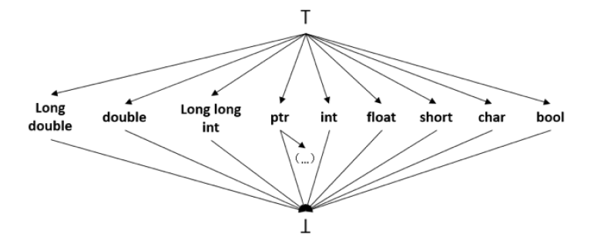
Approach
Classifier Training and Type Predicting
After the classifiers are trained, we can use them to predict the most possible type for each variable that have been recovered from new or unseen binaries.
We use supervised learning to train our classifier. In this work , we choose Support Vector Machine(SVM).
We only consider the base types without type quantifiers.
The reason is that (1) the other types, such as struct, can be composed from the base types; (2) too many levels may make against the classifier.
Notes:
Finally，After the classifiers are trained, we can use them to predict the most possible type for new or unseen variable.
We use supervised learning to train our classier. In this work, we choose Support Vector Machine(SVM). Trying some other machine learning algorithm will be the future work.
For now, we only consider the base types without type quantifiers. These are the labels we are learning in this paper. The reason is that (1) the other types, such as structure, can be composed from the base types; (2) too many levels may make against the classifier.

Slide 18
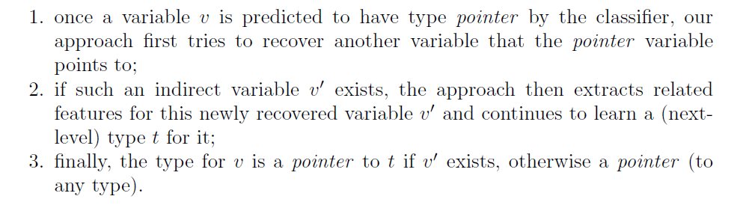
Approach
Type Lattice
ꓔ
Long double
double
Long long int
ptr
int
float
short
char
bool
（…）
ꓕ
Our approach handles pointer level-by-level
Notes:
Finally, we present the lattice of our types that we are learning, which gives the hierarchy of types and will be used to measure the precision of our approach.
In this lattice, there is a “pointer" to the lattice itself for the type pointer. In other words, our approach handles pointer level-by-level, which proceeds as follows:
1. once a variable v is predicted to have type pointer by the classier, our approach first tries to recover another variable that the pointer variable points to;
2. if such an indirect variable v0 exists, the approach then extracts related features for this newly recovered variable v0 and continues to learn a (next-level) type t for it;
3. finally, the type for v is a pointer to t if v0 exists, otherwise a pointer (to any type).
Theoretically, our approach can handle a pointer with any levels (and thus may not terminate). While in practice, we found only 3 levels are enough.

Slide 19
Experiments
We have implemented our approach as a prototype called BITY.
(BInary Type)
We collect binaries as the training dataset from:
Programs that are used in teaching materials
Commonly used algorithms and real-world programs
Benchmark: coreutils (v8.4 ):
We first compile the test programs into (stripped) binaries, and then use BITY to predict types for the recovered variables. To measure the accuracy of our approach, we compare the types that BITY predicts with the type information extracted from the binaries that are obtained by compiling the test programs with debug support.
Comparison: Hex-Rays decompiler-v2.2.0
Another metrics: Distance (TIE)
Notes:
In the following, we conduct some experiments.
We have implemented our approach as a prototype called BITY.
For a high precision, we consider a training dataset that should contain different possible usages of different types. For that, we collect binaries with debug information obtained from programs used in teaching materials and from commonly used algorithms and real-world programs.
To evaluate our approach, we perform our tool BITY on programs from coreutils(v8.4), a benchmark used by several existing work.
We also compare our tool BITY against Hex-Rays decompiler-v2.2.0.153, a plugin of the commercial tool IDA Pro.

Slide 20
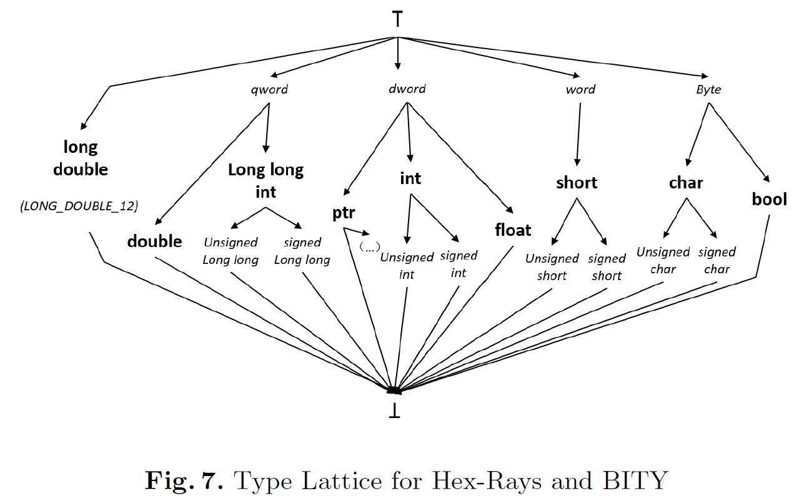
Experiments
extended type lattice:
We say that two types are compatible if one of them is a subtype of the other one following the top-level lattice.
Notes:
In order to Compare with Hex-Rays, we extend our type lattice with the types recovered by Hex-Rays, which is shown in the picture.
We say that two types are compatible if one of them is a subtype of the other one following the top-level lattice.

Slide 21
Experiments
BITY
correct types for 58.15% variables,
compatible types for 31.22% variables,
in total proper types for 89.37% variables.
Hex-Rays
correct types for 54.80% variables,
compatible types for 25.26% variables,
in total proper types for 80.06% variables.
Notes:
In this part, I show a brief result of our experiments. More detail is in our full paper.
The results show that our tool predicts correct types for 58.15% (1356) variables and compatible types for 31.22% (728) variables, in total proper types for 89.37%(2084) variables; while Hex-Rays recovers correct types for 54.80% (1278) variables and compatible types for 25.26% (589) variables, in total proper types for 80.06% (1876) variables.
This indicates that our tool is more precise than Hex-Rays, both in terms of correct types and compatible types.

Slide 22
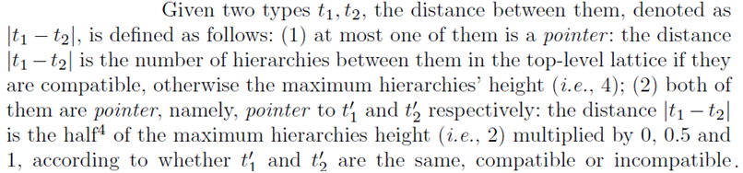
Experiments
Another metrics: Distance (TIE)
Notes:
We borrow the notation distance from TIE to measure between types.
Distance addresses how to compare compatible types. The distance between two types is the number of levels between them in the primitive lattice if they are subtypes of each other, otherwise, the maximum lattice height.
In word, the shorter the distance, the more accurate.

Slide 23
Experiments
The average distance measured by our tool is 0.72.
The average distance measured by Hex-Rays is 1.02.
Our tool is more precise than Hex-Rays.
Notes:
For most programs, our tool predict types with a shorter distance than Hex-Rays.
The average distance measured by our tool is 0.72; while Hex-Rays is 1.02.
This also indicates that our tool is more precise than Hex-Rays.

Slide 24
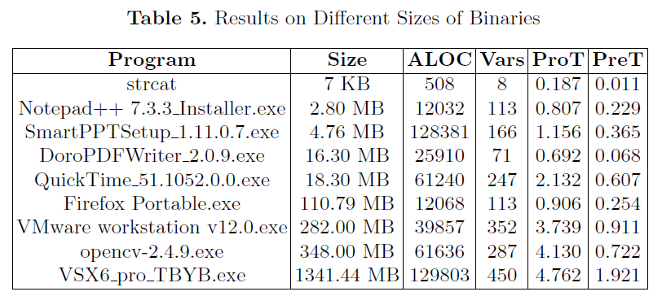
Experiments
Performance
(ALOC denotes the lines of the assemble codes, Vars denotes the number of recovered variables in stack, ProT denotes the preprocessing time excluding the disassembling time by IDA Pro, PreT denotes the predicting time.)
The results show that
The preprocessing time accounts for a great proportion and is linear on LOC and variable numbers;
The predicting time does not cost too much and is linear on variable numbers;
Our tool predicts types for binaries of different sizes in just a few seconds, which indicates our tool is scalable and suitable in practice.
Notes:
To evaluate the scalability of our tool, we conduct experiments on binaries of different sizes.
This Table shows the experimental results.
The results show that our tool predicts types for binaries of different sizes in just a few seconds, which indicates our tool is scalable and suitable in practice.

Slide 25
Conclusion
We have proposed a new approach to predicting the most possible types for recovered variables. Different with existing work, our approach bases on classifiers, without resorting to program analysis like constraint solving techniques.
We have implemented our approach in a prototype and carried out some interesting experiments. The results show that our tool is more precise than the commercial tool Hey-Rays and our tool is scalable and viable in practice.
As for future work, We may perform a points-to analysis to improve our analysis on multi-level pointers. We can also take type quantifiers (e.g., signed) or the composite types (e.g., struct) into account.
Notes:
In conclusion
Thank you very much

Slide 26
That ‘s all.
Thank you very much!

