Slide 1
Full Stack Web Development
Markdown / Getting Started

Slide 2
What Is Markdown?
Markdown is a markup language with plain text formatting syntax designed so that it can be converted to HTML and many other formats using a tool by the same name.
Markdown is used to format readme files, online discussion forums, and creating rich text using a plain text editor
Markdown files use a .md or a .markdown file extension

Slide 3
Readability Is Key
The key design goal of Markdown is readability
Uses a plain text format and can optionally be converted to valid HTML/XHTML
No tags and minimal punctuation/symbols/characters unlike markup languages like RTF and HTML

Slide 4
Extended Markdown
There are lightweight markup languages available that extending Markdown and add features such as
Tables
Footnotes
Definition Lists
MD inside HTML Blocks
Some examples are Markdown Extra, Multi-Markdown and the Pandoc Markdown extension

Slide 5
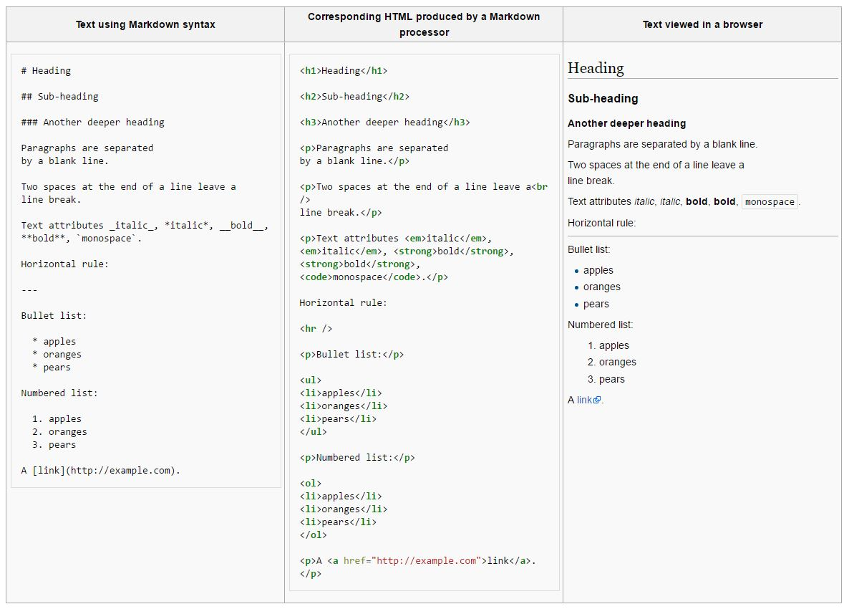

Slide 6
Popular Markdown Editors
Markdown can be created with any text editor but there are editors and tools that are geared toward Markdown code
Texts – For Windows and Mac. Looks like Notepad
WriteMonkey – Clean and simple interface with split screen. Windows only
Haroopad – Windows Mac and Linux compatible. Full-featured, split screen, code highlighting, etc
Markpad – Windows only, not many features and a little buggy
MarkdownPad 2 – One of the first created. Many features. Pro and free editions..Windows only

Slide 7


