Slide 1
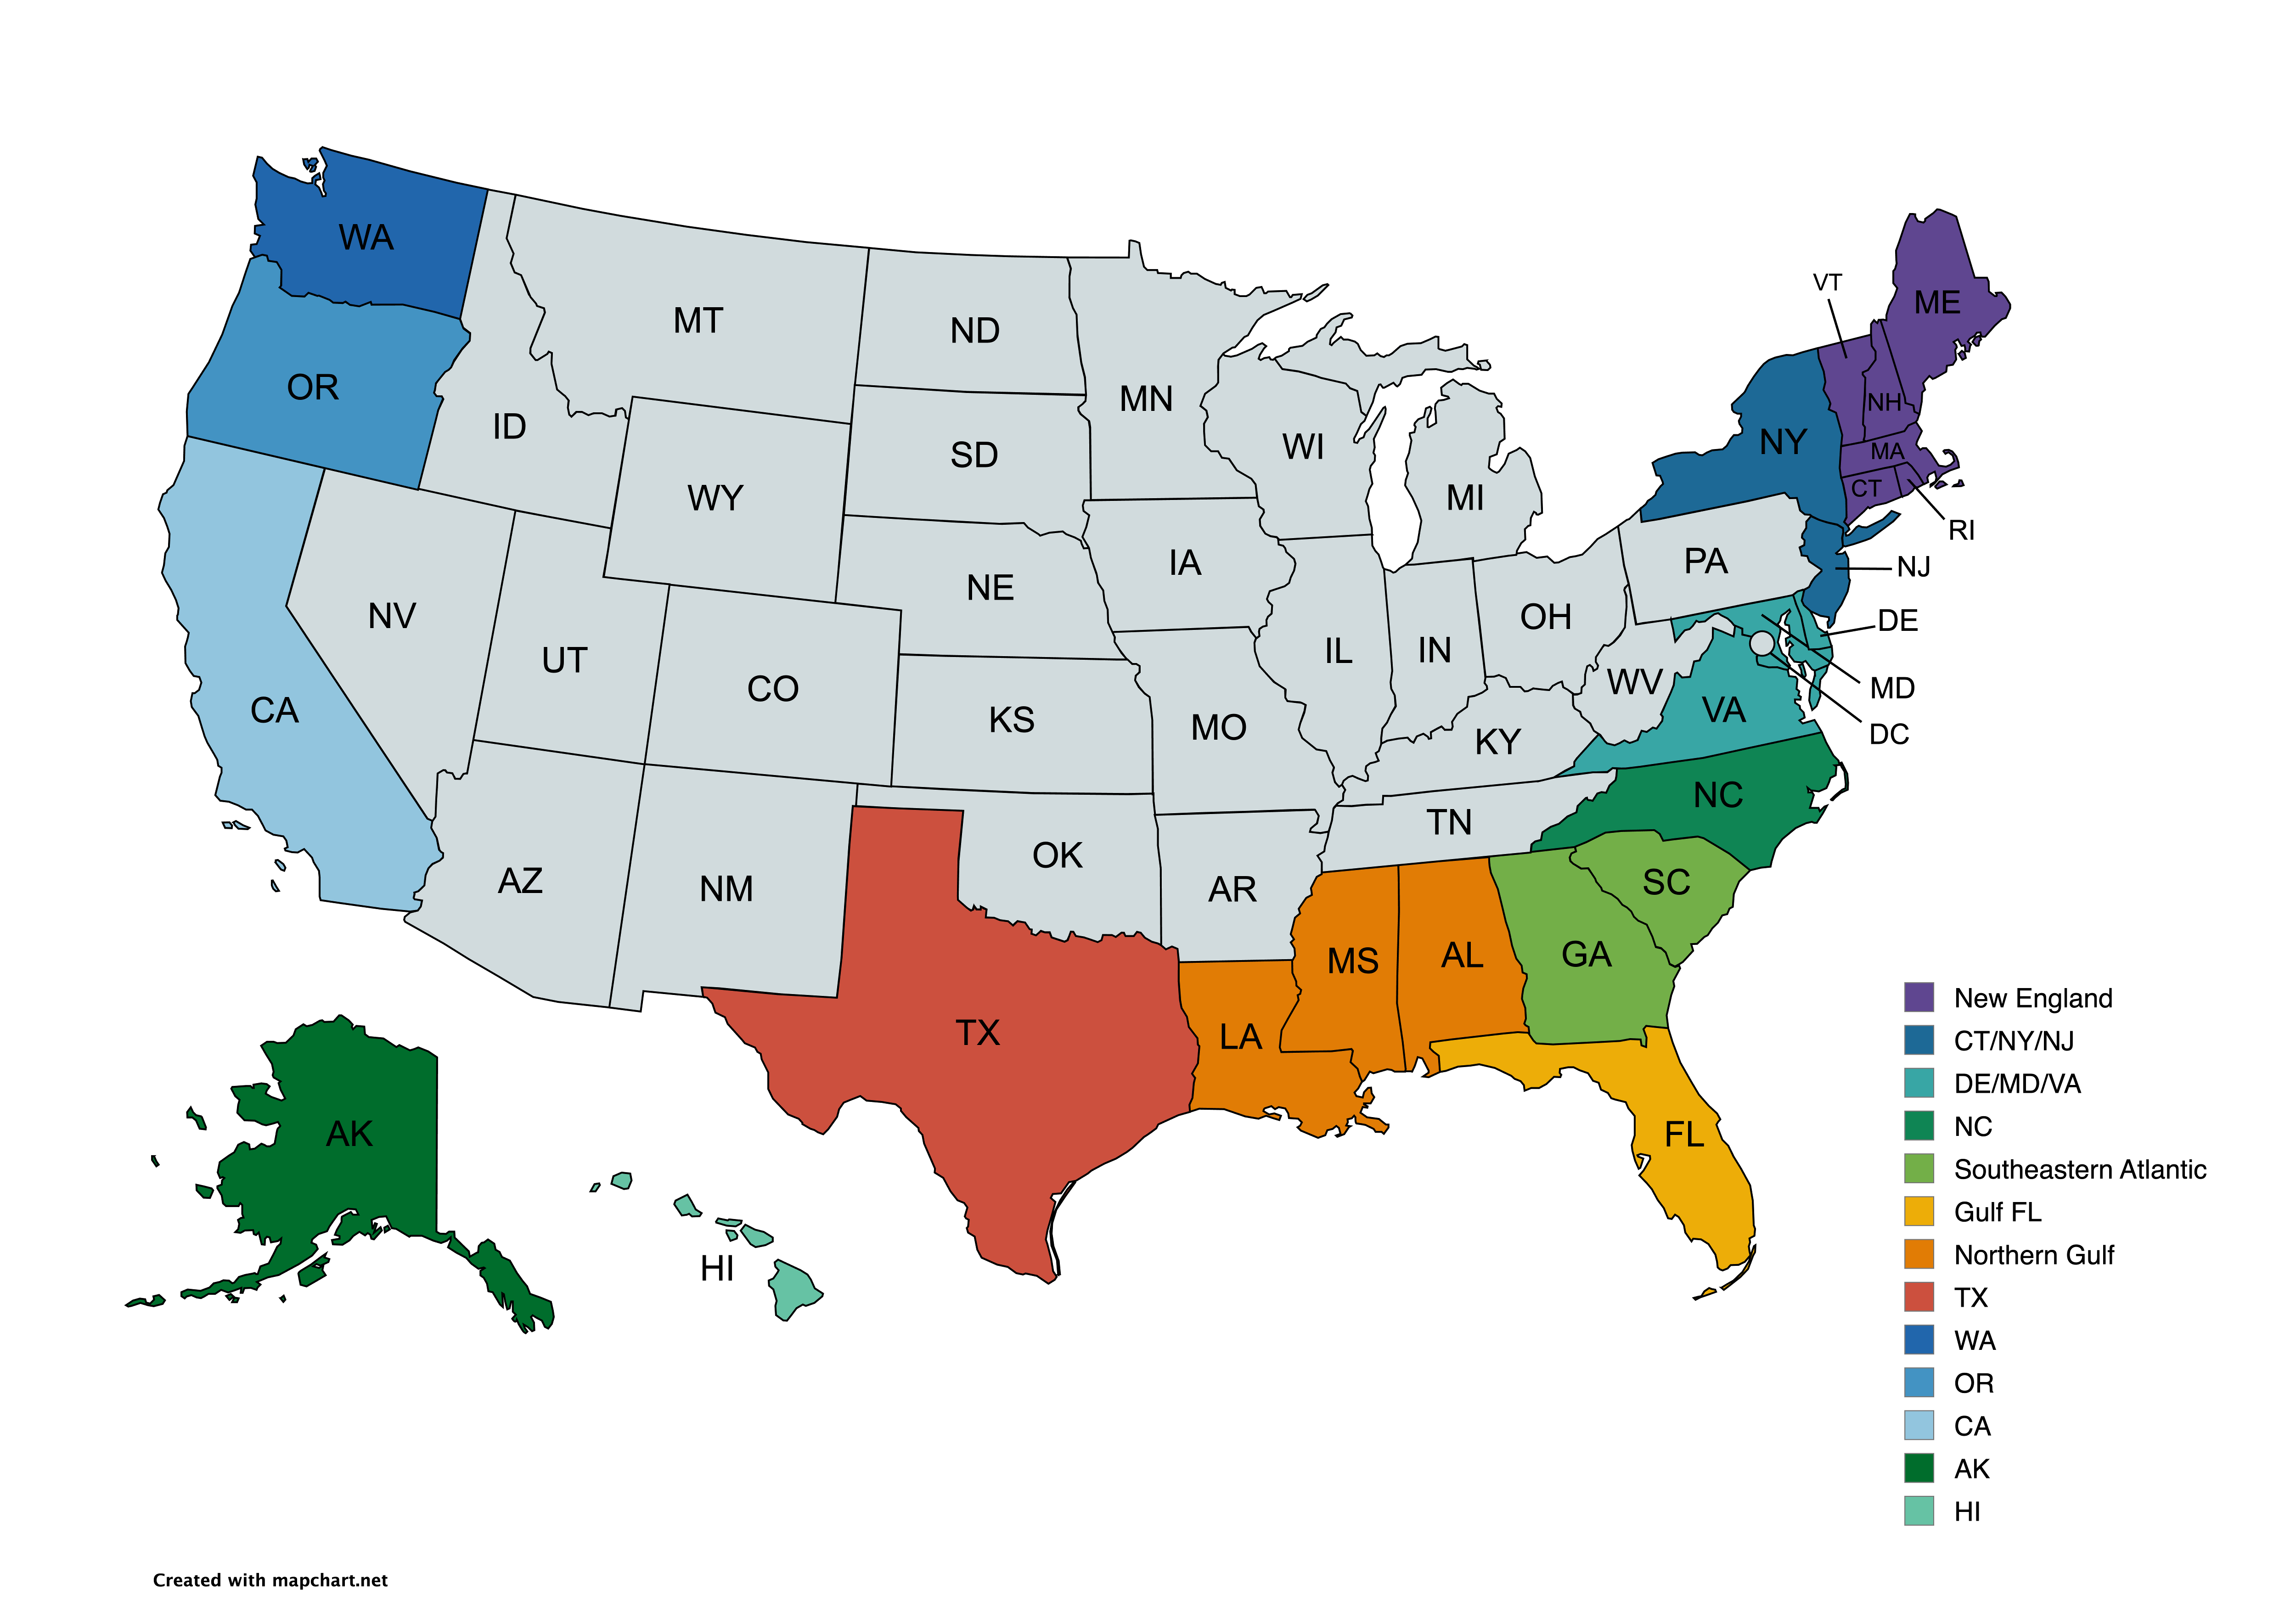











April 24, 2025
1
0
4
4
0
0
6
8
4
7
3
5
0
0

Slide 2






May 1, 2025
1
0
4
4
0
8
0
10
4
5
4
4
0
0

Slide 3

May 8, 2025
1
0
3
1
7
0
10
4
7
5
5
0
0

Slide 4
May 15, 2025
1
0
4
1
9
0
11
3
6
5
5
0
0

Slide 5
May 22, 2025
1
0
6
1
8
0
10
4
7
6
4
0
0

Slide 6

May 29, 2025
1
0
6
1
9
0
10
4
8
6
4
0
0

Slide 7

June 5, 2025
4
6
1
9
10
4
8
7
4
0
0

Slide 8


June 12, 2025
2
5
1
9
11
4
8
7
4
0
0

Slide 9



June 19, 2025
4
6
1
9
9
4
9
6
4
0
0

Slide 10

June 26, 2025 by Area
4
7
1
8
12
4
8
7
4
0
0

Slide 11


July 3, 2025 by Area
3
5
1
9
9
4
7
7
5
0
0

Slide 12
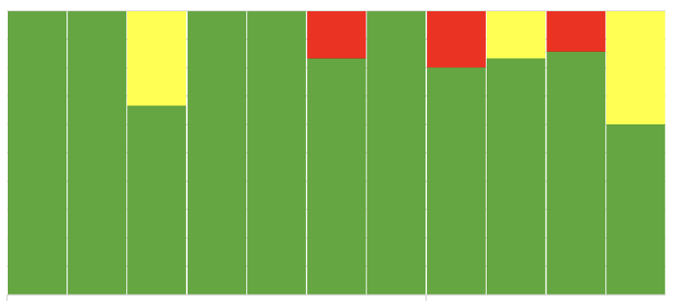

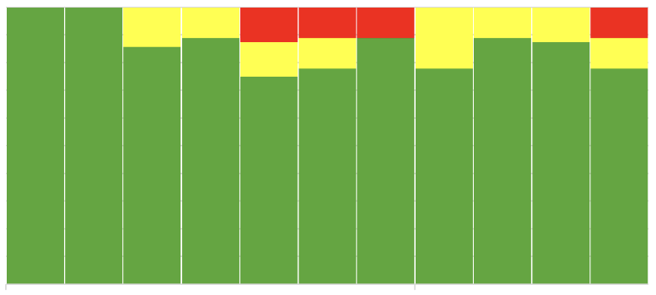
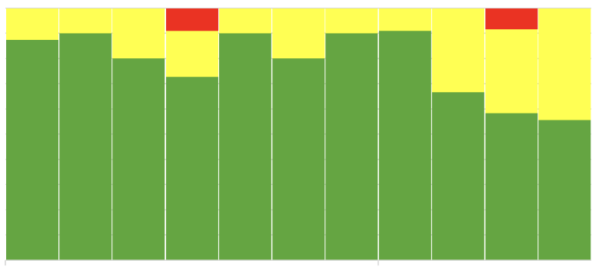
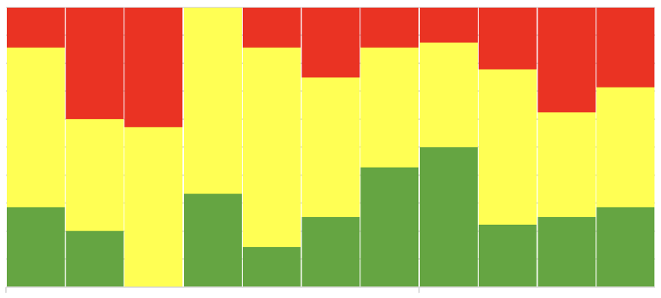
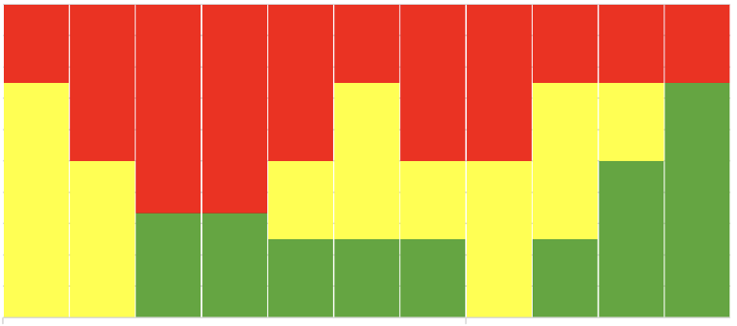
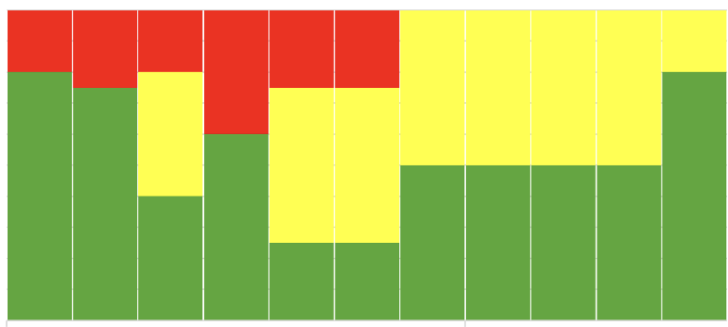
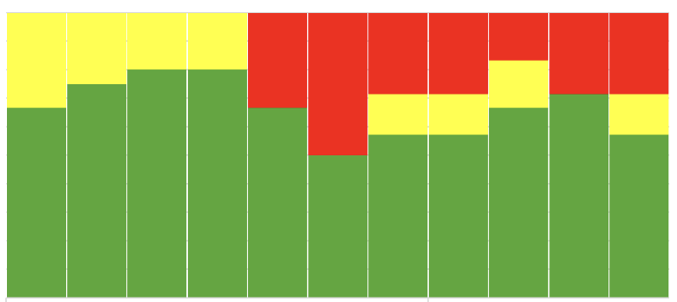
April 24 to July 3, 2025
by Area
New England
WA, CA
MD, VA
NC
LA, MS, AL
SE Atlantic
TX
Gulf FL

