Slide 1
A Framework for Intelligent Message Routing on SNS
hupili [at] ie [dot] cuhk [dot] edu [dot] hk
HU Pili
Dec 4, 2012

Slide 2












Slide 3

Motivation -- SNSAPI
Too Many Platforms
Heterogeneous Interface
Data Safety!! (they may block your account one day!)
Msg = Read(Renren)
Write(msg, SQLite)

Slide 4

SNSAPI Framework
CLI
channel
Application
C1
C2
C3
C4
C5
C6
Pocket
……
SNSBase
Derive
Interface
Type
Platform
Conf
Crypto
Physical
Log
Error
Utility
OAuth
HTTP

Slide 5
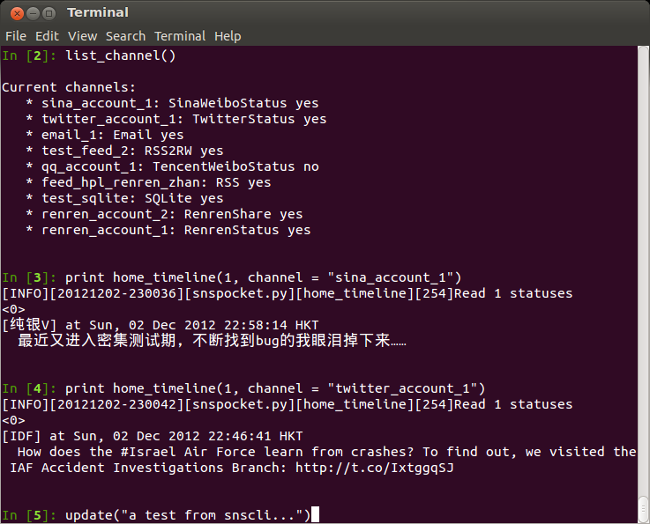
snscli screenshot
1. Python Functions
list current loaded channels
2. STDIN STDOUT
read statuses
read statuses
update a status

Slide 6


Motivation -- SNSRouter
Too many messages
Different quality.
Noise.
C1
C2
C3
C4
C5
C6
Pocket
……

Slide 7
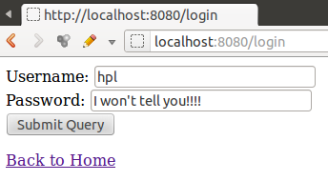
SNSRouter Frontend Screenshot
Use “bottle” as micro-framework
FE is all Python; run everywhere

Slide 8
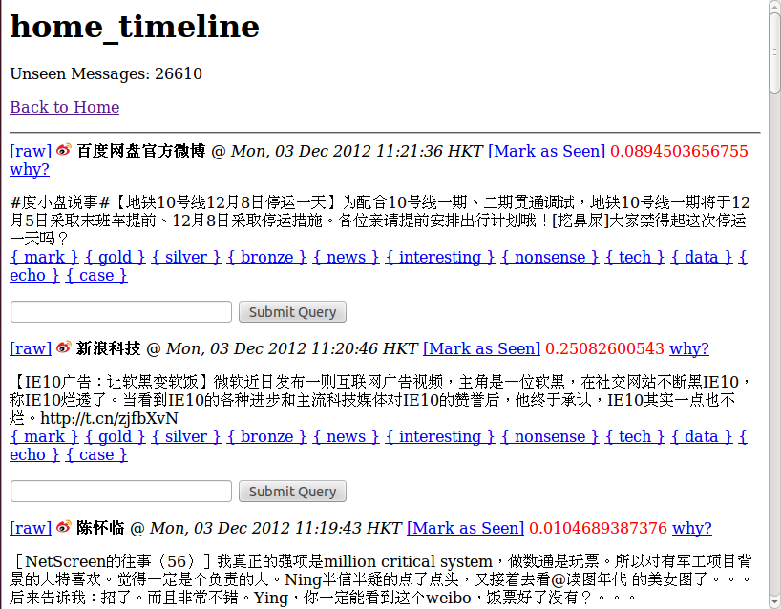
SNSRouter Frontend Screenshot
Original
Not informative for me
Sounds interesting
Not informative for me

Slide 9
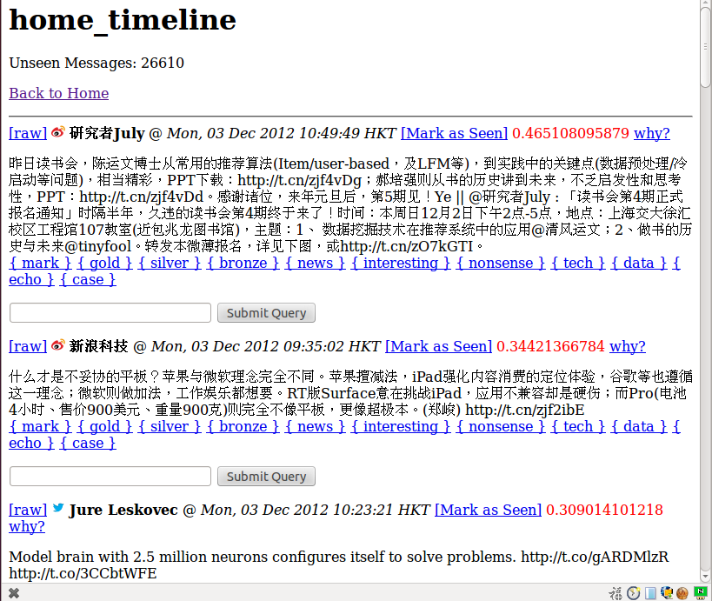
SNSRouter Frontend Screenshot
Ranked !!!!!!
Recsys fits my recent interest!
Industrial news, I may want to follow the link and read further
Tweets from a renowned social network researcher

Slide 10
Formulation
Extracted k-D features for N messages:
Linear combination yields a score:
The score y should capture user preference.
Sort messages by y.
HOW?

Slide 11
Graph Induction
gold
silver
bronze
User Specified
Graph Induced
mark
news
interesting
e.g.
Floyd Algorithm
null
nonsense
shit

Slide 12
Formulation
Induced preference graph:
Linear regression with preference constraint:
Rank Preserving Regression (RPR)
RPR is my temporary term. If you know somebody has already done this, please kindly inform me.

Slide 13
Transformation
Existing solvers?
Ordinal regression?
Isotonic regression?
Constraint as objective: (indicator function)
Approximation by Sigmoid:

Slide 14
Training
Gradient Descent: (S short for Sigmoid)
Observation: full gradient is the summation of per pair partial gradient
Stochastic Gradient Descent (SGD)

Slide 15
Evaluation
Kendall’s tau correlation coefficient: (modified version for our problem)
# of correct pairs
# of incorrect pairs
# of total pairs
K takes value in [-1, 1]

Slide 16
Result – Basic Statistics
Item | Value
# of total messages | 32533
# of seen messages | 7553
# of tagged messages | 924
# of forwarded messages | 167
# of derived pairs (training) | 231540
# of derived pairs (testing) | 229009
# of features (+1 noise) | 15
Data source: HU Pili personal deployment. Oct 2012 – Dec 2012

Slide 17
Result – Training with SGD
Item | 1. | 2. | 3.
# of rounds of SGD | 200,000 | 400,000 | 1,000,000
Wall clock time | 32.63s | 60.81s | 159.57s
Kendall’s score (training) | 0.8178 | 0.8349 | 0.8414
Kendall’s score (testing) | 0.7598 | 0.7758 | 0.7865
Straight SGD implemented in SNSRouter project. Code has not been optimized.
Scale linearly
Online learning is possible
Easy configuration
Easy to add new features

Slide 18


Project Output
SNSAPI (5000+ lines)
A middleware for different SNS
…more to come.
SNSRouter (2800+ lines)
A portable web frontend
Real data collection (1+ month)
A flexible algorithm framework (RPR-SGD)
Sample feature extraction modules

Slide 19
Reference
SNSAPI Website: https://snsapi.ie.cuhk.edu.hk/
SNSAPI Github: https://github.com/hupili/snsapi/
SNSRouter Github: https://github.com/hupili/sns-router
Related Work
IFTTT: https://ifttt.com/
Yahoo Pipe: http://pipes.yahoo.com/pipes/
Acknowledgements
LI Junbo @ BUPT: Cofounder of SNSAPI project.

Slide 20
Thanks
Join SNSAPI development!
- https://github.com/hupili/snsapi/
- Towards a FREE / SAFE / RELIABLE Social Network Overlay.
In support of Free Web Action:
- https://www.google.com/takeaction/
Q/A?

Slide 21
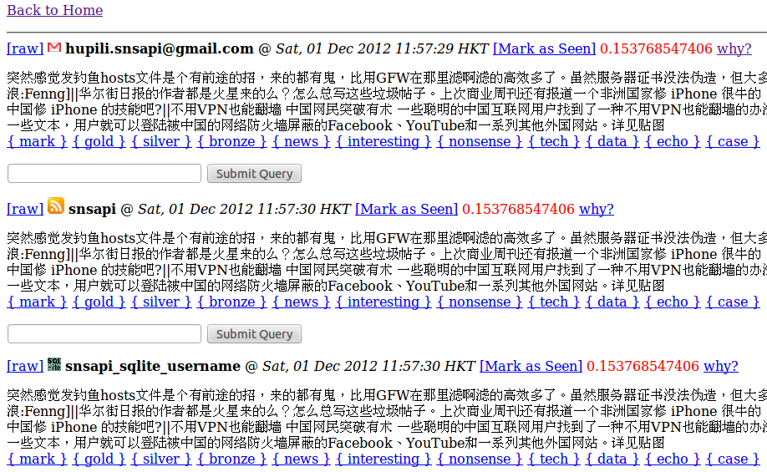
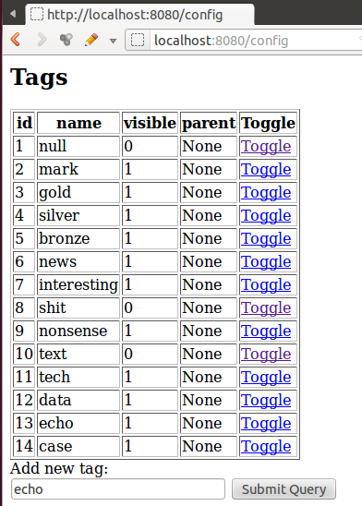
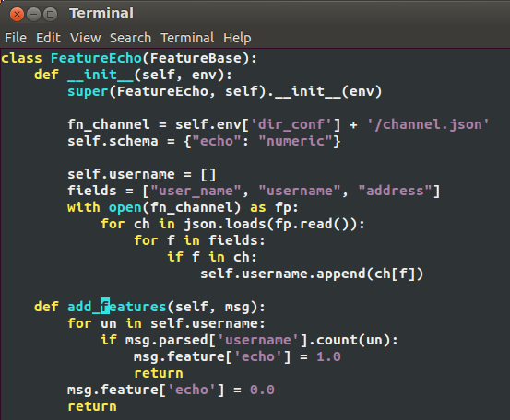
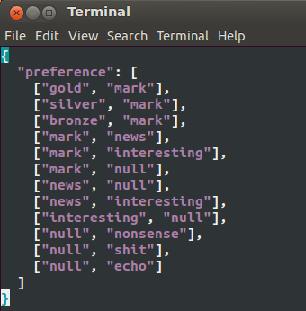
Add a new feature
Backup slides
Cancel echo:
1. Add tag “echo”
2. Specify preference
3. Add feature
4. AUTO train weights
Most platforms will echo the message you post there, but they do not give you more information. We want to SOFTLY cancel them.

Slide 22
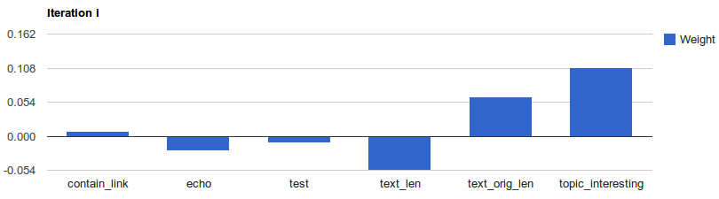
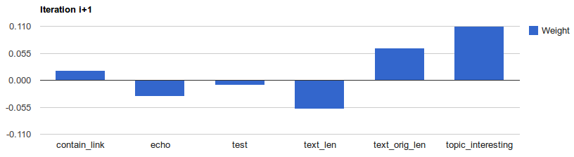
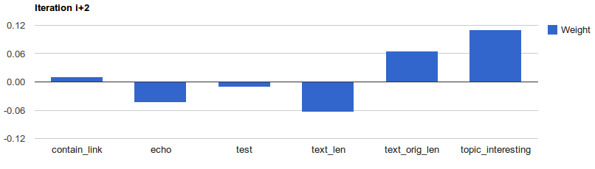
Backup slides
Auto Weight Learning
The weight of “echo” feature goes down iteration by iteration. Messages with “echo=1” will be ranked lower. This is auto learned by our RPR-SGD framework.

Slide 23
Features
Backup slides
Name | Description
noise | Random variable [0,1]
echo | Whether the message is from myself
contain_link | Whether the message contain text link
topic_interesting | TF*IDF for {interesting}
topic_tech | TF*IDF for {mark}{gold}{silver}{bronze}
topic_news | TF*IDF for {news}
topic_nonsense | TF*IDF for {nonsense}{shit}
user_interesting | As above; regard “user” as “term”
user_tech | As above
user_news | As above
user_nonsense | As above
text_len | Length of all message (original + retweet)
text_len_clean | Length without face icon, link, @xxx, and puctuation
text_orig_len | Length of original message

Slide 24
Reaction to noise
Backup slides
Start with already trained weights for other features. Largest magnitude is <10.
Inject 1 noise feature, picking U[0,1]. Init it’s weights by 10.
 | Init | Round=200K | Round=400K
Kendall | 0.0772 | 0.5435 | 0.8060
W(“noise”) | 10.0 | 1.3407 | -0.0132

Slide 25
Future Works -- System
Backup slides
RESTful interface for all components
e.g. one can outsource computationally intensive training to other servers
SNSRouter as a platform
e.g. can be used to aggregate multiple channels

Slide 26
Future Works -- Algorithm
Backup slides
Add regularization to alleviate overfiting
Advanced feature extraction.
SGD can do online training.
e.g. one sample in, derive some pairs, do SGD on those pairs.
Naturally time sliding.

Slide 27
Why not classification?
Backup slides
Less competitive result (logit) or hard to interpret rules (J48)
Hard cut
Do not output a “likelihood”
Human can only process sequentially
Accurate classification is not needed.
A sample branch for mark (3.0/1.0):
topic_news <= 0.00603 && topic_tech <= 0.041455 && topic_interesting <= 0.042225 && topic_nonsense <= 0.010593 && text_len > 0.12 && id <= 30634 && user_tech <= 0.010894 && text_len_clean <= 0.0575 && user_tech > 0.001621

