Slide 1
William Hopkins’ Final Year Project
Tempo Induction/Estimation

Slide 2
Tempo Induction/Estimation
A task in MIR (Music Information Retrieval)
Attempt to find the global tempo of a piece of music.
Tempo refers to the speed of the music, measured in BPM.
Local TI is called Beat Tracking.
Useful to provide annotations for other applications. (e.g. music recommendation, playlist generation)

Slide 3
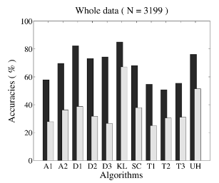
Background
The first public evaluation of TI methods occurred in 2004.
It evaluated the accuracy of 11 algorithms.
Won by Anssi Klapuri.
Dark Bar – ACC1
Light Bar – ACC2
ACC1 = ~80%
ACC2 = ~65%
Ref: F. Gouyon et al. “An experimental comparison of audio tempo induction algorithms”. IEEE Transactions on Audio, Speech, and Language Processing. 14.5(2006), pp. 1832–1844.

Slide 4
TI Metrics
ACC1 - computes a 0 or 1 score per track, which indicates the correctness of an estimate, allowing a 4% tolerance.
ACC2 - computes a 0 or 1 score per track, allowing estimates to be wrong by the factors 2, 3, 1/2 or 1/3.
P-Score – takes tempo ambiguity into account and treats it as an inherent property of music.

Slide 5
P-Score
P=ST1∗TT1+(1−ST1)∗TT2
Each track annotated with two reference tempi T1 and T2, along with ST1.
ST1 – T1s relative perceptual strength
TT1 – 0 or 1, showing correctness of estimate of T1, allowing a 8% tolerance
TT2 – Same as TT1 but for T2

Slide 6
Problems with these metrics
ACC1 – 4% tolerance somewhat arbitrary. Not suited to a lot of music with variable tempo.
ACC2 – Says nothing about a system’s ability to help a user distinguish between slow and fast tracks.
P-Score – expensive. Requires multiple annotations to provide ground truth values.
Schreiber et al. 2020 argues that the binary nature of these metrics hides information.

Slide 7

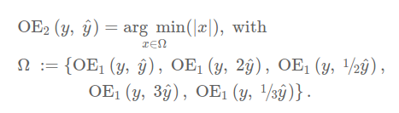
Formal Octave Error
Proposed OE1 and OE2:
Ref: Schreiber, H., Urbano, J. and Müller, M., 2020. Music Tempo Estimation: Are We Done Yet?. Transactions of the International Society for Music Information Retrieval, 3(1), pp.111–125.

Slide 8
How do current approaches fare?
Madmom - Bock, S., Krebs, F., & Widmer, G. (2015). Accurate tempo estimation based on recurrent neural networks and resonating comb filters.
Tempocnn - Schreiber, H., & Muller, M. (2018b). A single-step approach to musical tempo estimation using a convolutional neural network.

Slide 9
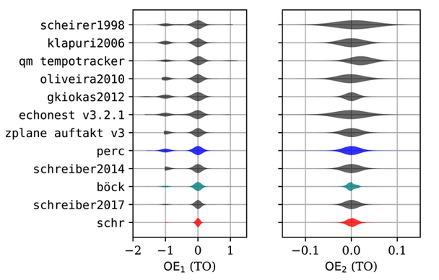
How do current approaches fare?
Ref: Schreiber, H., Urbano, J. and Müller, M., 2020. Music Tempo Estimation: Are We Done Yet?. Transactions of the International Society for Music Information Retrieval, 3(1), pp.111–125.

Slide 10
My Aim
I aim to take a step back and devise a more intuitive geometrical approach to the problem of Tempo Induction.
I want to investigate the how Octave Error affects my algorithm compared to previous metrics.
I hope to simplify the problem to gain more insight into how tempo is found from a raw input.

Slide 11
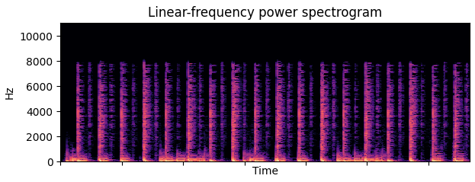
My Aims
Intuitively, musical beats are going to be stressed more than the off-beats.
‘Queen – Another one bites the dust’ in spectrogram view.

