Slide 1
External Statistics &
National Internet Directory
User Experience Designs
April 2015
APNIC

Slide 2
General Public Experience
Clean, Consistent & Easy to Use for Unauthenticated Users
Summary tab provides view of all resource types
Resource specific views accessible through ASN, IPv4 and IPv6 tabs
Left hand filter menu & top search bar provide region based refinement
Users can toggle between graph based tile view or a geospatial map view
Advanced refinement options are displayed inline with applicable graphs & tables
Individual resource and holder views displayed as modals

Slide 3
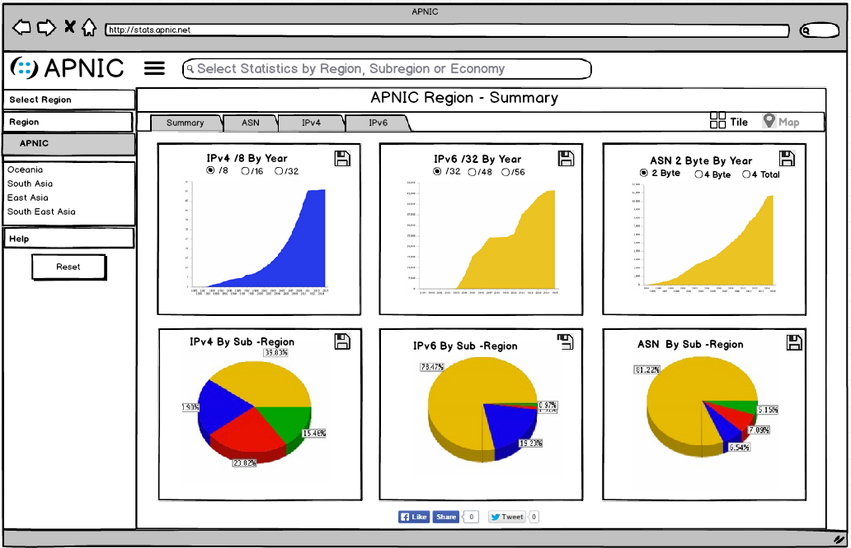
APNIC Summary View
Notes:
Note that for summary views, the map view is grayed out as there is no applicable map view for multiple resources types

Slide 4
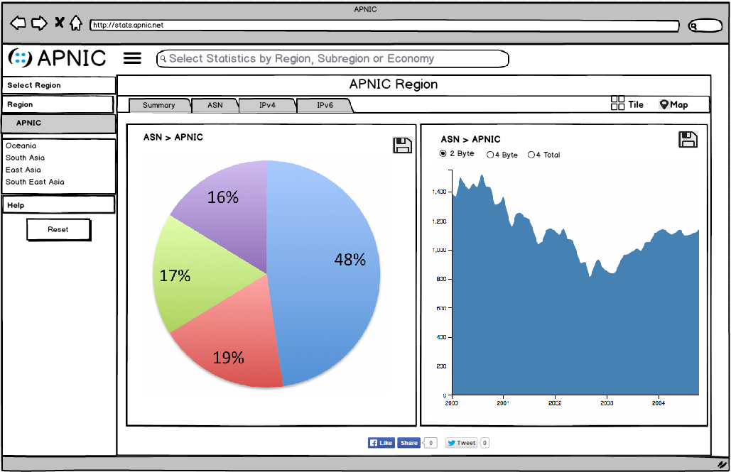
APNIC ASN View

Slide 5
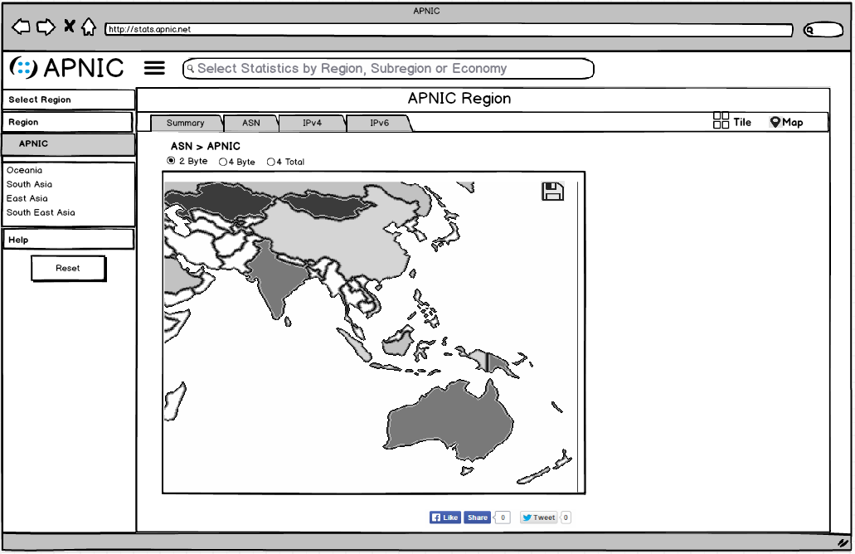
APNIC Map View

Slide 6
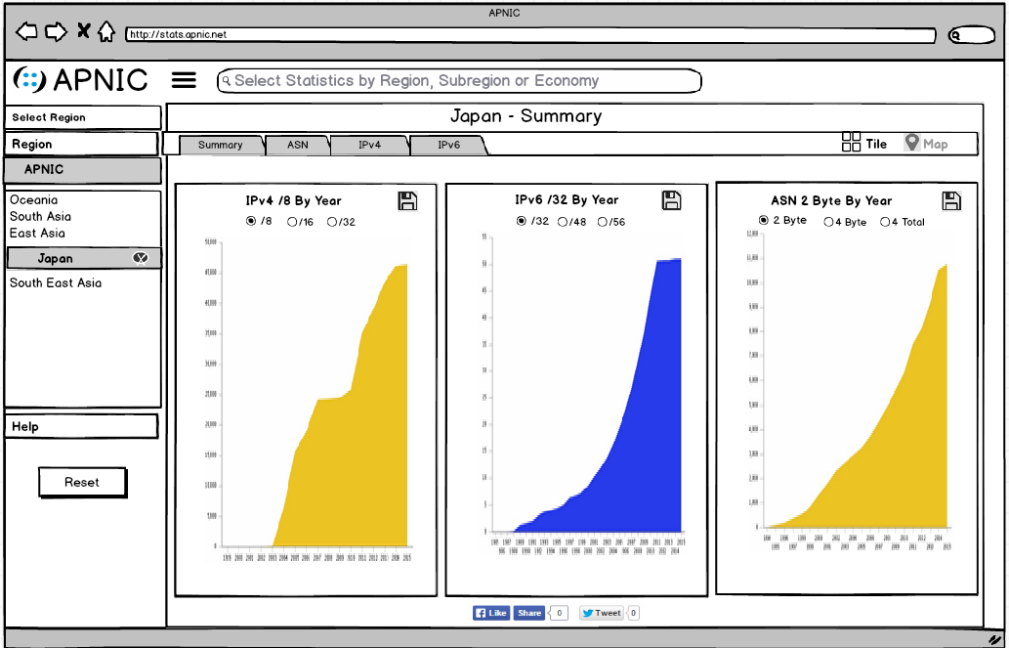
Economy Summary View

Slide 7
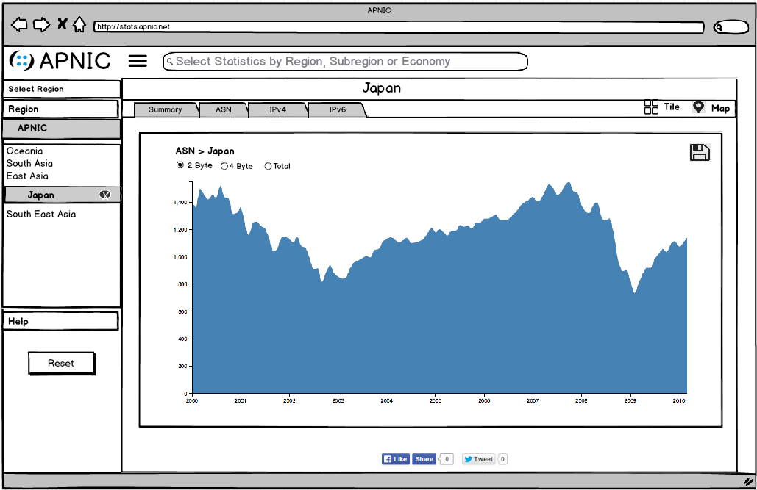
Economy ASN View

Slide 8
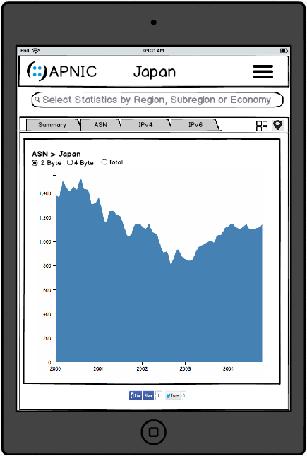
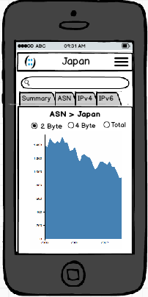
Mobile Views
Notes:
Responsive design ensures each view is optimised for tablet and mobile devices

Slide 9
National Internet Directory Experience
Clean, Consistent & Simple to Use for Authenticated Users
Left hand filter menu and top level search removed for users with single economy permissions to maximise screen real estate
Summary, ASN, IPv4, IPv6 & Holder tabs provide easy access to a variety of information views
Table search feature enables users to search for individual resources and holders
Individual resource and holder views displayed in a modal
Profile and activity views displayed in a modal

Slide 10
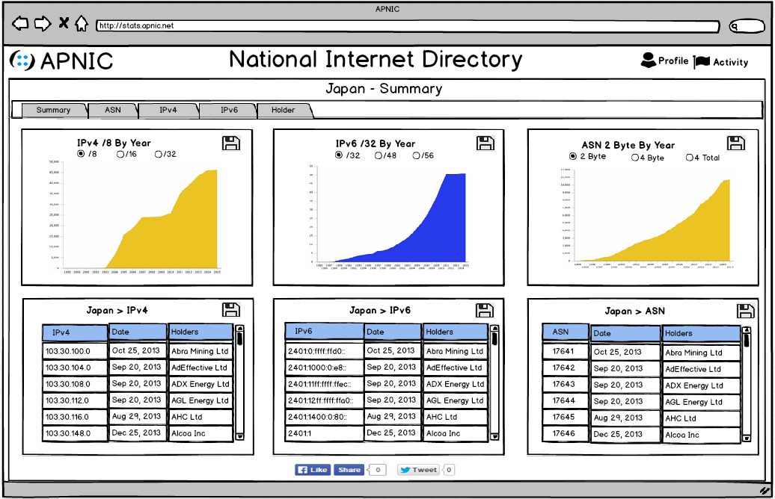
Summary View

Slide 11
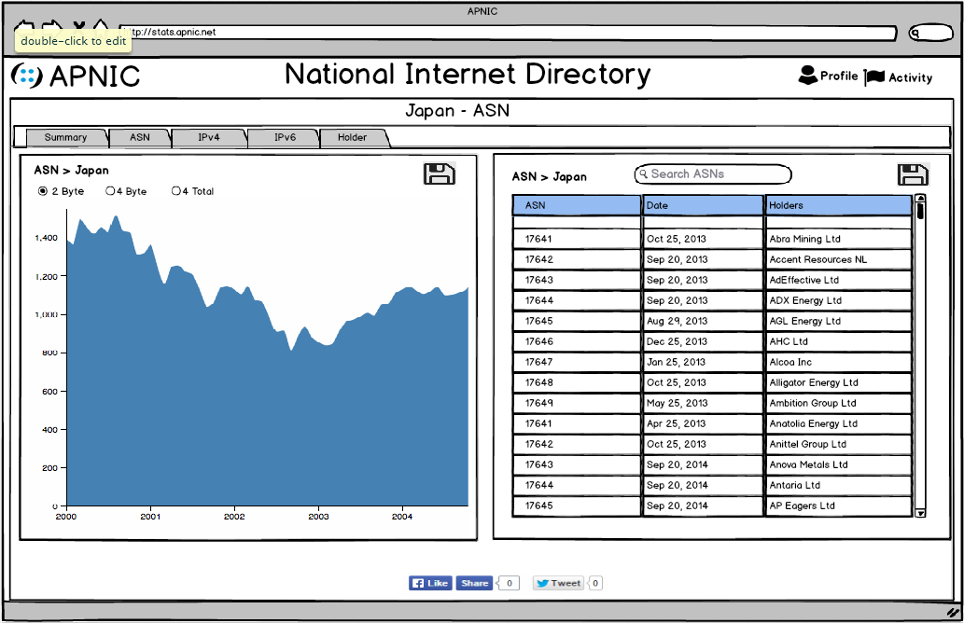
ASN View

Slide 12
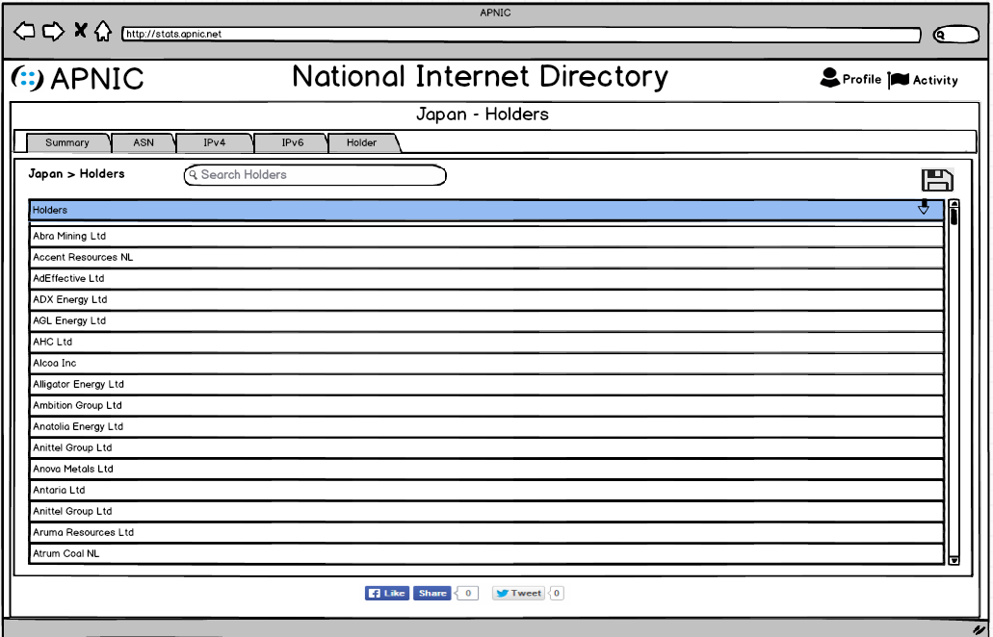
Holder View

Slide 13
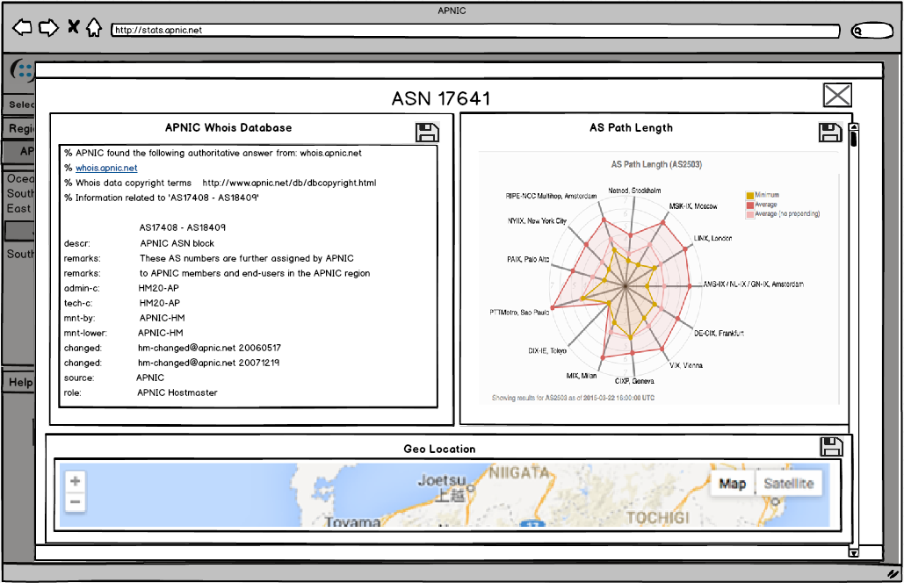
Individual Resource Modal View
Notes:
When a user clicks on an individual resource in the table a model is launched displaying information on that resource

Slide 14
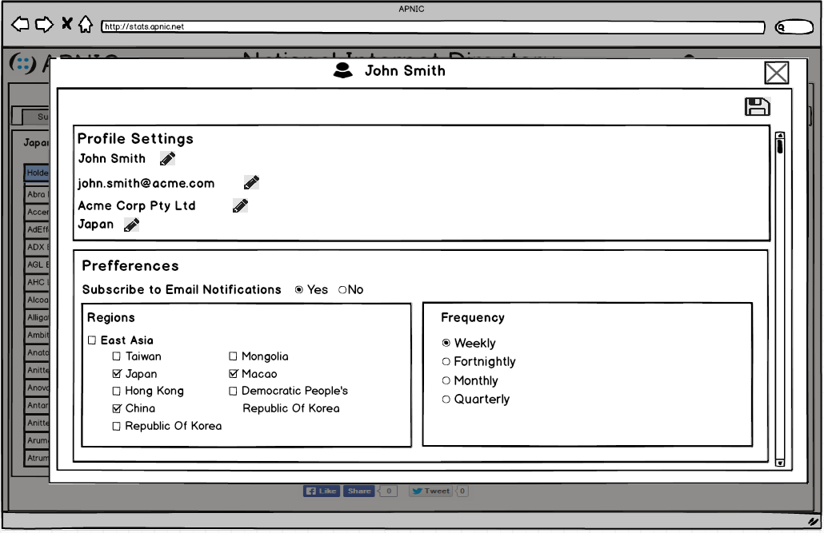
Profile View

Slide 15
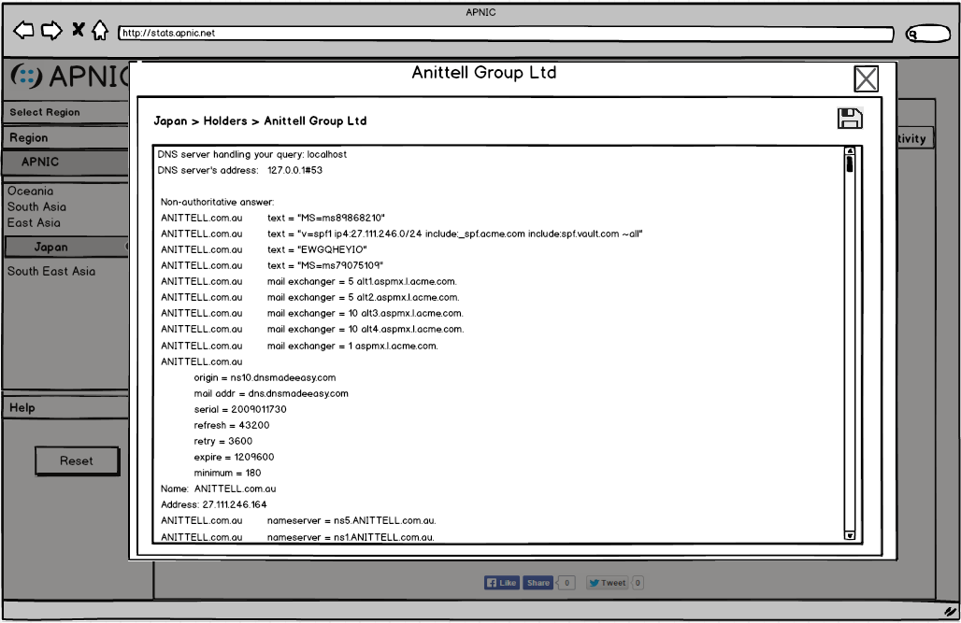
Individual Holder Modal View
Notes:
When a user clicks on an individual holder in the table a model is launched displaying information on that holder
This view can be ignored should APNIC chose not to display any holder information for the general public experience.

Slide 16
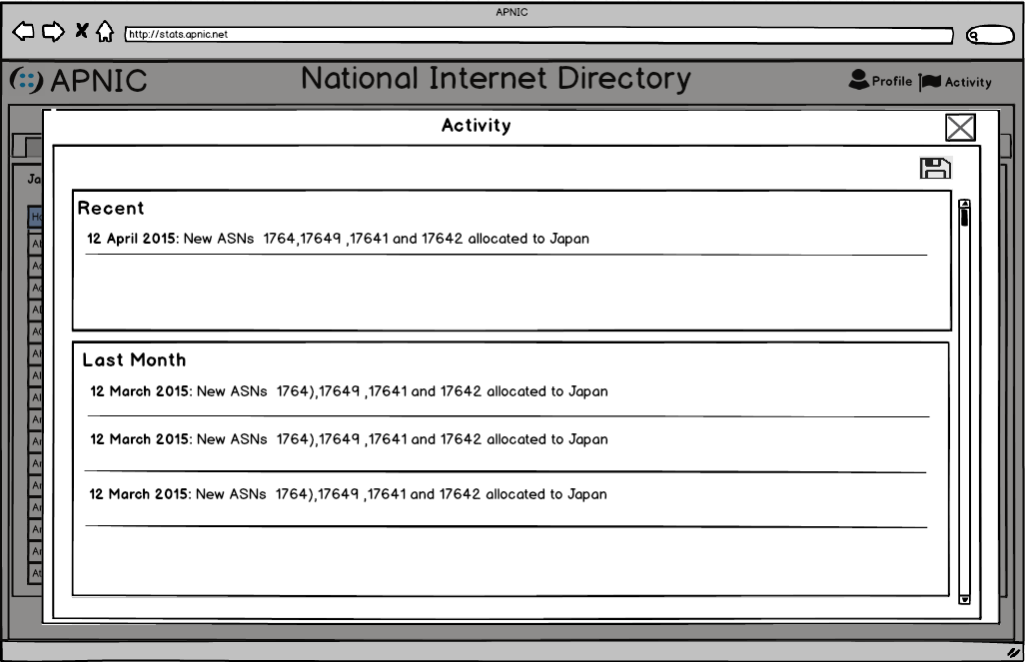
Activity View

Slide 17
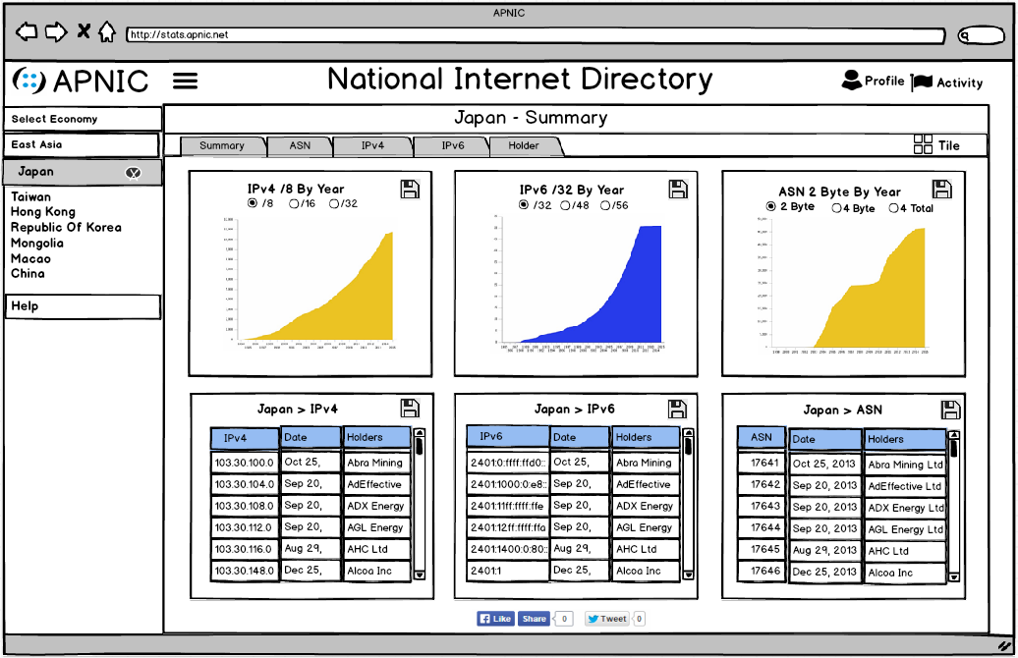
Multi Economy Permission View
Notes:
For 90% of users who have permission to view only a single economy, the left hand menu will be hidden.
For the 10% who do have permission to view multiple economies, the left hand menu will be available to help them to navigate between the economy views.
In this example, the user has been allocated permissions to view all economies in the East Asia sub region.

Slide 18
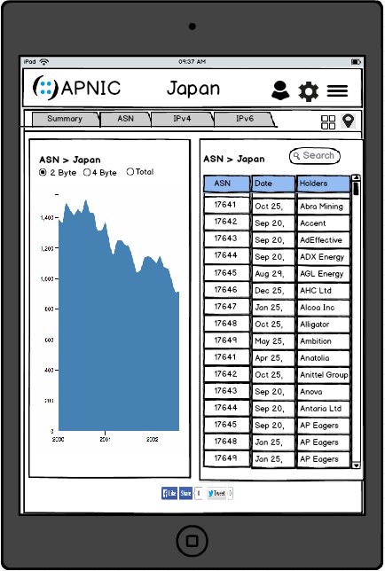
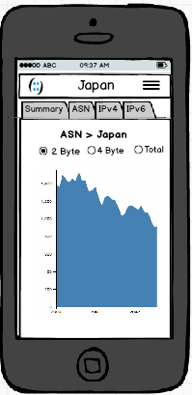
Mobile Views
Notes:
Responsive design ensures each view is optimised for tablet and mobile devices

Slide 19


