Slide 1
Mutual Fund Analytics
Data Analytics, Performance Evaluation & Investor Insights
Presented by: Krishna Kumar Verma B.Tech. CSE (AI) Chhatrapati Shahu Ji Maharaj University

Slide 2
PROBLEM & OBJECTIVE
• Mutual fund data is large and difficult to analyze manually. • Investors need clear information about fund risk and returns. • Raw financial datasets require cleaning and transformation. • Comparing multiple schemes manually is time-consuming.
• Analyze NAV, AUM, SIP and investor transactions. • Evaluate fund performance and risk. • Identify industry and investor trends. • Build an interactive Power BI dashboard.

Slide 3
DATA SOURCES
• Fund Master — 40 schemes • NAV History — ~46,000 records • AUM by Fund House • Monthly SIP Inflows • Category Inflows • Industry Folio Count • Scheme Performance • Investor Transactions — ~32,778 records • Portfolio Holdings • Benchmark Indices
Technologies: Python | Pandas | SQL | SQLite | Power BI

Slide 4
ARCHITECTURE
csv data
Data cleaning & transformation
Power BI dashboard

Slide 5
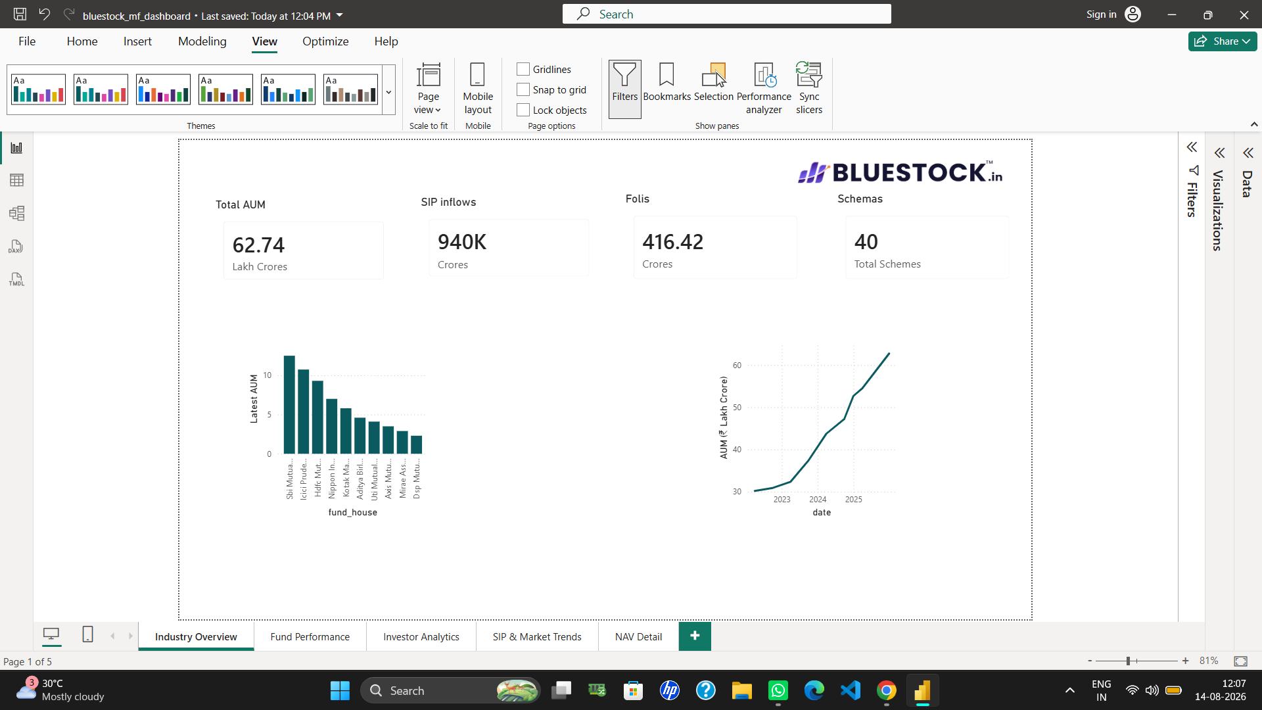
Industry Trends
• Analyzed AUM growth across the study period. • Examined monthly SIP inflow trends. • Compared AUM across fund houses. • Analyzed category-wise inflows.

Slide 6
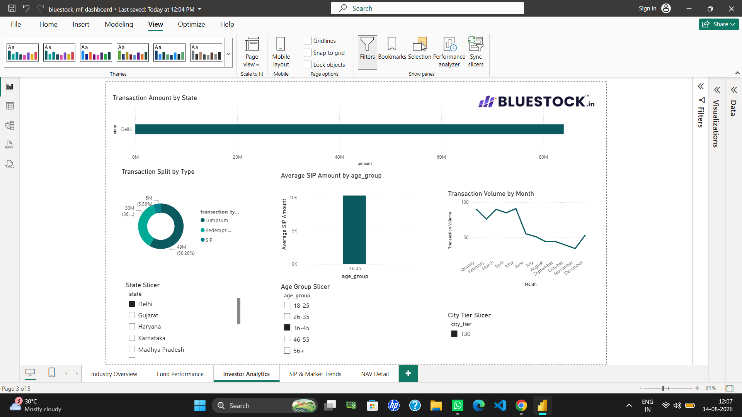
Investor Analytics
• Analyzed investor transactions by state. • Compared SIP, Lumpsum and Redemption transactions. • Performed investor cohort analysis. • Analyzed SIP continuity and at-risk investors.

Slide 7
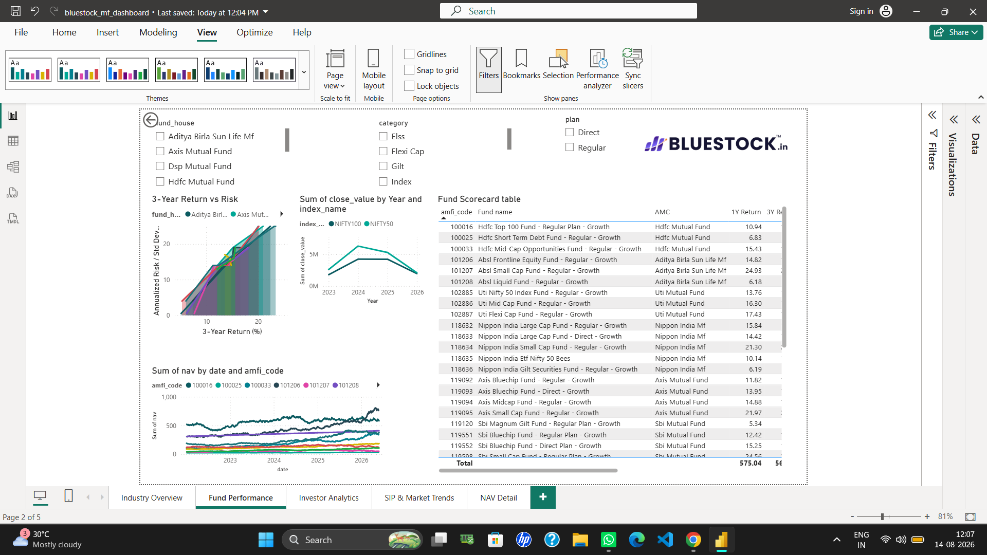
Return & Risk
• 1-Year CAGR • 3-Year CAGR • 5-Year CAGR • Standard Deviation • Sharpe Ratio • Sortino Ratio

Slide 8
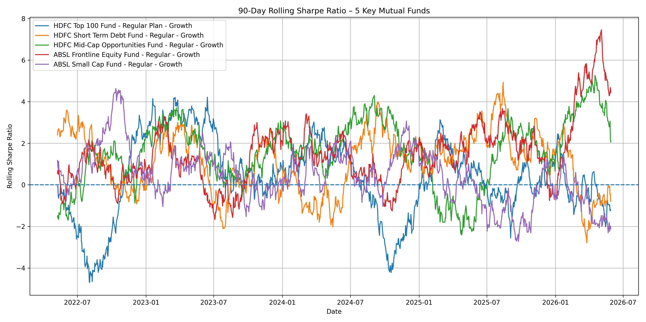
Advanced Risk & Performance Analysis
• Alpha & Beta • Maximum Drawdown • Historical VaR (95%) • CVaR • 90-Day Rolling Sharpe Ratio • Composite Fund Scorecard

Slide 9
Industry Overview
KPIs: Total AUM | SIP Inflows | Folios | Schemes Charts: AUM Trend | AMC-wise AUM

Slide 10
Fund & Investor Analytics
• Risk vs Return Analysis • Fund Performance Comparison • Investor Transactions • Investor Behavior

Slide 11
Key Findings & Recommendations
• Mutual fund schemes show different risk-return profiles. • Risk-adjusted metrics improve fund comparison. • SIP and AUM trends reveal important industry patterns. • Investor transaction data provides useful behavioral insights. • Advanced risk metrics help identify downside risk.

Slide 12
THANK YOU
Mutual Fund Analytics Python | SQL | SQLite | Power BI | Pandas

