Slide 1
CS-472: Web Application Programming Project: Hotel Management System
MAHARISHI UNIVERSITY OF MANAGEMENT
Professors:
Keith Levi
Mahmoud Salem Mohamed Gibily
Team members:
Minh Sang Nguyen – 987019
Efrem Tekle - 109623
Habtom Abraha Gebre -109641

Slide 2

Introduction
Hotel Management System is the web application use for managing various hotel processes such as booking the room, check in/check out the room, room payment, etc.

Slide 3









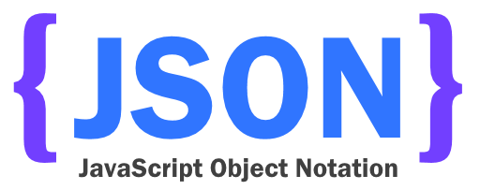
Technologies
We use the tools and technologies through out the course including:

Slide 4
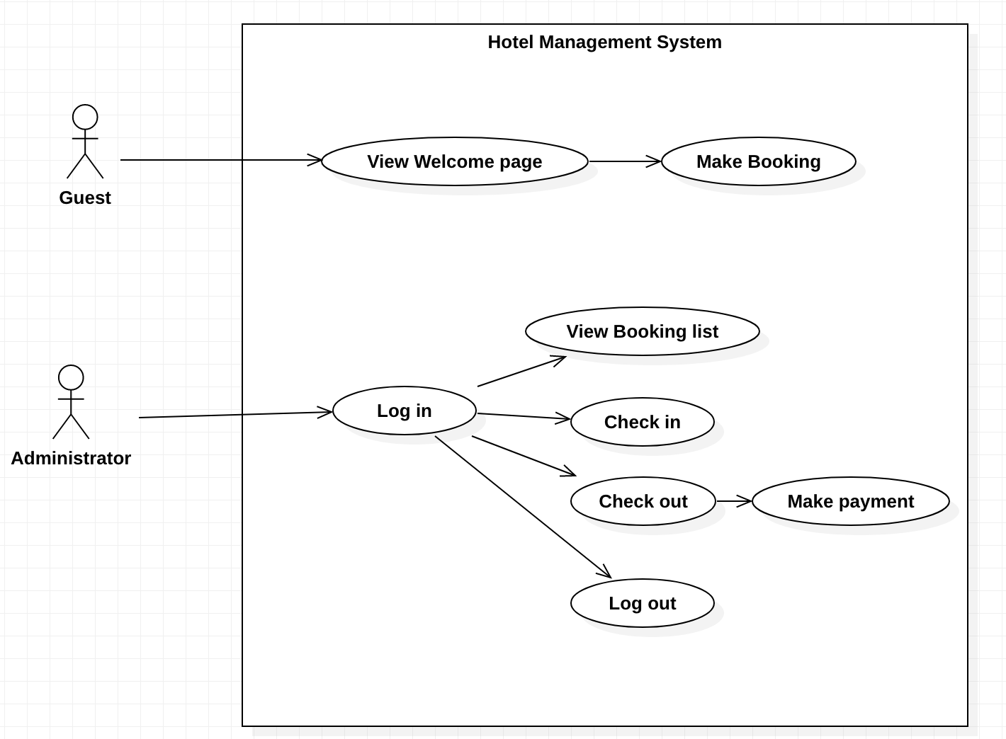
Use Case Diagram

Slide 5


Demonstration

Slide 6
What we learned?
Use application context for storing necessary global variables
Use cookie and session effectively in Login/Logout function
Maintain data while navigating between pages
Future functionalities …
Show more details for room booking
Add more business and policies for Booking Form
Utilize more information in check-in/check-out function

Slide 7


