Slide 1
Final Course Project Big Data Technology – CS523
Submitted by
Name: Minh Sang Nguyen
ID: 987019
Submitted to
Prof. Mrudula Mukadam

Slide 2
Agenda
Spark Streaming
Apache HBase
Kafka
Architecture
Data source and technologies used
Reference links
Demo
Future implementation

Slide 3
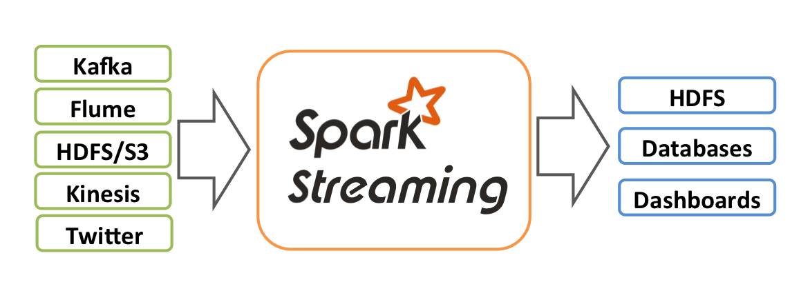
Spark Streaming
Spark Streaming is an extension of the core Spark API that enables scalable, high-throughput, fault-tolerant stream processing of live data streams
Spark Streaming receives live input data streams such as Kafka, Kinesis, ...
Write Spark Streaming programs in Scala, Java or Python

Slide 4

Apache HBase
What is HBase?
HBase is an open-source non-relational distributed database modeled after Google's Bigtable and written in Java, developed as part of Apache Software Foundation's Apache Hadoop project and runs on top of Hadoop and HDFS
Why choose Apache HBase?
Need random, real time read/write access to your Big Data
Able to host very large tables on top of clusters of commodity hardware
Need a NoSQL key/value database on Hadoop

Slide 5

Apache Kafka
What is Kafka?
Apache Kafka is an open-source stream-processing software platform developed by the Apache Software Foundation, written in Scala and Java
Why choose Kafka?
real-time data feed
low-latency platform, high-performance on data pipelines, streaming analytics, data integration
reliable (used by thousands of companies)
popular (has a large network of users and developers)

Slide 6







Architecture
Twitter Dataset
Spark Client Application: read data from data source and push messages to Kafka
Responsible for:
- Receive messages from any client
- Store messages
- Allow any consumer application (such as Spark Streaming application)
Spark Streaming Application:
- Subscribe Kafka event
- Retrieve new messages
- Process simple calculation
- Save result to HBase
HBase: store result

Slide 7
Data source and technologies used
Data source: using a small sample Twitter data source to simulate integration environment on Hadoop Cloudera
Technologies used: Spark, Spark Streaming, Kafka, HBase
Programing language used:
Java (in simulator Spark Application)
Scala (in Spark Streaming Application)

Slide 8
Reference links
https://spark.apache.org/docs/latest/streaming-programming-guide.html
https://www.xenonstack.com/blog/real-time-streaming/
https://docs.cloudera.com/HDPDocuments/HDP3/HDP-3.1.5/developing-spark-applications/content/developing_spark_applications.html
https://www.trackmyhashtag.com/twitter-dataset
https://henning.kropponline.de/2015/04/26/spark-streaming-with-kafka-hbase-example/
https://www.tutorialspoint.com/apache_kafka/apache_kafka_simple_producer_example.htm

Slide 9
Demo
Spark Client Application:
Simulate Twitter data by getting data from data source file
Working as a publisher to Kafka
Kafka:
Monitor messages coming from simulator application
Spark Streaming Application
Working as a subscriber to Kafka to get any latest messages
Process simple process or report
Extract result to HBase database in Hadoop
Verify result in HBase

Slide 10
Future implementation
Integrate with Twitter real time API (that is currently simulated by another client application)
Since Twitter development account is pending approval
Develop user interface for showing result that is processed by Spark Streaming App
HBase table has simple structure to store result, it may not support for complex queries in future, need more analysis to develop complete HBase table

Slide 11
Thank you!

