Slide 1
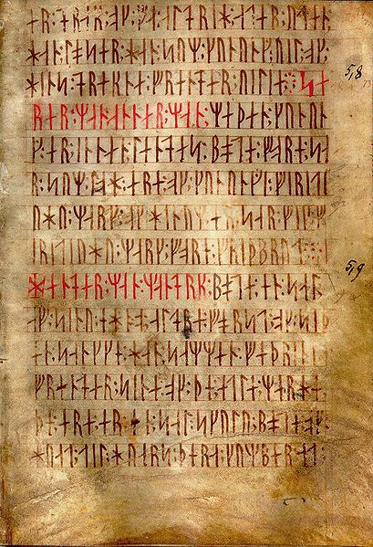
Chapter 23
Text Processing
Bjarne Stroustrup
www.stroustrup.com/Programming

Slide 2
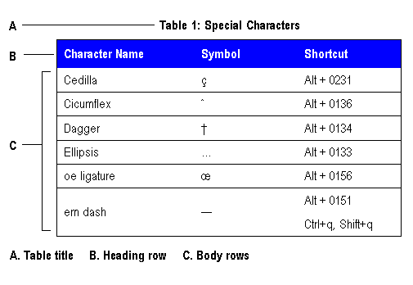
Overview
Application domains
Strings
I/O
Maps
Regular expressions
Stroustrup/PPP - Oct'11

Slide 3
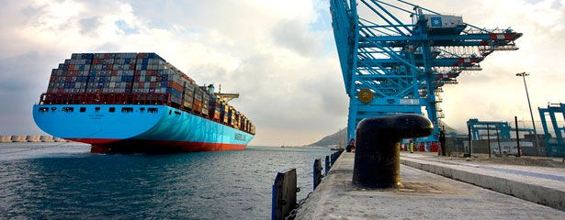
Now you know the basics
Really! Congratulations!
Don’t get stuck with a sterile focus on programming language features
What matters are programs, applications, what good can you do with programming
  Text processing
  Numeric processing
  Embedded systems programming
  Banking
  Medical applications
  Scientific visualization
  Animation
  Route planning
  Physical design
Stroustrup/PPP - Oct'11

Slide 4

Text processing
“all we know can be represented as text”
  And often is
Books, articles
Transaction logs (email, phone, bank, sales, …)
Web pages (even the layout instructions)
Tables of figures (numbers)
Mail
Programs
Measurements
Historical data
Medical records
…
Amendment I
Congress shall make no law respecting
an establishment of religion, or prohibiting
the free exercise thereof; or abridging the
freedom of speech, or of the press; or the
right of the people peaceably to assemble,
and to petition the government for a redress
of grievances.
Stroustrup/PPP - Oct'11

Slide 5
String overview
Strings
  std::string
    <string>
    s.size()
    s1==s2
  C-style string (zero-terminated array of char)
    <cstring> or <string.h>
    strlen(s)
    strcmp(s1,s2)==0
  std::basic_string<Ch>, e.g. unicode strings
    typedef std::basic_string<char> string;
  Proprietary string classes
Stroustrup/PPP - Oct'11

Slide 6
String conversion
Simple to_string
  template<class T> string to_string(const T& t)
  {
  ostringstream os;
  os << t;
  return os.str();
  }
For example:
  string s1 = to_string(12.333);
  string s2 = to_string(1+5*6-99/7);
Stroustrup/PPP - Oct'11

Slide 7
String conversion
Simple extract from string
  template<class T> T from_string(const string& s)
  {
  istringstream is(s);
  T t;
  if (!(is >> t)) throw bad_from_string();
  return t;
  }
For example:
double d = from_string<double>("12.333");
Matrix<int,2> m = from_string< Matrix<int,2> >("{ {1,2}, {3,4} }");
Stroustrup/PPP - Oct'11

Slide 8
General stream conversion
template<typename Target, typename Source>
Target lexical_cast(Source arg)
{
std::stringstream ss;
Target result;
if (!(ss << arg) // read arg into stream
|| !(ss >> result) // read result from stream
|| !(ss >> std::ws).eof()) // stuff left in stream?
throw bad_lexical_cast();
return result;
}
string s = lexical cast<string>(lexical_cast<double>(" 12.7 ")); // ok
// works for any type that can be streamed into and/or out of a string:
XX xx = lexical_cast<XX>(lexical_cast<YY>(XX(whatever))); // !!!
Stroustrup/PPP - Oct'11

Slide 9
I/O overview
 | Stream I/O
in >> x | Read from in into x according to x’s format
out << x | Write x to out according to x’s format
in.get(c) | Read a character from in into c
getline(in,s) | Read a line from in into the string s
istream
ostream
istringstream
ifstream
iostream
ofstream
ostringstream
stringstream
fstream
Stroustrup/PPP - Oct'11

Slide 10
Map overview
Associative containers
  <map>, <set>, <unordered_map>, <unordered_set>
  map
  multimap
  set
  multiset
  unordered_map
  unordered_multimap
  unordered_set
  unordered_multiset
The backbone of text manipulation
  Find a word
  See if you have already seen a word
  Find information that correspond to a word
See example in Chapter 23
Stroustrup/PPP - Oct'11

Slide 11
Map overview
multimap<string,Message*>
“John Doe”
“John Doe”
“John Q. Public”
Mail_file:
vector<Message>
Stroustrup/PPP - Oct'11

Slide 12
A problem: Read a ZIP code
U.S. state abbreviation and ZIP code
  two letters followed by five digits
string s;
while (cin>>s) {
if (s.size()==7
&& isletter(s[0]) && isletter(s[1])
&& isdigit(s[2]) && isdigit(s[3]) && isdigit(s[4])
&& isdigit(s[5]) && isdigit(s[6]))
cout << "found " << s << '\n';
}
Brittle, messy, unique code
Stroustrup/PPP - Oct'11

Slide 13
A problem: Read a ZIP code
Problems with simple solution
  It’s verbose (4 lines, 8 function calls)
  We miss (intentionally?) every ZIP code number not separated from its context by whitespace
    "TX77845", TX77845-1234, and ATM77845
  We miss (intentionally?) every ZIP code number with a space between the letters and the digits
    TX 77845
  We accept (intentionally?) every ZIP code number with the letters in lower case
    tx77845
  If we decided to look for a postal code in a different format we have to completely rewrite the code
    CB3 0DS, DK-8000 Arhus
Stroustrup/PPP - Oct'11

Slide 14
TX77845-1234
1st try: wwddddd
2nd (remember -12324): wwddddd-dddd
What’s “special”?
3rd: \w\w\d\d\d\d\d-\d\d\d\d
4th (make counts explicit): \w2\d5-\d4
5th (and “special”): \w{2}\d{5}-\d{4}
But -1234 was optional?
6th: \w{2}\d{5}(-\d{4})?
We wanted an optional space after TX
7th (invisible space): \w{2} ?\d{5}(-\d{4})?
8th (make space visible): \w{2}\s?\d{5}(-\d{4})?
9th (lots of space – or none): \w{2}\s*\d{5}(-\d{4})?
Stroustrup/PPP - Oct'11

Slide 15
Regex library – availability
Not part of C++98 standard
Part of “Technical Report 1” 2004
Part of C++0x
Ships with
  VS 9.0 C++, use <regex>, std::tr1::regex
  GCC 4.3.0, use <tr1/regex>, std::tr1::regex
  www.boost.org, use <boost/regex>, std::boost::regex
Stroustrup/PPP - Oct'11

Slide 16
#include <boost/regex.hpp>
#include <iostream>
#include <string>
#include <fstream>
using namespace std;
int main()
{
ifstream in("file.txt"); // input file
if (!in) cerr << "no file\n";
regex pat ("\\w{2}\\s*\\d{5}(-\\d{4})?"); // ZIP code pattern
cout << "pattern: " << pat << '\n';
// …
}
Stroustrup/PPP - Oct'11

Slide 17
int lineno = 0;
string line; // input buffer
while (getline(in,line)) {
++lineno;
smatch matches; // matched strings go here
if (regex_search(line, matches, pat)) {
cout << lineno << ": " << matches[0] << '\n'; // whole match
if (1<matches.size() && matches[1].matched)
cout << "\t: " << matches[1] << '\n‘; // sub-match
}
}
Stroustrup/PPP - Oct'11

Slide 18
Results
Input: address TX77845
ffff tx 77843 asasasaa
ggg TX3456-23456
howdy
zzz TX23456-3456sss ggg TX33456-1234
cvzcv TX77845-1234 sdsas
xxxTx77845xxx
TX12345-123456
Output: pattern: "\w{2}\s*\d{5}(-\d{4})?"
1: TX77845
2: tx 77843
5: TX23456-3456
: -3456
6: TX77845-1234
: -1234
7: Tx77845
8: TX12345-1234
: -1234
Stroustrup/PPP - Oct'11

Slide 19
Regular expression syntax
Regular expressions have a thorough theoretical foundation based on state machines
  You can mess with the syntax, but not much with the semantics
The syntax is terse, cryptic, boring, useful
  Go learn it
Examples
  Xa{2,3} // Xaa Xaaa
  Xb{2} // Xbb
  Xc{2,} // Xcc Xccc Xcccc Xccccc …
  \w{2}-\d{4,5} // \w is letter \d is digit
  (\d*:)?(\d+) // 124:1232321 :123 123
  Subject: (FW:|Re:)?(.*) // . (dot) matches any character
  [a-zA-Z] [a-zA-Z_0-9]* // identifier
  [^aeiouy] // not an English vowel
Stroustrup/PPP - Oct'11

Slide 20
Searching vs. matching
Searching for a string that matches a regular expression in an (arbitrarily long) stream of data
  regex_search() looks for its pattern as a substring in the stream
Matching a regular expression against a string (of known size)
  regex_match() looks for a complete match of its pattern and the string
Stroustrup/PPP - Oct'11

Slide 21
Table grabbed from the web
KLASSE ANTAL DRENGE ANTAL PIGER ELEVER IALT
0A 12 11 23
1A 7 8 15
1B 4 11 15
2A 10 13 23
3A 10 12 22
4A 7 7 14
4B 10 5 15
5A 19 8 27
6A 10 9 19
6B 9 10 19
7A 7 19 26
7G 3 5 8
7I 7 3 10
8A 10 16 26
9A 12 15 27
0MO 3 2 5
0P1 1 1 2
0P2 0 5 5
10B 4 4 8
10CE 0 1 1
1MO 8 5 13
2CE 8 5 13
3DCE 3 3 6
4MO 4 1 5
6CE 3 4 7
8CE 4 4 8
9CE 4 9 13
REST 5 6 11
Alle klasser 184 202 386
Numeric fields
Text fields
Invisible field separators
Semantic dependencies
  i.e. the numbers actually mean something
    first row + second row == third row
    Last line are column sums
Stroustrup/PPP - Oct'11
Notes:
The columns don’t match up – that’s the way the table looked *after* I grabbed it from the web.
We’d have to analyze it just to get it properly printed.

Slide 22
Describe rows
Header line
  Regular expression: ^[\w ]+( [\w ]+)*$
  As string literal: "^[\\w ]+( [\\w ]+)*$"
Other lines
  Regular expression: ^([\w ]+)( \d+)( \d+)( \d+)$
  As string literal: "^([\\w ]+)( \\d+)( \\d+)( \\d+)$"
Aren’t those invisible tab characters annoying?
  Define a tab character class
Aren’t those invisible space characters annoying?
  Use \s
Stroustrup/PPP - Oct'11

Slide 23
Simple layout check
int main()
{
ifstream in("table.txt"); // input file
if (!in) error("no input file\n");
string line; // input buffer
int lineno = 0;
regex header( "^[\\w ]+( [\\w ]+)*$"); // header line
regex row( "^([\\w ]+)( \\d+)( \\d+)( \\d+)$"); // data line
// … check layout …
}
Stroustrup/PPP - Oct'11

Slide 24
Simple layout check
int main()
{
// … open files, define patterns …
if (getline(in,line)) { // check header line
smatch matches;
if (!regex_match(line, matches, header)) error("no header");
}
while (getline(in,line)) { // check data line
++lineno;
smatch matches;
if (!regex_match(line, matches, row))
error("bad line", to_string(lineno));
}
}
Stroustrup/PPP - Oct'11

Slide 25
Validate table
int boys = 0; // column totals
int girls = 0;
while (getline(in,line)) { // extract and check data
smatch matches;
if (!regex_match(line, matches, row)) error("bad line");
int curr_boy = from_string<int>(matches[2]); // check row
int curr_girl = from_string<int>(matches[3]);
int curr_total = from_string<int>(matches[4]);
if (curr_boy+curr_girl != curr_total) error("bad row sum");
if (matches[1]==“Alle klasser”) { // last line; check columns:
if (curr_boy != boys) error("boys don’t add up");
if (curr_girl != girls) error("girls don’t add up");
return 0;
}
boys += curr_boy;
girls += curr_girl;
}
Stroustrup/PPP - Oct'11

Slide 26
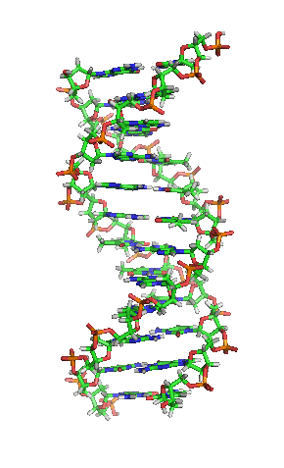
Application domains
Text processing is just one domain among many
  Or even several domains (depending how you count)
  Browsers, Word, Acrobat, Visual Studio, …
Image processing
Sound processing
Data bases
  Medical
  Scientific
  Commercial
  …
Numerics
Financial
…
Stroustrup/PPP - Oct'11

