Slide 1
BBDA: informatic: tool and data management
BBDA 20-12-2021 Wim de Leeuw

Slide 2
Schedule
9:30 Lecture introduction
10:00 Practical Conda & Git
11:15 Discussion and wrap-up

Slide 3
Software management
Not all software is installed on system
System is shared among users, not full control over system
Programs come with dependencies

Slide 4
Conda
Tools depend on programs and libraries with specific versions
Different tools can be incompatible
Conda
User control
Keeps track of dependencies
Separate environments for different tools
Alternatives for Conda
Machine image
Docker: popular, not on Crunchomics
Singularity on Crunchomics not yet very common
Own infrastructure
Real
Cloud

Slide 5
History management
Scripts tend to evolve over time
Features are added and removed
Script files are split over multiple files or merged
Go back to older version as improvement did not work out as expected

Slide 6
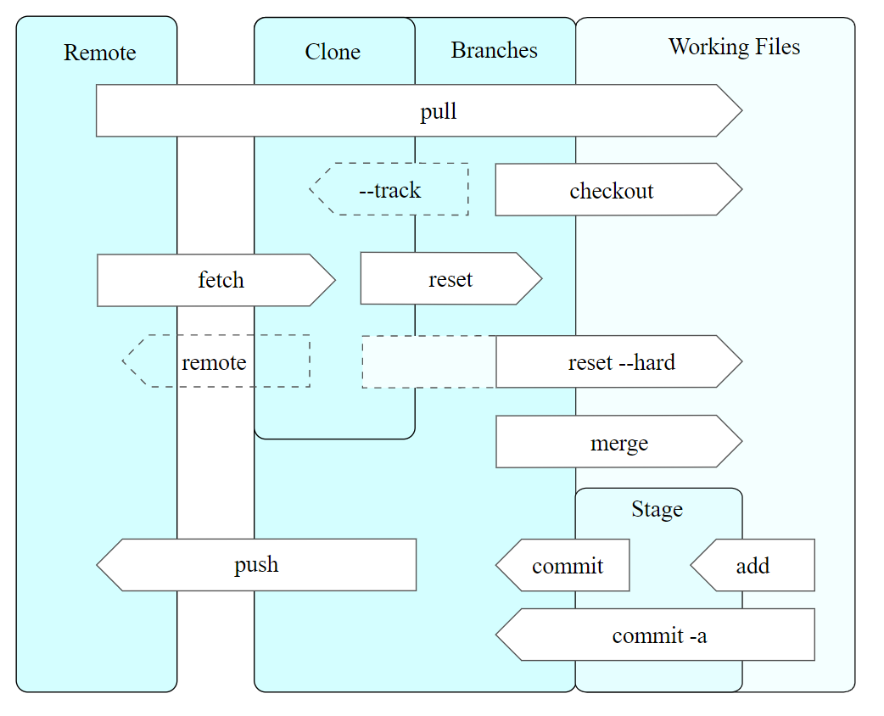
Git
Store history of changes
Branching
Distributed people can cooperate
Complex at first
Not restricted to code
Not big data

Slide 7
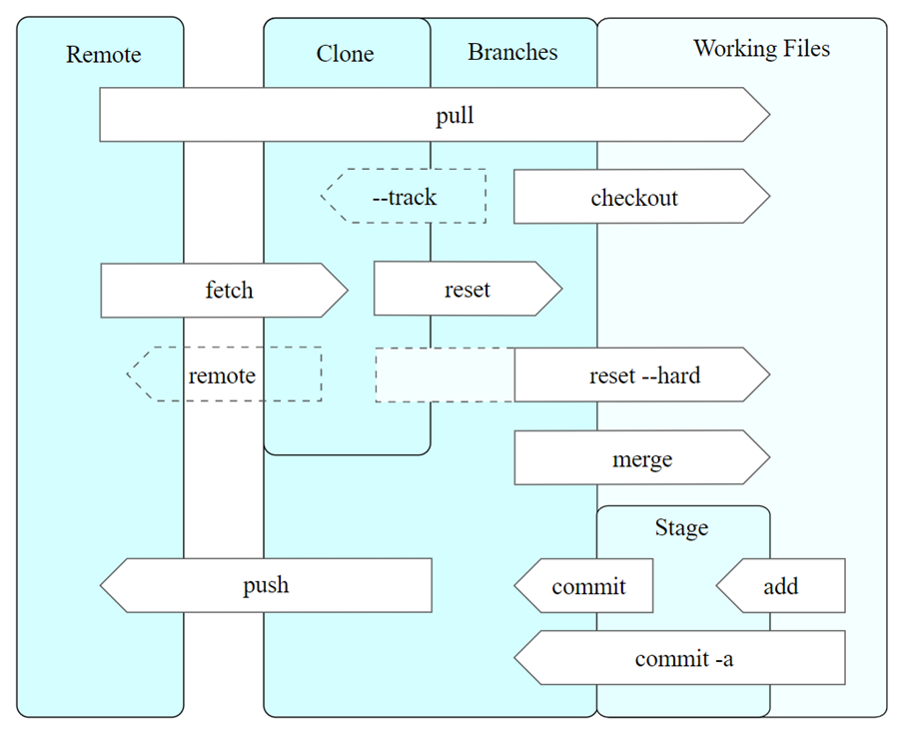
Working directory and repository
Working files: a directory with a set of files and subdirectories which develop over time
Repository: usually in the .git directory

Slide 8
Staging and committing
Two steps to put file in repository
Stage: set up file for storage
Commit: store all staged files
Commits can be restored
Tags can be used to name commits

Slide 9
Remote repositories and cloning
Remote access git repositories possible
Github
Clone: local copy

Slide 10
Data management
Typical omics experiment involve large data sets
Typical analysis several steps with large intermediate data
Plan and organize data during project
Ideal: only store raw data and process description/script to get end results
Make explicit which data is temporary (scratch directory)
Add meta data annotate and comment
Delete temporary data if not longer needed
For others and for yourself in the future

Slide 11
Practical
https://sils-pub.science.uva.nl/mad/education/BBDA/bioinformatics/
Demo installation of miniconda
Introduction to git

Slide 12
Wrap up
Software management: Conda
History/version management: Git
(Big) data management: do it!

