Slide 1
Authority is constructed and contextual

Slide 2
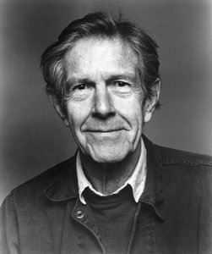

Slide 3
Information resources reflect their creators’ expertise and credibility, and are evaluated based on the information need and the
context in which the information will be used.
Authority is constructed in that various communities may recognize different types of authority.
It is contextual in that the information need may help to determine the level of authority required.

Slide 4
Information resources reflect their creators’ expertise and credibility, and are evaluated based on the information need and the context in which the information will be used.
Authority is constructed in that various communities may recognize different types of authority.
It is contextual in that the information need may help to determine the level of authority required.

Slide 5
Temporary slide about expertise.

Slide 6
