Slide 1
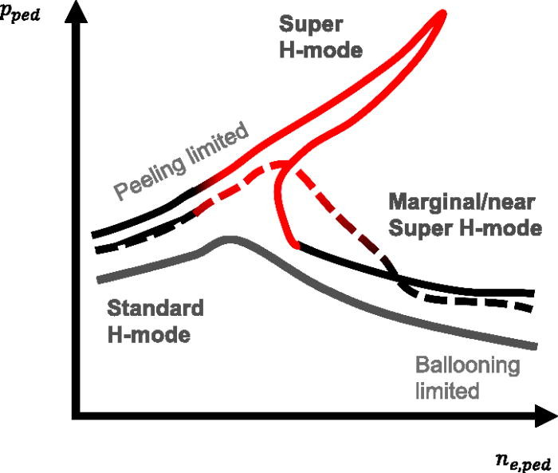
FIG. 1. Pedestal bifurcation during Super H-mode in density–pressure space. Standard H-mode conditions, marginal Super H-modes, and deep SH channel access in dependence of shaping and beta.
Published in: M. Knolker; P. B. Snyder; T. E. Evans; T. Wilks; D. Eldon; B. Grierson; A. Jaervinen; X. Jian; F. Laggner; J. McClenaghan; A. G. McLean; T. Osborne; C. Paz-Soldan; F. Scotti; W. Solomon; Physics of Plasmas 27, 102506 (2020)
DOI: 10.1063/5.0011008
Copyright © 2020 Author(s)

