Slide 1
The wake panels are
aligned with the x-axis
z
Ground: Vz=0
x
Virtual mirror model

Slide 2
Type 6 analyses: the model is rotated
around the origin of the body axes
z
The wake panels are
aligned with the x-axis
α
Ground: Vz=0
x
Virtual mirror model

Slide 3
z
Virtual mirror hydrofoil
Free surface: dVz/dz=0
x
Hydrofoil

Slide 4
For each
operating point
Set up the control surfaces,
inertia etc.
Make the wake panels aligned
with the freestream velocity
Type 6 loop
Make the influence matrix
Add the wake’s contribution
LU factorize
Vorton wake loop
Viscous loop
Make the RHS, including
vorton wake influence
Back-substitute
Compute the balance velocities
(T6/2)
Update the virtual twist
Update the vorton wake
Compute the operating point

Slide 5
Type 1-2-3 loop
Make the wake panels aligned
with the x-axis
Solve the
linear problem
Make unit RHS
Make influence matrix
Add the wake’s contribution
LU Factorize
Back-substitute
unit RHS
Make unit panel
surface velocities
For each
operating point
Make doublet strengths
by linear combinations
Compute on-body Cp
Compute far-field forces
Compute the balance velocities
(T2&3)
Compute the operating point

Slide 6
For each
operating point
Set up the control surfaces,
inertia etc.
Make the wake panels aligned
with the x-axis
Type 7 loop
Make the influence matrix
Add the wake’s contribution
LU factorize
Make the unit RHS,
Back-substitute
Compute the
balanced aoa
using aoa
dichotomy
Combine unit RHS
Compute Cp coefficients
Compute Cm, update aoa
Compute the balance velocity
Compute the stability
and control derivatives
using forward differentiation
Compute the eigenvalues
and eigenvectors
Compute the operating point

Slide 7
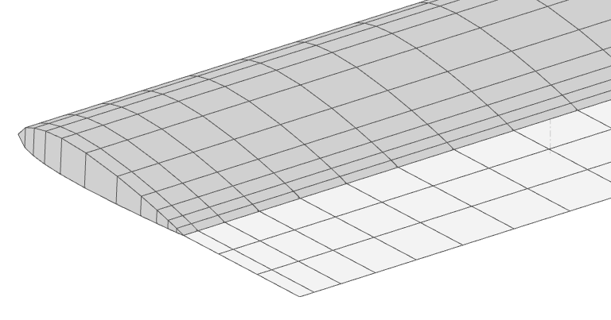
Note: the recommendations are provisional, may be updated with experience
Vortex segments negating the wake panels’ end vortex
L0 = 1st step
Recommendation : 1.0 (x MAC)
L1 = g x L0
Recommendation : g = 1.0
Buffer wake panels
Recommendation:
length = 0.2-1.0 (x MAC)
Vortons

Slide 8
Freestream velocity
Vortex segments negating the wake panels’ end vortex
Buffer wake panels
Vortons

Slide 9
Note: the recommendations are provisional, may be updated with experience
L0 = 1st step
Recommendation : 1.0 (x MAC) or less
L1 = g x L0
Recommendation : g = 1.0
Buffer wake panels
Recommendation:
length = 0.3 (x MAC)
Vortons
The VPW should extend to a point where the influence of the vortons is no longer felt by the wings.
Recommendations:
typically >30 MAC – but depends on the plane’s geometry
ensure that vortons further downstream are discarded
run tests to adjust the value
The vorton core size should be as small as possible, but not so small that the VPW becomes chaotic.
Recommendation: ~ 1 MAC

Slide 10
The far-field plane
Drag = V x Γdl
Γdl
Vinduced

Slide 11
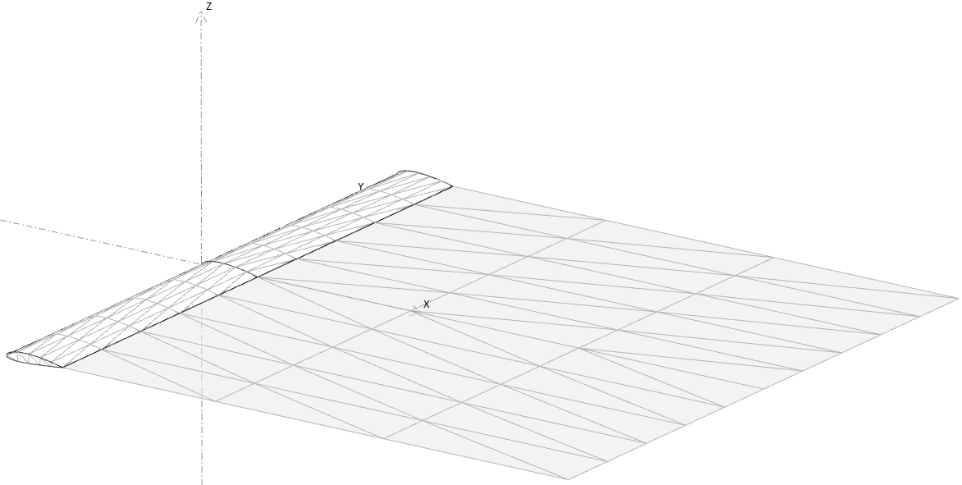
Uniform doublet density
and continuous approximation
Freestream velocity
vortons

Slide 12
Linear Doublet density
and continuous approximation
Freestream velocity
vortons

Slide 13
z
zw
xw
α
yw
x
β
y

Slide 14
z
zw
α
xw
β
α
yw
x
y

Slide 15
zgeom
zw
α
xw
β
xgeom
α
α
yw
xstab
β
ygeom
ystab
zstab

Slide 16
∑ δl nli
hinge axis
n0i
ni
hl = hinge vector
∑ δl nli
n⁰i
ni
hinge axis
hl = hinge vector

Slide 17
z
zw
α
xw
β
α
yw
x
y

Slide 18
y
v
x
u

Slide 19
n
Vs
Vinf
Vinf.n

Slide 20
13
12
11
14
10
nStripNodes=8
9
15
4
3
2
1
0
8
6
5
0
2
1
7
3
6
5
4
12
11
10
9
13
8
7
3
2
1
0
6
5
4

Slide 21
13
12
11
14
10
nStripNodes=8
7
9
9
5
3
15
2
1
0
8
11
6
4
10
8
0
2
1
7
3
6
5
4

Slide 22
Delaunay flip:
if α1 +α2 >180° the diagonal is flipped to improve the quality of the triangles
α2
α1

Slide 23
New opposite vertex
Search radius
R = coef. x base edge length
Ideal equilateral triangle
Existing base edge

Slide 24
SOLID
SHELL
FACE
EDGE
VERTEX

Slide 25
AWA∞
WA∞
High altitude
AWS∞
AWS∞
AWS∞
TWS∞
z
TWS∞
x
VB
y
Wind gradient
Low altitude
AWS
AWA
WA
TWS
AWS
TWS
x
VB = Boat velocity
VB
x
y

Slide 26
AWA∞
TWA∞
High altitude
AWS∞
AWS∞
AWS∞
TWS∞
z
TWS∞
x
VB
y
Wind gradient
Low altitude
AWS
AWA
TWA∞
TWS
AWS = VA
x
TWS = VT
VB
VB
x
y
y

Slide 27
Surface normal
μ1
μ0
μ2
Neigbour triangles are rotated on the panel’s plane
μ3
Panel’s plane

Slide 28
Node normal
μ2
μ3
μ1
μ0
μ4
μ5
Neigbour nodes are rotated on the tangent plane
Tangent plane
Tangent plane

Slide 29
V∞
Blowing
velocity
Modified geometry
Node

