Slide 1
DC Motor
H-bridge
Controls the speed of DC motor using PWM
Additional 9V connected to power the DC motor
Arduino UNO
Controls and directs signals from various components
Connected to the bird via gears to enable movement
Bird
Gears
Wings
Links to enable wing movements

Slide 2
DC Motor
H-bridge
Controls the speed of DC motor using PWM
Additional 9V connected to power the DC motor
Arduino UNO
Controls and directs signals from various components
Connected to the bird via gears to enable movement
Bird
Gears
Wings
Links to enable wing movements
Arduino NANO
Controls and directs signals from various components
IMU sensor
Enables gesture control by varying 6 DOFs or more
Communication via nRF module

Slide 3
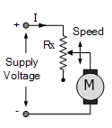
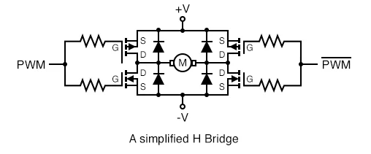
(a)
(b)

