Slide 1
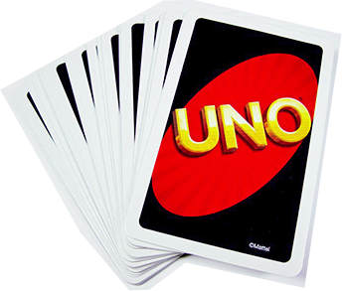
Simplified UNO! for 2

Slide 2
Data structure – Back End
Card Pile = Array of card objects
Card object = {
label: ‘Red Three',
value: 3,
color: 0,
image: 'graphics/03.png'
}

Slide 3
Data structure – Front End DOM
Draw Pile
Human Player Pile
Computer Player Pile
Discard Pile
Start Button
Reset Button
Draw Card Button
Human Player Cards Array
Game Message

Slide 4
Flow – Button Event Listeners
Start
Reset
Draw
Shuffle
Deal to Discard Pile, Human Player, Computer Player
Add event listeners for Human Player cards
Display piles: Create element & append child
Reload page
Check if Turn = Human and Game Started
Check need to draw
Add card to Human Pile

Slide 5
Human Play (DOM Card Element Event Listener)
Is Human Turn?
Is Playable?
Onclick
Y
Print “Awaiting Human move”
Y
Update Card arrays & update DOM display elements
End
N
Y
Human Balance = 1?
Print Not Playable
Print UNO!
Set Player Turn = Human
N
N
Y
Human Balance = 0?
Print Win!
Return: Not Played
Computer Plays
Successful Played?
Reset()
Set Player Turn = Computer
End
Return: Successful Played
Y

