Slide 1
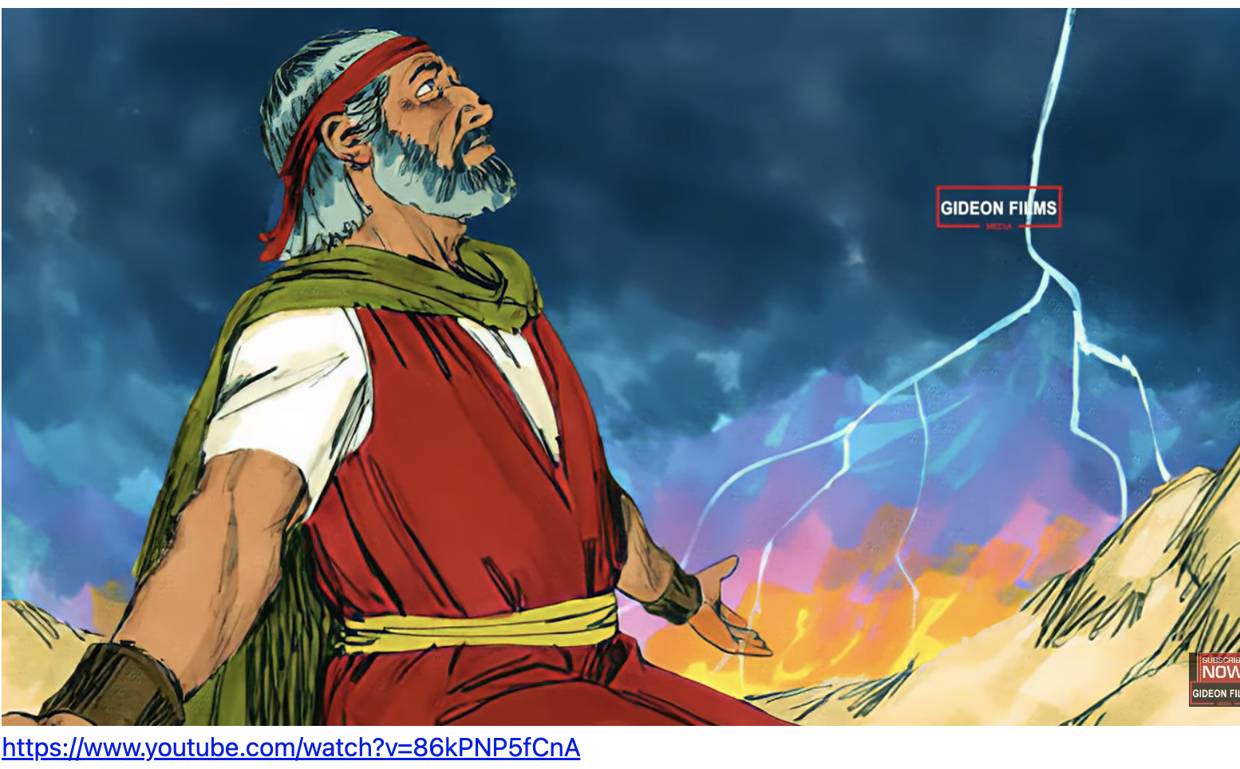
Exodus 出埃及記 32:11-14 Moses’ Intercessory Prayer 摩西的代禱
親子靈修 William分享
09-13-2025

Slide 2
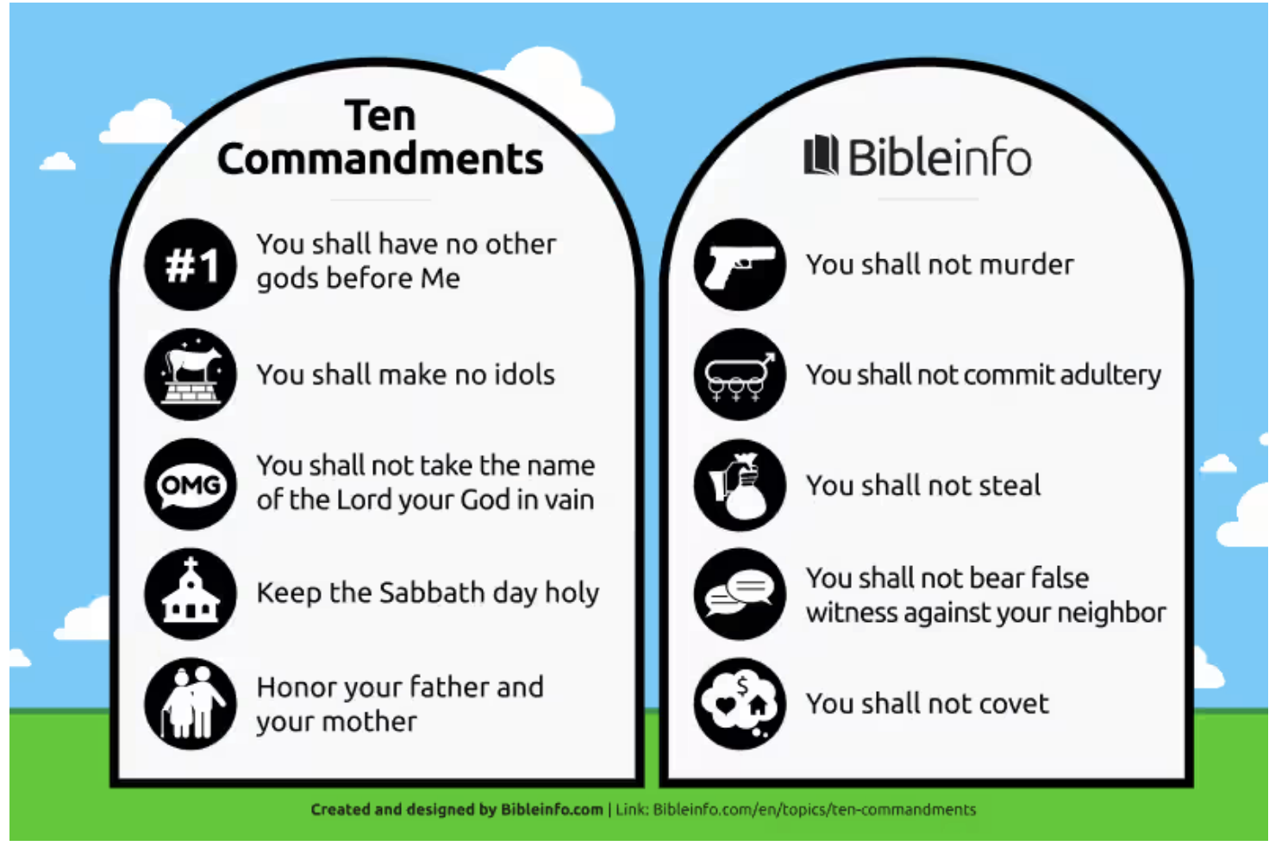
Do you remember the Ten Commandments? 出埃及記(Exodus) 16:32-36

Slide 3
Study Exodus 32 from the Parenting Perspective
# | Key Figures in Exodus 32 | Parenting Figures
1 | Moses | father
2 | Arron | mother
3 | Israelites | children

Slide 4
https://www.youtube.com/watch?v=86kPNP5fCnA
English Version Video: Exodus 30:11-14.
(2 min)

Slide 5
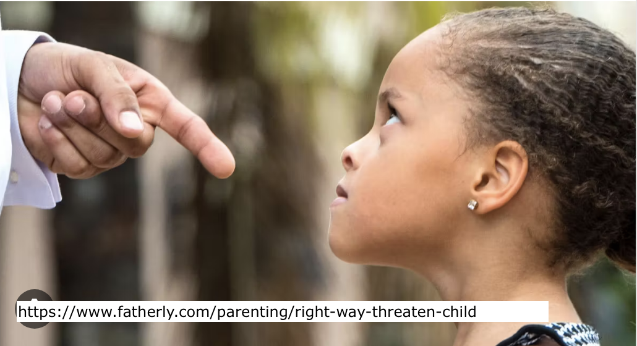
Question to Parents (Exo32:11-14)
What would you do when your child commits a sin?
Lose anger toward the child.
Beat the child.
ground
Leave him alone.
Encourage.
Coax the child.
Pray

Slide 6
What is the intercessory prayer (代禱)?
Intercessory prayer is the act of praying on behalf of others.
--https://www.gotquestions.org/intercessory-prayer.html

Slide 7
Moses’ Prayer on behalf of the Israelites (代禱)
1. Remember the Mercy of God
"But Moses sought the favor of the Lord his God. "O Lord ," he said, "why should your anger burn against your people, whom you brought out of Egypt with great power and a mighty hand?" (Exo32:11 NIV)
"摩西便恳求耶和华他的 神说、耶和华阿、你为甚么向你的百姓发烈怒呢、这百姓是你用大力和大能的手、从埃及地领出来的．" (Exo32:11 CUVS)

Slide 8
Moses’ Prayer on behalf of the Israelites (代禱)
2. Consider if Punishment could Glory God
“Why should the Egyptians say, 'It was with evil intent that he brought them out, to kill them in the mountains and to wipe them off the face of the earth'?." (Exo32:12 NIV)
"为甚么使埃及人议论说、他领他们出去、是要降祸与他们、把他们杀在山中、将他们从地上除灭．" (Exo32:12 CUVS)

Slide 9
Moses’ Prayer on behalf of the Israelites (代禱)
3. Request not to punish if not glorifying God
“Turn from your fierce anger; relent and do not bring disaster on your people." (Exo32:12 NIV)
"求你转意、不发你的烈怒、后悔、不降祸与你的百姓。" (Exo32:12 CUVS)

Slide 10
Moses’ Prayer on behalf of the Israelites (代禱)
4. Remember God’s Promise
“"Remember your servants Abraham, Isaac and Israel, to whom you swore by your own self: 'I will make your descendants as numerous as the stars in the sky and I will give your descendants all this land I promised them, and it will be their inheritance forever.' "" (Exo32:13 NIV)
"求你记念你的仆人亚伯拉罕、以撒、以色列．你曾指着自己起誓说、我必使你们的后裔像天上的星那样多、并且我所应许的这全地、必给你们的后裔、他们要永远承受为业。" (Exo32:13 CUVS)

Slide 11
Result of Moses’ Intercessory Prayer
"Then the Lord relented and did not bring on his people the disaster he had threatened." (Exo32:14 NIV)
"于是耶和华后悔、不把所说的祸降与他的百姓。" (Exo32:14 CUVS)

Slide 12
個人反思 & 教養智慧
個人反思 Personal Reflection：
How should parents pray on behalf of children?
教養智慧：
"但耶和华的慈爱、归于敬畏他的人、从亘古到永远．他的公义、也归于子子孙孙．" (Psm103:17 CUVS)
"But from everlasting to everlasting the Lord 's love is with those who fear him, and his righteousness with their children's children-" (Psm103:17 NIV)

Slide 13
Closing Prayer
Dear Heavenly Father, the Glorious Lord, the Creator, and Sovereign of all things. Thank you for your mercy and grace. Thank you for calling us, the parents. Thank you for giving us, the parents, the educational authority. Our children are your heritage. We are the sinners; we do not deserve it. May Your Holy Spirit call us, guide us. Bless our children and young generation to be able to know you, follow you to be the devotional generation. May your name be glorified, generation by generation, and forever. I pray in the name of Jesus. Amen.

Slide 14
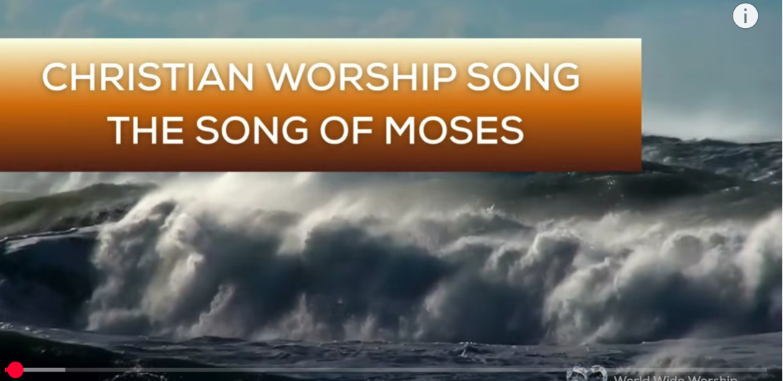
1.No Turning Back
https://www.youtube.com/watch?v=yNtid3wdDWA&list=RDyNtid3wdDWA&start_radio=1&ab_channel=GaiseBaba
Christian Kids
2. The Song of Moses https://www.youtube.com/watch?v=a-wWKL-7Mrg
The Song of Moses Like You've Never Heard Before | Christian Worship Song/ World Wide Worship

