Slide 1
列王紀上 第16章29-34節
ACCC
早禱靈修
William Wei Ding分享
01-14-2024

Slide 2
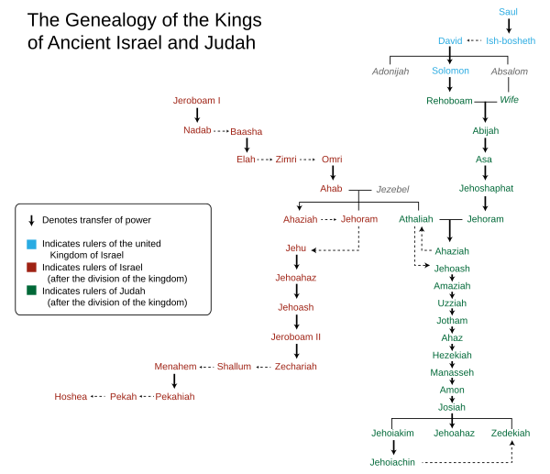
Kings Cart (https://en.wikipedia.org/wiki/Kings_of_Israel_and_Judah#/media/File:Genealogy_of_the_kings_of_Israel_and_Judah.svg)
"and Jesse the father of King David. David was the father of Solomon, whose mother had been Uriah's wife," (Mat1:6 NIV)
"耶西生大卫王。大卫从乌利亚的妻子生所罗门．" (Mat1:6 CUVS)
"Solomon the father of Rehoboam, Rehoboam the father of Abijah, Abijah the father of Asa," (Mat1:7 NIV)
"所罗门生罗波安．罗波安生亚比雅．亚比雅生亚撒．" (Mat1:7 CUVS)
"Asa the father of Jehoshaphat, Jehoshaphat the father of Jehoram, Jehoram the father of Uzziah," (Mat1:8 NIV)
"亚撒生约沙法．约沙法生约兰．约兰生乌西亚．" (Mat1:8 CUVS)

Slide 3
1Ki 16:30 Do Evil in the Eyes of the Lord. 行耶和华眼中看为恶的事 (1Ki16:30 CUVS). (x47)
# | Exodus | Lord’s Commands
1 | 20:3 | You shall have no other gods before me. 除了我以外、你不可有别的神。
2 | 20:4 | You shall not make for yourself an idol in the form of anything 不可为自己雕刻偶像
3 | 20:7 | You shall not misuse the name of the Lord your God. 不可妄称耶和华你 神的名.
4 | 20:8 | Remember the Sabbath day by keeping it holy. 当记念安息日、守为圣日。
5 | 20:12 | Honor your father and your mother. 当孝敬父母

Slide 4
Do Evil in the Eyes of the Lord. 行耶和华眼中看为恶的事 (1Ki16:30 CUVS)
# | Exodus | Lord’s Commands
6 | 20:13 | You shall not murder. 不可杀人。
7 | 20:14 | You shall not commit adultery. 不可奸淫。
8 | 20:15 | You shall not steal. 不可偷盗。
9 | 20:16 | You shall not give false testimony against your neighbor. 不可作假见证陷害人。
10 | 20:17 | You shall not covet your neighbor's house. 不可贪恋人的房屋

Slide 5
Check List of Moses’ Ten Commands
# | Names | 1 gods | 2 idol | 3 misuse | 4 Sabbath | 5 Parents | 6 Murder | 7 adultery | 8 Steal | 9 Testament | 10 Covet
1 | USA |  |  | ? |  |  |  | XXX
2 | PRC |  |  |  | XX |  | XXX |  | XXX
3 | TW |  | XXX |  | X |  |  | (x)
4 | HK |  | XXX |  | XX |  |  | Xx
5 | Russia |  |  |  |  |  | XXX
6 | Israel
7 | Me | x | x | x | x | x | x | x | x | x | x

Slide 6
Spiritual War
"I know that nothing good lives in me, that is, in my sinful nature. For I have the desire to do what is good, but I cannot carry it out." (Rom7:18 NIV)
"我也知道、在我里头、就是我肉体之中、没有良善．因为立志为善由得我、只是行出来由不得我。" (Rom7:18 CUVS)
"For what I do is not the good I want to do; no, the evil I do not want to do -- this I keep on doing." (Rom7:19 NIV)
"故此、我所愿意的善、我反不作．我所不愿意的恶、我倒去作。" (Rom7:19 CUVS)
"Now if I do what I do not want to do, it is no longer I who do it, but it is sin living in me that does it." (Rom7:20 NIV)
"若我去作所不愿意作的、就不是我作的、乃是住在我里头的罪作的。" (Rom7:20 CUVS)
"So I find this law at work: When I want to do good, evil is right there with me." (Rom7:21 NIV)
"我觉得有个律、就是我愿意为善的时候、便有恶与我同在。" (Rom7:21 CUVS)

Slide 7
"For in my inner being I delight in God's law;" (Rom7:22 NIV) "因为按着我里面的意思。〔原文作人〕我是喜欢 神的律．" (Rom7:22 CUVS) "but I see another law at work in the members of my body, waging war against the law of my mind and making me a prisoner of the law of sin at work within my members." (Rom7:23 NIV) "但我觉得肢体中另有个律、和我心中的律交战、把我掳去叫我附从那肢体中犯罪的律。" (Rom7:23 CUVS) "What a wretched man I am! Who will rescue me from this body of death?" (Rom7:24 NIV) "我真是苦阿、谁能救我脱离这取死的身体呢?" (Rom7:24 CUVS)
Spiritual War

Slide 8
Praise Jesus Christ our Lord
Thanks be to God –
through Jesus Christ our Lord!
So then, I myself in my mind am a slave to God's law,
but in the sinful nature a slave to the law of sin.
感谢 神、
靠着我们的主耶稣基督
就能脱离了。
这样看来、我以内心顺服 神的律．
我肉体却顺服罪的律了。 (Rom7:25 CUVS)

Slide 9
Love of God:
"耶稣对他说、你要尽心、尽性、尽意、爱主你的 神。" "Jesus replied: 'Love the Lord your God with all your heart and with all your soul and with all your mind.'" (Mat22:37 NIV)
"其次也相仿、就是要爱人如己。"
"And the second is like it: 'Love your neighbor as yourself.'" (Mat22:39 NIV)

Slide 10
Don’t Live in Comfort Zone
“所以你们要去、使万民作我的门徒、奉父子圣灵的名、给他们施洗凡我所吩咐你们的、都教训他们遵守我就常与你们同在、直到世界的末了。”
"Therefore go and make disciples of all nations, baptizing them in the name of the Father and of the Son and of the Holy Spirit, and teaching them to obey everything I have commanded you. And surely I am with you always, to the very end of the age." (Mat28:19-20 NIV). (G.M.B.T.)

Slide 11
Pray: Don’t Do Evil in the Eyes of the Lord
我们在天上的父、愿人都尊你的名为圣。
愿你的国降临。愿你的旨意行在地上、如同行在天上.
Father in heaven, hallowed be your name, your kingdom come, your will be done on earth as it is in heaven
求你看顾保守教会牧师弟兄。不要叫我们遇见试探。救我们脱离凶恶。
Please watch over and protect the pastors and brothers in the church. Do not lead us into temptation. Deliver us from evil.
兴旺福音和教会.
Thriving gospel and church.

Slide 12
Pray: Don’t Do Evil in the Eyes of the Lord
求你看顾保守美国的根基永不动摇。以耶稣为神。
Please watch over and preserve the foundations of America so that they will never be shaken. Believe in Jesus as God.
求你看顾保守美国年青的一代, 寻求真理,
不叫他们被色情,毒品,异端所掠去。
Please watch over and protect the younger generation,
Seeking the Truth,
Don't let them be taken away by pornography, drugs, and heresy liberal thoughts.

Slide 13
https://www.youtube.com/watch?v=8sXlbTkH6SE&ab_channel=ACCCAtlanta
為主而活
https://www.youtube.com/watch?v=bmUnSstK854
行祢旨意
(Go) Hillsong In Chinese
Hillsong 华语

