Slide 1
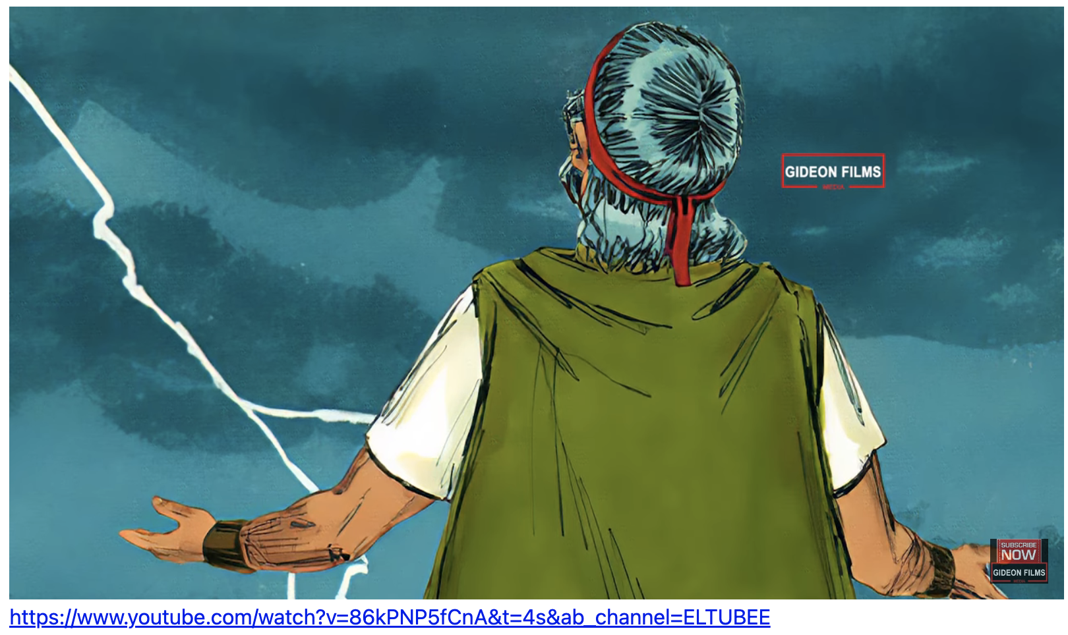
Exodus 出埃及記 32:15-35 Consequence of Sin
親子靈修 William分享
09-13-2025

Slide 2
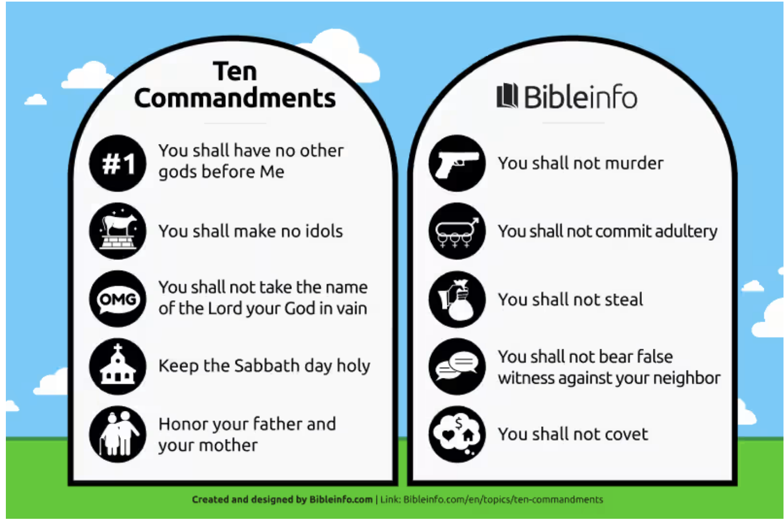
Do you remember the Ten Commandments? 出埃及記(Exodus) 16:32-36

Slide 3
Study Exodus 32 from a Parenting Perspective
# | Key Figures in Exodus 32 | Parenting Figures
1 | Moses | father
2 | Arron | mother
3 | Israelites | children

Slide 4
https://www.youtube.com/watch?v=86kPNP5fCnA
English Version Video: Exodus 30:11-14.
(2 min)

Slide 5
The Consequences of Sin against God
Consequence 1: Losing the Tablets of Stone.
"When Moses approached the camp and saw the calf and the dancing, his anger burned and he threw the tablets out of his hands, breaking them to pieces at the foot of the mountain." (Exo32:19 NIV)
"摩西挨近营前、就看见牛犊、又看见人跳舞、便发烈怒、把两块版扔在山下摔碎了。" (Exo32:19 CUVS)

Slide 6
The Consequences of Sin against God
Consequence 2: Drinking the Dirty Water.
"And he took the calf they had made and burned it in the fire; then he ground it to powder, scattered it on the water and made the Israelites drink it." (Exo32:20 NIV)
"又将他们所铸的牛犊、用火焚烧、磨得粉碎、撒在水面上、叫以色列人喝。" (Exo32:20 CUVS)

Slide 7
The Consequences of Sin against God
Consequence 3: The Slaughtering of Idolaters
"利未的子孙照摩西的话行了．那一天百姓中被杀的约有三千。" (Exo32:28 CUVS)
"The Levites did as Moses commanded, and that day about three thousand of the people died." (Exo32:28 NIV)

Slide 8
Which Consequence is the Most Painful?
Which Consequence is the Most Significant?
Consequence 1: Losing the Tablets of Stone.
Consequence 2: Drink the Dirty Water.
Consequence 3: Human Slaughtering.

Slide 9
Paul Said:
"For the wages of sin is death, but the gift of God is eternal life in Christ Jesus our Lord." (Rom6:23 NIV)
"因为罪的工价乃是死．惟有 神的恩赐、在我们的主基督耶稣里、乃是永生。" (Rom6:23 CUVS)

Slide 10
Repent:
因为他的怒气不过是转眼之间．他的恩典乃是一生之久．一宿虽然有哭泣、早晨便必欢呼。" (Psm30:5 CUVS)
For his anger lasts only a moment, but his favor lasts a lifetime; weeping may remain for a night, but rejoicing comes in the morning." (Psm30:5 NIV)

Slide 11
個人反思 & 教養智慧
個人反思 Personal Reflection：
What kinds of idols do we have in our family? Harvard? Money? Fame?
教養智慧：
不忍用杖打儿子的、是恨恶他．疼爱儿子的、随时管教。" (Pro13:24 CUVS)
He who spares the rod hates his son, but he who loves him is careful to discipline him." (Pro13:24 NIV)

Slide 12
Closing Prayer
Dear Heavenly Father, the Glorious Lord, the Creator, and Sovereign of all things. Thank you for your mercy and grace. Thank you for calling us, the parents. Thank you for giving us, the parents, the educational authority. Our children are your heritage. We are the sinners; we do not deserve it. May Your Holy Spirit call us, guide us. Bless our children and young generation to be able to know you, follow you to be the devotional generation. May your name be glorified, generation by generation, and forever. I pray in the name of Jesus. Amen.

Slide 13
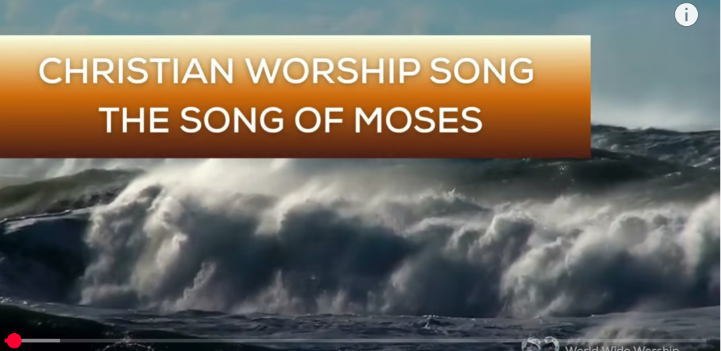
1.No Turning Back
https://www.youtube.com/watch?v=yNtid3wdDWA&list=RDyNtid3wdDWA&start_radio=1&ab_channel=GaiseBaba
Christian Kids
2. The Song of Moses https://www.youtube.com/watch?v=a-wWKL-7Mrg
The Song of Moses Like You've Never Heard Before | Christian Worship Song/ World Wide Worship

