Slide 1
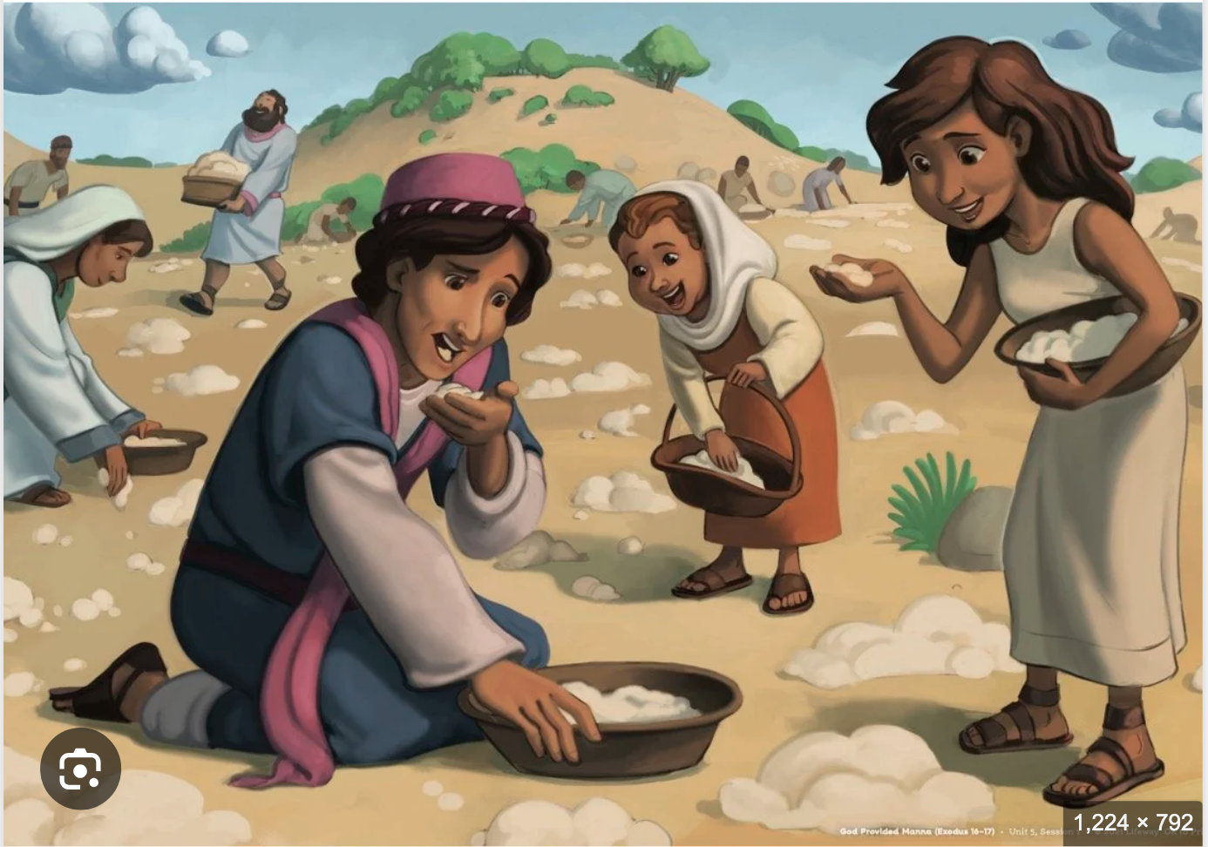
Exodus 出埃及記 16:1-18 Moses and Parenting
https://www.crosswayfellowship.org/kids-resources/u5-lesson1
親子靈修 William分享
08-01-2025

Slide 2
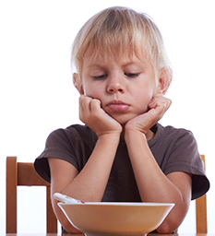
出埃及記(Exodus) 16:1-18
經文取自《聖經和合本NIV》— 漢語聖經協會出版，承蒙允准使用。
Key Word: grumble怨言
Grumble: complain about something in a bad-tempered way.
https://www.paultripp.com/articles/posts/grumbling-and-disputing

Slide 3
https://www.youtube.com/watch?v=Ln5Aa8jiEAM&ab_channel=GIDEONFILM
Shttps://www.youtube.com/shorts/rPtPxme8ZSM
English Version Video: Exodus 16:1-18. (3 min)

Slide 4
To Children
When was the last time you grumbled against your parents?
What did you grumble about?
- The food is bad.
- Someone means to me.
- ….
Have you ever thought of God at that time?

Slide 5
To Children
Who did the Israelites grumble against? Moses and Arron
What did the Israelites grumble about?
The Israelites said to them, "If only we had died by the Lord 's hand in Egypt! There we sat around pots of meat and ate all the food we wanted, but you have brought us out into this desert to starve this entire assembly to death." (Exo16:3 NIV)

Slide 6
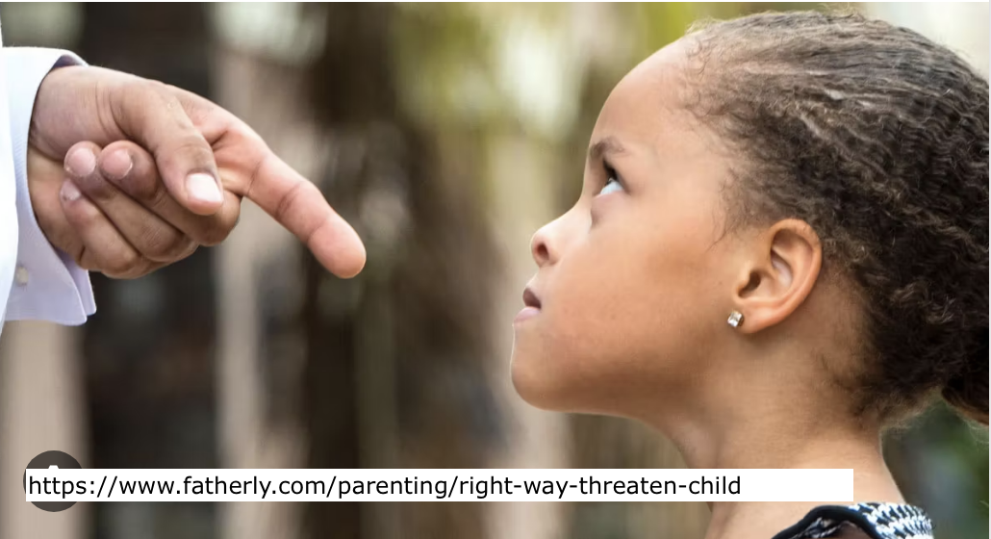
To Parents
What would you do when your child grumbled?
Threaten the child to stop grumbling.
Beat the child to stop grumbling.
Leave him alone.
Fully meet the child’s desires.
Coax the child
…

Slide 7
What did Moses and Aaron say?
Golden Verses: Exo 16:7
"and in the morning you will see the glory of the Lord , because he has heard your grumbling against him. Who are we, that you should grumble against us?"" (Exo16:7 NIV)
"早晨、你们要看见耶和华的荣耀、因为耶和华听见你们向他所发的怨言了．我们算甚么、你们竟向我们发怨言呢。" (Exo16:7 CUVS)

Slide 8
What did God say when the Israelites grumbled?
Golden Verses: Exo 16:12
I have heard the grumbling of the Israelites. Tell them, 'At twilight you will eat meat, and in the morning you will be filled with bread. Then you will know that I am the Lord your God.' "" (Exo16:12 NIV)
"我已经听见以色列人的怨言．你告诉他们说、到黄昏的时候、你们要吃肉、早晨必有食物得饱、你们就知道我是耶和华你们的 神。" (Exo16:12 CUVS)

Slide 9
個人反思 & 教養智慧
個人反思 Personal Reflection：
Is it right to follow Jesus in order to become rich?
教養智慧：
"Keep falsehood and lies far from me; give me neither poverty nor riches, but give me only my daily bread." (Pro30:8 NIV)
“求你使虚假和谎言远离我．使我也不贫穷、也不富足. 赐给我需用的饮食．" (Pro30:8 CUVS)

Slide 10
Closing Prayer
Dear Heavenly Father, the Glorious Lord, the Creator, and Sovereign of all things. Thank you for your mercy and grace. Thank you for calling us, the parents. Thank you for giving us, the parents, the educational authority. Our children are your heritage. We are the sinners; we do not deserve it. May Your Holy Spirit call us, guide us. Bless our children and young generation to be able to know you, follow you to be the devotional generation. May your name be glorified, generation by generation, and forever. I pray in the name of Jesus. Amen.

Slide 11
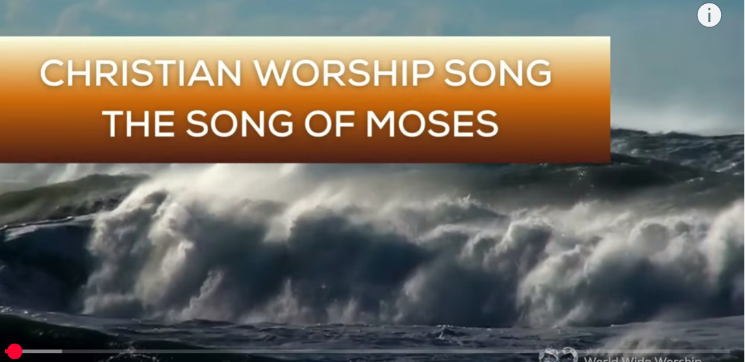
1.No Turning Back
https://www.youtube.com/watch?v=yNtid3wdDWA&list=RDyNtid3wdDWA&start_radio=1&ab_channel=GaiseBaba
Christian Kids
2. The Song of Moses https://www.youtube.com/watch?v=a-wWKL-7Mrg
The Song of Moses Like You've Never Heard Before | Christian Worship Song/ World Wide Worship

