Slide 1
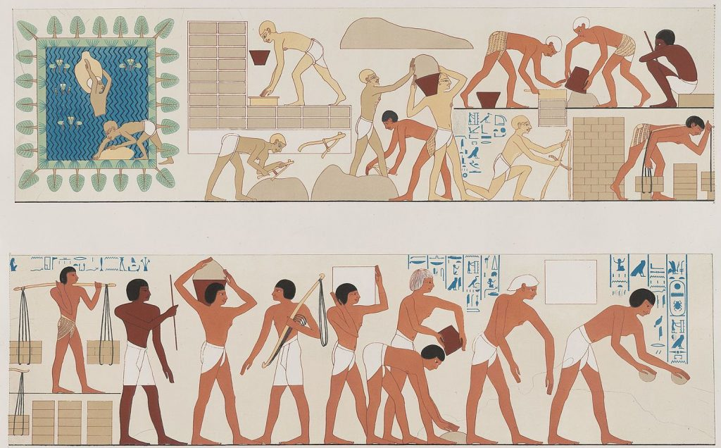
Exodus1:8-14
Family
Devotion
Betty Lu
08-03-2025
https://cmcbiblereading.com/wp-content/uploads/2018/02/mudbricks.jpg
上图：古埃及第十二王朝阿蒙涅姆赫特三世（Amenemhat III，主前1860–1814年在位） 金字塔，用泥砖建造。

Slide 2
Exodus 1:8-14 (NIV)
https://www.biblegateway.com/ -- NIV
From： https://www.biblegateway.com/passage/?search=exodus%201:8-14&version=NIV
8 Then a new king, to whom Joseph meant nothing, came to power in Egypt.
9 “Look,” he said to his people, “the Israelites have become far too numerous for us.
10 Come, we must deal shrewdly with them or they will become even more numerous and, if war breaks out, will join our enemies, fight against us and leave the country.”
11 So they put slave masters over them to oppress them with forced labor, and they built Pithom and Rameses as store cities for Pharaoh.
12 But the more they were oppressed, the more they multiplied and spread; so the Egyptians came to dread the Israelites
13 and worked them ruthlessly.
14 They made their lives bitter with harsh labor in brick and mortar and with all kinds of work in the fields; in all their harsh labor the Egyptians worked them ruthlessly.

Slide 3
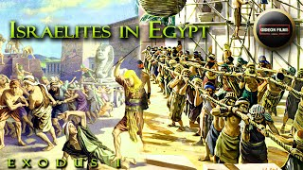
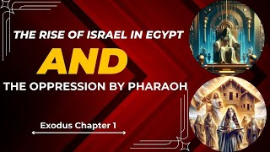
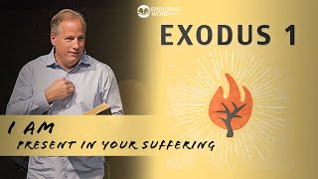
Reading English Version with beloved ones!!!!!
If you are planning to have a devotion
(1) with young kids, please watch the following video with you lovely ones.
(2) with primary school children, please listen to the video above & read the message listed in this PPT.
(3) with teens or youths, please try to
listen to the video– Exodus 1 - I AM Present in Your Suffering
or read the following message:
https://godsbless.ing/commentary/exodus/exodus_1_8-14/ , “What does Exodus 1:8-14 really mean?”
by Reverend Michael Johnson

Slide 4

Exodus1：8-14
https://thebiblesays.com/en/commentary/exo+1:8
Page 1
Many years before the birth of Moses, the Egyptians got concerned with the Israelites flourishing in their land. They decided to oppress the Israelites with hard labor.In an effort to reduce the number of Israelites and as a result reduce the threat, the Egyptians decided to oppress the Israelites with hard labor in an effort to discourage them from multiplying. Just the opposite resulted, so they increased the severity of the work they forced them to do. ‘.......
...... The pharaoh voiced his concerns about the number and influence of the Israelites and he consulted with his people (his close advisors??). He pointed out two worrisome things about the sons of Israel - that they were more and mightier than the Egyptians. The Pharaoh recognizes that the Israelites had grown greatly in number (from 70 to probably over 1.5 million) and as a result had become powerful within Egyptian society and culture.
He gathered his advisors to seek to deal wisely with the Israelites. Apparently, he wanted to come up with an effective, workable solution that would deal wisely

Slide 5
Exodus1：8-14
https://thebiblesays.com/en/commentary/exo+1:8
Exodus 1:8-14 page 2
with them because he was concerned that the Israelites would join themselves to an alliance of Egypt's enemies (to those who hate us) and would wage war against the pharaoh. Then perhaps in the chaos they would depart from the land, depriving Egypt of a great source of labor and prosperity.
The decision they came up with is they appointed taskmasters over them (literally "rulers of forced laborers"). The job of these taskmasters was to afflict them with hard labor. Evidently, they thought that making the Israelites' lives miserable with hard labor would discourage them from bringing children into such a harsh world.
The result of the oppressive labor is that they built for Pharaoh storage cities, Pithom and Raamses. These cities (on the east side of the Nile River delta in northeast Egypt) were used to store grain and other necessities for the Egyptians. Building these cities probably took perhaps as many as twenty years to complete. So these cities were built several years before the birth of Moses (Exodus 2Exodus 2 commentary).

Slide 6
Exodus1：8-14
https://thebiblesays.com/en/commentary/exo+1:8
page 3
The result of the oppressive labor is that they built for Pharaoh storage cities, Pithom and Raamses. These cities (on the east side of the Nile River delta in northeast Egypt) were used to store grain and other necessities for the Egyptians. Building these cities probably took perhaps as many as twenty years to complete. So these cities were built several years before the birth of Moses (Exodus 2Exodus 2 commentary).
The plan to prevent the Israelites from multiplying did not work. In fact, just the opposite occurred - the more they afflicted them, the more they multiplied and the more they spread out. So, instead of removing the Egyptian leadership's fear, the opposite occurred - they were in dread of the sons of Israel. Their fear turned to dread.
Was this oppression part of the plan of God? Yes. In fact, it was declared by God hundreds of earlier to Abraham (Genesis 15 commentary). While God clearly does not feel compelled to justify Himself to us as to why He allowed this suffering, it clearly was a part of God's plan, and it shows that oppression and opposition cannot prevent God from blessing His covenant people. It is also meant to show Israel that their survival and thriving is the work of God, not their own. It arguably led to the greatest blessing of all for Israel, their deliverance from slavery.

Slide 7
Exodus1：8-14
https://thebiblesays.com/en/commentary/exo+1:8
page 4
These cities (on the east side of the Nile River delta in northeast Egypt) were used to store grain and other necessities for the Egyptians. Building these cities probably took perhaps as many as twenty years to complete. So these cities were built several years before the birth of Moses (Exodus 2Exodus 2 commentary).
Instead of immediately moving on from a plan that obviously failed, the Egyptians compelled the sons of Israel to labor rigorously. It seems that, in their minds, there was not enough oppression to prevent the Israelites from multiplying, so they made it even worse for them. In fact, they made their lives bitter with hard labor. They were to labor in mortar and bricks and at all kinds of labor in the field, implying that they were given the worst jobs possible when doing construction, resulting in all their labors which they rigorously imposed on them. In other words, there was no restriction on what kind of labor the Israelites were tasked with or on the severity of the work.
This was obviously designed to make the lives of the Israelites so miserable that they were either unable or unwilling to have more children. But the increased severity of the labor did not work, because the Egyptians had to come up with another plan to reduce the number of Israelites.

Slide 8
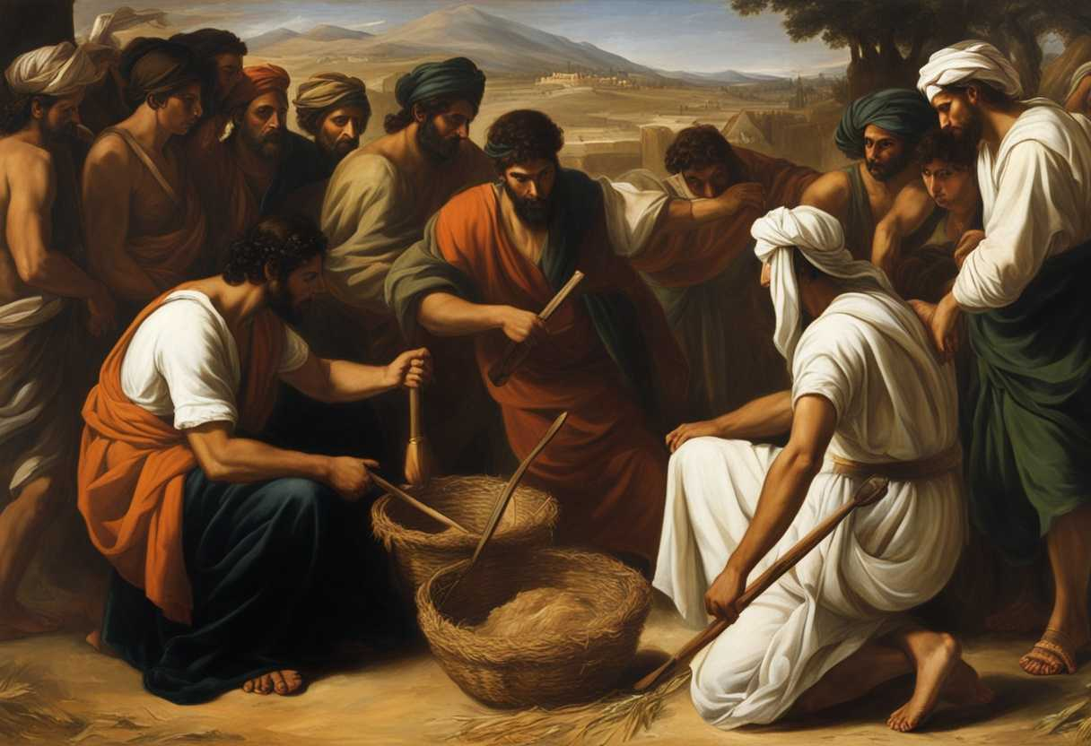

Exodus 1:8-14
今
In this particular scene, we see Pharaoh giving orders to the Egyptian taskmasters to increase the oppression on the Israelites. The taskmasters, in turn, are seen carrying out Pharaoh’s commands, making the Israelites’ lives even more difficult. The Israelites, who had once found favor in Egypt during Joseph’s time, were now facing severe persecution and hardship under Pharaoh’s rule.
The surroundings are bleak and oppressive, with the Israelites toiling under the scorching sun, building structures and working on various projects for the Egyptians. The scene is filled with tension and despair as the Israelites struggle under the weight of their burdens, while Pharaoh’s orders hang over them like a dark cloud, symbolizing the harsh reality of their situation as slaves in a foreign land.
日
亮
點
https://godsbless.ing/commentary/exodus/exodus_1_8-14/
What does Exodus 1:8-14 really mean?
Reverend Michael Johnson

Slide 9
Personal
Reflection
Discuss about “Why does God allow the Israilites to go through those sever persecution and hardship of slavery?
Please recall your life at USA, any oppressions or difficulties you or your families encountered in the past?
Reflect how God has leading you and/or whole your family members going through those days?
What have you learned in that process?
& share it with your youngsters.

Slide 10
教 养
智
慧
-- Have your pre-teen or teens share about one challenge, he/she has gone through。
& Encourage him or her to share about how God has walk along with, support her/him and change the senario?
-- Use love and encouarging words to help little ones to know about your care to him/her. But also explain why does Mommy or Daddy will discipline him/her.

Slide 11
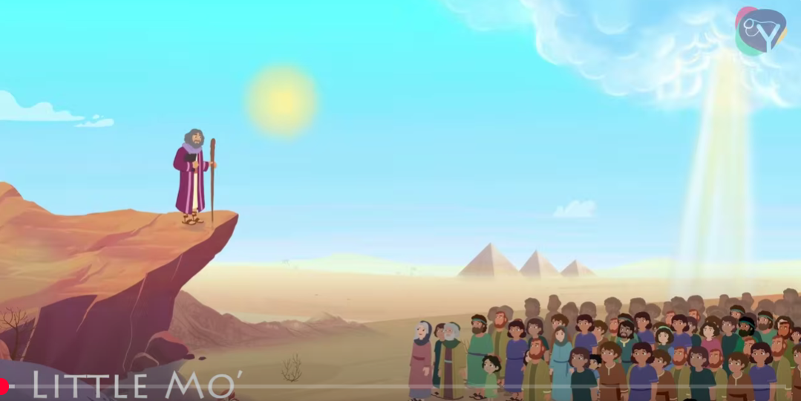

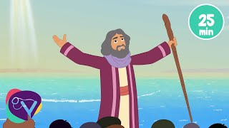
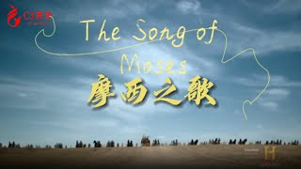


SONGS OF WORSHIP
For Children--
Bible songs about Moses - Animated, with Lyrics
DG Bible Songs
For Adults --
【精選詩歌】摩西之歌--English； C3靈修網路聖經學院
https://www.youtube.com/watch?v=yglb1QpWrkw
摩西之歌 (祢是我的神) Song of Moses-- 中文版
InOne Music Ministries 合一音樂事工

Slide 12


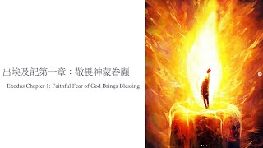
References
– Reading： https://godsbless.ing/commentary/exodus/exodus_1_8-14/
What does Exodus 1:8-14 really mean
----------------------------中文參考資料--------------------------------------------
1. 210403 出埃及記 1章8~14節 埃及新王虐待以色列人；
淡江教會-國度影音
2. https://www.youtube.com/watch?v=QEWropnsxTQ
主日信息，出埃及記第一章，敬畏神得眷顧，釋經講道。// 靈聽

