Slide 1
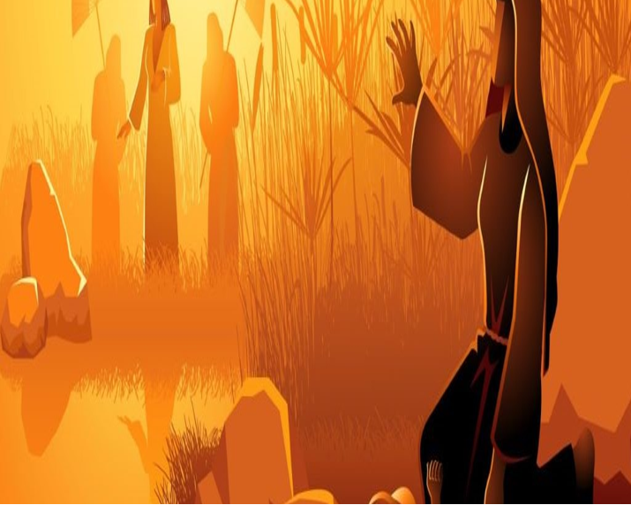

Exodus 2:1-10
出埃及記 二章1-10節
親子靈修 呂沈仁娣分享
08-05-2025

Slide 2
I、Bible Reading (NIV)
(Take turns reading either Chinese or English version)
The Birth of Moses
2 Now a man of the tribe of Levi married a Levite woman, 2 and she became pregnant and gave birth to a son. When she saw that he was a fine child, she hid him for three months. 3 But when she could hide him no longer, she got a papyrus basket[a] for him and coated it with tar and pitch. Then she placed the child in it and put it among the reeds along the bank of the Nile. 4 His sister stood at a distance to see what would happen to him.
5 Then Pharaoh’s daughter went down to the Nile to bathe, and her attendants were walking along the riverbank. She saw the basket among the reeds and sent her female slave to get it. 6 She opened it and saw the baby. He was crying, and she felt sorry for him. “This is one of the Hebrew babies,” she said.
7 Then his sister asked Pharaoh’s daughter, “Shall I go and get one of the Hebrew women to nurse the baby for you?”
8 “Yes, go,” she answered. So the girl went and got the baby’s mother. 9 Pharaoh’s daughter said to her, “Take this baby and nurse him for me, and I will pay you.” So the woman took the baby and nursed him. 10 When the child grew older, she took him to Pharaoh’s daughter and he became her son. She named him Moses,[b] saying, “I drew him out of the water.”

Slide 3
字義解説摘自：ttps://cmcbiblereading.com/2015/03/02/出埃及记第2章逐节注解、祷读/
I、讀經: 與兒女輪流讀(中或英)
經文選自：香港聖經公會https://rcuv.hkbs.org.hk/RCUV2/EXO/2:1-10/
出埃及記 2章1-10節--摩西的出生 | 字義 解説
1 有一個利未家的人娶了一個利未女子為妻。 | 「蒲草」一种生长在尼罗河畔的植物，古埃及人用蒲草造船（赛十八2），「蒲草箱」可漂浮在水面。「抹上石漆和石油」，指在外表涂上一层防水的沥青和石油。「搁在河边的芦荻中」，可隐藏孩子，也可防止被水流冲走，表明摩西母亲的计划并非是要把孩子放在河里飘走。 「姊姊」就是米利暗（出15：20-21） 「法老的女儿」可能是阿赫摩斯一世的女儿； 「箱」、「箱子」（5节）原文与「方舟」（创六14）是同一个字。
2 那女人懷孕，生了一個兒子，見他俊美，就把他藏了三個月，
3 後來不能再藏，就取了一個蒲草箱，抹上柏油和樹脂，將孩子放在裏面，把箱子擱在尼羅河邊的蘆葦中。
4 孩子的姊姊遠遠站著，要知道他究竟會怎樣。
5 法老的女兒來到尼羅河邊洗澡，她的女僕們在河邊行走。她看見在蘆葦中的箱子，就派一個使女把它拿來。
6 她打開箱子，看見那孩子。看哪，男孩在哭，她就可憐他，說：「這是希伯來人的一個孩子。」

Slide 4
經文選自：香港聖經公會https://rcuv.hkbs.org.hk/RCUV2/EXO/2:1-10/
字義解説摘自：ttps://cmcbiblereading.com/2015/03/02/出埃及记第2章逐节注解、祷读/
讀經: 與兒女輪流讀(中或英)
出埃及記 2章1-10節--摩西的出生 | 字義 解説
7 孩子的姊姊對法老的女兒說：「我去叫一個希伯來婦人來作奶媽，替你乳養這孩子，好嗎？」 | 「为你奶这孩子」，这话把孩子的所有权推给法老的女儿了。 「童女」原文指还没有结婚的年轻女子，米利暗可能已经十多岁了。 「为我奶他」，表明法老的女儿已经承认这孩子是属于她的。 「孩子渐长」指断奶以后，大约3-5岁。「作了她的儿子」：接纳摩西成为埃及王室里的一员。
8 法老的女兒對她說：「去吧！」那女孩（童女 ）就去叫了孩子的母親來。
9 法老的女兒對她說：「你把這孩子抱去，替我乳養這孩子，我必給你工錢。」那婦人就把孩子接過來，乳養他。
10 孩子長大了，婦人把他帶到法老的女兒那裏，就作了她的兒子。她給孩子起名叫摩西，說：「因我把他從水裏拉出來。」 【「摩西」名字的希伯来文意思是「被拉的」，埃及文意思是「儿子」, 媽媽的名字此處沒提；但在出埃及記 6:20和民數記 26:59提到，她是約基別 (“神的榮耀”)；先生暗蘭是她的侄子，耶基別是姑姑。】

Slide 5
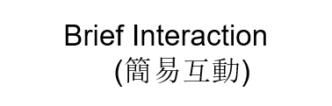
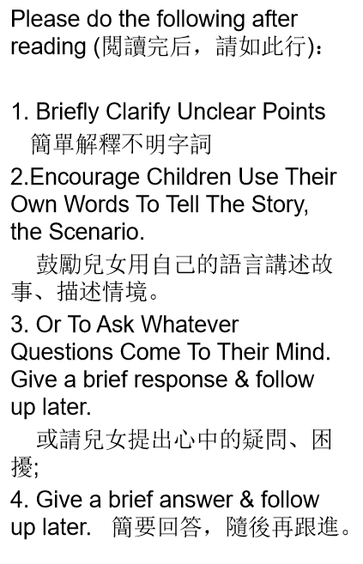
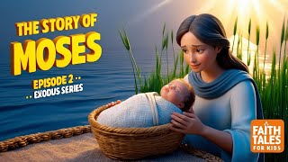
II. Film Watching Together–No. 1. – The Story of Moses
親子同觀賞影帶--01– 摩西的故事
https://www.youtube.com/watch?v=0jq2_HfDmaU
The Story of Moses: How God Saved Him | Exodus Episode 2 | Faith Tales for Kids
Faith Tales

Slide 6
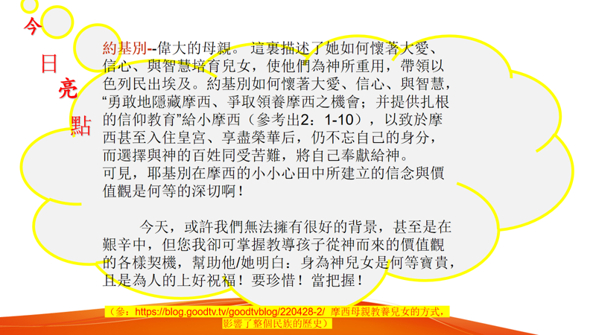
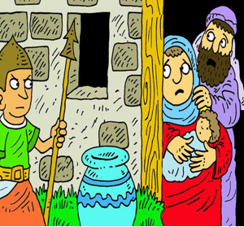


Slide 7
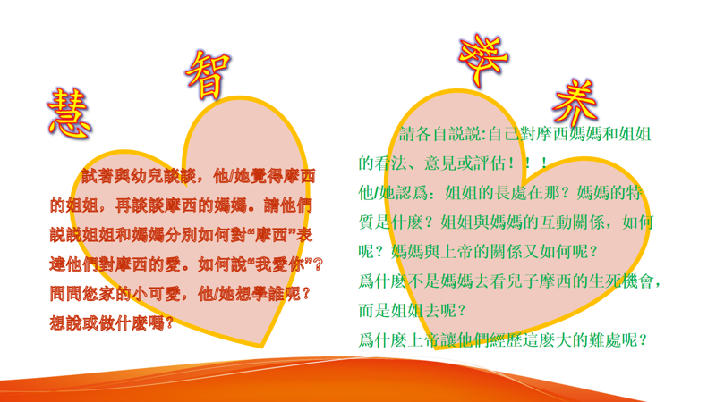
IV. Parenting Reflections 教養反思

Slide 8
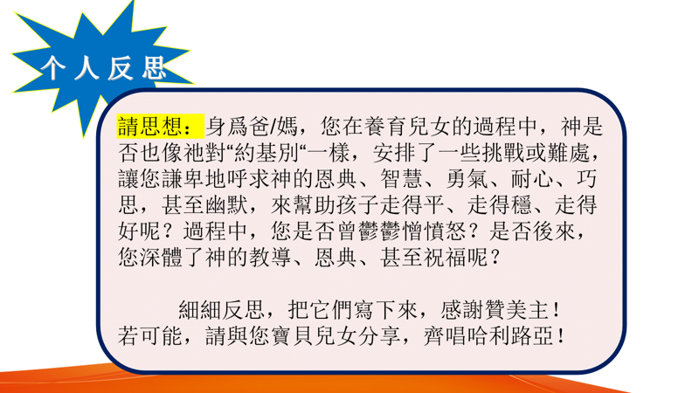

Slide 9
VI. Closing Prayer 結束禱告：
Dear Lord, grand us the love, faith, wisdom and bravety as Moses’ Mom and/or sister had to face whatever challenges or difficulties I experienced. Thank you, Jesus. Amen.
親愛的主，求賞賜給我們像摩西媽媽或姐姐那樣的愛心、信心、智慧和來面勇氣來面對我們所經歷的任何挑戰和難處。謝謝耶穌，阿門！

Slide 10

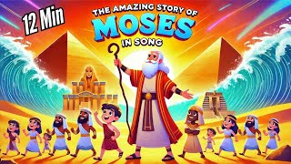
VI. Closing Song 結束詩歌
https://www.youtube.com/watch?v=c-orVCmdabs&t=8s
The Story of Moses | Kids Bible Songs Compilation | From Birth to the 10 Commandments
Crawl Walk Shuffle (for kids)6.7K subscribers

Slide 11
MORE。。。。。。

Slide 12
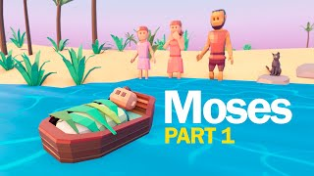
MORE。。。。。。
Film Watching – The Story of Moses（Kids along or With Parents)
獎勵影帶 – 摩西的故事 （兒女單獨看或父母同觀賞）
https://www.youtube.com/watch?v=uzAosxBDouY
MOSES Part 1 👶🏽 Baby in the basket - Animated Bible stories | Bibtoons GO
Bibtoons GO
Mar 9, 2022
Moses was born in a dificult time for the hebrew people, they were slaves on Egypt.
The king decided to kill every male child that was born, in fear for the growing number of slaves.
But Moses parents decided to save his life by putting him on a basket and into the river.
God had big plans for that child,

Slide 13
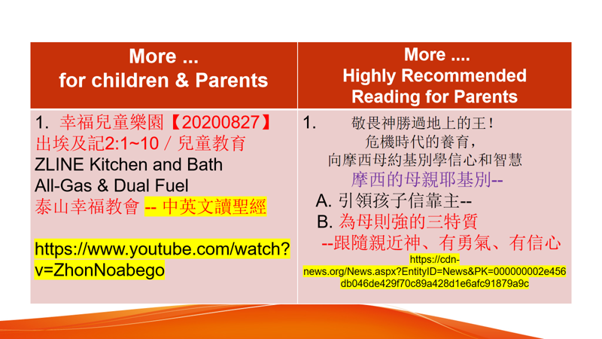
MORE。。。。。。
Film Watching – The Story of Moses（Kids along or With Parents)
獎勵影帶 – 摩西的故事 （兒女單獨看或父母同觀賞）

Slide 14
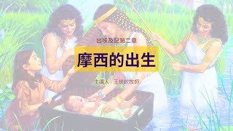
More。。。。 恩言慧語-- For parents
摩西的出生｜晨禱讀經 Ep.127｜
出埃及記第二章1-10節｜王世欽牧師
幸福城市教會
Premiered Apr 14, 2024 -- Time 23:15
信息重點：
1. 摩西出生了；
2. 法老的女兒找到摩西；
3. 法老的女兒照顧並撫養摩西
如果我們對神有正確的認識、對自己的身份有清楚的了解，我們就能夠靠著神完成許多不可能的事；相反地，如果我們不認識神、又對自己有錯誤的身份認同，我們便會陷入撒旦的謊言而無法自拔，在許多事上充滿恐懼、無力與憂慮

