Slide 1
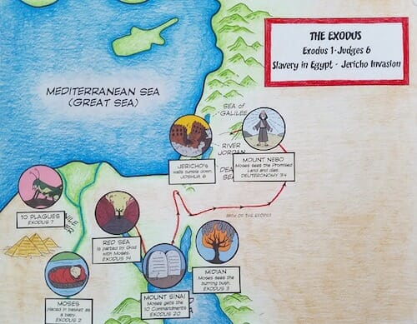
Exodus ？：11-15出埃及記 ？章11-15節
親子靈修 呂沈仁娣分享
08-06-2025
https://teachsundayschool.com/i/wp-content/uploads/2017/02/MosesMap500px.jpg

Slide 2
I、Bible Reading (NIV)-- Exodus 2：11-15
(Take turns reading either Chinese or English version)
https://www.biblegateway.com/passage/?search=Exodus%202%3A11-15&version=NIV
Moses Flees to Midian
11 One day, after Moses had grown up, he went out to where his own people were and watched them at their hard labor. He saw an Egyptian beating a Hebrew, one of his own people. 12 Looking this way and that and seeing no one, he killed the Egyptian and hid him in the sand.
13 The next day he went out and saw two Hebrews fighting. He asked the one in the wrong, “Why are you hitting your fellow Hebrew?” 14 The man said, “Who made you ruler and judge over us? Are you thinking of killing me as you killed the Egyptian?” Then Moses was afraid and thought, “What I did must have become known.”
15 When Pharaoh heard of this, he tried to kill Moses, but Moses fled from Pharaoh and went to live in Midian, where he sat down by a well.

Slide 3
I-1. 讀經: 與兒女輪流讀(中或英)
經文選自：香港聖經公會https://rcuv.hkbs.org.hk/RCUV2/EXO/2:1-10/
字義解説摘自：ttps://cmcbiblereading.com/2015/03/02/出埃及记第2章逐节注解、祷读/
出埃及記 2章11-15節--摩西逃往米甸 | 字詞/文意解説
 | 「出去到他弟兄那里」，指来到以色列人中间，表明摩西已经了解到自己的身世，并且认识了自己「父亲的神」（三6）。 *** 摩西看到希伯来人被埃及人压迫，心中就起了拯救弟兄的雄心大志。 希伯来人不但没有感谢这位有能力、有地位的王子为他们出头，反而完全不领情。 「米甸地」位于埃及东方的旷野，摩西从埃及逃往米甸，是被迫放弃过去的四十年。

Slide 4
I-2. Guidelines For Brief Interaction (簡易互動原則）
Please do the following after read through the passage
(閲讀完經文后，請如此行)：
1. Briefly Clarify Unclear Points
簡單解釋不明字詞
2.Encourage Children Use Their Own Words To Tell The Story, the Scenario.
鼓勵兒女用自己的語言講述故事、描述情境。
3. Or To Ask Whatever Questions Come To Their Mind. Give a brief response & follow up later.
或請兒女提出心中的疑問、困擾;
4. Give a brief answer & follow up later.
簡要回答，隨後再跟進。

Slide 5
II. Film Watching Together–No. 1. – The Story of Moses 親子同賞影帶--01– 摩西的故事
Watch either one or both of the following film together
https://www.youtube.com/watch?v=HyIAUpdHCO4
[兒童聖經故事] 摩西出生並長大 (國語) 兒童聖經故事
Jun 21, 2022
Time:
https://www.youtube.com/watch?v=jAlnud_eNg4&t=60s
A baby in a basket, Moses 👶🏻🧺 | Animated Bible Stories | My First Bible | 20
Time: 8 minuets
My First Bible

Slide 6
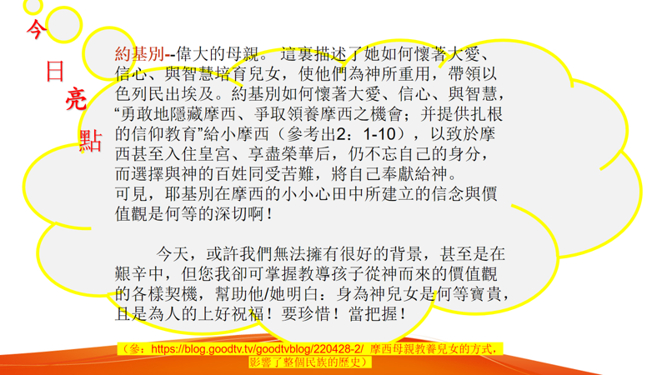
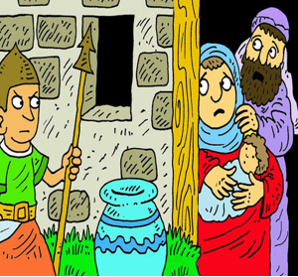

III. Today’s Hightlights 今日亮點

Slide 7

IV. Reflections–Parenting 教養反思
教 养
與幼兒談談，他/她覺得。。。。
https://img.tukuppt.com/photo-big/09/32/86/3464e30470d467b3181.jpg
智
慧

Slide 8

IV. Reflections–Parenting 教養反思--older kids
智
教 养
慧
請與孩子輪流説説:自己對。。。。
處呢？
上帝如何保護摩西？
請問：上帝也會保護我們嗎？祂如何保護我們呢？舉個例子吧！
https://img.lovepik.com/photo/50772/0271.jpg_wh860.jpg

Slide 9
IV. Reflections–Personal 個人反思
請思想：身爲爸/媽，您在養育兒女的過程中，神是否也像祂對“約基別“一樣，。。。。。。
來幫助孩子走得平、走得穩、走得好呢？
過程中，您是否曾。。。。？但後來，您是否體會到神的。。。。？
細細反思，把它們寫下來，感謝贊美主！
若可能，請與您寶貝兒女分享，齊唱哈利路亞！
个 人 反 思

Slide 10
VI-1. Closing Prayer 結束禱告
Dear Lord, grand us the love, faith, wisdom and bravety as Moses’ Mom and/or sister had to face whatever challenges or difficulties I experienced. Thank you, Jesus. Amen.
親愛的主，求賞賜給我們像摩西媽媽或姐姐那樣的愛心、信心、智慧和來面勇氣來面對我們所經歷的任何挑戰和難處。謝謝耶穌，阿門！

Slide 11

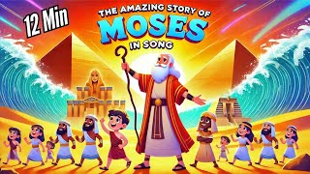
V-2. Closing Song 結束詩歌
https://www.youtube.com/watch?v=c-orVCmdabs&t=8s
The Story of Moses | Kids Bible Songs Compilation | From Birth to the 10 Commandments
Crawl Walk Shuffle (for kids)
6.7K subscribers
Closing Prayer：

Slide 12
MORE。。。。。。

Slide 13
MORE。。。。。。
Film Watching – The Story of Moses（Kids alone or With Parents)
獎勵影帶 – 摩西的故事 （兒女單獨看或父母同觀賞）
More ... for children & Parents
1. 幸福兒童樂園【20200828】出埃及記2:11~22／兒童教育 泰山幸福教會 -- 中英文讀聖經 https://www.youtube.com/watch?v=rHVSdFXLY5o | https://www.youtube.com/watch?v=uzAosxBDouY MOSES Part 1 👶🏽 Baby in the basket - Animated Bible stories | Bibtoons GO Bibtoons GO Mar 9, 2022 Moses was born in a dificult time for the hebrew people, they were slaves on Egypt. The king decided to kill every male child that was born, in fear for the growing number of slaves. But Moses parents decided to save his life by putting him on a basket and into the river. God had big plans for that child,

Slide 14
More。。。。 恩言慧語-- For parents
https://www.youtube.com/watch?v=hzHWO-DmzVE
摩西逃往米甸｜晨禱讀經 Ep.129｜出埃及記第二章15-25節｜
王世欽牧師｜ Apr 17, 2024
Time: 23:24
幸福城市教會HCC
《摩西逃往米甸》
在跟隨神的道路中，有時候我們會灰心喪志，放棄或是遺忘神所給我們的命定；但是神卻不會忘記祂的應許，也不停止祂的計劃。祂甚至能夠趁著我們身處曠野的時候在我們生命中動工，使我們可以承接祂給我們的使命。

