Slide 1

Exodus 出埃及記 10:16-29 Moses and Parenting
https://www.cclifefl.org/View/Article/8730
親子靈修 William分享
08-01-2025

Slide 2
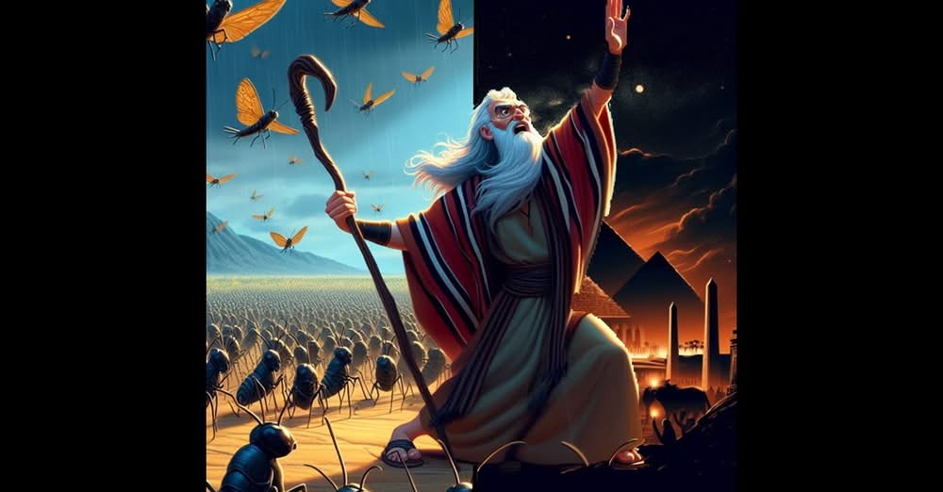
English Version Video: Exodus 10:16-29.

Slide 3
出埃及記(Exodus) 10:16-29
經文取自《聖經和合本NIV》— 漢語聖經協會出版，承蒙允准使用。
Golden Verses Exo 10:2
我们的牲畜也要带去，连一蹄也不留下，因为我们要从其中取出来，事奉耶和华我们的神。我们未到那里，还不知道用什么事奉耶和华。(Exo10:26 CUVS)
Our livestock too must go with us; not a hoof is to be left behind. We have to use some of them in worshiping the Lord our God, and until we get there we will not know what we are to use to worship the Lord .(Exo10:26 NIV)

Slide 4
To Parents and Children
What do you want to bring with you when you plan to travel to a new place?
Bring money, credit cards,
Bring clothes, drink, and food.
Bring an umbrella, sunglasses.
Bring my favorite toy.
…

Slide 5
To Parents and Children
What is your purpose in bringing those with you?
Buy anything I want.
Enjoy the meals and sleep.
Self-protection.
Enjoy worldly life.
…

Slide 6
What did Moses say to Pharaoh?
Golden Verses Exo 10:26
我们的牲畜也要带去，连一蹄也不留下，因为我们要从其中取出来，事奉耶和华我们的神。我们未到那里，还不知道用什么事奉耶和华。(Exo10:26 CUVS)
Our livestock too must go with us; not a hoof is to be left behind. We have to use some of them in worshiping the Lord our God, and until we get there we will not know what we are to use to worship the Lord .(Exo10:26 NIV)

Slide 7
Remember: Trilateral Relationship
God
Parents
父母
Children
孩子

Slide 8
個人反思 & 教養智慧
個人反思：
“我愿意让孩子相信神，但对我来说无所谓 。” 对吗?
“I hope my children to believe in God. But it doesn’t matter to me.” Is that right?
教養智慧：
"至于我、和我家、我们必定事奉耶和华。" (Jos24:15 CUVS)
“as for me and my household, we will serve the Lord ." (Jos24:15 NIV).

Slide 9
Closing Prayer
Dear Heavenly Father, the Glorious Lord, the Creator, and Sovereign of all things. Thank you for your mercy and grace. Thank you for calling us, the parents. Thank you for giving us, the parents, the educational authority. Our children are your heritage. We are the sinners; we do not deserve it. May Your Holy Spirit call us, guide us. Bless our children and young generation to be able to know you, follow you to be the devotional generation. May your name be glorified, generation by generation, and forever. I pray in the name of Jesus. Amen.

Slide 10
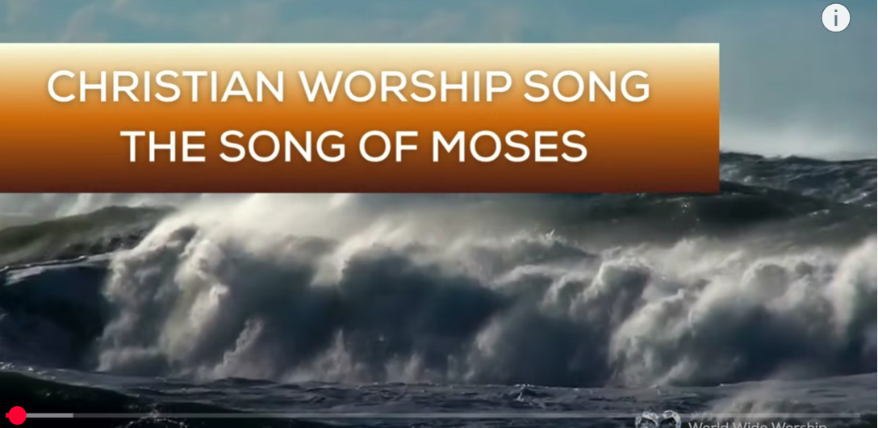
1.No Turning Back
https://www.youtube.com/watch?v=yNtid3wdDWA&list=RDyNtid3wdDWA&start_radio=1&ab_channel=GaiseBaba
Christian Kids
2. The Song of Moses https://www.youtube.com/watch?v=a-wWKL-7Mrg
The Song of Moses Like You've Never Heard Before | Christian Worship Song/ World Wide Worship

