Slide 1
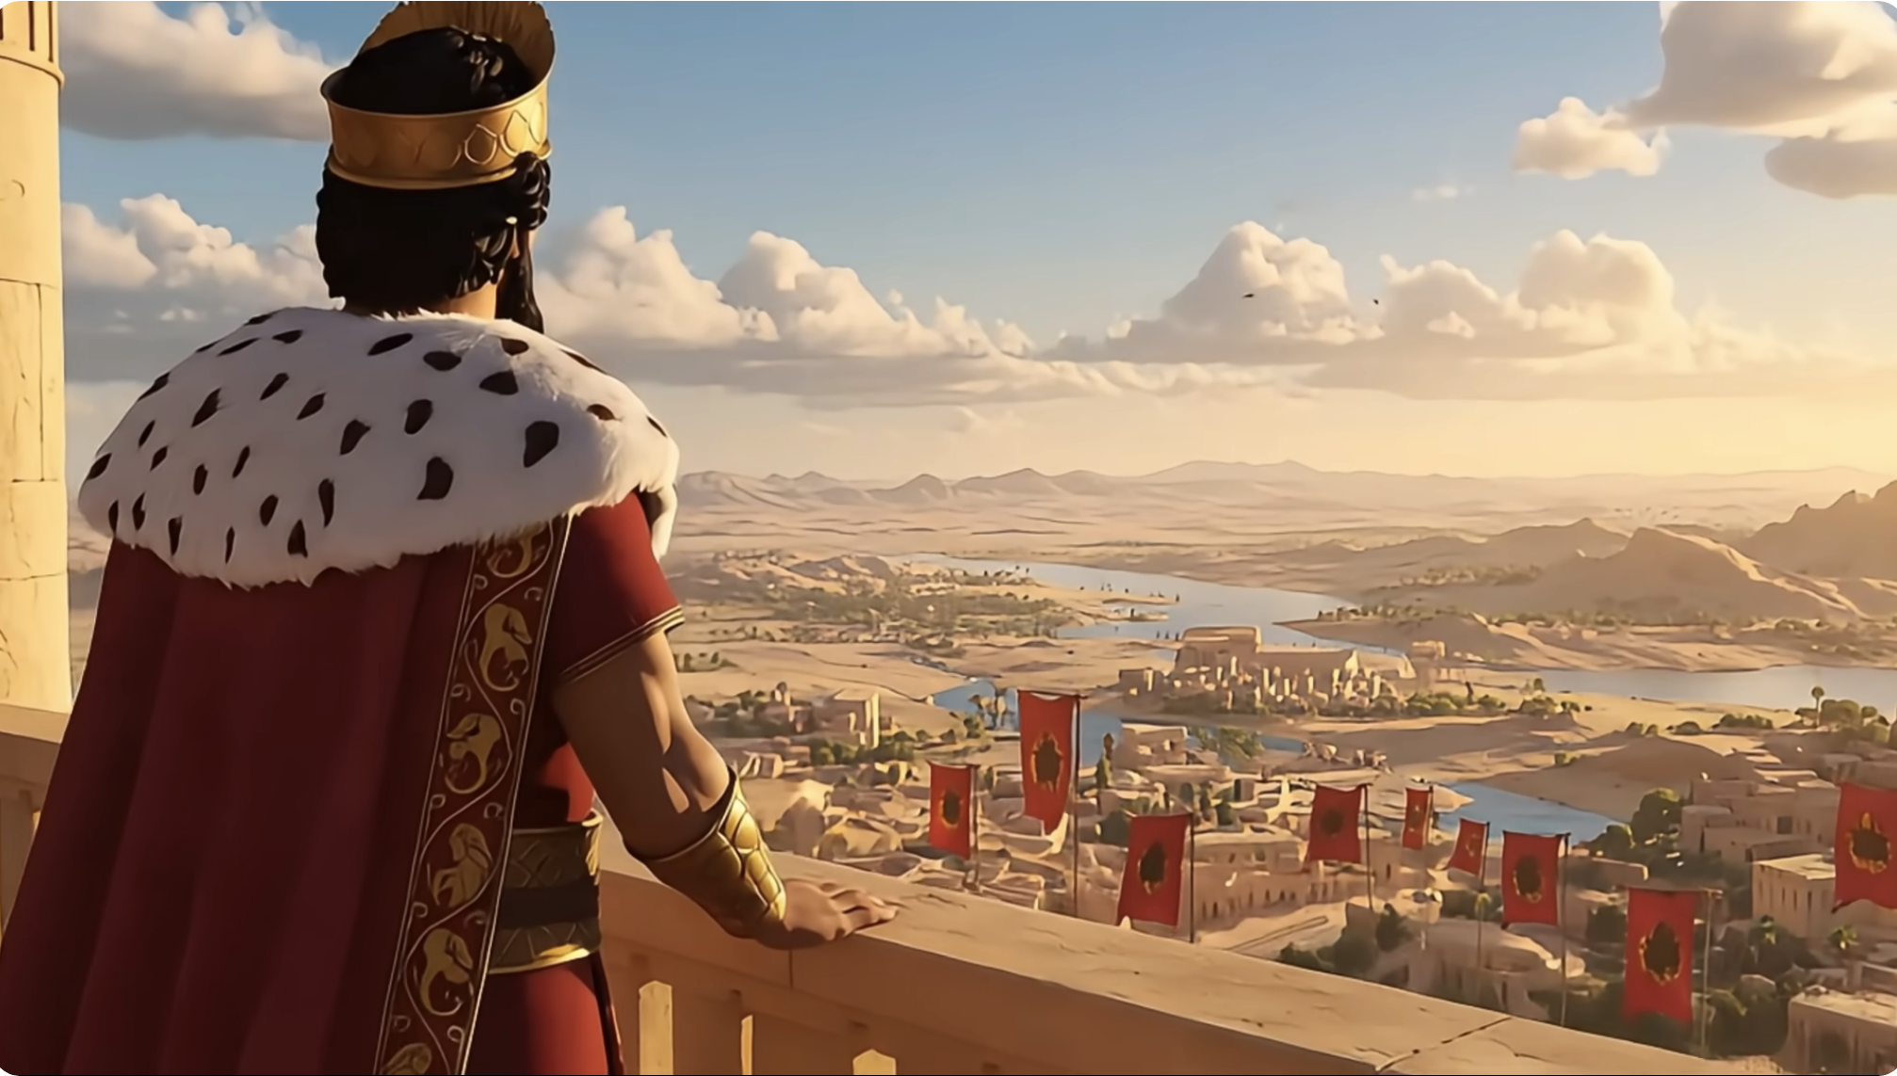
Esther (以斯帖) Chapter 1 Book of Esther and Parenting in Adversity 逆境中教养孩子
https://www.youtube.com/watch?v=oK3JOfPFuGw
親子靈修 William分享
08-01-2026

Slide 2
Time of the Story
Around 475 BC: The story is set over 100 years after the Babylonian exile of the Israelites from their land in 586 BC.
While some Jews did return to Jerusalem (see Ezra-Nehemiah), many did not. The book of Esther is about a Jewish community living in Susa (Shushan), the capital city of the ancient Persian empire.

Slide 3
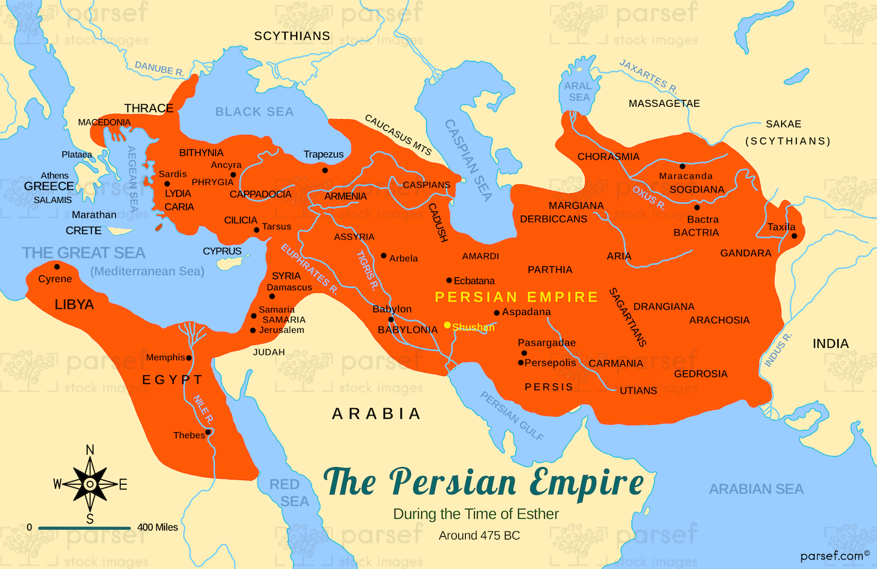
Location of the Story
Shushan
City
https://history.kidsbiblemaps.com/geography/persian-empire-at-time-of-esther-map

Slide 4
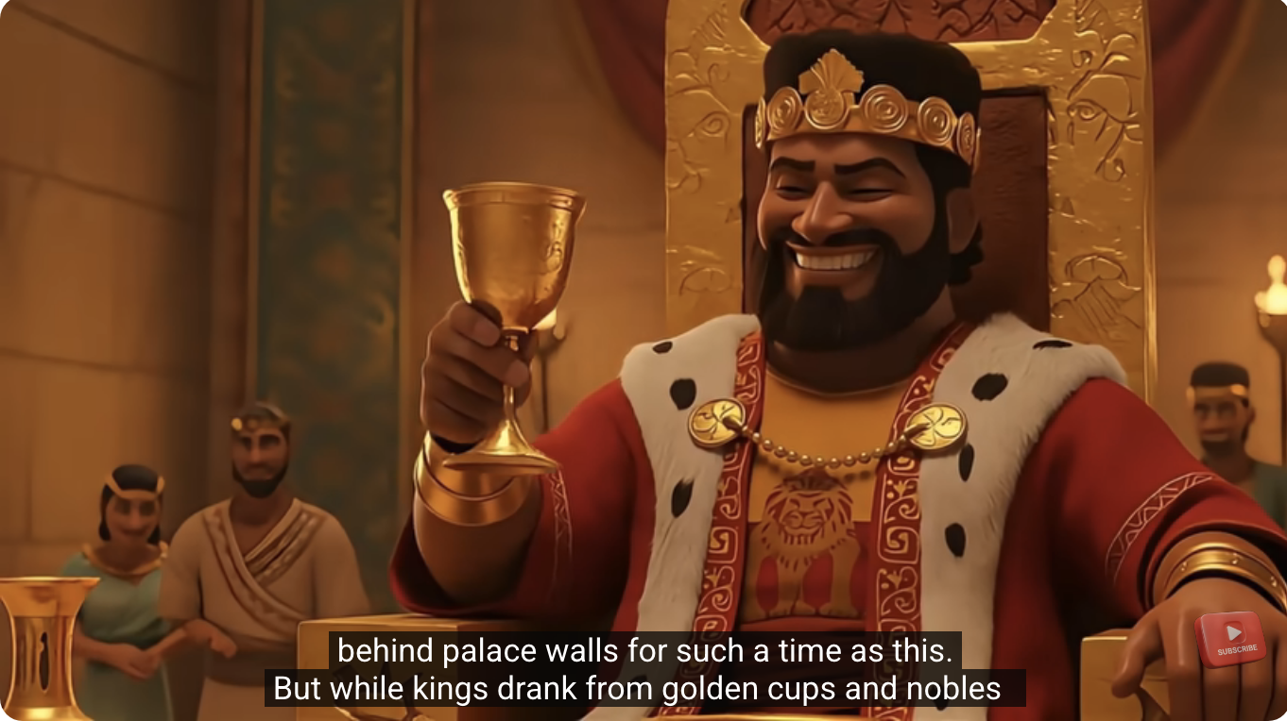
https://www.youtube.com/watch?v=oK3JOfPFuGw
Persia King Xerxes’ Power.

Slide 5
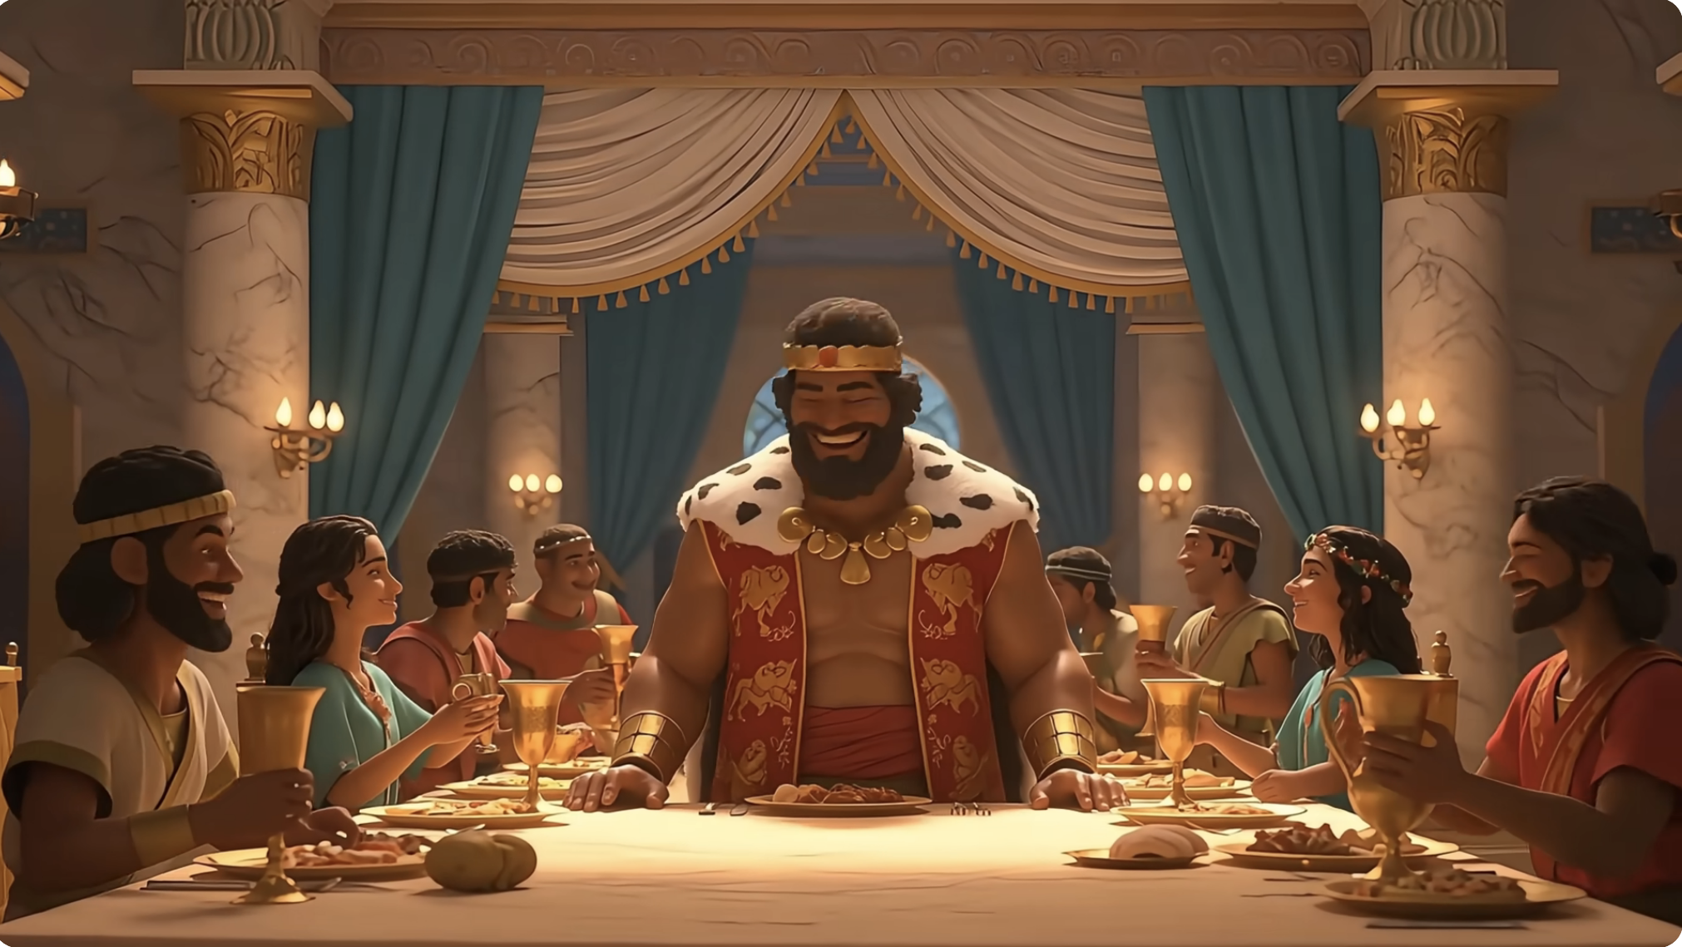
https://www.youtube.com/watch?v=oK3JOfPFuGw
Persia King Xerxes’ Glory.

Slide 6
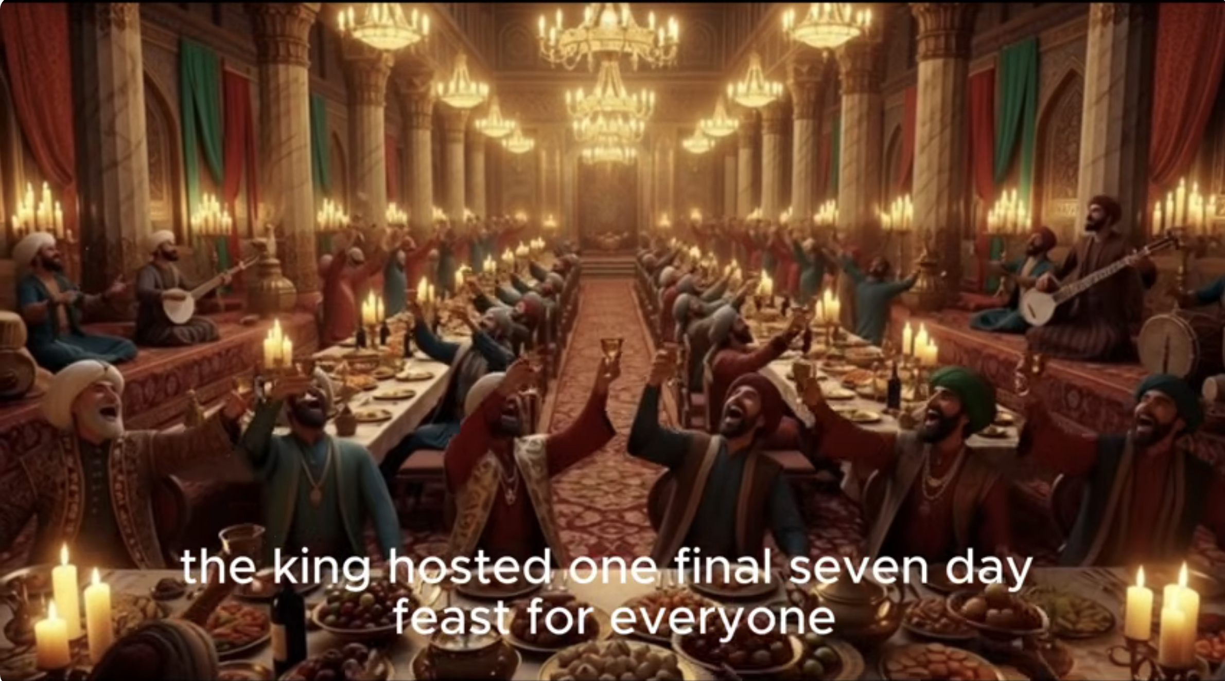
https://www.youtube.com/watch?v=oK3JOfPFuGw
Persia King Xerxes’ Love of its People.

Slide 7
How Strong our Enemy Is:
"See how my enemies have increased and how fiercely they hate me!" (Psm25:19 NIV) "求你察看我的仇敌、因为他们人多．并且痛痛的恨我。" (Psm25:19 CUVS)
"Many are those who are my vigorous enemies; those who hate me without reason are numerous." (Psm38:19 NIV)但我的仇敌又活泼又强壮．无理恨我的增多了。" (Psm38:19 CUVS)
"See how your enemies are astir, how your foes rear their heads." (Psm83:2 NIV)"因为你的仇敌喧嚷．恨你的抬起头来。" (Psm83:2 CUVS).

Slide 8
How Weak We Are:
"How long must I wrestle with my thoughts and every day have sorrow in my heart? How long will my enemy triumph over me?" (Psm13:2 NIV)"我心里筹算、终日愁苦、要到几时呢．我的仇敌升高压制我、要到几时呢。" (Psm13:2 CUVS)
"then let my enemy pursue and overtake me; let him trample my life to the ground and make me sleep in the dust. Selah" (Psm7:5 NIV)"就任凭仇敌追赶我、直到追上．将我的性命踏在地下、使我的荣耀归于灰尘。〔细拉〕" (Psm7:5 CUVS)
"Lead me, O Lord , in your righteousness because of my enemies make straight your way before me." (Psm5:8 NIV) "耶和华阿、求你因我的仇敌、凭你的公义、引领我．使你的道路在我面前正直。" (Psm5:8 CUVS)

Slide 9
個人反思
Parenting When Life is Hard：How to raise your child during the difficult and hopeless times?
Do you want your child to be a king like Xerxes? Who is not so bad though.
Do you want your child to attend Harvard? To gain prestige, knowledge, fames, richness, freedom, more job opportunities, . . .
Do you want your child to be a pastor or missionary?

Slide 10
Common Mistakes for Parenting in Adversity?
Admire the king’s glory, power, and palace.
Admire the upper classes.
Admire the famous people.
Admire the rich people.
Enjoy with the worldly people.
Make friends with worldly people.

Slide 11
Correct Parenting in Adversity?
"Do not conform any longer to the pattern of this world, but be transformed by the renewing of your mind. Then you will be able to test and approve what God's will is -- his good, pleasing and perfect will." (Rom12:2 NIV) “不要效法这个世界．只要心意更新而变化、叫你们察验何为 神的善良、纯全可喜悦的旨意。" (Rom12:2 CUVS)

Slide 12
Closing Prayer
Dear Heavenly Father, the Lord Jesus Christ. Thank you for giving me the child. It is your property and your inheritance. May you guide me to raise your child, teach my child according to your will. Do not lead us into temptation. May your name be glorified, generation by generation, and forever. I pray in the name of Jesus. Amen.

Slide 13
1. A Mighty Fortress is our God https://www.youtube.com/watch?v=8XUYZoguhEQ&list=RD8XUYZoguhEQ&start_radio=1 2. A song for Children: It's Purim!
https://www.youtube.com/watch?v=frwpuMEVA5k
3. Purim - New York Boys Choir - Hipil Pur
https://www.youtube.com/watch?v=7AMpwghyjwg&list=RD7AMpwghyjwg&start_radio=1 4. The Purim Song https://www.youtube.com/watch?v=BDEnbL0FOUs&list=RDBDEnbL0FOUs&start_radio=1

