Slide 1
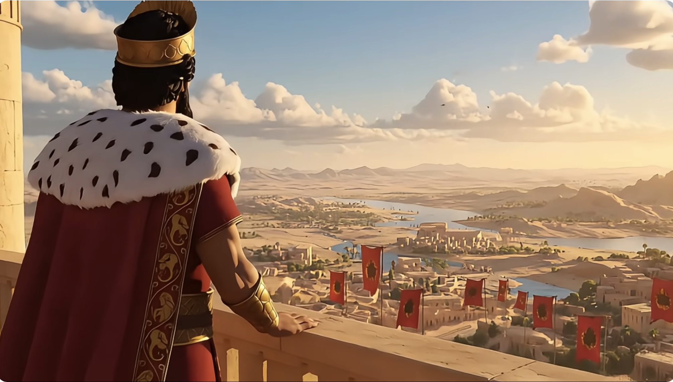
Esther (以斯帖) Chapter 2 Book of Esther and Parenting in Adversity 逆境中教养孩子
https://www.youtube.com/watch?v=oK3JOfPFuGw
親子靈修 William分享
08-01-2026

Slide 2
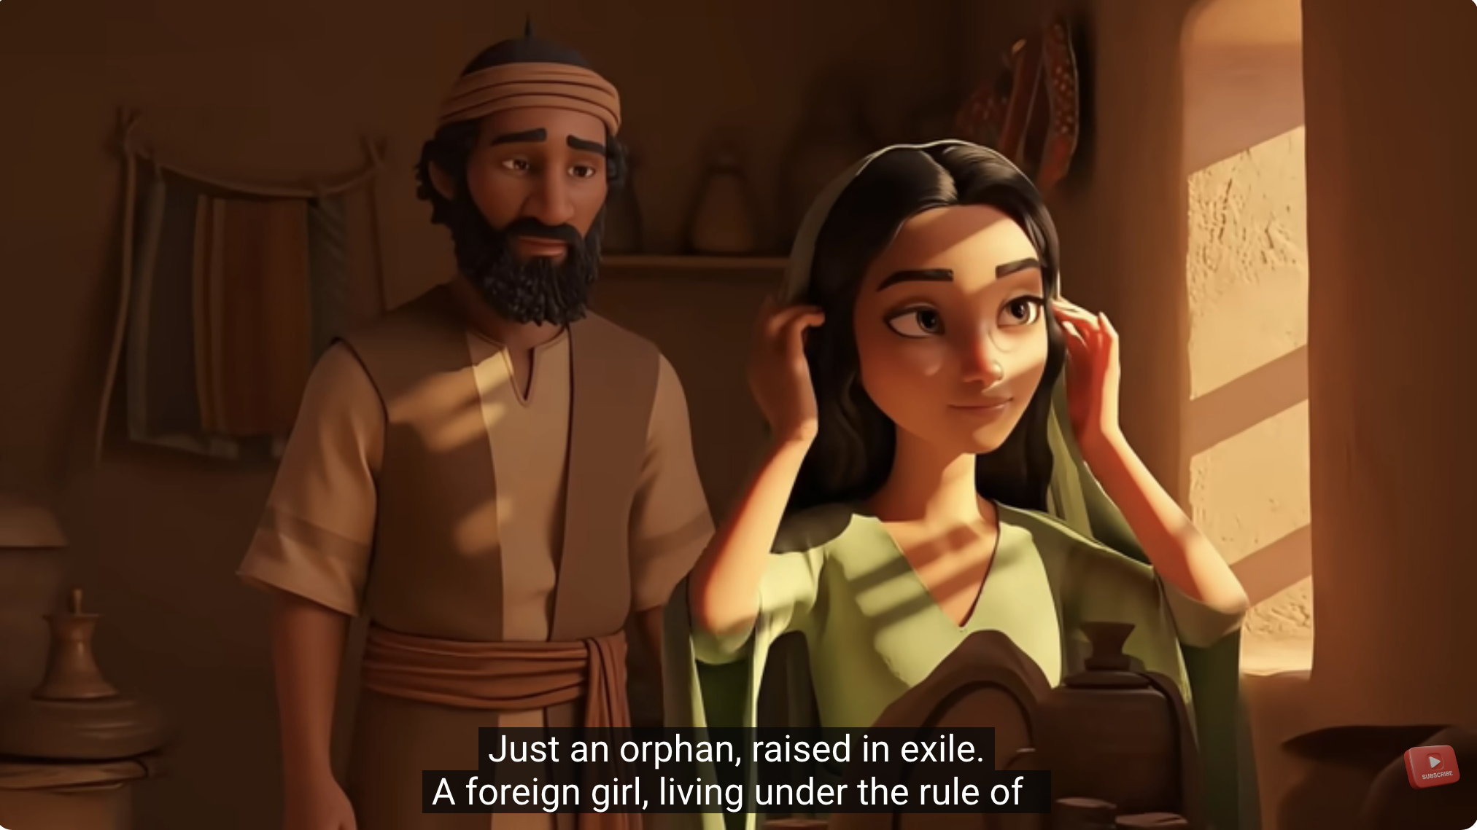
https://www.youtube.com/watch?v=oK3JOfPFuGw
Who is Esther?

Slide 3
Who is Esther? a hopeless child and in a hopeless generation.
# | Who is Esther (Hadasah) | Position in Sciety
1 | A girl | Weak
2 | An orphan (her parents died when she was little) | Humiliated
3 | An immigrant (exiled from Jerusalem to Persia) | Lowest in society
4 | An offspring of Benjaminite. A tribe of declined Israelites | A declined race
5 | Raised by uncle Mordecai (estimated about 80 yrs old) "who had been carried into exile from Jerusalem by Nebuchadnezzar king of Babylon, among those taken captive with Jehoiachin king of Judah." (Est2:6 NIV) "从前巴比伦王尼布甲尼撒将犹大王耶哥尼雅（又名约雅斤）和百姓从耶路撒冷掳去、末底改也在其内。" (Est2:6 CUVS) | Unfamous family
6 | Captured people (slavery or working class) | Loser

Slide 4
How to raise a hopeless child in adversity?
Throw away the child
Send child to orphan organization
Dislike the child
Despise the child
Look down upon the child
Beat/maltreat child
Complain the child
…

Slide 5
Parenting Learning from Mordecai (1)
Have a heart of the mercy of the God: adopt Esther as it is.
No complain to take over the parenting duty.
Be patient: hard working to raise child.

Slide 6
Parenting Learning from Mordecai (2)
Never forget the God in heart in adversity.
Educate Esther to protect herself in adversity.
"Esther had not revealed her nationality and family background, because Mordecai had forbidden her to do so." (Est2:10 NIV)"以斯帖未曾将籍贯宗族告诉人、因为末底改嘱咐他不可叫人知道。" (Est2:10 CUVS).
Sow a seed of God in her heart.

Slide 7
Parenting Learning from Mordecai (3)
Take care of Esther in the adversity.
"Every day he walked back and forth near the courtyard of the harem to find out how Esther was and what was happening to her." (Est2:11 NIV) "末底改天天在女院前边行走、要知道以斯帖平安不平安、并后事如何。" (Est2:11 CUVS)

Slide 8
Parenting Learning from Mordecai (4)
Keep contact with Esther in the adversity.
Esther 2:21–23.
"But Mordecai found out about the plot and told Queen Esther, who in turn reported it to the king, giving credit to Mordecai." (Est2:22 NIV) "末底改知道了、就告诉王后以斯帖．以斯帖奉末底改的名、报告于王．" (Est2:22 CUVS)

Slide 9
Parenting Learning from Mordecai (5)
Esther
Beauty
Brave
Favored by King
Chosen in Divine Purpose
Fulfilled God’s Plan
Mordecai
Faithfulness
Endurance
Peacefulness
Hope
Love
Convert to

Slide 10
Summary of Parenting Learning from Mordecai (6)
Successful
Parenting
is
a Key
SuccessfulChildren
of the God
Leading to

Slide 11
God’s Reward
"Those who sow in tears will reap with songs of joy." (Psm126:5 NIV)
"流泪撒种的、必欢呼收割。" (Psm126:5 CUVS)

Slide 12
個人反思
Parenting When Life is Hard：How to raise your child during the difficult and hopeless times?
Behold the Lord. Never give up.

Slide 13
Closing Prayer
Dear Heavenly Father, the Lord Jesus Christ. Thank you for giving me the child. It is your property and your inheritance. May you guide me to raise your child, teach my child according to your will. May you use my child for your Kingdom of God. Do not lead us into temptation. May your name be glorified, generation by generation, and forever. I pray in the name of Jesus. Amen.

Slide 14
1. A song for Children: It's Purim!
https://www.youtube.com/watch?v=frwpuMEVA5k
2. Purim - New York Boys Choir - Hipil Pur
https://www.youtube.com/watch?v=7AMpwghyjwg&list=RD7AMpwghyjwg&start_radio=1 https://www.youtube.com/watch?v=un8HXJwQzA8&list=RDun8HXJwQzA8&start_radio=1
The Purim Song https://www.youtube.com/watch?v=BDEnbL0FOUs&list=RDBDEnbL0FOUs&start_radio=1

