Slide 1
列王紀上 第20章22-28節
ACCC
早禱靈修
Wei Ding分享
01-14-2024

Slide 2
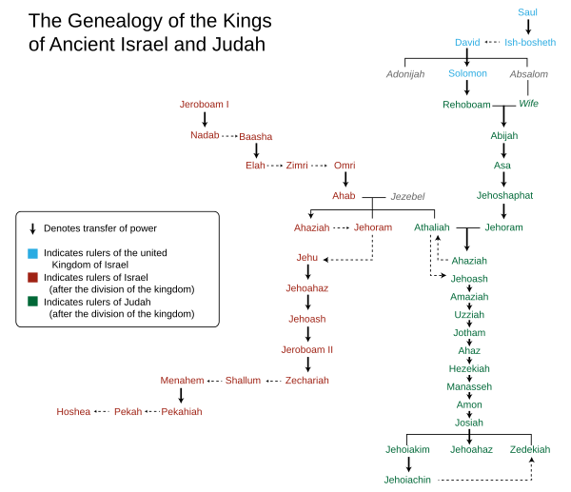
Kings Cart (https://en.wikipedia.org/wiki/Kings_of_Israel_and_Judah#/media/File:Genealogy_of_the_kings_of_Israel_and_Judah.svg)
"and Jesse the father of King David. David was the father of Solomon, whose mother had been Uriah's wife," (Mat1:6 NIV)
"耶西生大卫王。大卫从乌利亚的妻子生所罗门．" (Mat1:6 CUVS)
"Solomon the father of Rehoboam, Rehoboam the father of Abijah, Abijah the father of Asa," (Mat1:7 NIV)
"所罗门生罗波安．罗波安生亚比雅．亚比雅生亚撒．" (Mat1:7 CUVS)
"Asa the father of Jehoshaphat, Jehoshaphat the father of Jehoram, Jehoram the father of Uzziah," (Mat1:8 NIV)
"亚撒生约沙法．约沙法生约兰．约兰生乌西亚．" (Mat1:8 CUVS)

Slide 3
1Ki 20:22 Afterward, the prophet came to the king of Israel and said, "Strengthen your position and see what must be done, because next spring the king of Aram will attack you again." (1Ki20:22 NIV) "那先知来见以色列王、对他说、你当自强、留心怎样防备、因为到明年这时候、亚兰王必上来攻击你。" (1Ki20:22 CUVS)

Slide 4
Strengthen your position当自强
Gentile Position | Christian Position
有神人来见以色列王说、耶和华如此说、亚兰人既说我耶和华是山神、不是平原的神．所以我必将这一大群人、都交在你手中、你们就知道我是耶和华。(1Ki20:28 CUVS) The man of God came up and told the king of Israel, "This is what the Lord says: 'Because the Arameans think the Lord is a god of the hills and not a god of the valleys, I will deliver this vast army into your hands, and you will know that I am the Lord .' " (1Ki20:28 NIV) | "既是儿女、便是后嗣、就是 神的后嗣、和基督同作后嗣．如果我们和他一同受苦、也必和他一同得荣耀。" (Rom8:17 CUVS) "Now if we are children, then we are heirs -- heirs of God and co-heirs with Christ, if indeed we share in his sufferings in order that we may also share in his glory." (Rom8:17 NIV)
- A god of Money (Treasure) 财神爷. - A god of Women 女神.

Slide 5
Watch-out People 留心,防备人 (1Ki120:22 CUVS)
# | Types | People
1 | devil | "应当防备犬类、防备作恶的、防备妄自行割的．" (Phl3:2 CUVS) "Watch out for those dogs, those men who do evil, those mutilators of the flesh." (Phl3:2 NIV)
2 | False Prophet | "Watch out for false prophets. They come to you in sheep's clothing, but inwardly they are ferocious wolves." (Mat7:15 NIV) "你们要防备假先知．他们到你们这里来、外面披着羊皮、里面却是残暴的狼。" (Mat7:15 CUVS)
3 | False teacher | "耶稣在教训之间、说、你们要防备文士、他们好穿长衣游行、喜爱人在街市上问他们的安、" (Mak12:38 CUVS) "As he taught, Jesus said, "Watch out for the teachers of the law. They like to walk around in flowing robes and be greeted in the marketplaces," (Mak12:38 NIV)
4 | gentile | "你们要防备人．因为他们要把你们交给公会、也要在会堂里鞭打你们．" (Mat10:17 CUVS) ""Be on your guard against men; they will hand you over to the local councils and flog you in their synagogues." (Mat10:17 NIV)
5 | Today | World Leaders, Dictators, Capitalists, Influential Worldly People.

Slide 6
Watch-out Disinformation 留心,防备假信息 (1Ki120:22)
# | Types | Knowledge
1 | teaching | "耶稣对他们说、你们要谨慎、防备法利赛人和撒都该人的酵。" (Mat16:6 CUVS) "Be careful," Jesus said to them. "Be on your guard against the yeast of the Pharisees and Sadducees." (Mat16:6 NIV)
2 | knowledge | "亲爱的弟兄阿、你们既然预先知道这事、就当防备、恐怕被恶人的错谬诱惑、就从自己坚固的地步上坠落。" (2Pe3:17 CUVS) "Therefore, dear friends, since you already know this, be on your guard so that you may not be carried away by the error of lawless men and fall from your secure position." (2Pe3:17 NIV)
3 | Today | Youtube, Tiktok, Instagram, X, Meta, Google, News, AI.

Slide 7
Love of God:
"耶稣对他说、你要尽心、尽性、尽意、爱主你的 神。" "Jesus replied: 'Love the Lord your God with all your heart and with all your soul and with all your mind.'" (Mat22:37 NIV)
"其次也相仿、就是要爱人如己。"
"And the second is like it: 'Love your neighbor as yourself.'" (Mat22:39 NIV)

Slide 8
Don’t Live in Comfort Zone
“所以你们要去、使万民作我的门徒、奉父子圣灵的名、给他们施洗凡我所吩咐你们的、都教训他们遵守我就常与你们同在、直到世界的末了。”
"Therefore go and make disciples of all nations, baptizing them in the name of the Father and of the Son and of the Holy Spirit, and teaching them to obey everything I have commanded you. And surely I am with you always, to the very end of the age." (Mat28:19-20 NIV). (G.M.B.T.)

Slide 9
Pray: Don’t Do Evil in the Eyes of the Lord
我们在天上的父、愿人都尊你的名为圣。
愿你的国降临。愿你的旨意行在地上、如同行在天上.
Father in heaven, hallowed be your name, your kingdom come, your will be done on earth as it is in heaven
求你看顾保守教会牧师弟兄。不要叫我们遇见试探。救我们脱离凶恶。
Please watch over and protect the pastors and brothers in the church. Do not lead us into temptation. Deliver us from evil.
兴旺福音和教会.
Thriving gospel and church.

Slide 10
Pray: Don’t Do Evil in the Eyes of the Lord
求你看顾保守美国的根基永不动摇。以耶稣为神。
Please watch over and preserve the foundations of America so that they will never be shaken. Believe in Jesus as God.
求你看顾保守美国年青的一代, 寻求真理,
不叫他们被色情,毒品,异端所掠去。
Please watch over and protect the younger generation,
Seeking the Truth,
Don't let them be taken away by pornography, drugs, and heresy liberal thoughts.

Slide 11
https://www.youtube.com/watch?v=8sXlbTkH6SE&ab_channel=ACCCAtlanta
為主而活
https://www.youtube.com/watch?v=bmUnSstK854
行祢旨意
(Go) Hillsong In Chinese
Hillsong 华语

