Slide 1
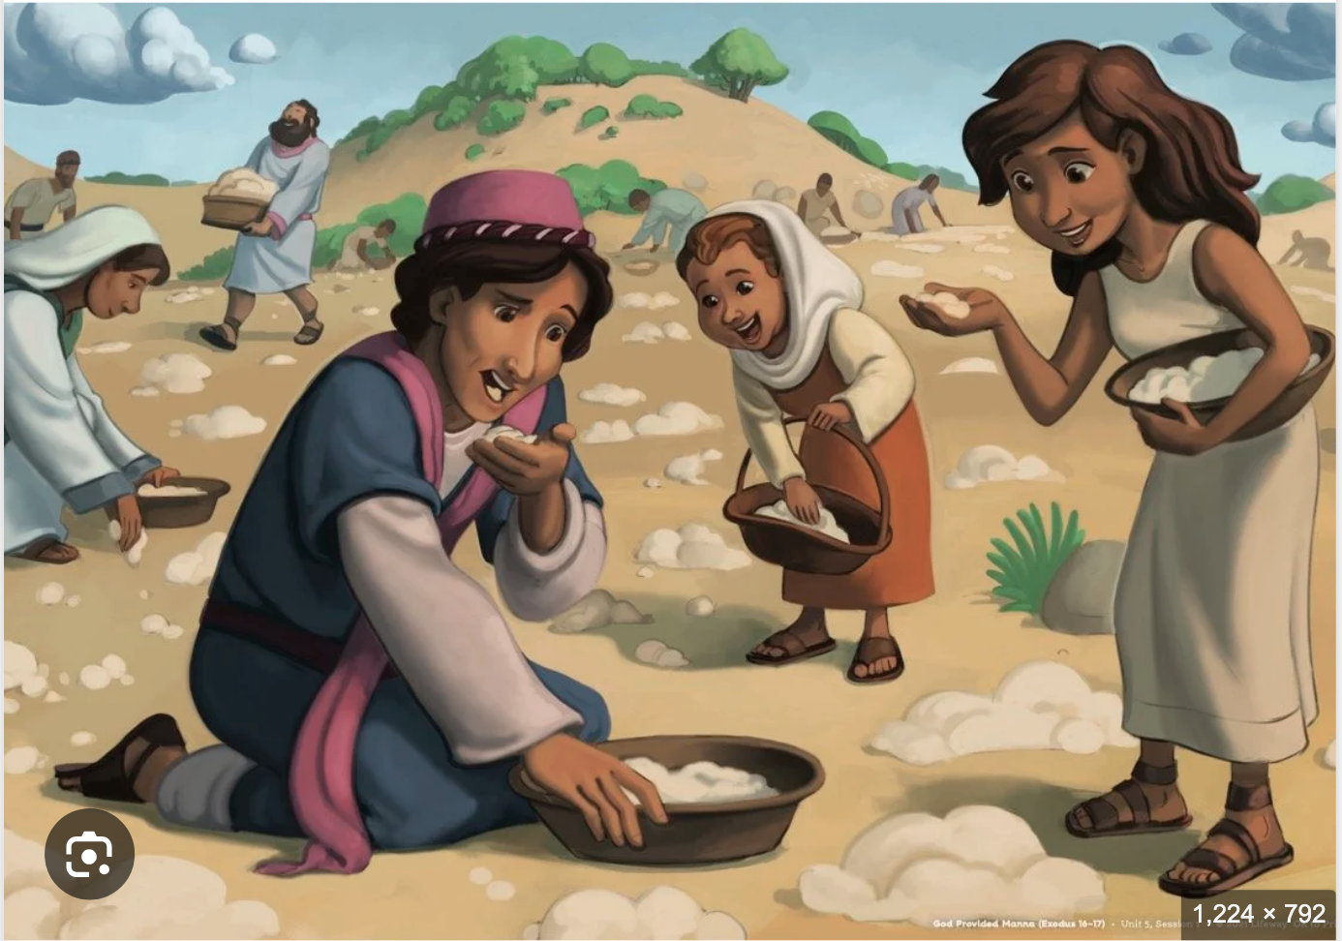
Exodus 出埃及記 16:19-31 Moses and Parenting
https://www.crosswayfellowship.org/kids-resources/u5-lesson1
親子靈修 William分享
10-23-2025

Slide 2
出埃及記(Exodus) 16:19-31
經文取自《聖經和合本NIV》— 漢語聖經協會出版，承蒙允准使用。
Key Verse:
Then the Lord said to Moses, "How long will you refuse to keep my commands and my instructions?" (Exo16:28 NIV)
耶和华对摩西说、你们不肯守我的诫命和律法、要到几时呢。 (Exo16:28 CUVS)
https://www.paultripp.com/articles/posts/grumbling-and-disputing

Slide 3
https://www.youtube.com/watch?v=Ln5Aa8jiEAM&ab_channel=GIDEONFILM
Shttps://www.youtube.com/shorts/rPtPxme8ZSM
English Version Video: Exodus 16:19-31. (2 min)

Slide 4
To Parents and Children
What were the results of disobeying the Lord’s instructions?
"然而他们不听摩西的话、内中有留到早晨的、就生虫变臭了．摩西便向他们发怒。" (Exo16:20 CUVS)
"However, some of them paid no attention to Moses; they kept part of it until morning, but it was full of maggots and began to smell. So Moses was angry with them." (Exo16:20 NIV)
"第七天百姓中有人出去收、甚么也找不着。" (Exo16:27 CUVS)
"Nevertheless, some of the people went out on the seventh day to gather it, but they found none." (Exo16:27 NIV)

Slide 5
To Parents and Children
What were the results of obeying the Lord’s instructions?
"及至用俄梅珥量一量、多收的也没有余、少收的也没有缺、各人按着自己的饭量收取。" (Exo16:18 CUVS)
"And when they measured it by the omer, he who gathered much did not have too much, and he who gathered little did not have too little. Each one gathered as much as he needed." (Exo16:18 NIV)
"他们就照摩西的吩咐留到早晨、也不臭、里头也没有虫子。" (Exo16:24 CUVS)
"So they saved it until morning, as Moses commanded, and it did not stink or get maggots in it." (Exo16:24 NIV)

Slide 6
To Parents and Children
What kind of heart caused the Israelites to disobey the instructions and the commands of the Lord?
- Greedy
- Self-righteous
- Sinful nature
- …

Slide 7
To Parents and Children
When was the last time you failed to keep the Lord’s Command and Instructions?
What kind of desires that led you to disobey the Lord’s commands?

Slide 8
出埃及記(Exodus) 16:19-31
經文取自《聖經和合本NIV》— 漢語聖經協會出版，承蒙允准使用。
Key Verse:
Then the Lord said to Moses, "How long will you refuse to keep my commands and my instructions?" (Exo16:28 NIV)
耶和华对摩西说、你们不肯守我的诫命和律法、要到几时呢。 (Exo16:28 CUVS)
https://www.paultripp.com/articles/posts/grumbling-and-disputing

Slide 9
個人反思 & 教養智慧
個人反思 Personal Reflection：
Can I keep the Lord’s command and instruction?
教養智慧：
"Thanks be to God -- through Jesus Christ our Lord! So then, I myself in my mind am a slave to God's law, but in the sinful nature a slave to the law of sin." (Rom7:25 NIV)
“感谢 神、靠着我们的主耶稣基督就能脱离了。这样看来、我以内心顺服 神的律．我肉体却顺服罪的律了。" (Rom7:25 CUVS)

Slide 10
Closing Prayer
Dear Heavenly Father, the Glorious Lord, the Creator, and Sovereign of all things. Thank you for your mercy and grace. Thank you for calling us, the parents. Thank you for giving us, the parents, the educational authority. Our children are your heritage. We are the sinners; we do not deserve it. May Your Holy Spirit call us, guide us. Bless our children and young generation to be able to know you, follow you to be the devotional generation. May your name be glorified, generation by generation, and forever. I pray in the name of Jesus. Amen.

Slide 11
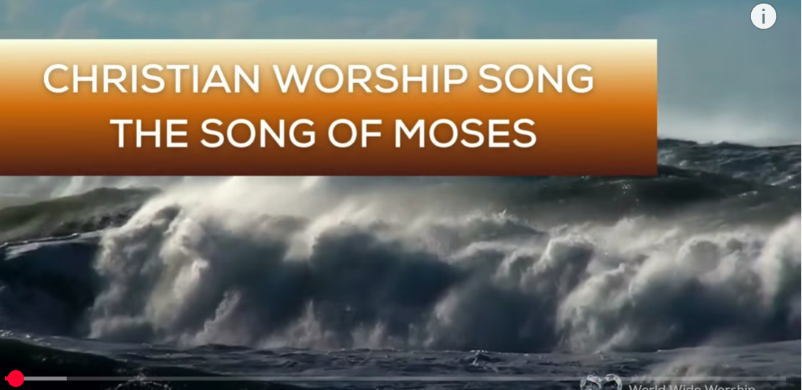
1.No Turning Back
https://www.youtube.com/watch?v=yNtid3wdDWA&list=RDyNtid3wdDWA&start_radio=1&ab_channel=GaiseBaba
Christian Kids
2. The Song of Moses https://www.youtube.com/watch?v=a-wWKL-7Mrg
The Song of Moses Like You've Never Heard Before | Christian Worship Song/ World Wide Worship

