Slide 1
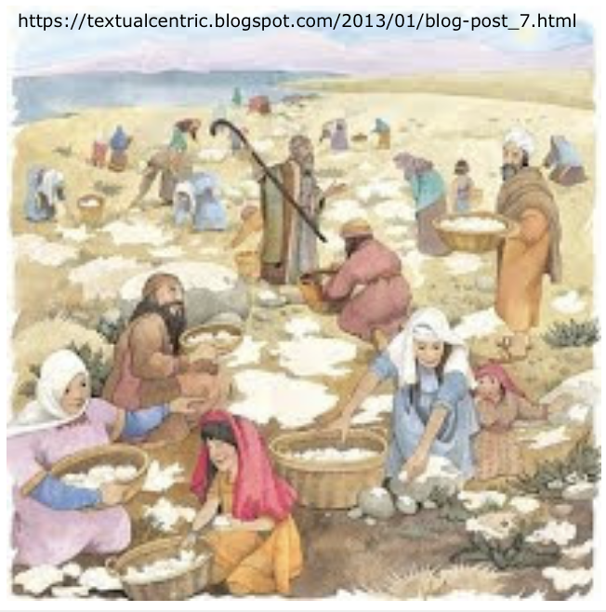
Exodus 出埃及記 16:32-36
Moses and Parenting
親子靈修
William分享
09-13-2025

Slide 2
出埃及記(Exodus) 16:32-36
經文取自《聖經和合本NIV》— 漢語聖經協會出版，承蒙允准使用。
Key Word: manna (吗哪)
In Hebrew: | מָה (ma)
Literal Meaning: | What is it?
Biblical Meaning: | the bread the Lord has given you to eat.
Origin: | "When the Israelites saw it, they said to each other, "What is it?" For they did not know what it was. Moses said to them, "It is the bread the Lord has given you to eat." (Exo16:15 NIV)

Slide 3
https://www.youtube.com/watch?v=Ln5Aa8jiEAM&ab_channel=GIDEONFILM
Shttps://www.youtube.com/shorts/rPtPxme8ZSM
English Version Video: Exodus 16:32-36.
(1 min)

Slide 4
To Parents and Children
Have you eaten Manna?
- No. I haven’t.
Broadly speaking, our daily food is manna. Because all food we eat was originally created by God, as if manna were from heaven in the desert.
"神说、看哪、我将遍地上一切结种子的菜蔬、和一切树上所结有核的果子、全赐给你们作食物。" (Gen1:29 CUVS)
"Then God said, "I give you every seedbearing plant on the face of the whole earth and every tree that has fruit with seed in it. They will be yours for food." (Gen1:29 NIV)

Slide 5
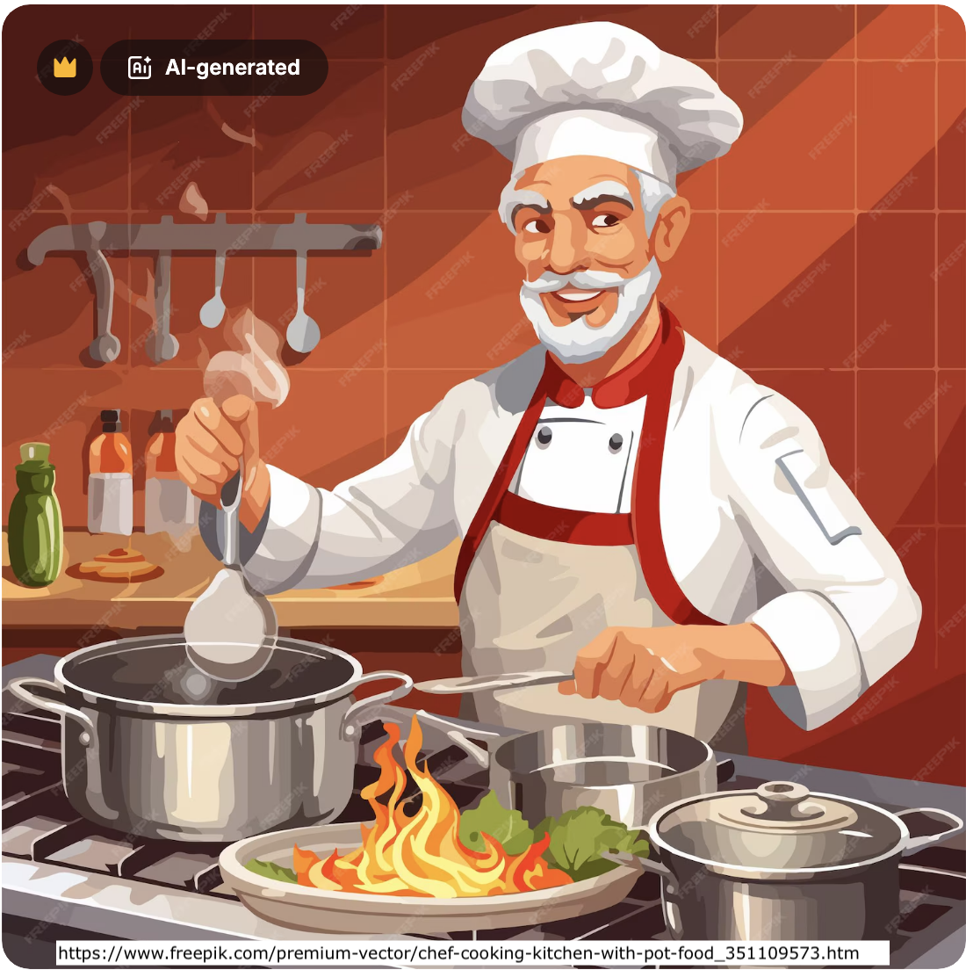
To Parents and Children
Human beings today can create a car or an iPhone.
Can human beings create food?
No, they cannot.
They can cook, but they cannot make food from the earth.

Slide 6
To Parents and Children
Spiritually speaking, Manna, associated with the miracles of God in the desert, symbolizes the spiritual food—the faith of God.
"Then Jesus declared, "I am the bread of life. He who comes to me will never go hungry, and he who believes in me will never be thirsty." (Jhn6:35 NIV)
耶稣说、我就是生命的粮．到我这里来的、必定不饿．信我的、永远不渴。 (Jhn6:35 CUVS)

Slide 7
To Parents
What are the important things that parents should pass down to children?
- Money?
- Knowledge?
- Food?
- Clothes?
- House?
- Car?
- Language?
- Cultural Heritage?

Slide 8
出埃及記(Exodus) 16:32
經文取自《聖經和合本NIV》— 漢語聖經協會出版，承蒙允准使用。
Key Verse:
Moses said, "This is what the Lord has commanded: 'Take an omer of manna and keep it for the generations to come, so they can see the bread I gave you to eat in the desert when I brought you out of Egypt.' " (Exo16:32 NIV)
摩西说、耶和华所吩咐的是这样．要将一满俄梅珥吗哪留到世世代代、使后人可以看见我当日将你们领出埃及地、在旷野所给你们吃的食物。" (Exo16:32 CUVS)
https://www.paultripp.com/articles/posts/grumbling-and-disputing

Slide 9
出埃及記(Exodus) 16:33
經文取自《聖經和合本NIV》— 漢語聖經協會出版，承蒙允准使用。
Key Verse:
"So Moses said to Aaron, "Take a jar and put an omer of manna in it. Then place it before the Lord to be kept for the generations to come."" (Exo16:33 NIV)
摩西对亚伦说、你拿一个罐子、盛一满俄梅珥吗哪、存在耶和华面前、要留到世世代代. (Exo16:33 CUVS)
https://www.paultripp.com/articles/posts/grumbling-and-disputing

Slide 10
個人反思 & 教養智慧
個人反思 Personal Reflection：
Should parents raise children in their own way or in God’s way?
教養智慧：
"教养孩童、使他走当行的道、就是到老他也不偏离。" (Pro22:6 CUV)
"Train a child in the way he should go, and when he is old he will not turn from it." (Pro22:6 NIV)

Slide 11
Closing Prayer
Dear Heavenly Father, the Glorious Lord, the Creator, and Sovereign of all things. Thank you for your mercy and grace. Thank you for calling us, the parents. Thank you for giving us, the parents, the educational authority. Our children are your heritage. We are the sinners; we do not deserve it. May Your Holy Spirit call us, guide us. Bless our children and young generation to be able to know you, follow you to be the devotional generation. May your name be glorified, generation by generation, and forever. I pray in the name of Jesus. Amen.

Slide 12
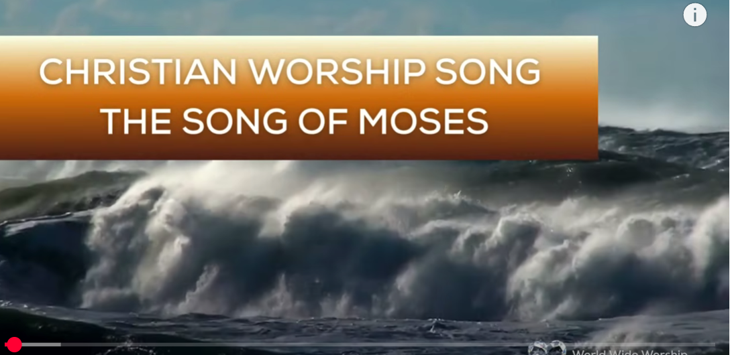
1.No Turning Back
https://www.youtube.com/watch?v=yNtid3wdDWA&list=RDyNtid3wdDWA&start_radio=1&ab_channel=GaiseBaba
Christian Kids
2. The Song of Moses https://www.youtube.com/watch?v=a-wWKL-7Mrg
The Song of Moses Like You've Never Heard Before | Christian Worship Song/ World Wide Worship

