Slide 1

Exodus 出埃及記 10:16-29 Moses and Parenting
https://www.cclifefl.org/View/Article/8730
親子靈修 William分享
08-01-2025

Slide 2
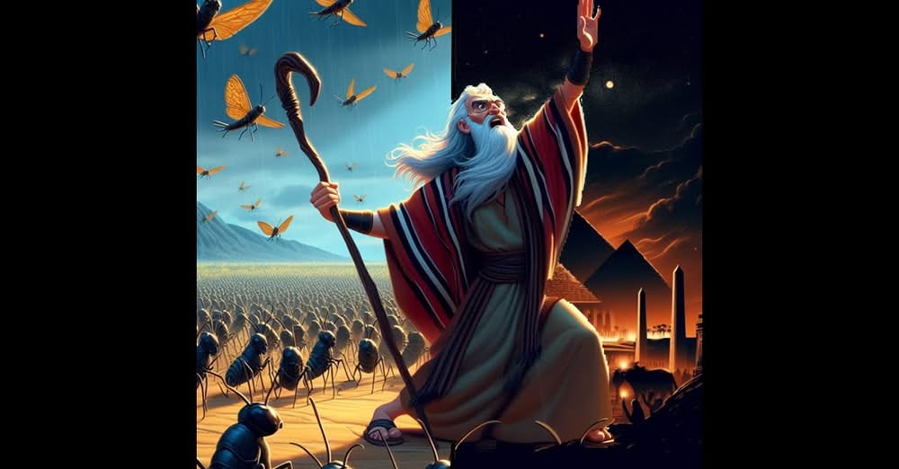
https://www.youtube.com/watch?v=fyekjTqqFNE&t=4s&ab_channel=ELTUBEE
English Version Video: Exodus 10:16-29. (start as 2:00)

Slide 3
出埃及記(Exodus) 10:16-29
經文取自《聖經和合本NIV》— 漢語聖經協會出版，承蒙允准使用。
Golden Verses Exo 10:2
我们的牲畜也要带去，连一蹄也不留下，因为我们要从其中取出来，事奉耶和华我们的神。我们未到那里，还不知道用什么事奉耶和华。(Exo10:26 CUVS)
Our livestock too must go with us; not a hoof is to be left behind. We have to use some of them in worshiping the Lord our God, and until we get there we will not know what we are to use to worship the Lord .(Exo10:26 NIV)

Slide 4
To Parents and Children
What do you want to bring with you when you plan to travel to a new place?
Bring money, credit cards,
Bring clothes, drink, and food.
Bring an umbrella, sunglasses.
Bring my favorite toy.
…

Slide 5
To Parents and Children
What is your purpose in bringing those with you?
Buy anything I want.
Enjoy the meals and sleep.
Self-protection.
Enjoy worldly life.
…

Slide 6
What did Moses say to Pharaoh?
Golden Verses Exo 10:26
我们的牲畜也要带去，连一蹄也不留下，因为我们要从其中取出来，事奉耶和华我们的神。我们未到那里，还不知道用什么事奉耶和华。(Exo10:26 CUVS)
Our livestock too must go with us; not a hoof is to be left behind. We have to use some of them in worshiping the Lord our God, and until we get there we will not know what we are to use to worship the Lord .(Exo10:26 NIV)

Slide 7
個人反思 & 教養智慧
個人反思 Personal Reflection：
If you travel overseas, what do you want to bring with you?
教養智慧：
"Do not take along any gold or silver or copper in your belts; "Do not take along any gold or silver or copper in your belts;" (Mat10:9-10 NIV)
“腰袋里、不要带金银铜钱。"行路不要带口袋、不要带两件褂子、也不要带鞋和拐杖．因为工人得饮食、是应当的。" (CUV)

Slide 8
Closing Prayer
Dear Heavenly Father, the Glorious Lord, the Creator, and Sovereign of all things. Thank you for your mercy and grace. Thank you for calling us, the parents. Thank you for giving us, the parents, the educational authority. Our children are your heritage. We are the sinners; we do not deserve it. May Your Holy Spirit call us, guide us. Bless our children and young generation to be able to know you, follow you to be the devotional generation. May your name be glorified, generation by generation, and forever. I pray in the name of Jesus. Amen.

Slide 9
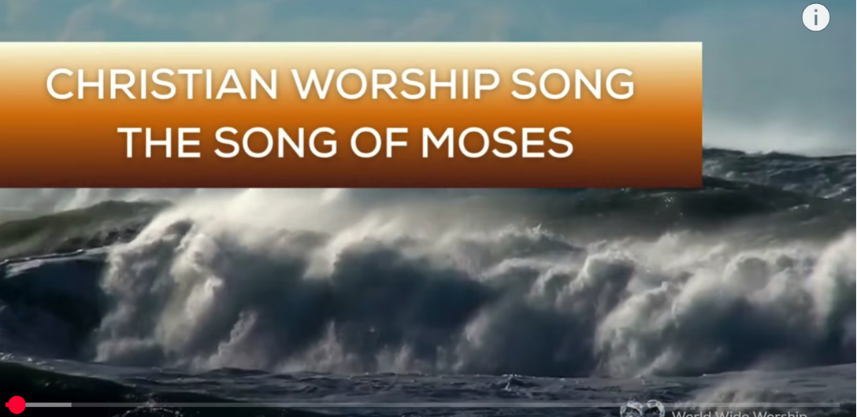
1.No Turning Back
https://www.youtube.com/watch?v=yNtid3wdDWA&list=RDyNtid3wdDWA&start_radio=1&ab_channel=GaiseBaba
Christian Kids
2. The Song of Moses https://www.youtube.com/watch?v=a-wWKL-7Mrg
The Song of Moses Like You've Never Heard Before | Christian Worship Song/ World Wide Worship

