Slide 1

Exodus 出埃及記 10:1-15 Moses and Parenting
https://www.cclifefl.org/View/Article/8730
親子靈修 William分享
08-01-2025

Slide 2
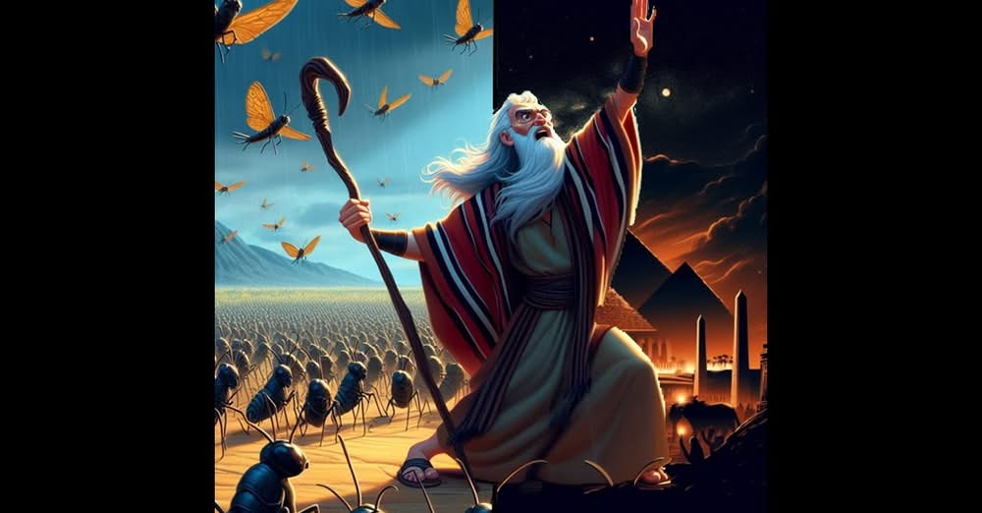
https://www.youtube.com/watch?v=fyekjTqqFNE&t=4s&ab_channel=ELTUBEE
English Version Video: Exodus 10:1-15.

Slide 3
出埃及記(Exodus) 10:1-15
經文取自《聖經和合本NIV》— 漢語聖經協會出版，承蒙允准使用。
Golden Verses Exo 10:2
并要叫你将我向埃及人所作的事，和在他们中间所行的神迹，传于你儿子和你孙子的耳中，好叫你们知道我是耶和华。
that you may tell your children and grandchildren how I dealt harshly with the Egyptians and how I performed my signs among them, and that you may know that I am the Lord ."" (Exo10:2 NIV)

Slide 4
To Parents
What do parents usually tell their children?
I once bragged in front of my children about my past successful hero-like story.
I told my child how hard I used to work.
I told my child how poor and miserable life used to be.
…

Slide 5
To Children
What do children usually hear from their parents?
My parents are heroes.
My parents are good people.
My parents are rich.
I am proud of my parents.
…

Slide 6
What did Moses say?
Golden Verses Exo 10:9
"摩西说，我们要和我们老的少的，儿子女儿同去，且把羊群牛群一同带去，因为我们务要向耶和华守节。" (Exo10:9 CUVS)
"Moses answered, "We will go with our young and old, with our sons and daughters, and with our flocks and herds, because we are to celebrate a festival to the Lord ."" (Exo10:9 NIV)

Slide 7
To Young Parents
As a house head and parent, what is your purpose in maintaining a family?
To glorify the family ancestor?.
To glorify my family?.
To glorify myself?.
To enjoy my worldly family life?

Slide 8
個人反思 & 教養智慧
個人反思：
What is the role of the family from a biblical perspective?
教養智慧：
"至于我、和我家、我们必定事奉耶和华。" (Jos24:15 CUVS)
“as for me and my household, we will serve the Lord ." (Jos24:15 NIV).

Slide 9
Closing Prayer
Dear Heavenly Father, the Glorious Lord, the Creator, and Sovereign of all things. Thank you for your mercy and grace. Thank you for calling us, the parents. Thank you for giving us, the parents, the educational authority. Our children are your heritage. We are the sinners; we do not deserve it. May Your Holy Spirit call us, guide us. Bless our children and young generation to be able to know you, follow you to be the devotional generation. May your name be glorified, generation by generation, and forever. I pray in the name of Jesus. Amen.

Slide 10
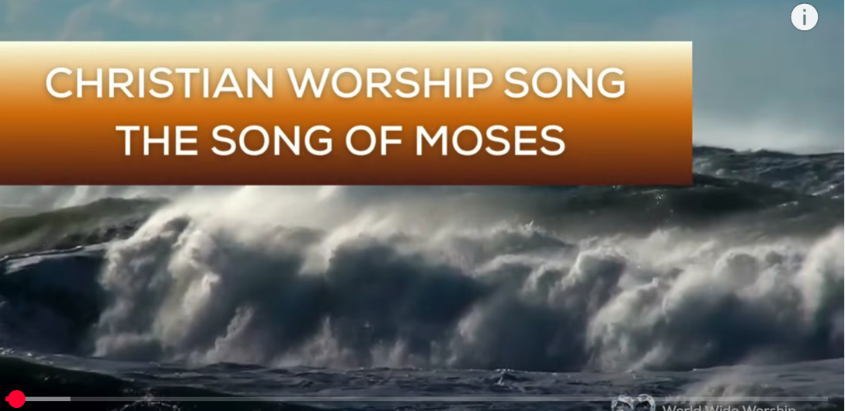
1.No Turning Back
https://www.youtube.com/watch?v=yNtid3wdDWA&list=RDyNtid3wdDWA&start_radio=1&ab_channel=GaiseBaba
Christian Kids
2. The Song of Moses https://www.youtube.com/watch?v=a-wWKL-7Mrg
The Song of Moses Like You've Never Heard Before | Christian Worship Song/ World Wide Worship

