Slide 1
Today’s Message
2022-03
Title:
Keep Living in a New Life:
Parable of New Wine and New Wineskin
Scripture:
Luke 5:37-39

Slide 2
Agenda
Today we are going to learn some basic knowledge about the wine.
Learn the Jesus’ parable: the new wine and new wineskin.
Please Note that: It is not recommended for children to drink any wine.

Slide 3
Jesus said
(Luke 5:37-39)
³⁷ And no one pours new wine into old wineskins. Otherwise, the new wine will burst the skins; the wine will run out and the wineskins will be ruined. ³⁸ No, new wine must be poured into new wineskins. ³⁹ And no one after drinking old wine wants the new, for they say, ‘The old is better.’”

Slide 4
Are you familiar with wine?

Slide 5
Wine made Noah drunk
(Gen 9:20-23)
Do you remember

Slide 6
Do you remember
Jesus turned water into wine at wedding ceremony (John 2)

Slide 7
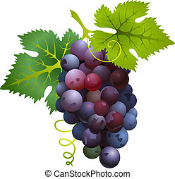
How do people make wine?
Let’s first look at

Slide 8
Wine is made from Grapes
Carrying: Grapes are carried over to crushing machine.
Crushing: Grapes are crushed to become meshed grape.
Pressing: Grape mesh is pressed to produce grape juice.
Fermentation: Grape juice is mixed with yeast for 21 days to become new wine.
Aging: New wine is stored in jars for further fermentation for one year to become old wine.
Clarification: Old wine is filtered.
Packaging: Filtered old wine is bottled for shopping center.

Slide 9
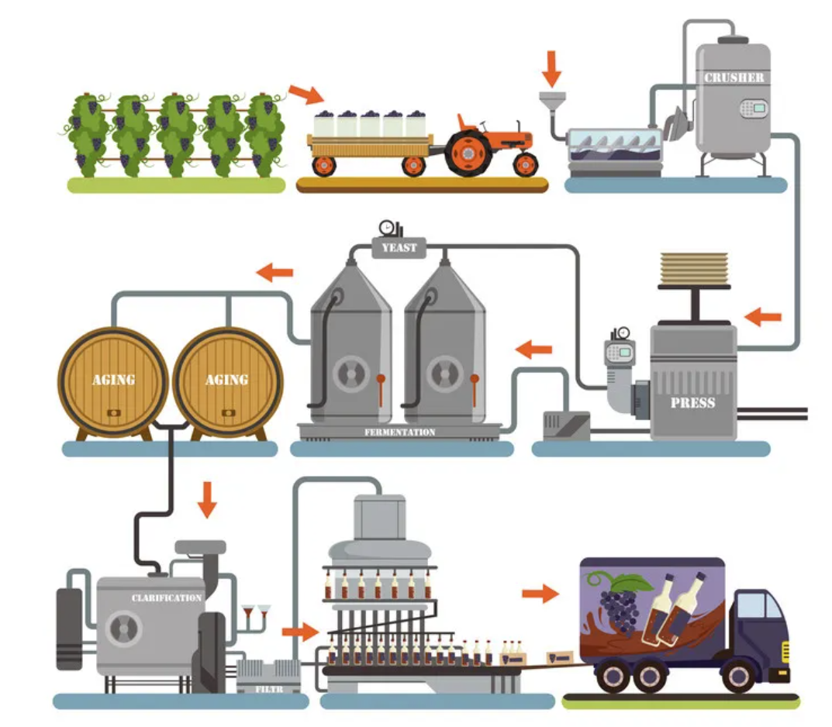
How wine is made?
2
Crushing
Grapes in harvest
1
Carrying-over
Crushing
Machine
Carried over
5
Aging
4
Fermentation
squeeze
3
Pressing
New Wine
21 days
Grape
mesh
Grape
Juice
1 year
Old Wine
7
Packaging
6
Clarification

Slide 10
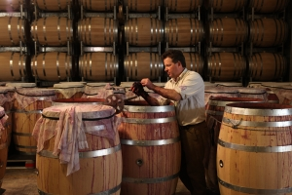
Stages from Grape to Wine
Fermentation
(21 days)
Aging
(1 year)
crunching
pressing
Crunched Grapes
Grape
Juice
New
Wine
Old
Wine
Grapes

Slide 11

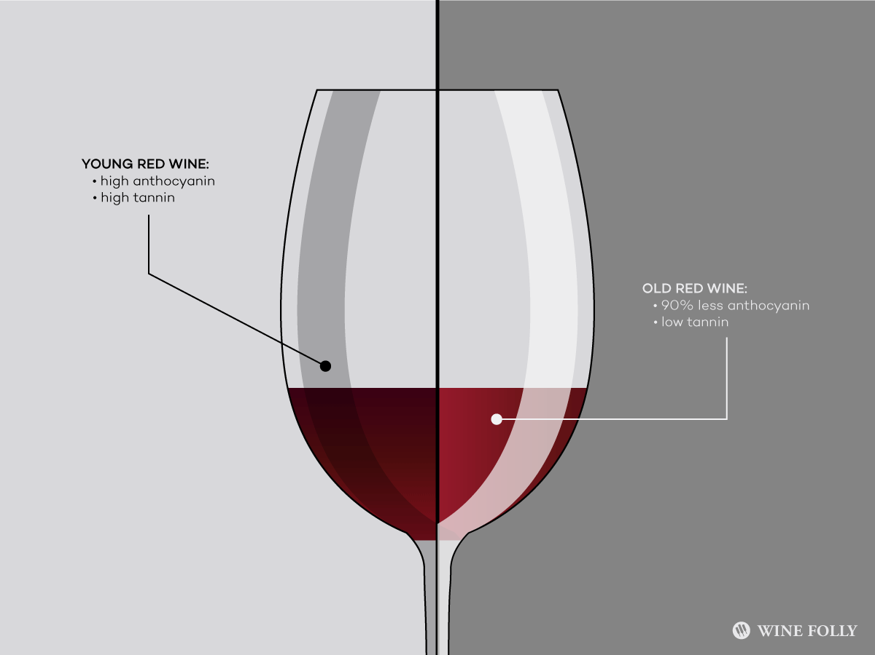
Comparison between
New and Old Wine
 | New Wine | Old Wine
Time | right after fermentation | At least a year after fermentation
Texture | juicy | Viscous and oily
Taste | strong fruit flavor
Smell | no | Aroma
Chemical Reaction | strong | Slightly and slow
Color | Ruby | Tanned leather
Smooth, rounder, gentler and pleasing with little fruit flavor.

Slide 12
Because the old wine taste and smell more pleasing than the new wine, people always say “The old is better.” (Luke 5:39)
Tasting historic wines that have withstood decades, and even centuries, is a transcendent experience.
And no one after drinking old wine wants the new, for they say, ‘The old is better.’” (Luke 5:39)

Slide 13
John 4:13 NIV
Jesus answered, "Everyone who drinks this water will be thirsty again, (Jhn4:13 NIV)
but whoever drinks the water I give him will never thirst. Indeed, the water I give him will become in him a spring of water welling up to eternal life." (Jhn4:14 NIV)

Slide 14
John7:37-38 NIV
On the last and greatest day of the Feast, Jesus stood and said in a loud voice, "If anyone is thirsty, let him come to me and drink. Whoever believes in me, as the Scripture has said, streams of living water will flow from within him.”

Slide 15
What is wineskin?
Now let’s learn
Wineskin is a container to hold wine, similar in shape to today’s military water bottle.
wineskin
military water bottle

Slide 16
What is wineskin made of?
The wineskin is made of animal skin, usually the goat skin.

Slide 17
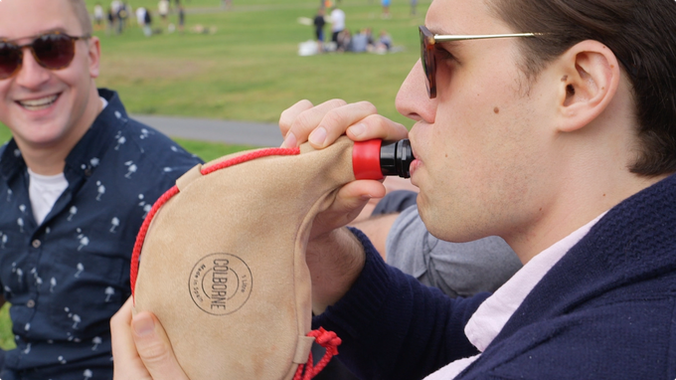
Usage of Wineskin
for wine aging.
Used as carry-on container
for wine or water or juice.

Slide 18
How long does a Wineskin last?
If a wineskin is carefully maintained and properly used, the wineskin can last thousands of years.
However, the stretchability of wineskin will be significantly reduced after certain period of time.

Slide 19



Comparison Between
New and Old Wineskins
# | Specification | New Wineskin (0--30 years old) | Old Wineskin (100 years old)
1 | stretchability
2 | softness
3 | strength
4 | insulation
5 | durability

Slide 20
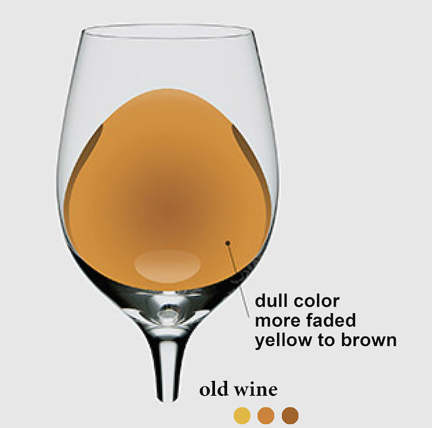


Wine and Wineskin
 | New Wine | Old Wine
New Wineskin
Old Wineskin

Slide 21
Because the new wine has stronger chemical reaction potential, and
Because the old wineskin has less stretchability and softness,
Hence, the new wine will burst the old skins; the wine will run out and the wineskins will be ruined.
New Wine
Old Wineskin

Slide 22


What does the parable mean?
Items | The Parallel (allegories, symbolic) in the Parable
New Wine | The new life after turning to Jesus
Old Wine | The wonderful Christian life – the amazing Grace tastes like the old wine.
New Wineskin | The new life style in Jesus.
Old Wineskin | The previous old sinful life style before turning to Jesus

Slide 23
What does the parable mean?
The new wine represent the new life turning to Jesus.
The new wineskin represents the new life lifestyle after the Repentance.
new wine must be poured into new wineskins
The parable means that those who turned to Jesus have to live out a new life style like Jesus in the world.

Slide 24
What does the parable mean?
The new wine represent the new life turning to Jesus.
The old wineskin represents the previous old lifestyle before turning to Jesus.
no one pours new wine into old wineskins
The parable means that those who turned his life to Jesus cannot live in a old life styles any more.

Slide 25
Jesus said
“No one sews a patch of unshrunk cloth on an old garment, for the patch will pull away from the garment, making the tear worse
(Matthew 22:21)

Slide 26
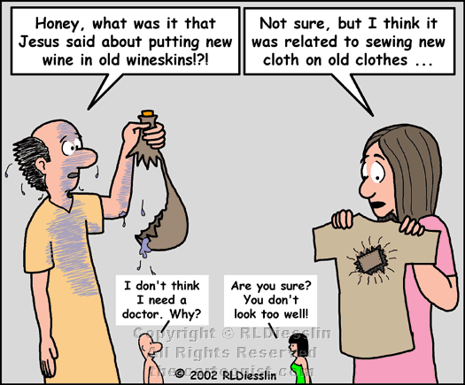

Slide 27
Jesus said
Give to Caesar what is Caesar's, and to God what is God’s. (Matthew 22:21)

Slide 28
Mat 3:8 NIV
Produce fruit in keeping with repentance.

Slide 29
What we learn from the parables of the new wine into the new wineskin?.
A new Christian must live in a new life so that his new heart can match his new behaviors:
Keep attending the Sunday worship.
Keep joining the Bible study fellowship,
Keep praying to God,
Keep following Jesus Great Commission to preach the Gospel all over the world.

Slide 30
What we learn from the parables of the new wine into the new wineskin?.
Christian’s life does not belong to the world but belongs to Christ.
Christians must live in Christ’s style.

Slide 31
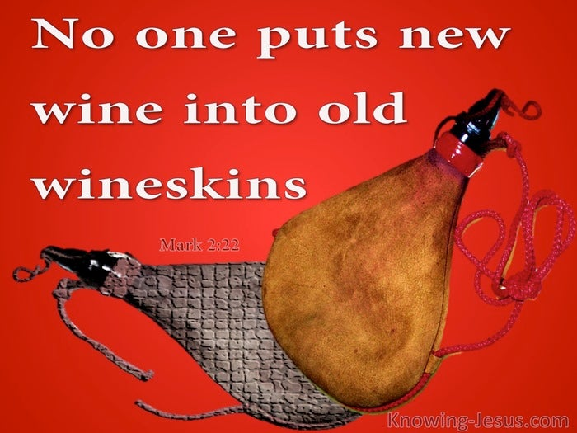
What we learn from the parables of the new wine into new wineskin?
Those who have accept Jesus as savior cannot live in a old life style of the world:
Don’t be over selfish.
Don’t be heartless,
Don’t be cold-blooded,
Don’t be unsympathetic,
Don’t be obsessed in bad habits (like video games)
Don’t follow the course of the world.

Slide 32
Let us pray
Dear Heavenly Father,
Thank you for choosing us to be your children because of Jesus. We love you; we belong to you.
We confess that we are sinners; we are easily attracted and persuaded in the world. We ask you not to lead us into temptation, but deliver us from the evil one. May you lead us to produce fruits in keeping with our repentance, to live out the new life style that you wanted us.
The Kingdom, the Power and the Glory are yours.
Pray in name of Jesus, Amen.

Slide 33
New Wine vs Old Wine
New wine: is the liquor after the fermentation of grape juice for 21 days.
Old wine: is the wine after the new wine stored in jars for at least one year.
Once age allows fruit flavors to subside, a magical new world of flavor opens up.
Tasting historic wines that have withstood decades, and even centuries, is a transcendent experience.
Wine tastes better with age because of a complex chemical reaction occurring among sugars, acids and substances known as phenolic compounds. In time, this chemical reaction can affect the taste of wine in a way that gives it a pleasing flavor. The chemical reaction can also change the color and aroma of the spirit, in addition to altering the way the wine feels in the mouth. Examples of wines with high phenol levels are Cabernet Sauvignon, Nebbiolo and Syrah.
Remember that the new wine will keep chemical reaction slowly only after for about one year.

