Slide 1
Today’s Message
04-27-2022
Message
The Parable of the Strong Man
Scripture
Matthew 12:29
Mark 3:22-30
web_ppt_link editable_link (download)

Slide 2

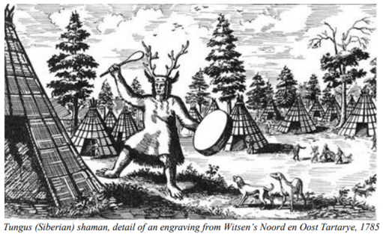
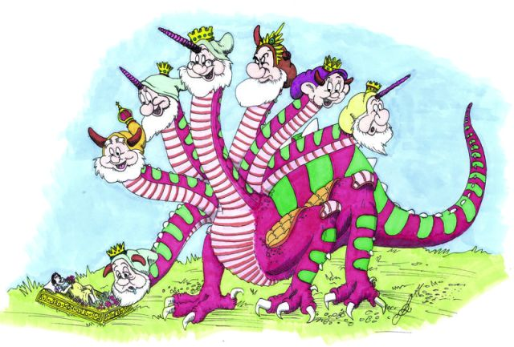
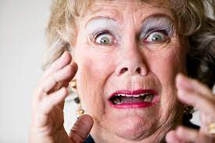
Demon and occult are real in our life.
They are not fun but dangerous and scaring.

Slide 3
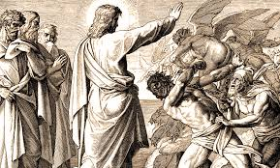
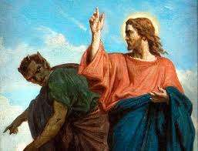
The Good News is Jesus is stronger than demons.

Slide 4
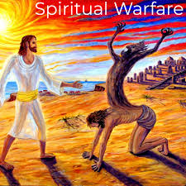
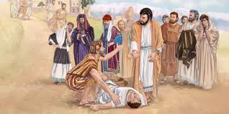
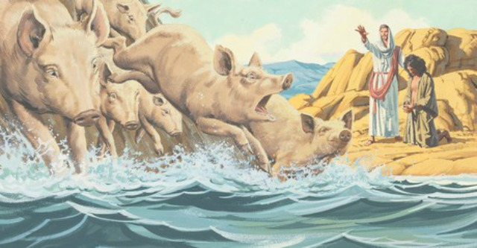
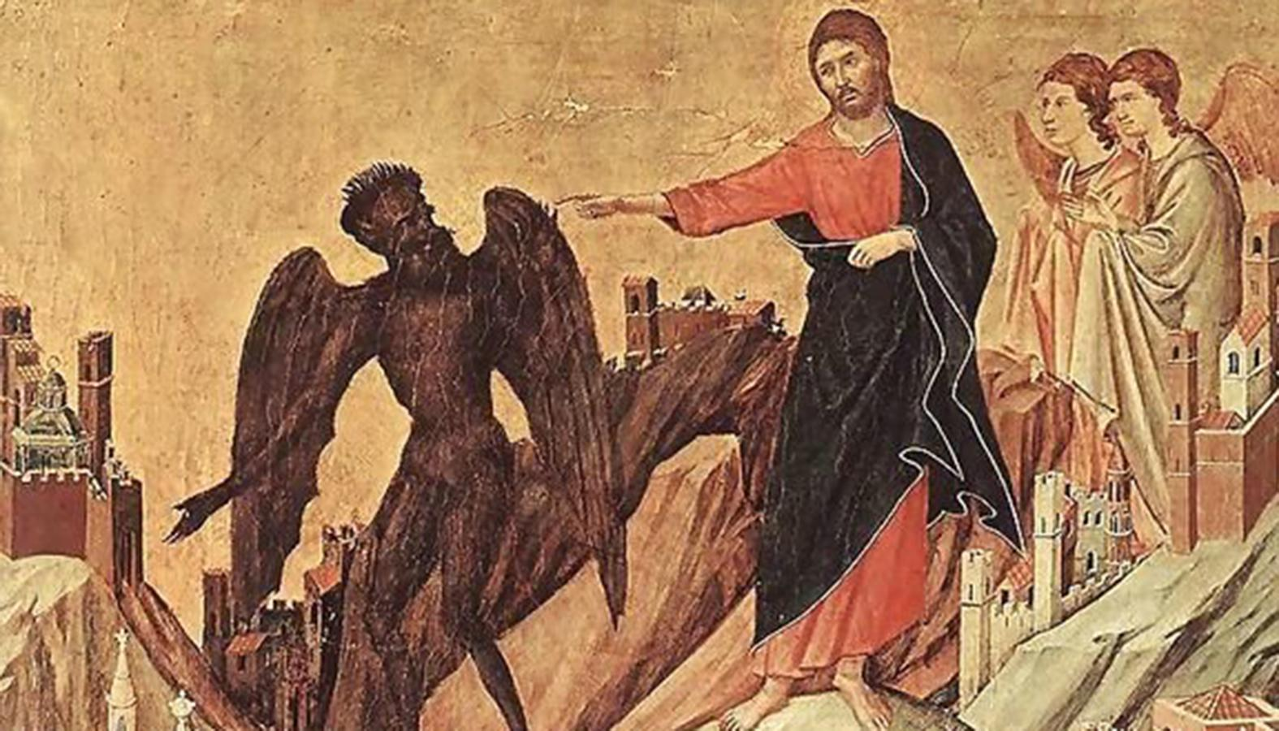
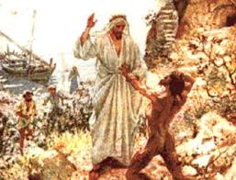
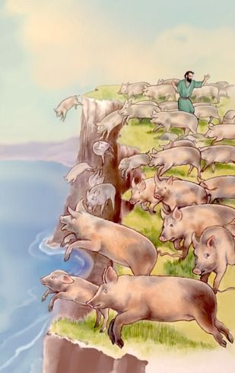
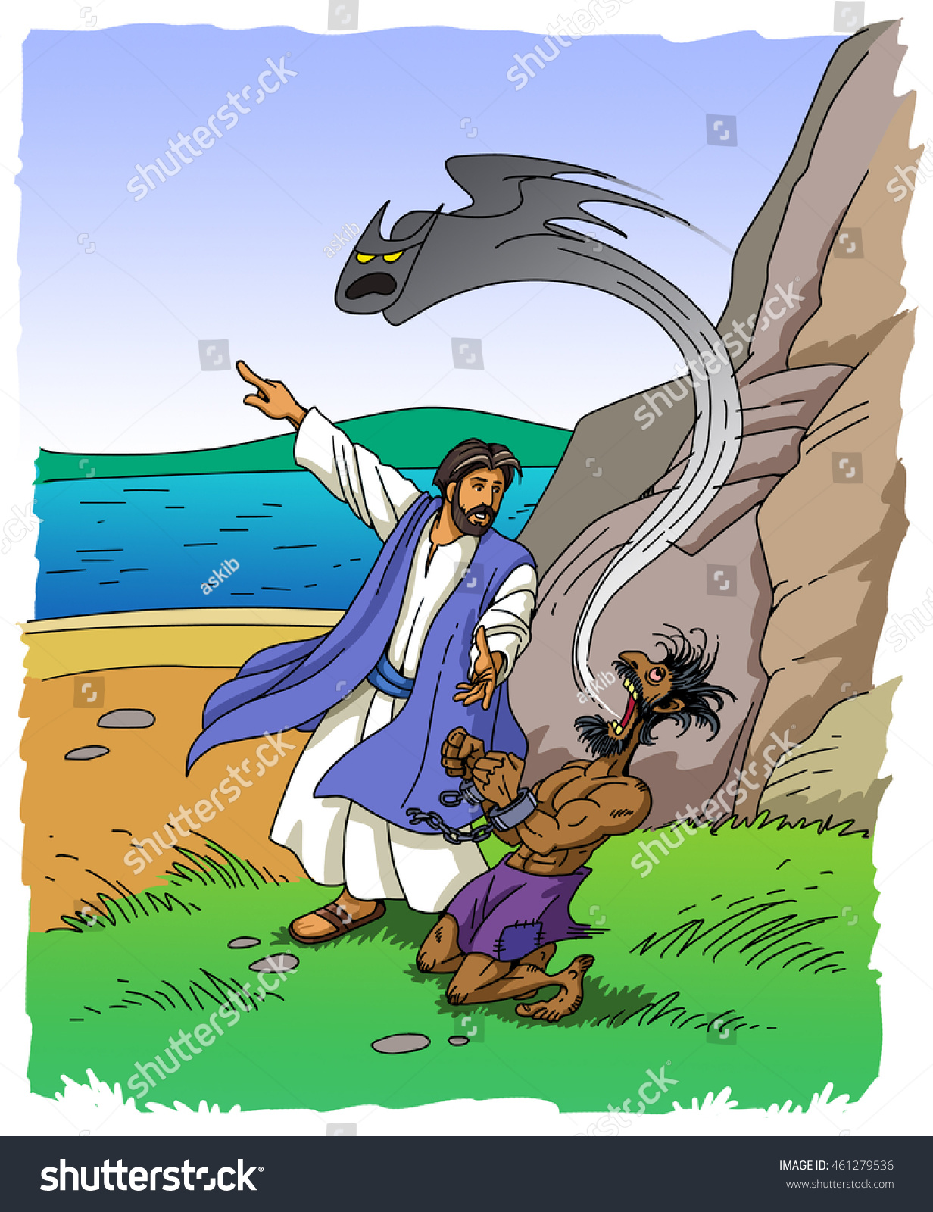
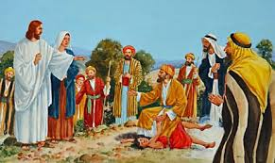
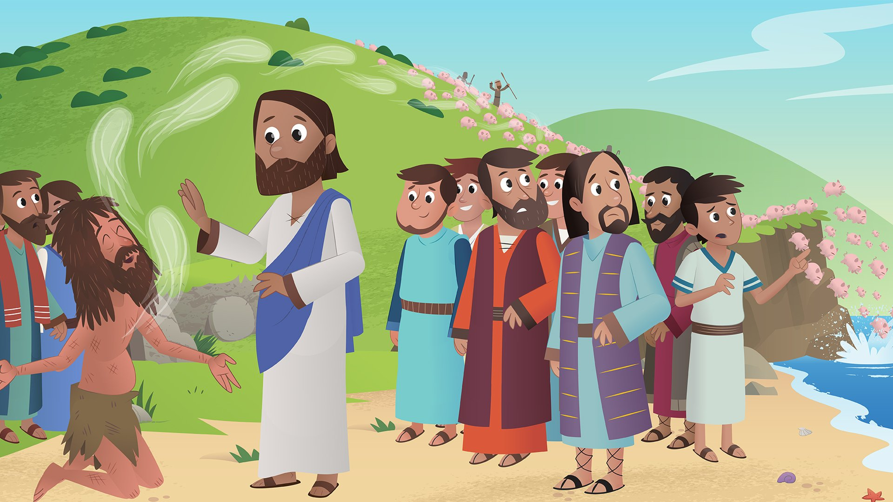
In the Gospels, Jesus casted out various demons at least ten times.

Slide 5
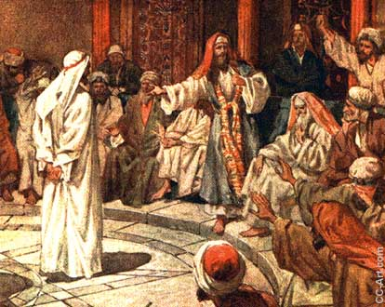
But the Pharisees and the teachers of the law in Jerusalen accused Jesus that he was possessed by demons, and he had an impure spirit.

Slide 6
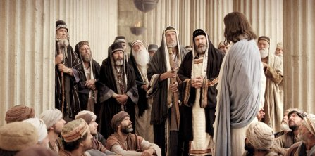
Mark 3:22-30
22 And the teachers of the law who came down from Jerusalem said,
He is possessed by Beelzebul! By the prince of demons he is driving out demons.”

Slide 7
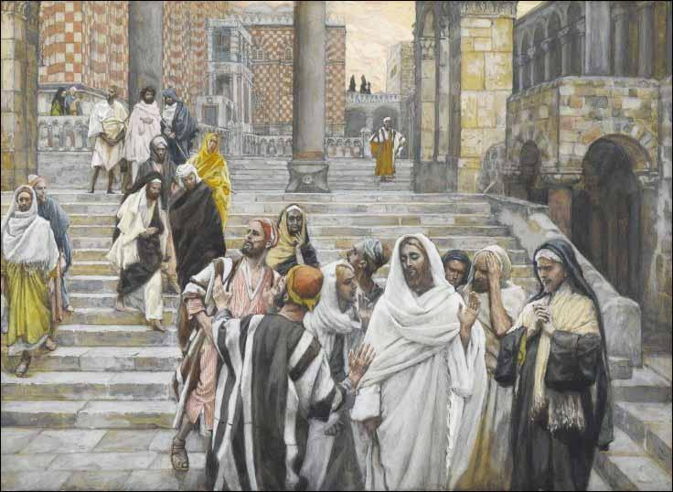
23 So Jesus called them over to him and began to speak to them in parables:

Slide 8
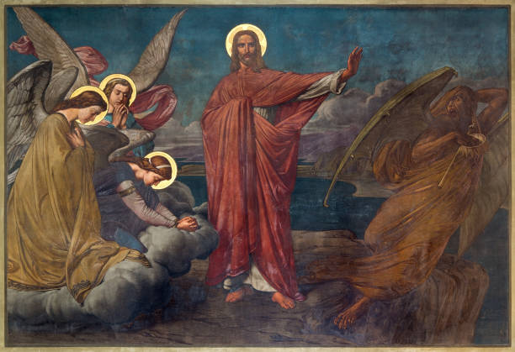
“How can Satan drive out Satan?

Slide 9
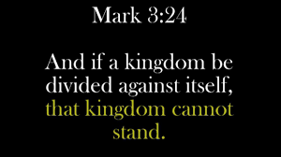

24. a kingdom is divided against itself, that kingdom cannot stand.

Slide 10
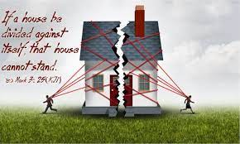
25 If a house is divided against itself, that house cannot stand.

Slide 11
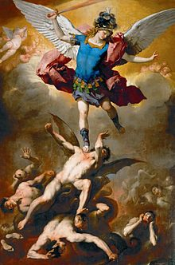
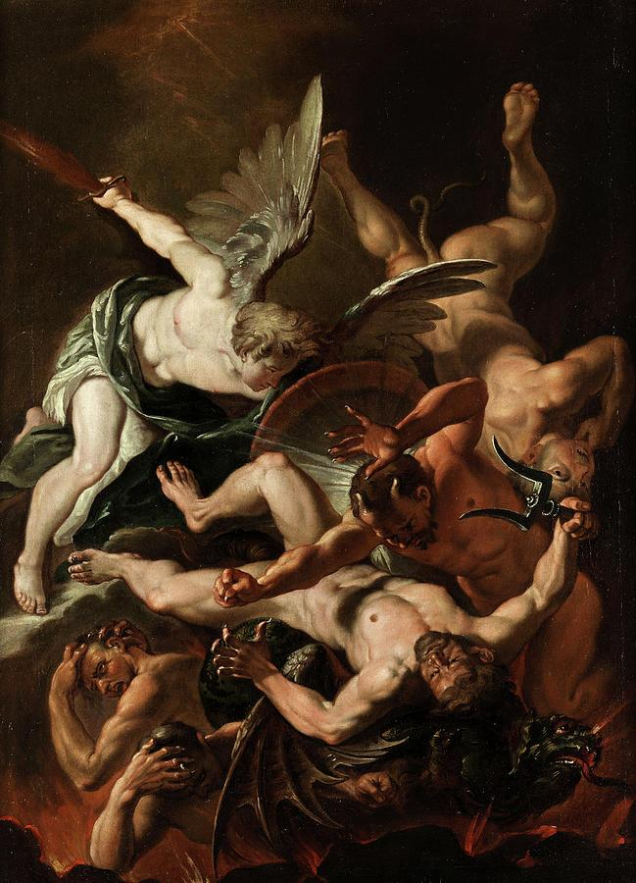
26 And if Satan opposes himself and is divided, he cannot stand; his end has come.

Slide 12
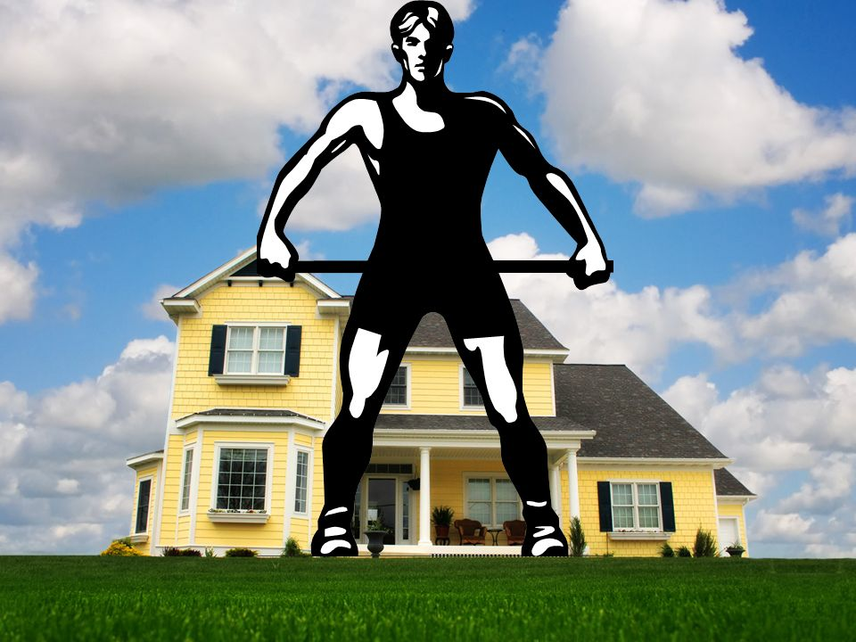

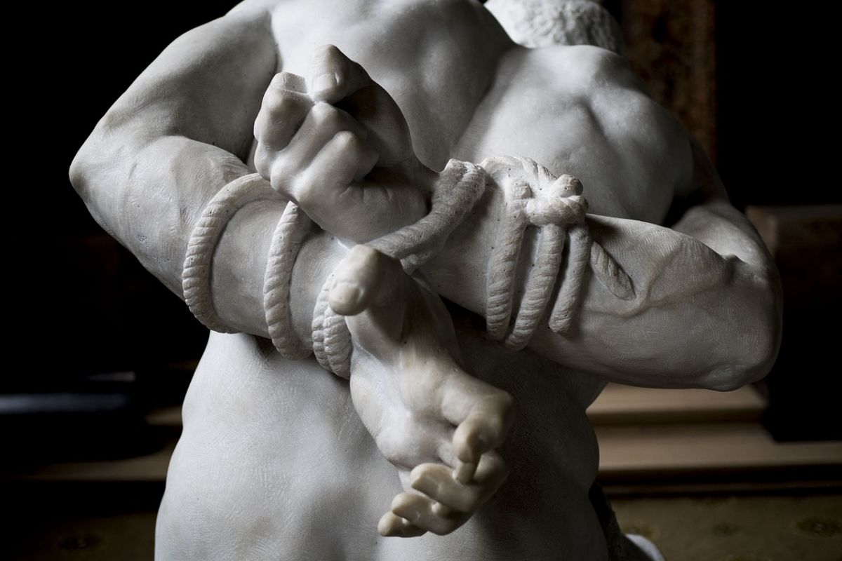
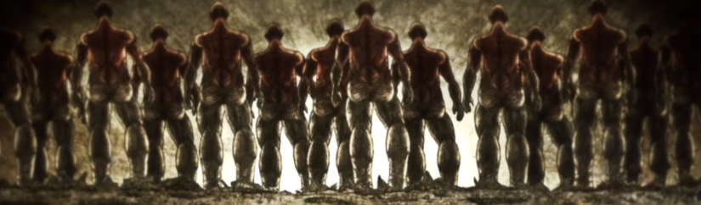
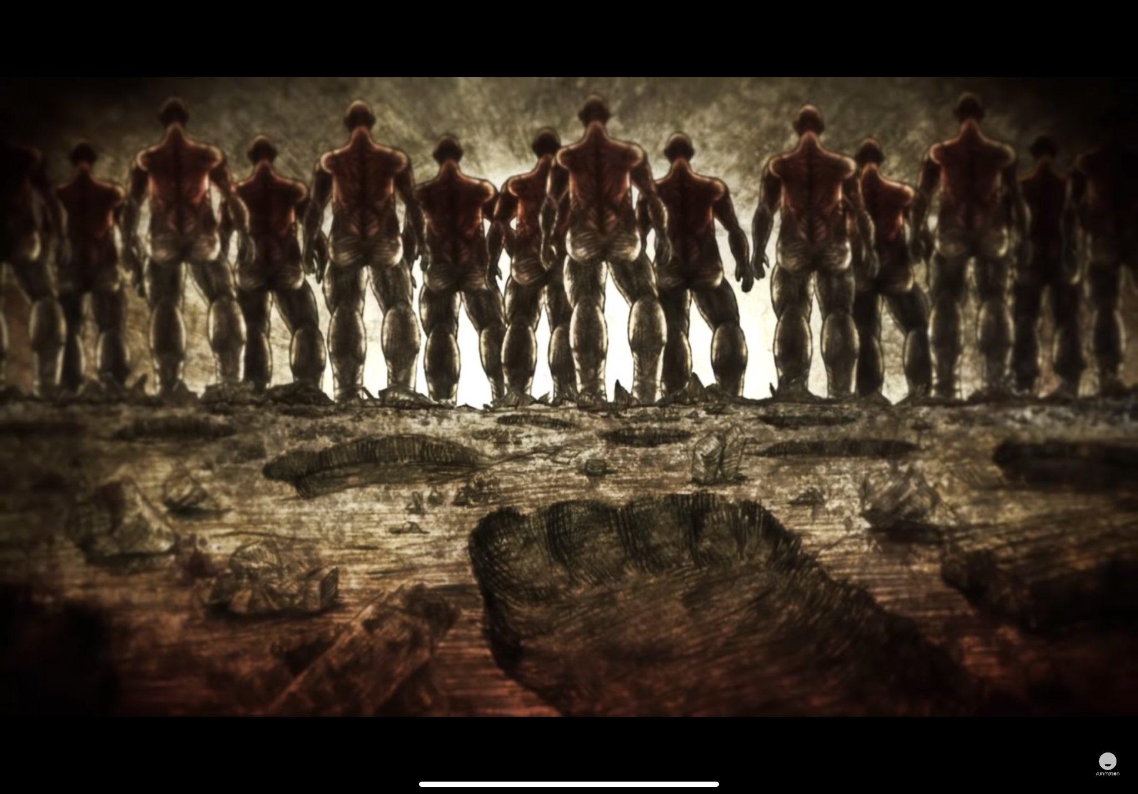
27 In fact, no one can enter a strong man’s house without first tying him up.

Slide 13
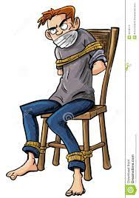
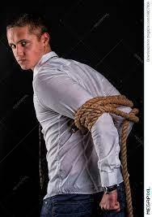
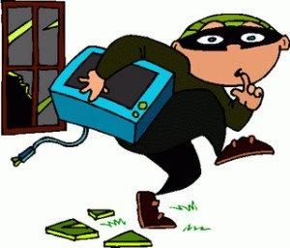


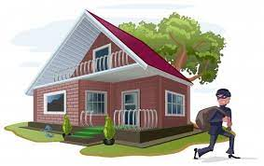
27 Then he can plunder the strong man’s house.

Slide 14
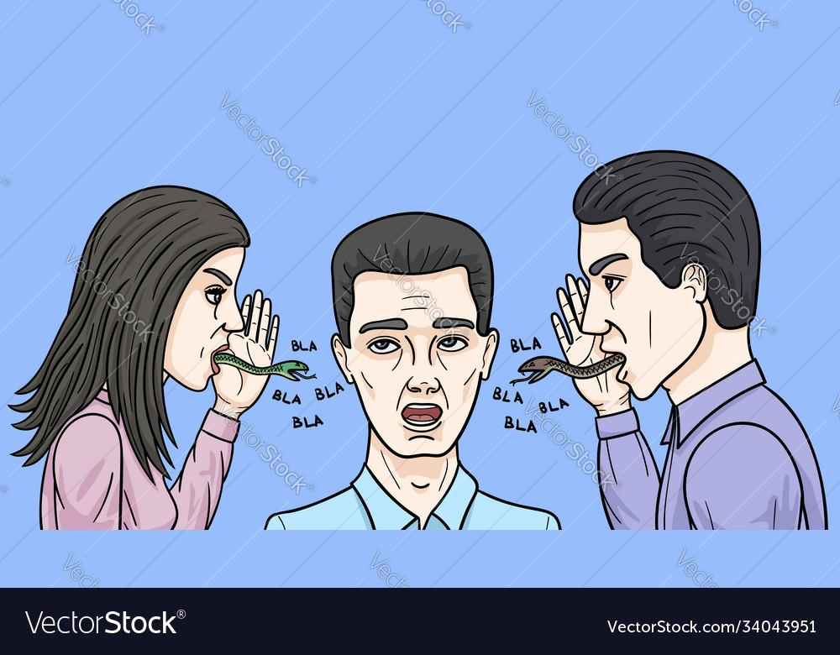

28 Truly I tell you, people can be forgiven all their sins and every slander they utter,

Slide 15
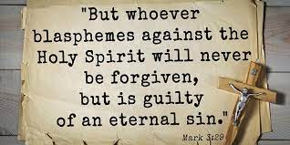
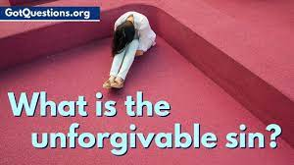
29 but whoever blasphemes against the Holy Spirit will never be forgiven; they are guilty of an eternal sin.”

Slide 16
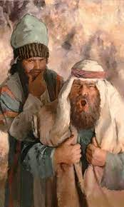
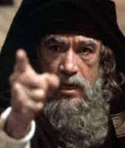
30 He said this because they were saying, “He has an impure spirit.”

Slide 17
Let us pray
Dear Heavenly Father,
May your Kingdom come on earth as it in heaven. Do not lead us into temptation, but deliver us from the evil one. Thank you for your providence that is more than what we wanted and desired. We love you and we want to follow you.
We ask you to forgive our sin our greedy.May your holy spirit fill us to love neighbors as you love us, especially be generous for those who are in poverty.
May your Kingdom come and your name be glorified. Pray in name of Jesus, Amen

Slide 18
End

Slide 19


