Slide 1

The Ones Who Stay
Some Promises Cost Everything
Written by: William Kapadia

Slide 2
Logline
A high school football star forms an unlikely bond with the terminally ill girl living across from him. When her life hangs in the balance, he must choose between the future he's spent years chasing and the girl he can't bear to lose.

Slide 3
Why this story matters
It challenges what success really means.
When faced with the possibility of losing someone he loves, Noah begins questioning whether achievement matters more than connection.
It gives a voice to lives often overlooked.
Ava's story explores chronic illness, isolation, and the desire to be seen as more than a diagnosis.
It explores the hidden struggles people carry.
Not every battle is visible.
It celebrates the people who stay.
At its core, the film is about choosing presence over convenience, love over certainty, and people over expectations.

Slide 4
The Window
Every Night at 8:30
Two Bedrooms
Two Lives
One Connection

Slide 5
Synopsis
After moving to a new neighborhood, Noah noticed Ava, the chronically ill girl next door. Through their facing bedroom windows, an unexpected friendship begins.
What started as exchanged notes and late-night conversations grows into something deeper. As Ava’s health declines, Noah finds himself questioning the future he’s spent years working for.
When Ava’s life is slipping, Noah makes a choice that could cost him everything.

Slide 6
At its core, The Ones Who Stay explores:
What really makes life meaningful?
What is a person willing to sacrifice for love?
Why do some people stay when others leave?

Slide 7



Tone & Feel

Slide 8

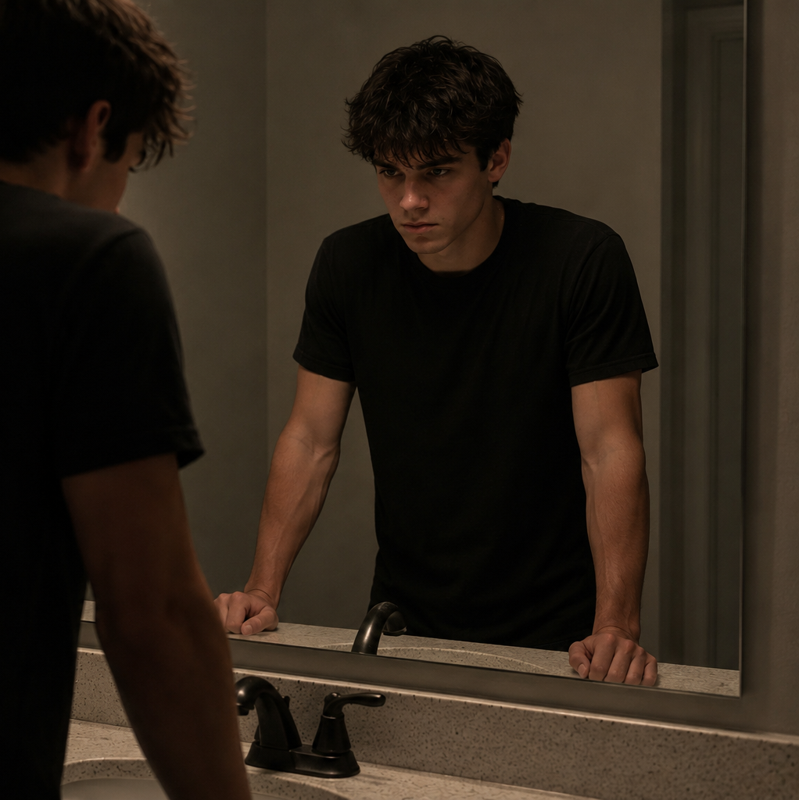

Noah Carter
A gifted athlete forced to choose between the future he’s worked for and the girl he loves.

Slide 9


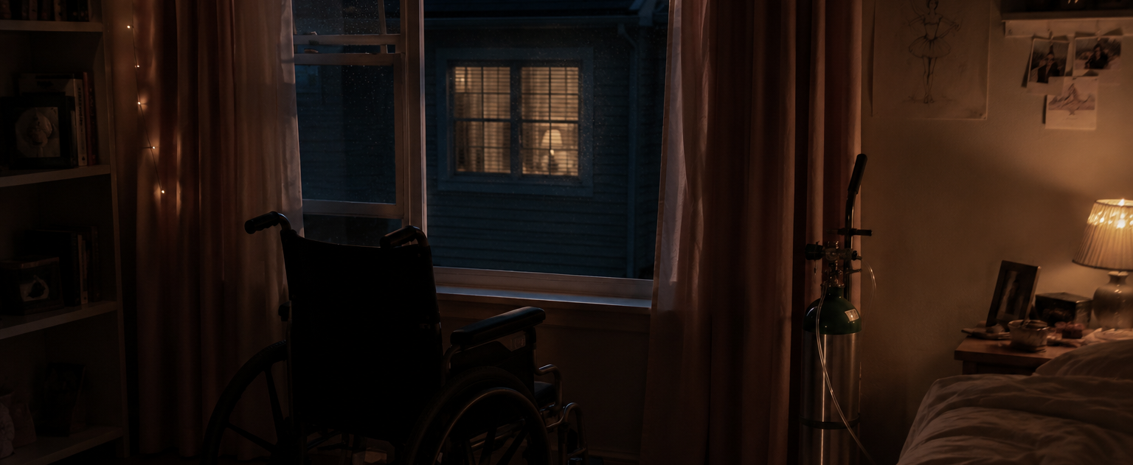
Ava Bennett
A seventeen-year-old girl who is determined to make the most of her life, knowing time may not be on her side.

Slide 10
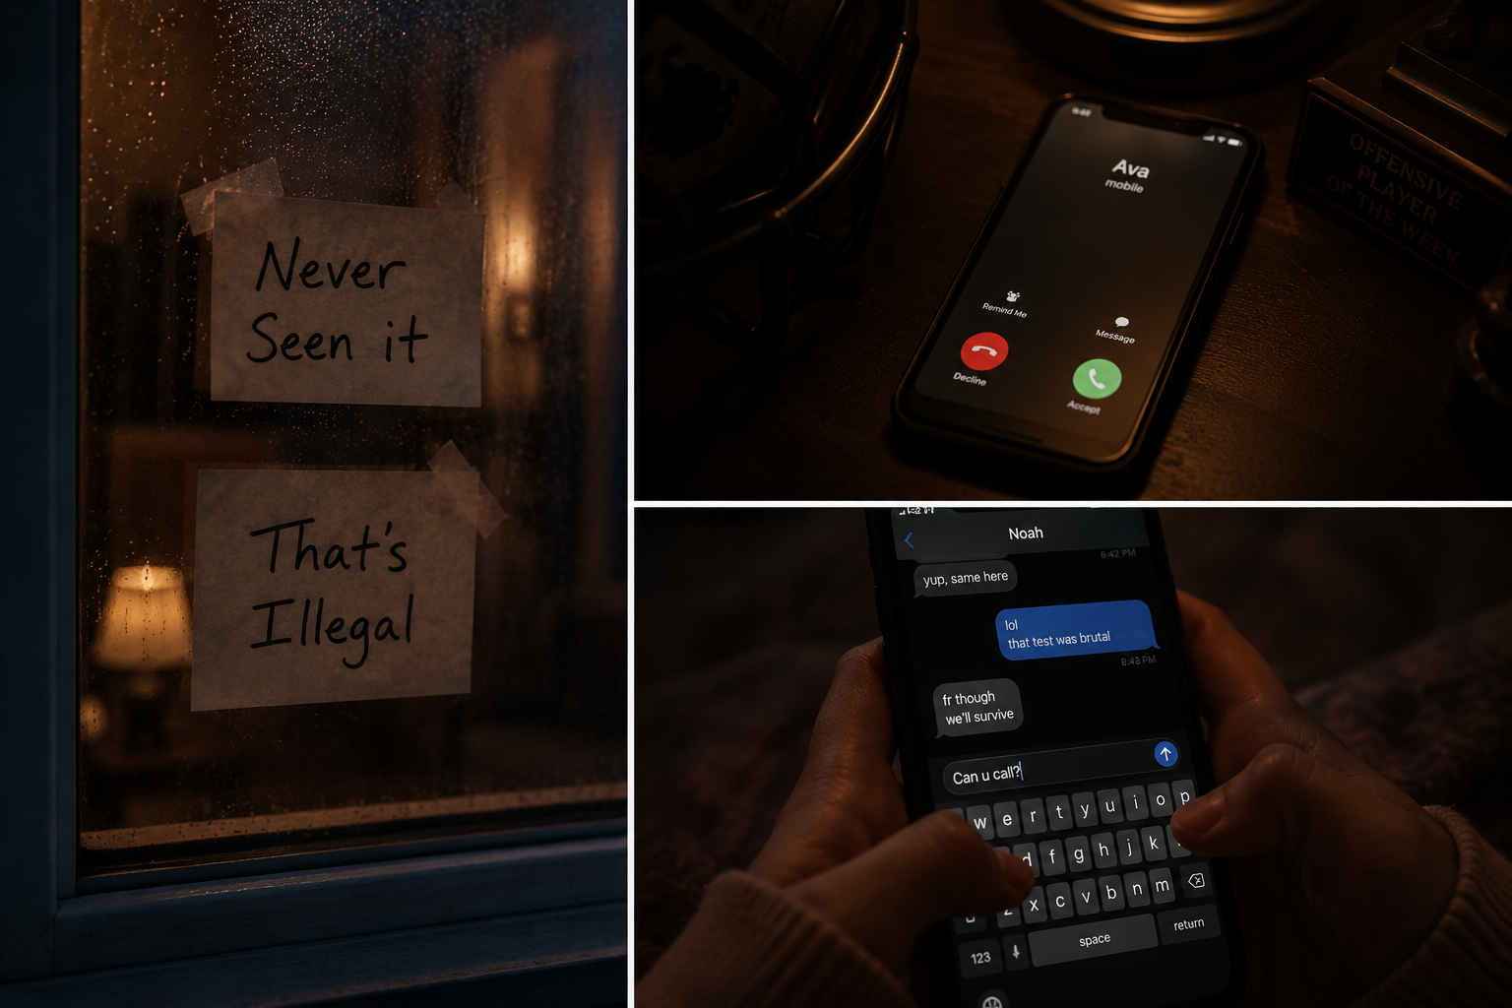
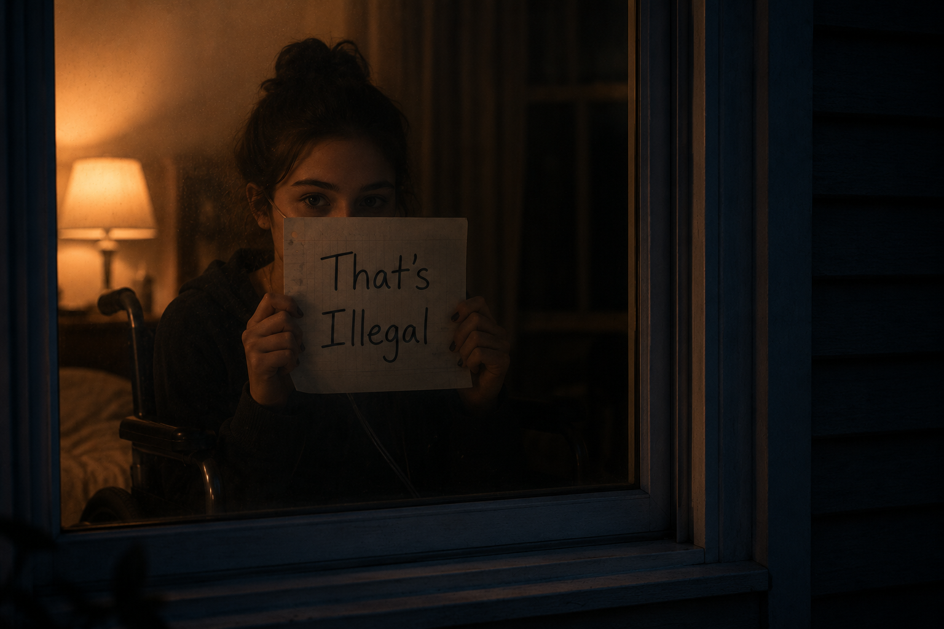
Noah and Ava
Their relationship begins with a wave through a window.
It grows through Notes held up to their windows and late-night phone calls.
Over time, friendship brings trust, and that becomes love.

Slide 11
Why Actors Respond To These Roles
NOAH
Athletic
Vulnerable
Romantic Lead
Emotional Transformation
AVA
Funny
Intelligent
Strong-willed
Emotionally Demanding Role

Slide 12
Production Overview
Format: Feature Film
Genre: Drama/Romance
Main Locations:
Residential Neighborhood
High School
Hospital
Production Advantages:
Character-driven
Contained locations
Strong roles for young actors
Emotionally marketable concept

Slide 13



Target Audience / Comparables
Target audience
Teens / Young Adults
Comparables
The Fault in Our Stars
Five Feet Apart
A Walk to Remember

Slide 14


William’s Role
Writer
Co-Producer

Slide 15
“I told her I wasn’t leaving.”

Slide 16
The Ones Who Stay A story about choosing to stay when everything tells you to leave. William Kapadia (864) 978-5651 william.d.kapadia@icloud.com

