Slide 1
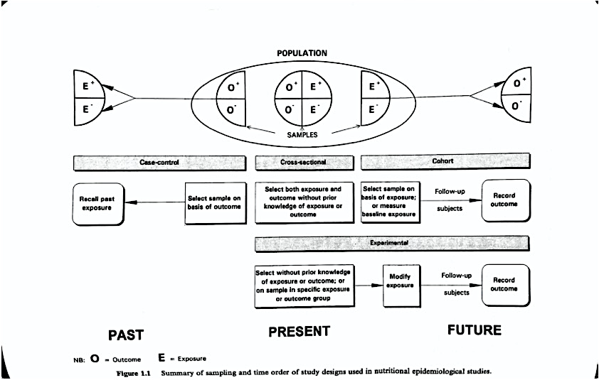

Slide 2
POPULATION
E⁺
O⁺
O⁺
E⁺
E⁺
O⁺
E⁻
O⁻
O⁻
E⁻
E⁻
O⁻
SAMPLES
Case-Control
Cross-sectional
Cohort
Recall past exposure
Select sample on basis of outcome
Select both exposure and outcome without prior knowledge of exposure or outcome
Select sample on basis of exposure; or measure baseline exposure
Follow-up
Record outcome
subjects
Experimental
Select without prior knowledge of exposure or outcome; or on sample in specific exposure or outcome group
Modify exposure
Follow-up
Record outcome
O = Outcome
E = Exposure
subjects
PAST
PRESENT
FUTURE

