Slide 1
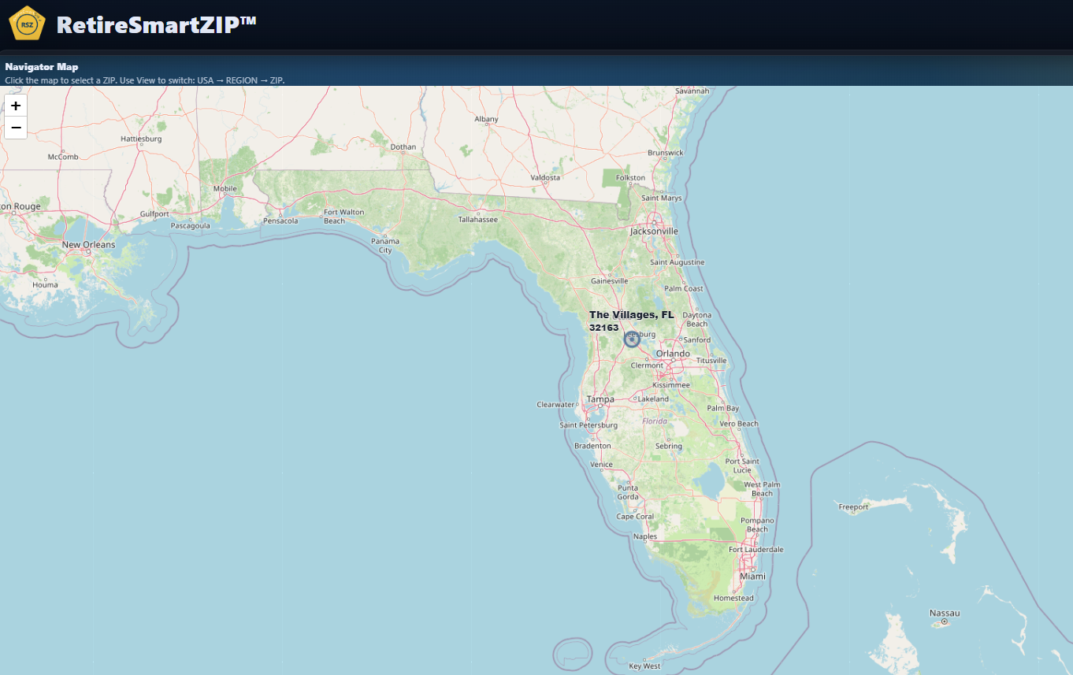
The Villages is one retirement region…
…but not one retirement experience.
RetireSmartZIP™

Slide 2
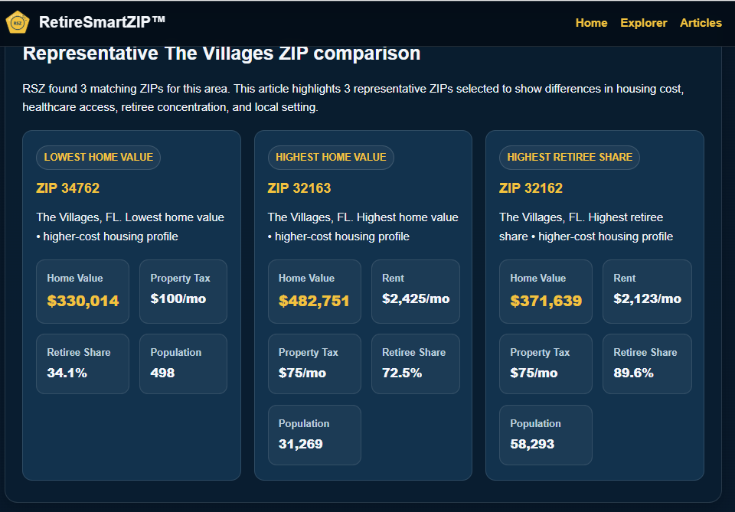
Nearby ZIPs can create very different retirement outcomes.
$330k vs $482k home values • 34% vs 89% retiree share
RetireSmartZIP™

Slide 3
A city can start the search.
A ZIP code is where retirement becomes real.
RetireSmartZIP.com/articles
RetireSmartZIP™

