Slide 1
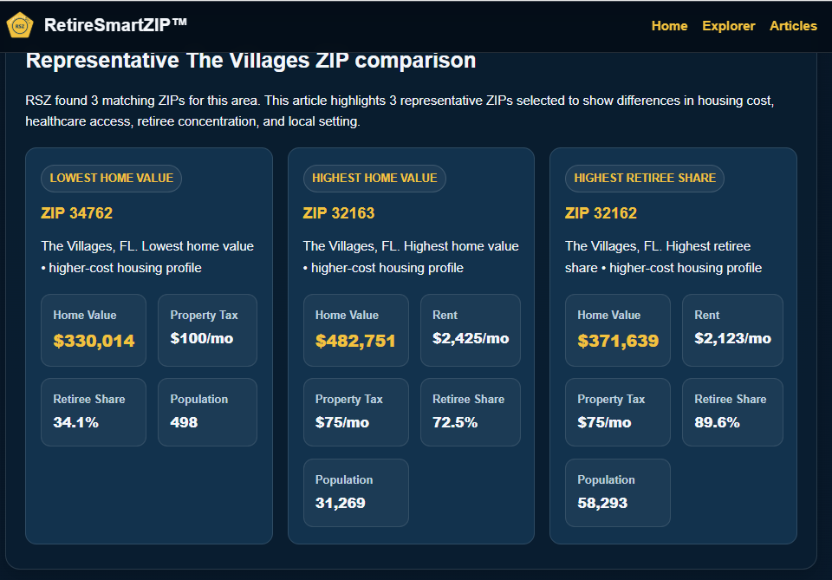
Nearby ZIPs can create very different retirement outcomes.
$330k vs $482k home values • 34% vs 89% retiree share
RetireSmartZIP™

