Slide 1
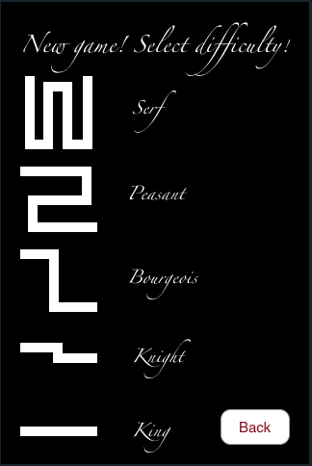
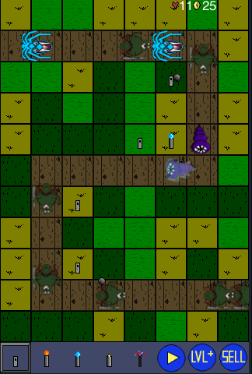
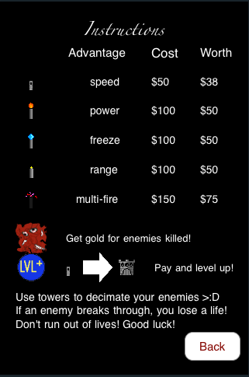
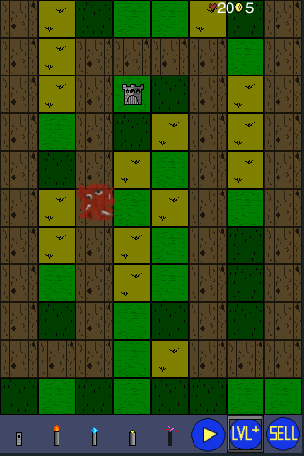
Defend Thy Kingdom!
A tower defense game brought to you by Jonathan Tilley and Yizhong Wei
Features:
5 path difficulty levels
10 waves of enemies
4 types of enemies
5 specialized types of towers
3 levels of tower upgrades
Hours of addicting fun!

