Slide 1
Fruit Prediction with Deep Learning
Springboard Machine Learning Career Track (May 2021) - Capstone Project
Deming Wang
2021/11/22

Slide 2
Agenda
About Me
Motivation
Model Setup
Training
Deployment with web app
Source code @ Github
Summary

Slide 3
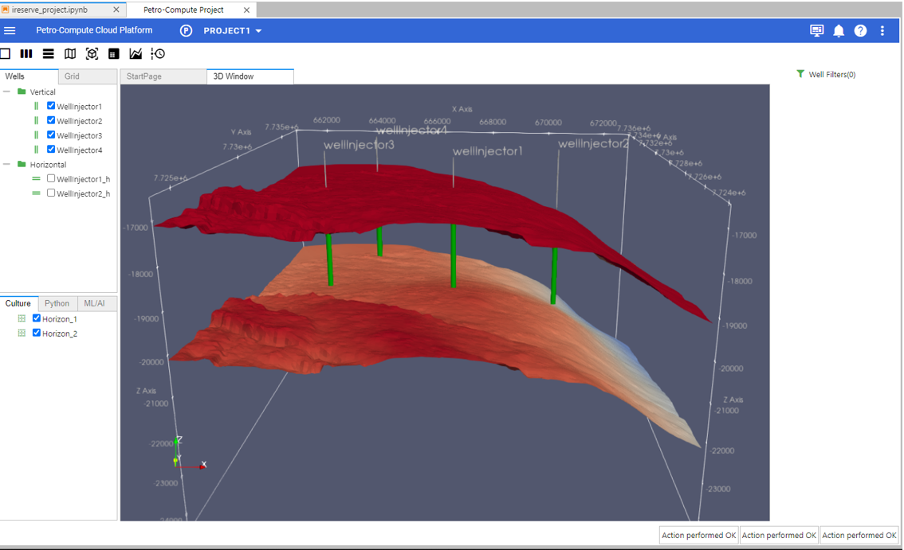
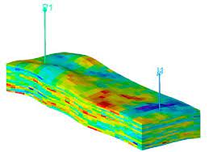
About Me
Deming Wang
Senior Petroleum Engineer/Software Engineer in Oil/Gas in dustry
Aramco Americas, Schlumberger, Subsurface Modeling, Seismo Electrics
Reservoir Simulation
CO2 sequestration
Software development
Linkedin: https://www.linkedin.com/in/deming-wang-16011611/

Slide 4
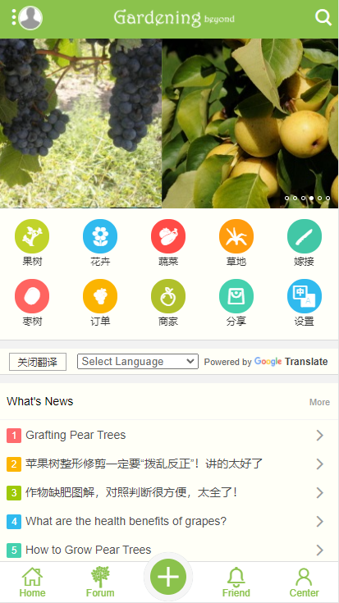
Motivation
fruit recognition for gardening community website gardeningbeyond.com
Identify user’s favorite fruit tree
Provide input for future recommended system
Potential application for oil/gas industry: fault detection, borehole breakouts detection

Slide 5
Model Setup
Split dataset to Train/Validation/Test
Group fruits into 36 folders and create labels from folder names
Normalize the image pixel values (divided by 255)
Build model architecture (Sequential)
Run model
Monitor accuracy and loss
Tunning and finalize parameters(epochs, learning rate, drop rate)

Slide 6
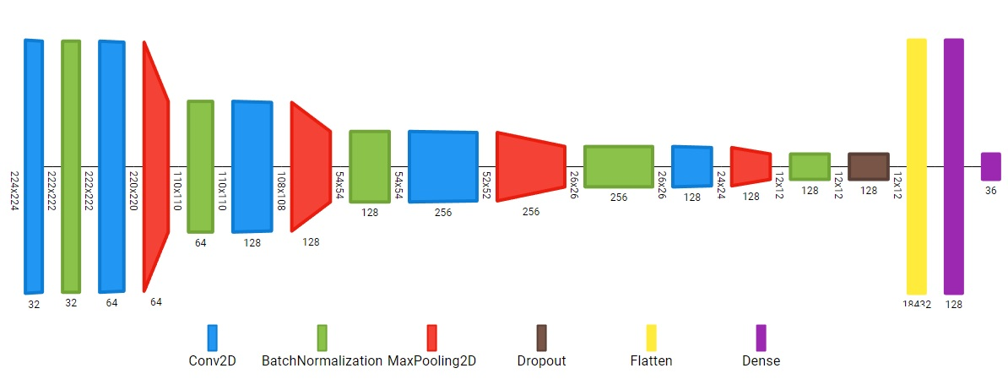

Slide 7
Training

Slide 8
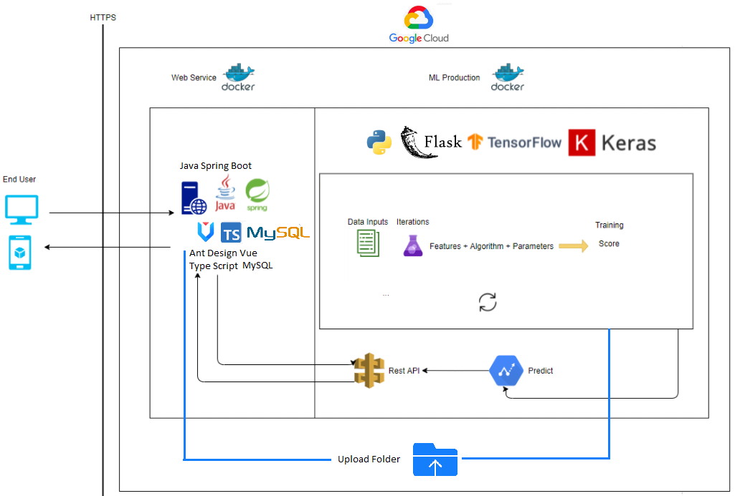
Deployment with web app

Slide 9
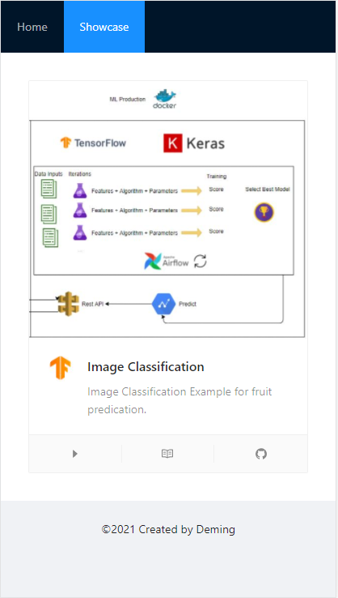
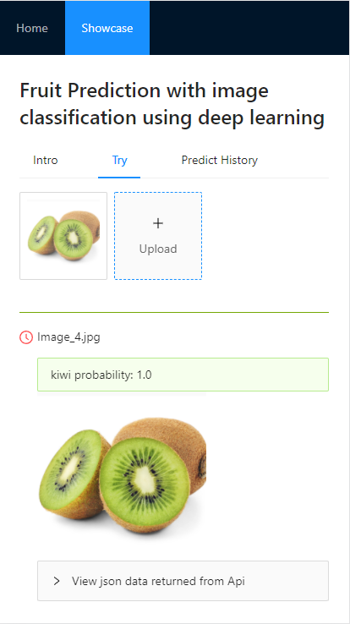
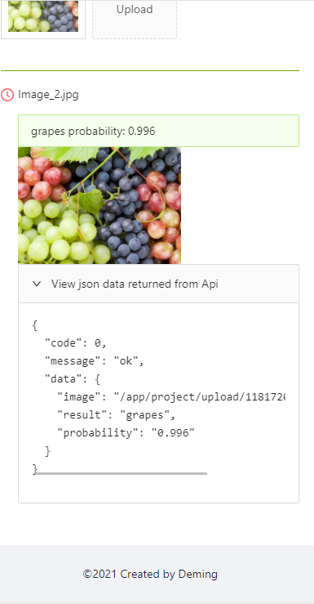
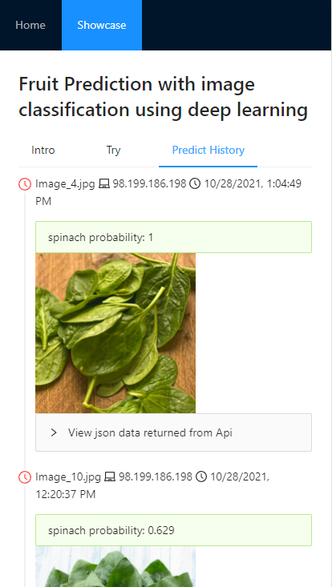

Slide 10
Source code @ github
Capstone_project_fruit_prediction:
https://github.com/wdmhouston/capstone_project_fruit_prediction
Capstone_project_project_blogapp:
https://github.com/wdmhouston/capstone_project_blogapp
Online document:
https://sc24613.readthedocs.io/en/main/

Slide 11
Summary
Model works as expected
Web app and prediction api makes it easy to use with friendly interface
It can be applied for my future work
Future work: expand dataset, use pre-trained model

