Slide 1
CONSTRUCTION PROJECT
CPMS
MANAGEMENT SYSTEM
Construction Project Management System
Oracle Database Solution for Resource Auditing
Site Logistics & Business Intelligence
University of Lay Adventists of Kigali (UNILAK) Faculty of Computing and Information Sciences DPR400210 - Database Programming (Capstone Project) MOHANAD MIRGHANI ALI | ID: 32407 Schema: CONSTRUCTION_32407 Instructor: Eric Maniraguha | 2025-2026

Slide 2
PROBLEM STATEMENT & OBJECTIVES
THE PROBLEM
OBJECTIVES
Construction firms suffer from operational bottlenecks, resource double-allocation, and financial tracking errors due to fragmented, manual administrative workflows.
1. Centralize operations mapping site tasks to contracts 2. Enforce validations preventing budget overruns 3. Guarantee data preservation via automated triggers 4. Provide real-time BI through Power BI dashboard
TARGET USERS
EXPECTED BENEFITS
Project Managers / Site Engineers / Accountants
3NF Normalization / Real-time Reporting / Audit Trails

Slide 3
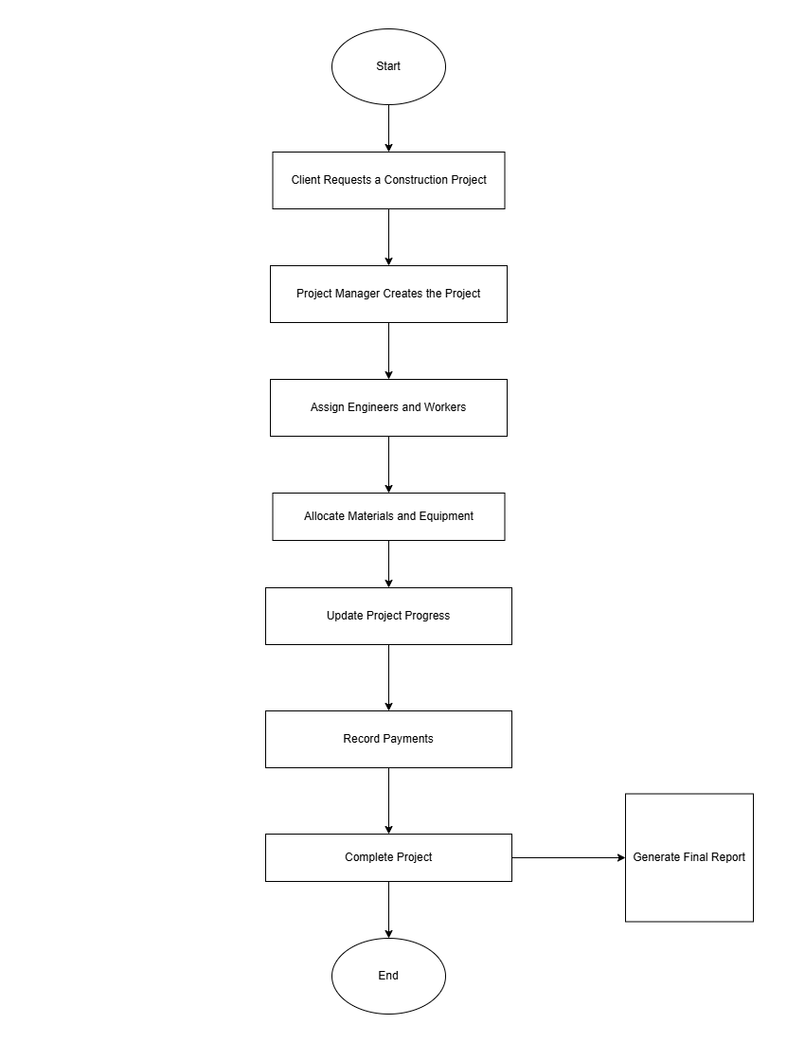
BUSINESS PROCESS MODELING
WORKFLOW
Full lifecycle: contract signing, engineer/worker deployment, material procurement, equipment allocation, milestone payments, project completion.
PROCESS SCOPE
Multi-swimlane: Client, Project Manager, Site Engineer, Accountant

Slide 4
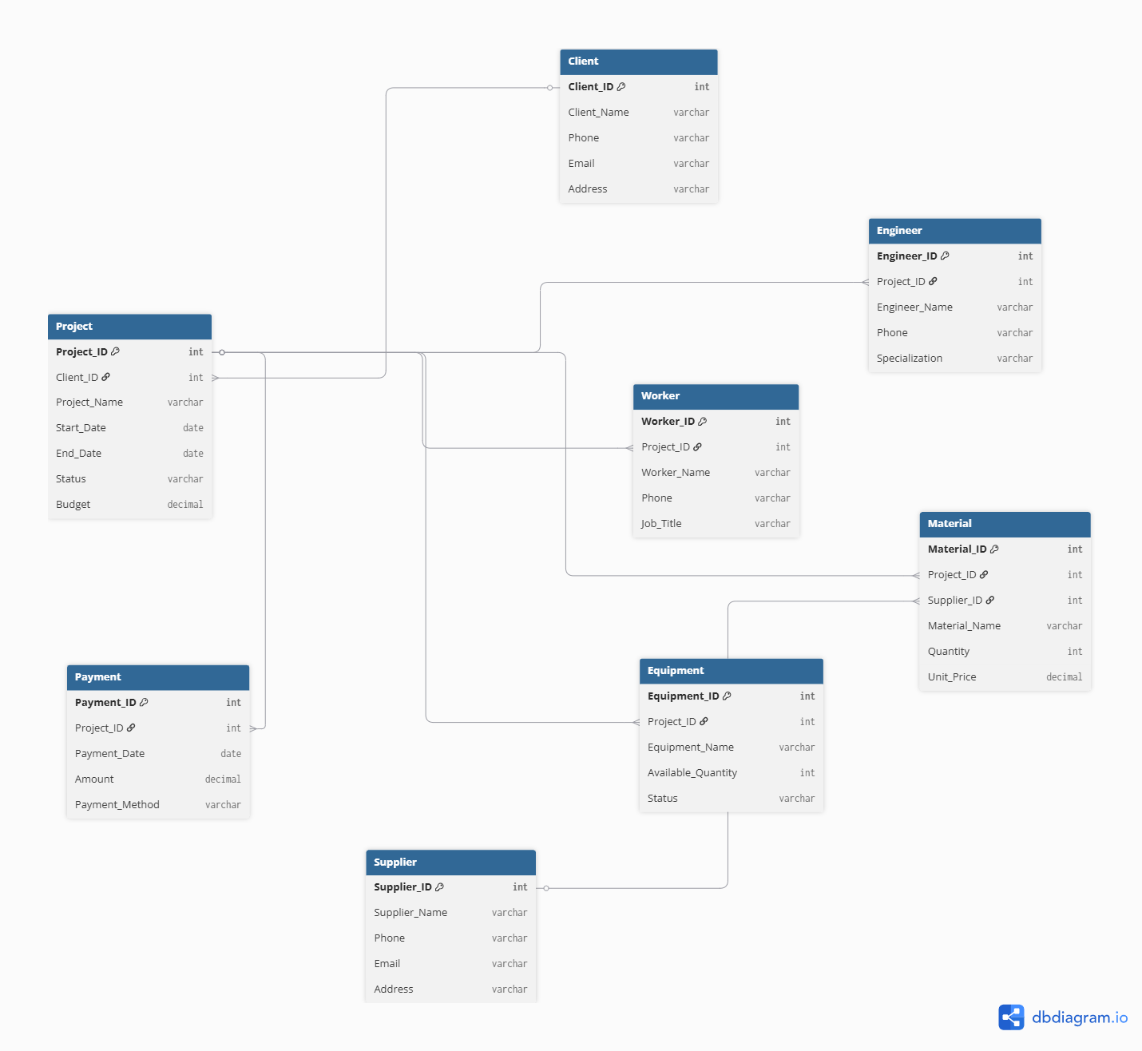
DATABASE ARCHITECTURE
ENTITIES
Client (PK) Project (PK, FK) Engineer (PK, FK) Worker (PK, FK) Supplier (PK) Material (PK, 2 FK) Equipment (PK, FK) Payment (PK, FK) Public_Holidays Audit_Log

Slide 5
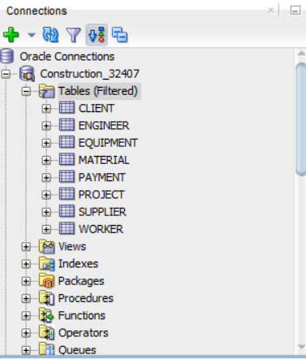
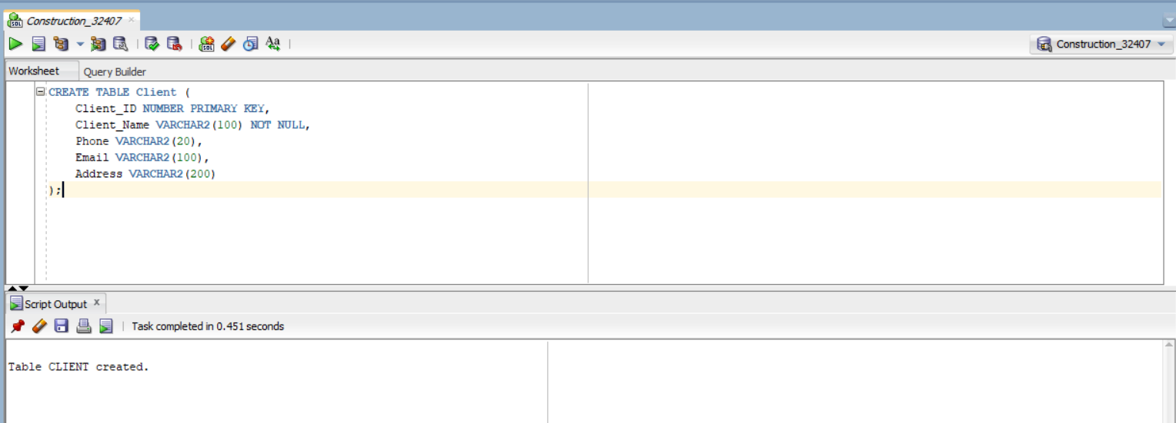
DATABASE IMPLEMENTATION
SCHEMA & TABLES
CONSTRUCTION_32407 with 10 tables, 7 FOREIGN KEY constraints enforcing referential integrity.
10 TABLES CREATED
Client -> Project -> Engineer Worker -> Supplier -> Material Equipment -> Payment Public_Holidays -> Audit_Log All with PRIMARY KEY, FOREIGN KEY, NOT NULL, and UNIQUE constraints.

Slide 6
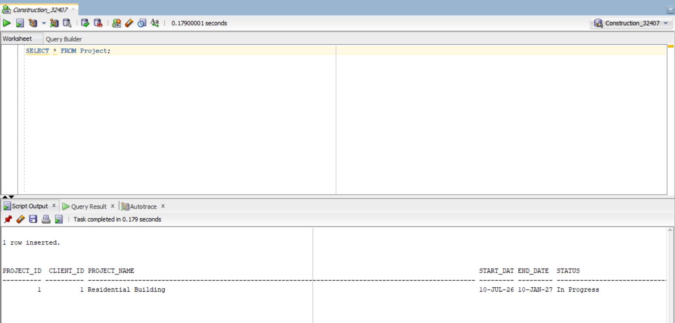
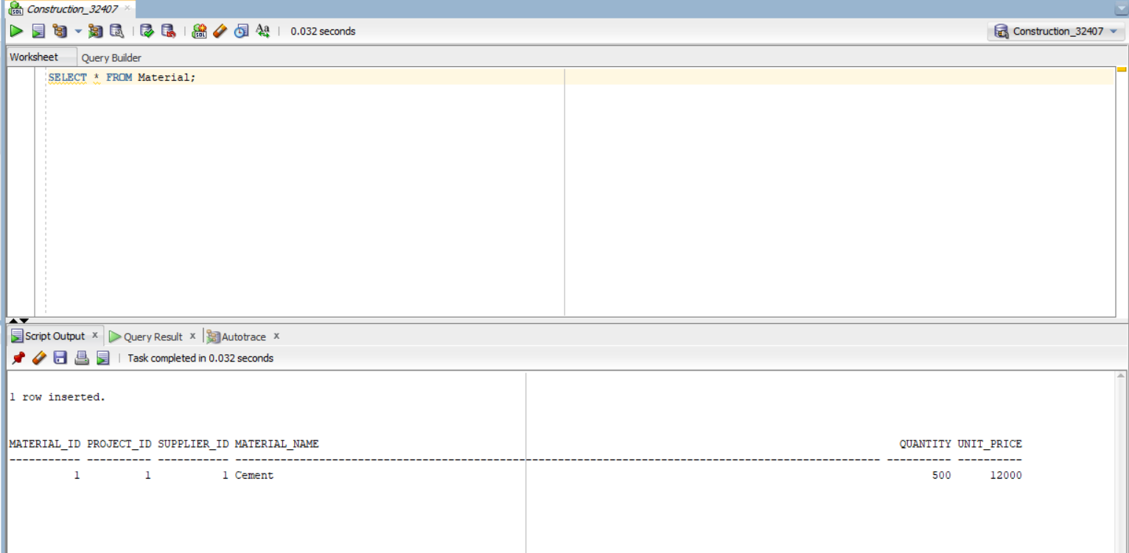
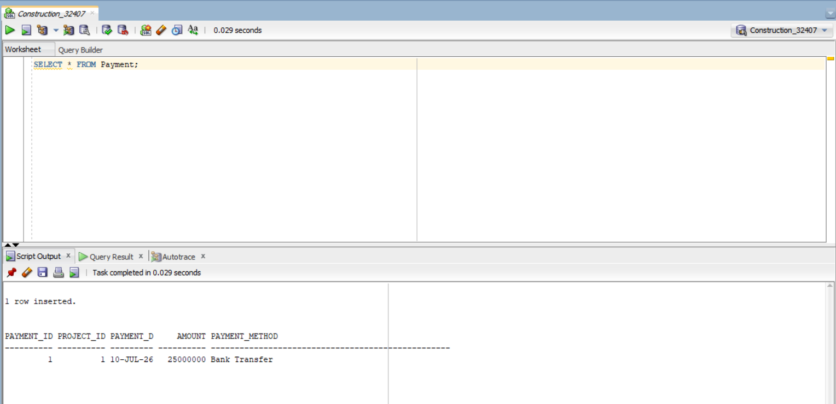
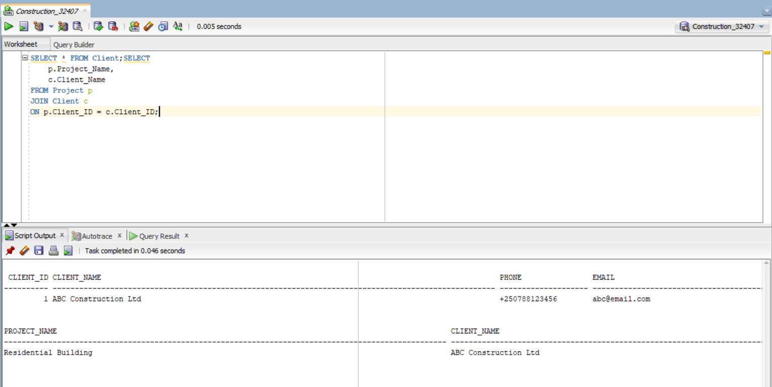
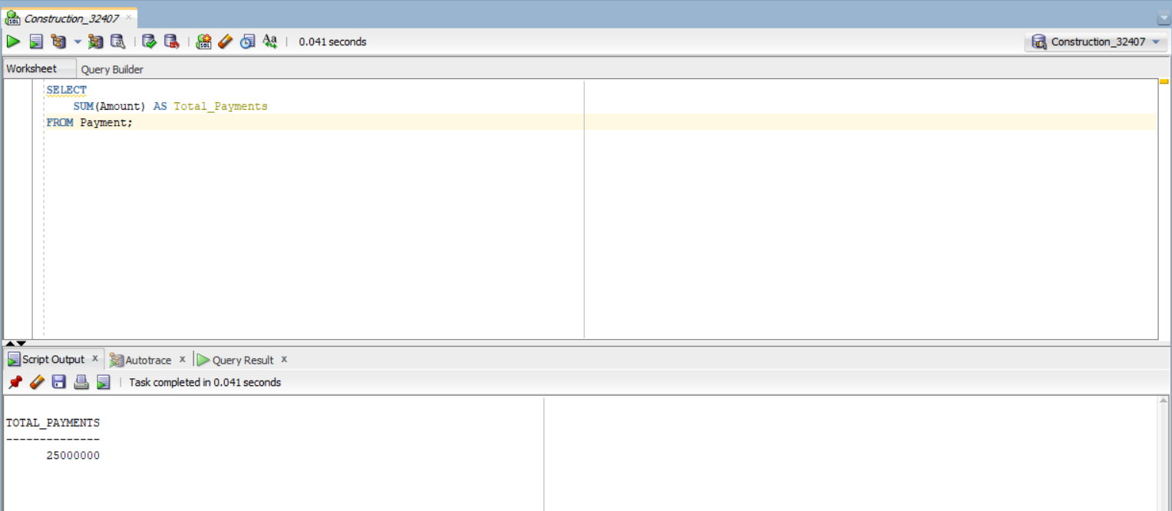
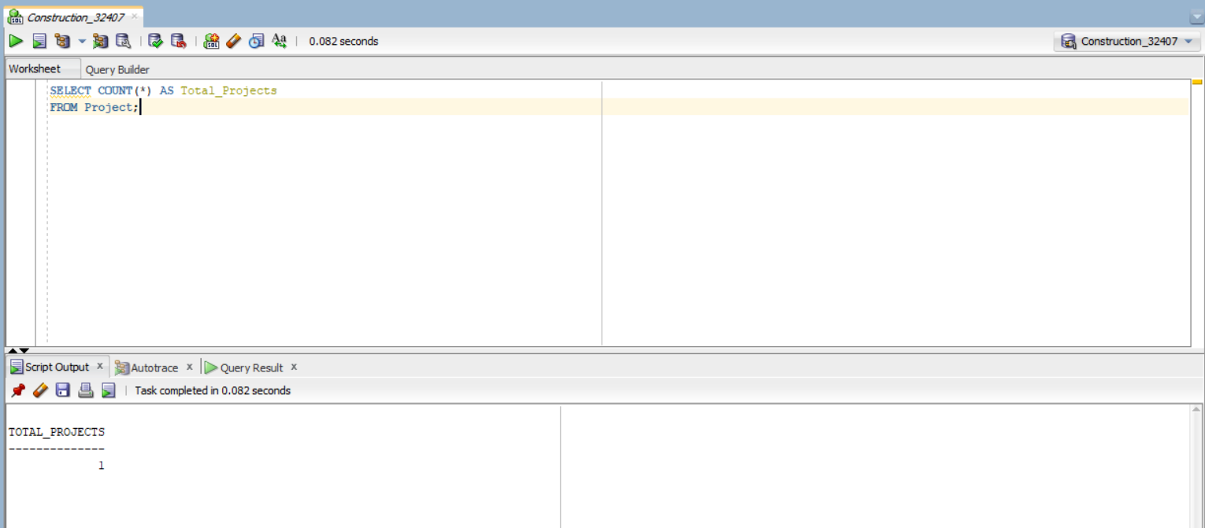
SQL QUERIES & DATA SEEDING
Sample data: Rwandan enterprise records (ABC Construction, Rwanda Building Supplies)
SQL: JOINs, SUM, COUNT, WHERE filtering

Slide 7
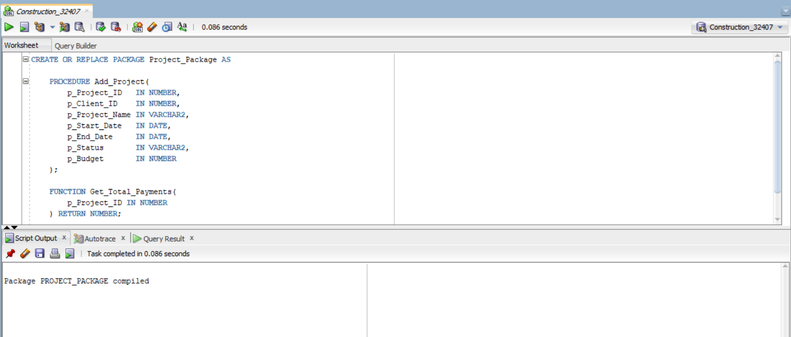
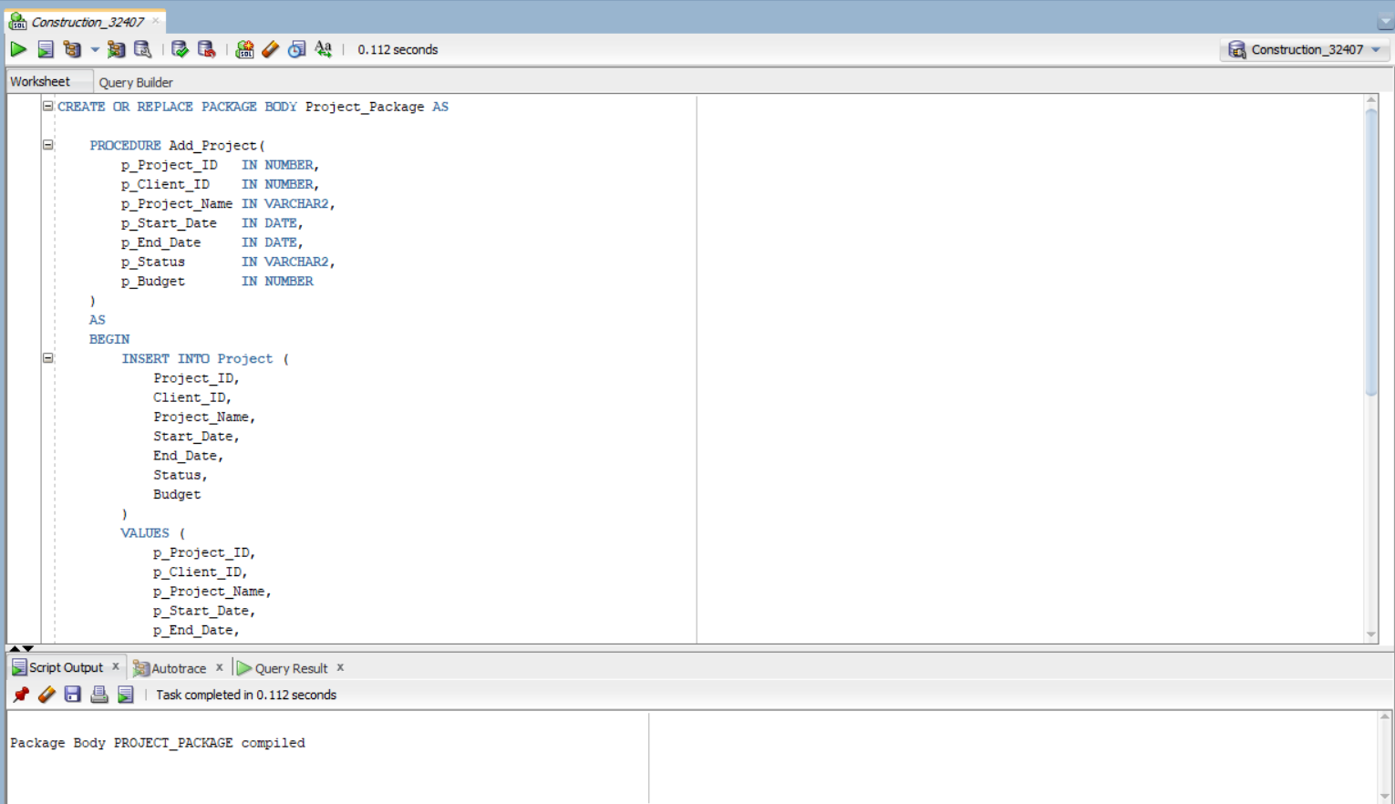
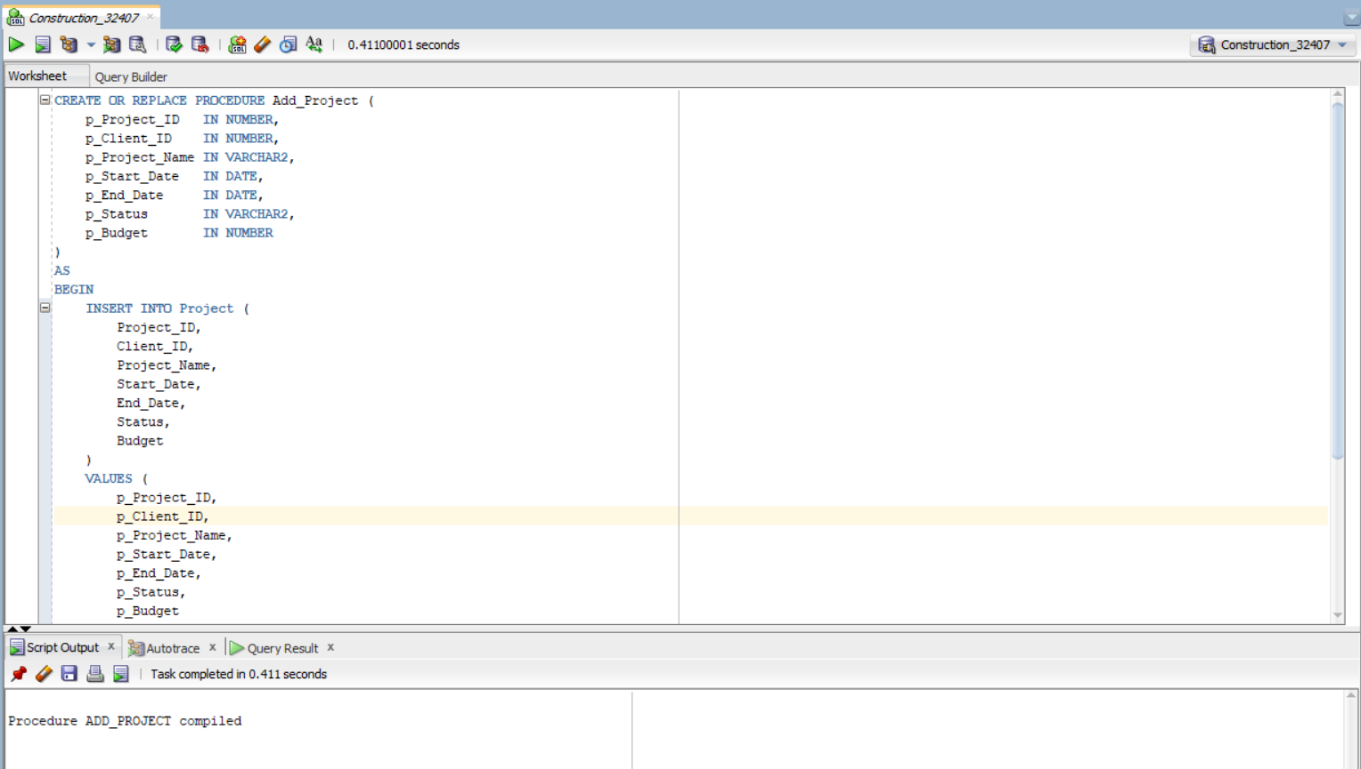
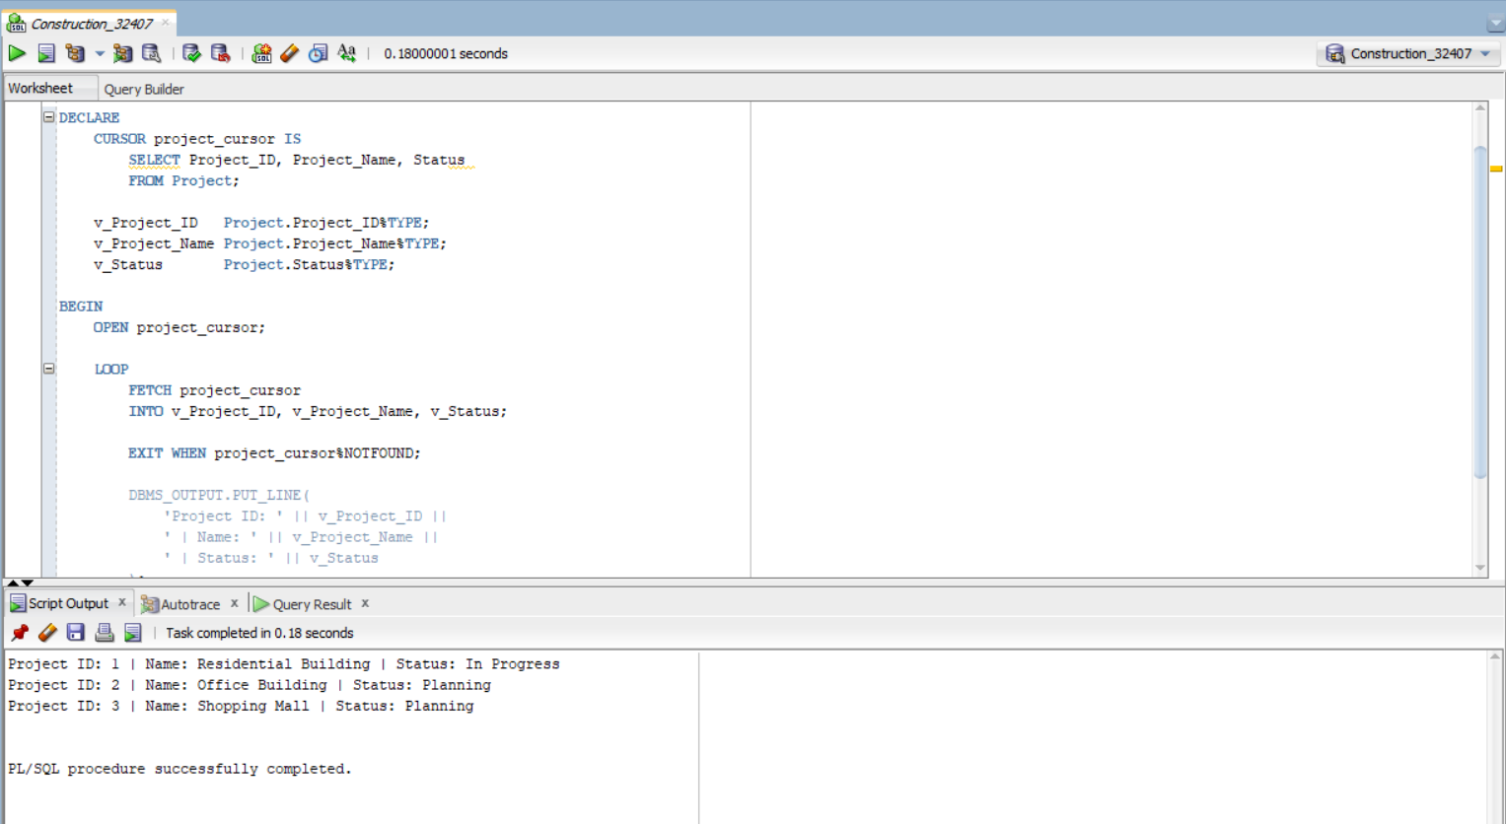
PL/SQL PROGRAMMING
PROJECT_PACKAGE
Add_Project procedure: - Parameterized INSERT - DUP_VAL_ON_INDEX exception - WHEN OTHERS error handler Get_Total_Payments function: - Returns SUM(Amount) via NVL - NULL-safe aggregation
CURSOR
Project_Cursor loops through all projects, fetches ID/Name/Status, outputs via DBMS_OUTPUT

Slide 8
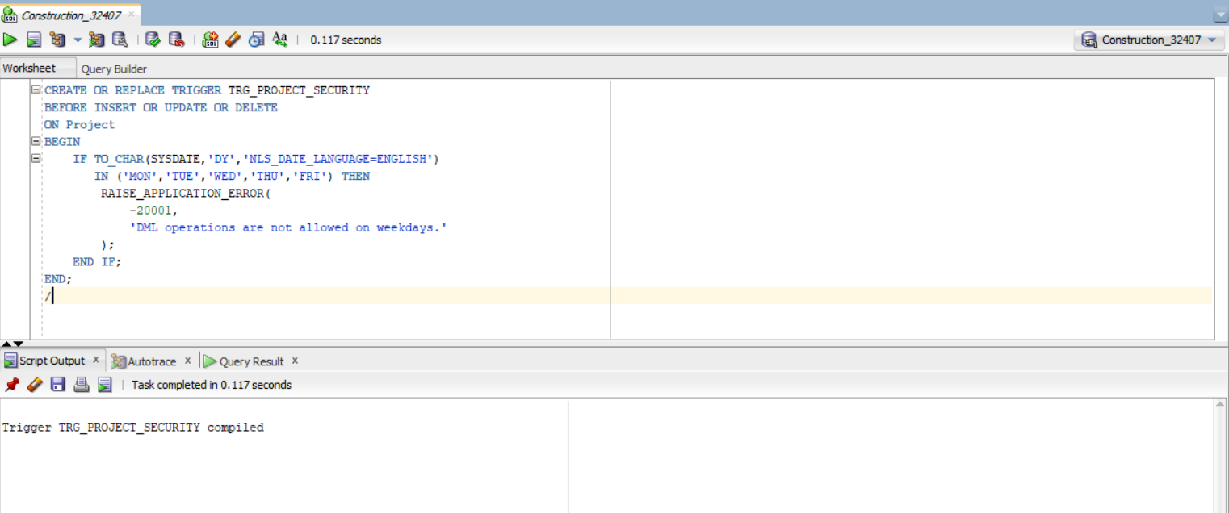
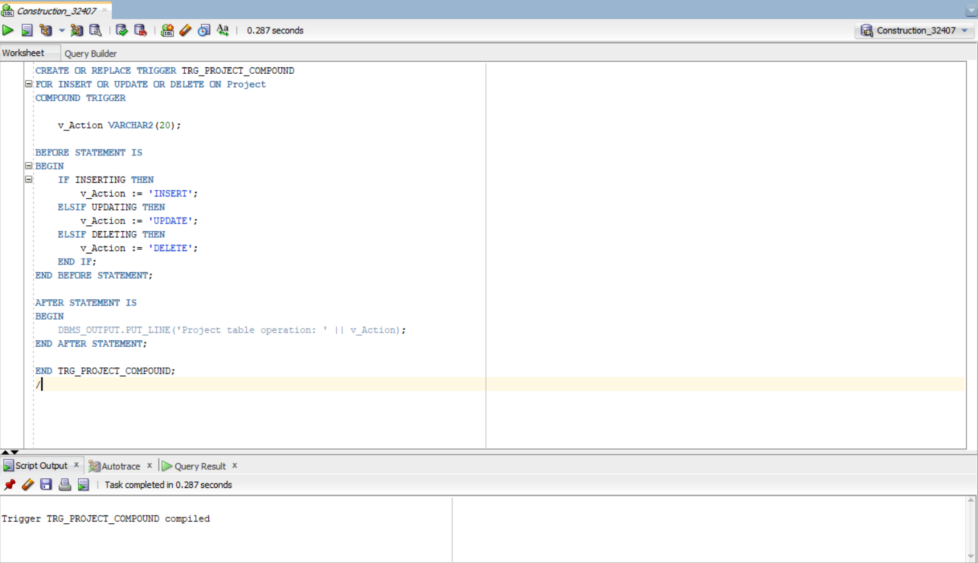
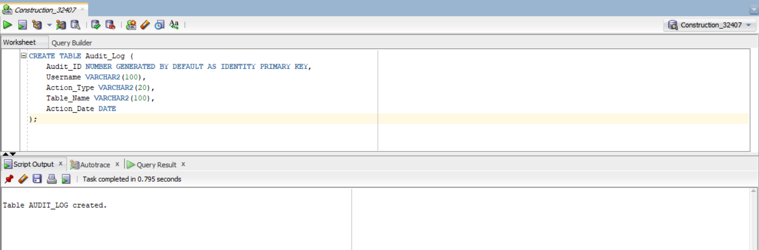
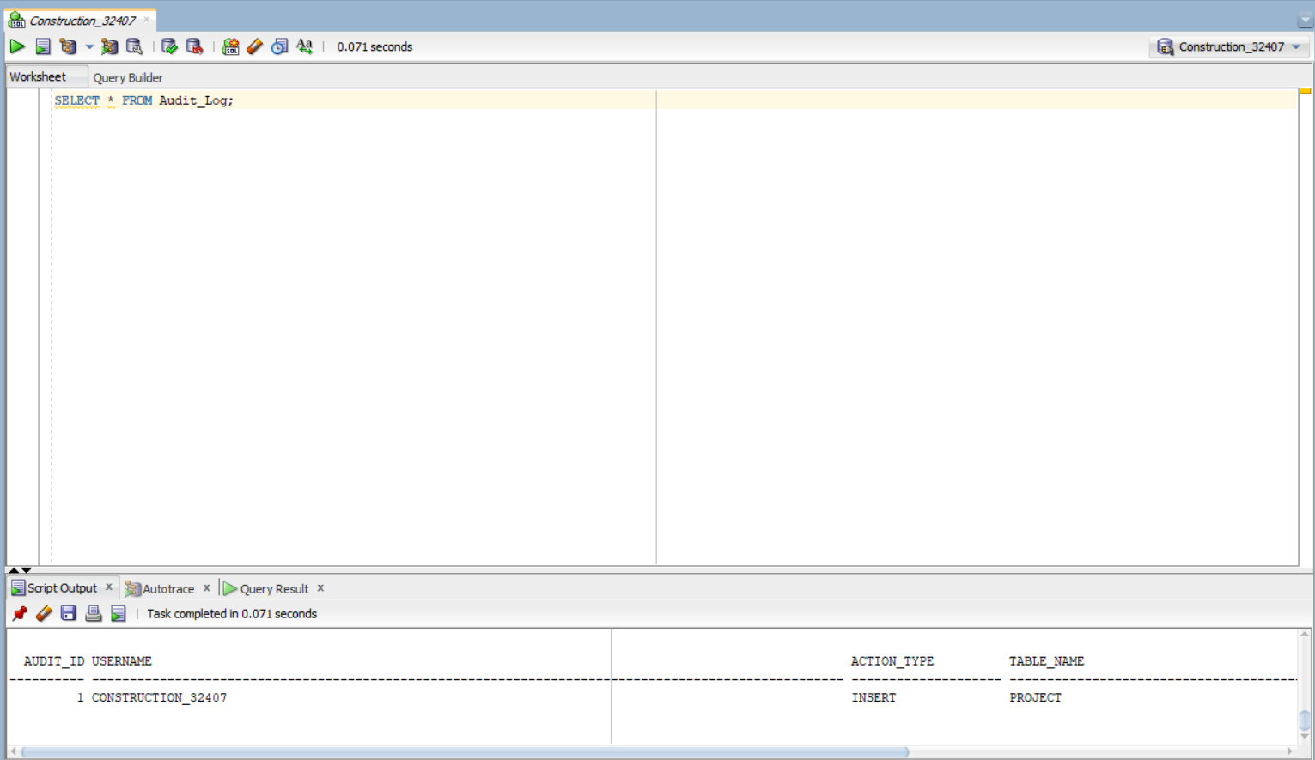
TRIGGERS & AUDIT SYSTEM
SIMPLE TRIGGER
TRG_PROJECT_AUDIT: AFTER INSERT logs user, action, timestamp to Audit_Log
COMPOUND TRIGGER
TRG_PROJECT_COMPOUND: INSERT/UPDATE/DELETE with BEFORE/AFTER STATEMENT
AUDIT SYSTEM
Audit_Log: Audit_ID, Username, Action_Type, Table_Name, Action_Date

Slide 9
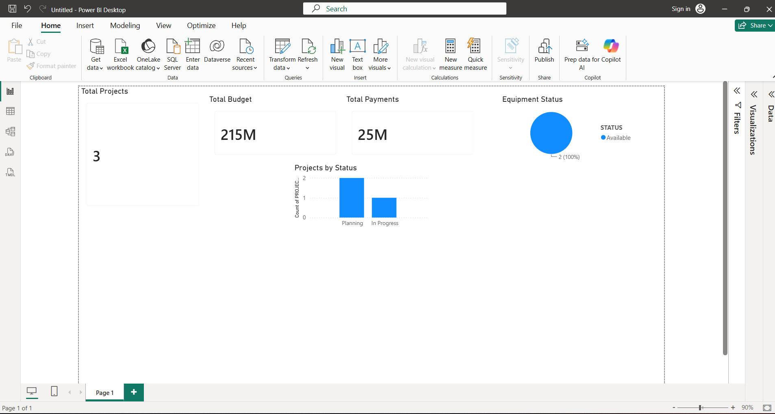
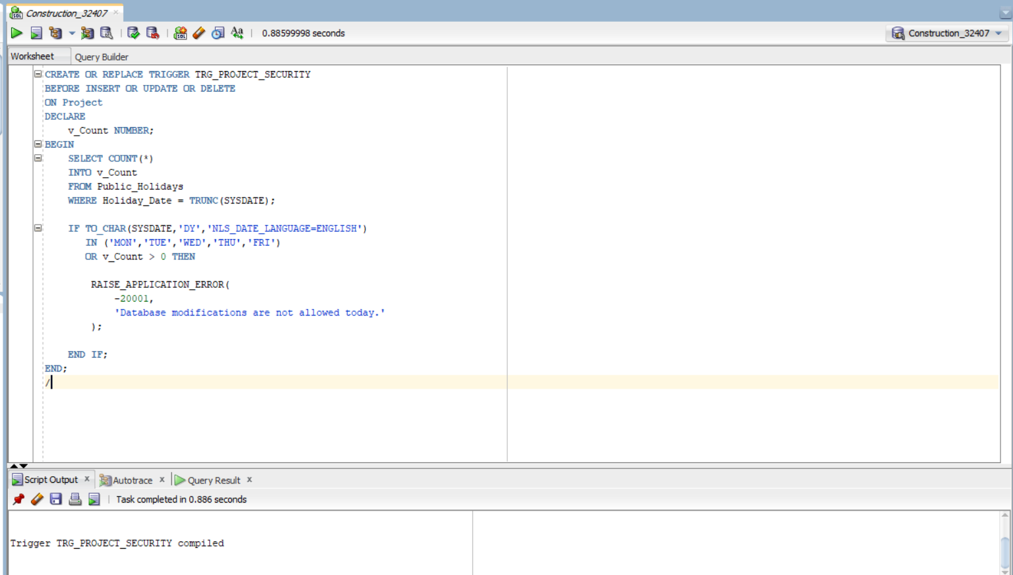
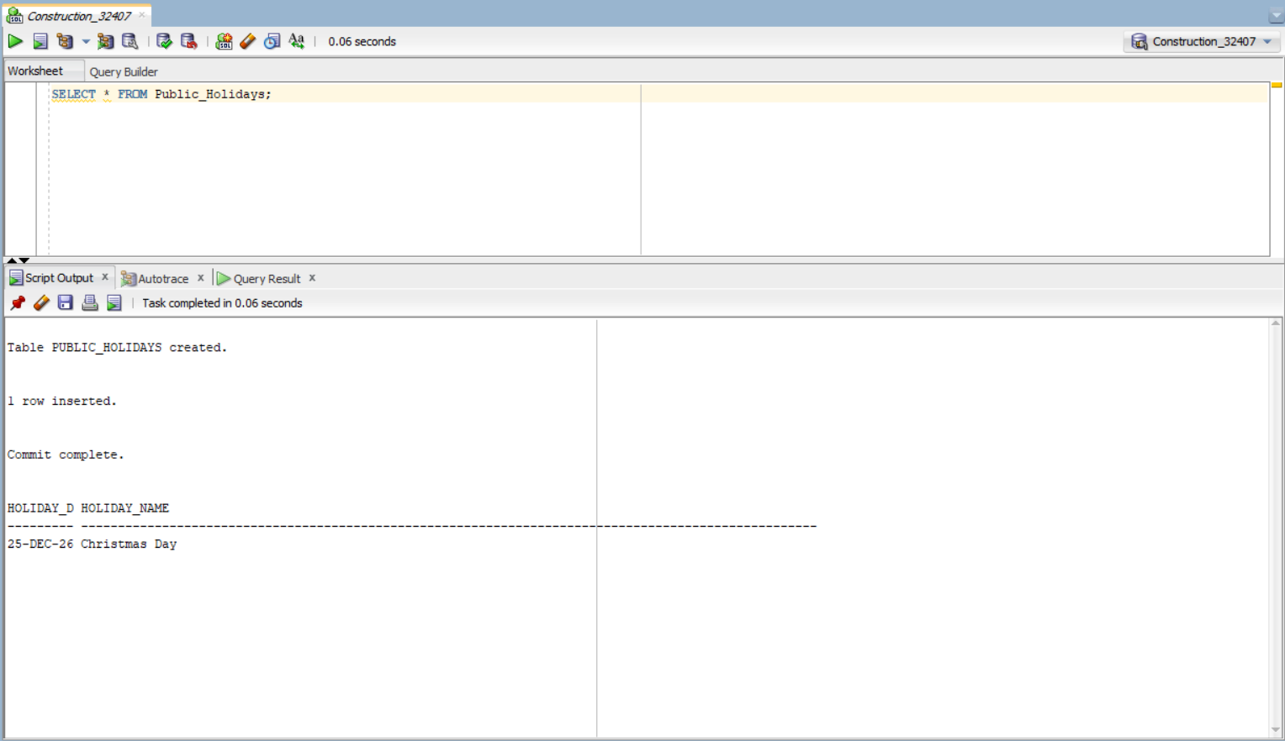
SECURITY & POWER BI
SECURITY TRIGGER
POWER BI DASHBOARD
TRG_PROJECT_SECURITY: BEFORE INSERT/UPDATE/DELETE Blocks DML on weekends and holidays References Public_Holidays table Raises ORA-20001 with secure message
Direct analytics channel from Oracle DB to Power BI. Real-time charts for expenditures, materials, labor.
ALL DATABASE OBJECTS
Tables, views, triggers, packages all compiled successfully under CONSTRUCTION_32407 schema

Slide 10
CONCLUSION
ACHIEVEMENTS
LESSONS LEARNED
FUTURE IMPROVEMENTS
3NF normalized design 10 tables with full integrity Automated PL/SQL packages Enterprise security controls Audit trail system Power BI dashboard 37 verification screenshots
Oracle DB architecture depth PL/SQL procedural mastery Trigger design patterns Data normalization practice BI tool integration GitHub version control Technical documentation
Web application interface Oracle APEX deployment Role-based access control Email notifications Mobile support PDF report generation Predictive analytics
THANK YOU FOR LISTENING.
MOHANAD MIRGHANI ALI | 32407/2025 | CONSTRUCTION_32407 | UNILAK

