Slide 1
HL7 Conformance Testing with Message Maker
Robert Snelick
National Institute of Standards & Technology (NIST)
rsnelick@nist.gov
http://www.nist.gov/messagemaker

Slide 2
Overview
HL7 Version 2 Overview
  Purpose, Definition, and Problems
Conformance using Message Profiles
  Methodology for producing a precise and unambiguous specification
Building Message Profiles
  MWB Tool to build XML representation of a message profile
Testing HL7 Systems (NIST)
  Message Maker tool to build message instances to test HL7 systems for conformance
Notes:
The focus is version 2.

Slide 3
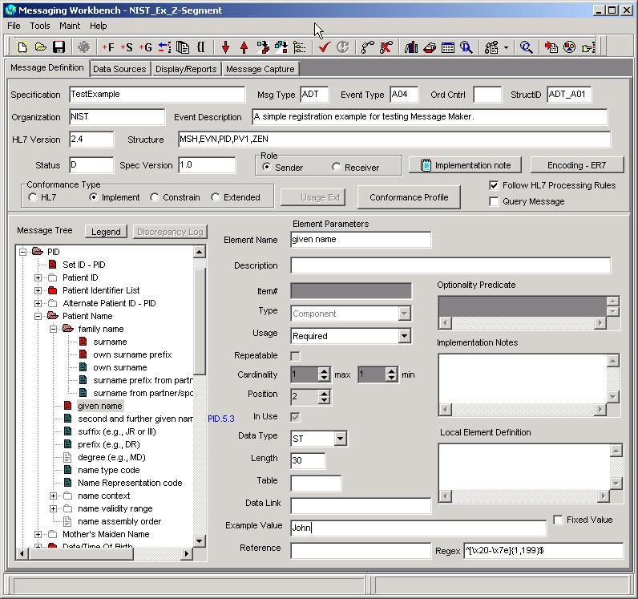
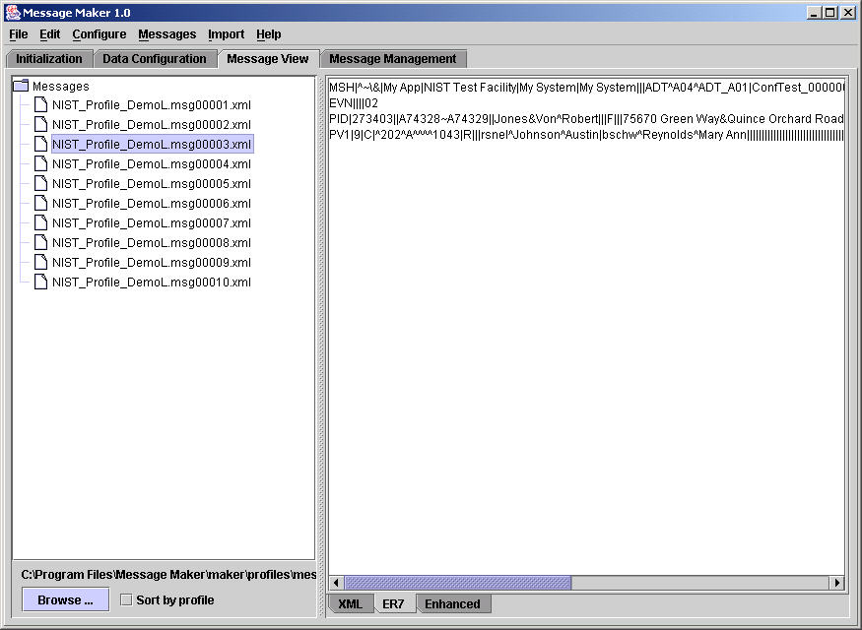
The Big Picture
HL7
Standard
Tools to build profiles
e.g., MWB (VA)
XML representation
ADT^A01
Message Profile
HL7 Message Structure
Message Profile
MSH
MSH
<?xml version="1.0"?>
<HL7v2xConformanceProfile H
<MetaData Name="CALINX" Or
<Encodings>
<Encoding>ER7</Encoding>
</Encodings>
<DynamicDef AccAck="NE" Ap
<HL7MsgType=“ADT"
EventType=“A01
<MetaData Name="CALINX" >
<Segment Name="MSH" LongN
<Field Name="Field Separator" Us
</Field>
<Field Name="Encoding Characters"
<Reference>2.16.9.2</Reference
</Field>
<Field Name="Sending Application"
EVN
EVN
PID
NK1
NK1
NK1
...
PID
...
NK1
NK1
NK1
NK1
NK1
NK1
NK1
PV1
...
PV1
...
Universal design
Riddled with optionality
Implementation chaos
Interoperability difficult
PV2
PV2
OBX
OBX
AL1
AL1
...
Messaging
Workbench
...
Agreement
Define constraints
HL7 System
Test
System
Test
Harness
MSH|^~\&|REGAEVN|A05|199901PID|1||191919^NK1|1|MASSIE^ENK1|2|MASSIE^I…
Message
Maker
Conforms?
Conformance testing needed
Improves reliability and interoperability
Testing Framework
Profile based
Suite of test messages
Suitable for conformance testing
Tools to build messages
Message Maker (NIST)
Automated and adaptable

Slide 4
What is HL7
Standards for the exchange, management, and integration of data for clinical care
HL7 Version 2 is an application level messaging standard
Deployed in 90% of US hospitals, international use growing
Messages, for example
  ADT
  Lab order
  Lab results
“A framework for negotiation”

Slide 5
HL7 and Healthcare Integration
R1
R2
R3
DICOM
Hospital
Firewall
RIS
Scheduling
Cardiology
Rx
NCPDP
X12
Billing
HL7
HIS
Diet
HL7
Nursing
LAB
HL7
ASTM
L1
L2
L3
L4

Slide 6
HL7 Message Structure
HL7 Message
Segments
Groups
Fields
Groups
Segments
Components
Sub-Components
Hierarchical data storage

Slide 7
Message Definition
ADT^A04^ADT_A01
MSH
EVN
PID
[ PD1 ]
[{ ROL }]
[{ NK1 }]
PV1
[ PV2 ] . . .
[{ GT1 } ]
[{
IN1
[ IN2 ]
[{ IN3 }]
[{ ROL }]
}]
[ ACC ]
[ UB1 ]
[ UB2 ]
[ PDA ]
Message maps to a real world event (admit a patient)
Hundreds of segments and events
Segments are defined once
Each message selects from a library of segments
Think of them as data structures (or classes)
Segment
Group
{} Segment can repeat
[] Segment is optional

Slide 8
PID: Patient Identification Segment
SEQ | LEN | DT | OPT | RP/# | TBL# | ITEM# | ELEMENT NAME
1 | 4 | SI | O |  |  | 00104 | Set ID - PID
2 | 20 | CX | B |  |  | 00105 | Patient ID
3 | 250 | CX | R | Y |  | 00106 | Patient Identifier List
4 | 20 | CX | B | Y |  | 00107 | Alternate Patient ID - PID
5 | 250 | XPN | R | Y |  | 00108 | Patient Name
6 | 250 | XPN | O | Y |  | 00109 | Mother’s Maiden Name
7 | 26 | TS | O |  |  | 00110 | Date/Time of Birth
8 | 1 | IS | O |  | 0001 | 00111 | Administrative Sex
9 | 250 | XPN | B | Y |  | 00112 | Patient Alias
10 | 250 | CE | O | Y | 0005 | 00113 | Race
11 | 250 | XAD | O | Y |  | 00114 | Patient Address
12 | 4 | IS | B |  | 0289 | 00115 | County Code
13 | 250 | XTN | O | Y |  | 00116 | Phone Number - Home
14 | 250 | XTN | O | Y |  | 00117 | Phone Number - Business
…
37 | 80 | ST | O |  |  | 01541 | Strain
38 | 250 | CE | O | 2 | 0429 | 01542 | Production Class Code
Segments contain fields

Slide 9
Extended Person Name (XPN)
Components: <family name (FN)> ^ <given name (ST)> ^
<second and further given names or initials thereof (ST)> ^ <suffix (e.g., JR or III) (ST)> ^
<prefix (e.g., DR) (ST)> ^ <degree (e.g., MD) (IS)> ^ <name type code (ID) > ^
<name representation code (ID)> ^ <name context (CE)> ^
<name validity range (DR)> ^ <name assembly order (ID)>
Subcomponents of family name: <surname (ST)> ^ <own surname prefix (ST)> ^
<own surname (ST)> ^ <surname prefix from partner/spouse (ST)> ^
<surname from partner/spouse (ST)>
Subcomponents of name context: <identifier (ST)> & <text (ST)> &
<name of coding system (IS)> &
<alternate identifier (ST)> & <alternate text (ST)> &
<name of alternate coding system (IS)>
Subcomponents of name validity range: <date range start date/time (TS)> &
<date range end date/time (TS)>

Slide 10
Elements have Attributes
Usage
  Indicates how the element can be used
  Required, Optional, Not Supported, Conditional, Required or Empty, etc.
Cardinality
  Indicates how many time the element can appear
  [0..0], [0..1], [1..1], [0..3], [3..5], [0..*]
Code Sets (Tables)
  Indicates a set of valid values for a given primitive element
  HL7 Table 001 Administrative Sex
Length
  Indicates the maximum of an element or a compound element

Slide 11
HL7 Message Framework
HL7 provides the framework to build messages
Groups and Messages are defined each time used
Building Blocks
  Segments, Fields, Components, Sub-Components, Data types, Tables (code sets) are defined once
Universal Design: Needed for broad support
Flexible framework for building messages for any given real world use case (e.g., request a blood test)

Slide 12
The Problem
Overwhelmingly large with many optional features
  Little agreement on how to define an interface
  Applications didn’t know what to expect
  No two interfaces were alike
Described as “total chaos” during implementation
Local Extensions (e.g., Z-segments) complicate matters further
Interoperability Issues – not plug-and-play
  Two systems could be HL7 compliant but not interoperable
  e.g., sending system could support 10 repetitions of a segment while the receiving systems may only support 5.

Slide 13
The Solution
Conformance SIG
Trading Partner Agreement
Eliminate optionality (“implementation Specification”)
Add specificity to existing messages and identify specific scenarios/use cases
Identify, document, and bridge semantic differences
Conformance through Message Profiles

Slide 14
Message Profile Defined
Refinement of the HL7 Standard
Provides an unambiguous specification of a standard HL7 message
Measurable
  What data will be passed in the message
  The format in which the data will be passed
  The acknowledgement responsibilities of the sender and the receiver
  Message instances can be validated against a message profile
Parts of a Message Profile
  Use case model
  Static Definition
  Dynamic Definition
Represented as an XML document (HL7 XML)

Slide 15
Static Definition
Building a Message Profile
ADT^A01
HL7 Message Structure
Message Profile
MSH
MSH
Segments/Segment Groups:
EVN
EVN
Usage (optionality)
Cardinality (min, max)
PID
PID
NK1
NK1
NK1
NK1
NK1
...
NK1
NK1
NK1
NK1
NK1
...
PV1
PV1
...
...
Fields/Components:
Field Usage (Optinality: R, RE, C, CE, X)
PV2
PV2
Cardinality (min, max)
Value Sets/Coding system
OBX
OBX
Descriptions
Length
AL1
AL1
...
...
Notes:
Note that the usage constraints are much tighter in the conformance specification. They are limited to (R, RE, X, C, CE). Cardinality also needs to be explicitly stated.

Slide 16
Tools for Building Profiles
Commercial: Orion’s Symphonia, others
Free: VA’s Messaging Workbench (MWB)

Slide 17
Message Profile Example (XML)
Snippet from PID segment
License is required and must appear exactly one time
SSN not supported
<Field Name="SSN Number - Patient" Usage="X" Min="0" Max="*" Datatype="ST" Length="16" ItemNo="00122">
<Reference>3.4.2.19</Reference>
</Field>
<Field Name="Driver's License Number - Patient" Usage="R" Min="1" Max="1" Datatype="DLN" Length="250" ItemNo="00123">
<Reference>3.4.2.20</Reference>
<Component Name="Driver's License Number" Usage="R" Datatype="ST" Length="100">
</Component>
<Component Name="Issuing State, province, country" Usage="R" Datatype="IS" Length="10" Table="0333">
</Component>
<Component Name="expiration date" Usage="R" Datatype="DT" Length="30">
</Component>
</Field>
<Field Name="Mother's Identifier" Usage=“X" Min="0" Max="*" Datatype="CX" Length="250" ItemNo="00124">
<Reference>3.4.2.21</Reference>
<Component Name="ID" Usage="X" Datatype="ST" Length="3">
</Component>
<Component Name="Check digit" Usage="X" Datatype="ST">
</Component>
<Component Name="code identifying the check digit scheme employed" Usage="X" Datatype="ID" Length="3" Table="0061">
</Component>
Value needs to be in table 0333
Value must be a valid date
* Provides a roadmap for creating messages *
* Input into Message Maker *

Slide 18
Conformance Testing
A way to verify implementations of a specification to determine whether or not deviations from the specifications exist (through the use of test suites)
Standards are not enough to ensure interoperability
Specification
(Requirements)
Implementation
Conformance Tests
Notes:
Tests capture the technical requirements within the specification.
Testing is bound in scope by the specification.
Internal structure of the product-under0test not accessible (black box testing)
Conformance testing is necessary, but not sufficient, for interoperability.
Interoperability: The ability of two or more systems to exchange and use information.
Portability: the ability to move software or applications among different systems.

Slide 19
Benefits of Conformance Testing
Increase probability that products are implemented correctly
  Contains required functionality
  Behaves as expected
  Performs functions in a known manner
Increased likelihood of portability and interoperability
  Portability – the ability to move software or applications among different systems
  Interoperability – the ability of two or more systems to exchange and use information
Provides a feedback loop for developers
Increases buyer’s confidence in a product and substantiate seller’s claim
Not locked into purchasing from a single vendor

Slide 20
The Need for Dynamic Test Creation
Message
Types
Message
Events
Message Profile
explicitly defines message components at each level
implementable specification
still sites defined their own profiles (many)
nature of the beast
Message Profile
Message Profile
explicitly defines message components at each level
implementable specification
still sites defined their own profiles (many)
nature of the beast
ADT^A01
Message Profile
explicitly defines message components at each level
implementable specification
still sites defined their own profiles (many)
nature of the beast
Message Profile
explicitly defines message components at each level
implementable specification
still sites defined their own profiles (many)
nature of the beast
ACK
ADR
ADT
BAR
CRM
CSU
DFT
DOC
DSR
EAC
EAN
EAR
EDR
EQQ
ERP
ESR
ESU
INR
INU
LSR
LSU
MCF
MDM
MFD
MFK
MFN
MFQ
MFR
NMD
NMQ
NMR
OMD
OMG
OML
OMN
OMP
OMS
ORD
ORF
ORG
ORL
ORM
ORN
ORP
ORR
ORS
ORU
OSQ
OSR
OUL
PEX
PGL
PIN
PMU
PPG
PPP
PPR
PPT
PPV
PRM
PRR
PTR
QBP
QCK
QCN
QRY
QSB
QSX
QVR
RAR
RAS
RCI
RCL
RDE
RDR
RDS
RDY
REF
RER
RGV
ROR
RPA
RPI
RPL
RPR
RQA
RQC
RQI
RQP
RQQ
RRA
RRD
RRE
RRG
RRI
RSP
SIU
SPQ
SQM
SRM
SSR
SSU
SUR
TBR
TCR
TCU
UDM
VQQ
VXQ
VXR
VXU
VXX
A01
A02
A03
A04
A05
A06
A07
A08
A09
A10
A11
A12
A13
A14
A15
A16
A17
A18
A19
A20
A21
A22
A23
A24
A25
A26
A27
A28
A29
A30
A31
A32
A33
A34
A35
A36
A37
A38
A38
A39
A40
A41
A42
A43
A44
A45
A46
A47
A48
A49
A50
A51
HL7 Message Structure
Message Profile
Message Profile
explicitly defines message components at each level
implementable specification
still sites defined their own profiles (many)
nature of the beast
MSH
Profile N
EVN
MSH
PID
EVN
<?xml version="1.0"?>
<HL7v2xConformanceProfile H
<MetaData Name="CALINX" Or
<Encodings>
<Encoding>ER7</Encoding>
</Encodings>
<DynamicDef AccAck="NE" Ap
<HL7MsgType=“ADT"
EventType=“A01
<MetaData Name="CALINX" >
<Segment Name="MSH" LongN
<Field Name="Field Separator" Us
</Field>
NK1
NK1
NK1
NK1
NK1
...
PID
NK1
NK1
NK1
NK1
...
PV1
NK1
...
PV1
...
PV2
PV2
OBX
OBX
AL1
AL1
...
...
MSH|^~\&|REGAEVN|A05|199901PID|1||191919^NK1|1|MASSIE^ENK1|2|MASSIE^I…
MSH|^~\&|REGAEVN|A05|199901PID|1||191919^NK1|1|MASSIE^ENK1|2|MASSIE^I…
MSH|^~\&|REGAEVN|A05|199901PID|1||191919^NK1|1|MASSIE^ENK1|2|MASSIE^I…
Need test messages and a testing framework to ensure that applications implement what was agreed upon in the message profiles
Notes:
Need to ensure that applications implement what they agreed to in the Message Profile
Test messages and testing framework are needed
One message profile handles one use case. Health care systems may have hundreds of profiles. Specific tests need to be developed for profile.
Further complicating the problem is that use cases will differ from site-to-site.
For example, “admit a patient” at hospital A and hospital B will likely have different profiles
Tests need to be developed
Process in tedious and expensive
Often systems go untested and are debugged while in production

Slide 21
Automated and Adaptable Message Creation
Manual Test Suite
tests needed for each profile
written individually
meticulous work
high cost $$$$$
often tests not performed
Build your own
Message Profile
explicitly defines message components at each level
implementable specification
still sites defined their own profiles (many)
nature of the beast
Message Profile
explicitly defines message components at each level
implementable specification
still sites defined their own profiles (many)
nature of the beast
Message Profile
explicitly defines message components at each level
implementable specification
still sites defined their own profiles (many)
nature of the beast
Message Profile
explicitly defines message components at each level
implementable specification
still sites defined their own profiles (many)
nature of the beast
Message Profile
explicitly defines message components at each level
implementable specification
still sites defined their own profiles (many)
nature of the beast
Profile N
<?xml version="1.0"?>
<HL7v2xConformanceProfile H
<MetaData Name="CALINX" Or
<Encodings>
<Encoding>ER7</Encoding>
</Encodings>
<DynamicDef AccAck="NE" Ap
<HL7MsgType=“ADT"
EventType=“A01
<MetaData Name="CALINX" >
<Segment Name="MSH" LongN
<Field Name="Field Separator" Us
</Field>
Message Maker Test Suite
tests needed for each profile
automatically generated
easy
lower cost $$
increases likelihood tests will be performed
Use Message Maker

Slide 22
Message Maker Overview
Purpose: to automatically and dynamically generate tests for any given profile
  Account for site-specific characteristics and options
  Produce self-adapting test suites
Development:
  tool to create test messages (Message Maker)
  Reference database of HL7 data items
  framework to send/receive messages, validate, and report
Capabilities:
  Message Variation
    structure
    constraint attributes
    data content
    validity
    message density
    specific test location and type
  Data Configuration
  Methods to automatically determine test suite
  Multiple encodings (XML, ER7)
  Test Descriptions

Slide 23
Message Maker Design
Specification
Tool (e.g., MWB)
Data Sources
HL7
Standard
DB
NIST HL7
Reference
Database
Message
Maker
HL7 V2
Profile (XML)
HL7 Test
Messages
Profile based
Structurally correct
Validated
Varied
Descriptive
Suitable basis for
conformance testing
Message
Factory
(XSLT)
NIST Data
Repository
(XML)
Table
Values
Example
Values
from Profile
Testing Options
Usage
Cardinality
Volume
Data Content
Length
etc.
Testing
Framework
Default
Values

Slide 24
HL7 Test Framework Environment
HL7 Test
Messages
Remote Tester
simulates application
controlled by Test Driver
receives and delivers messages with IUT
HL7 Test Driver
HL7 Implementation
Under Test (IUT)
HL7 Message
simulates application
controls testing
transmits HL7 messages to the IUT

