Slide 1
Guide to Using Message Maker
Robert Snelick
National Institute of Standards & Technology (NIST)
December 2005
rsnelick@nist.gov
http://www.nist.gov/messagemaker

Slide 2
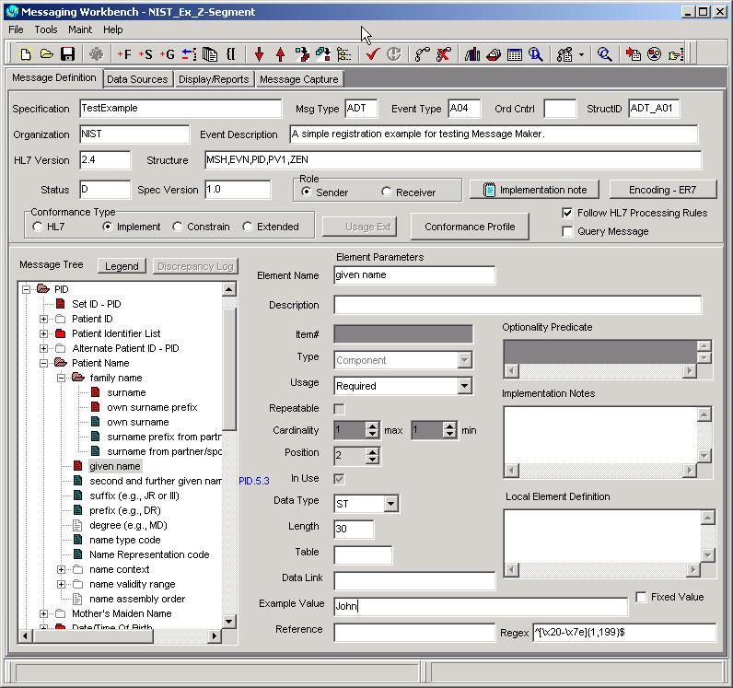
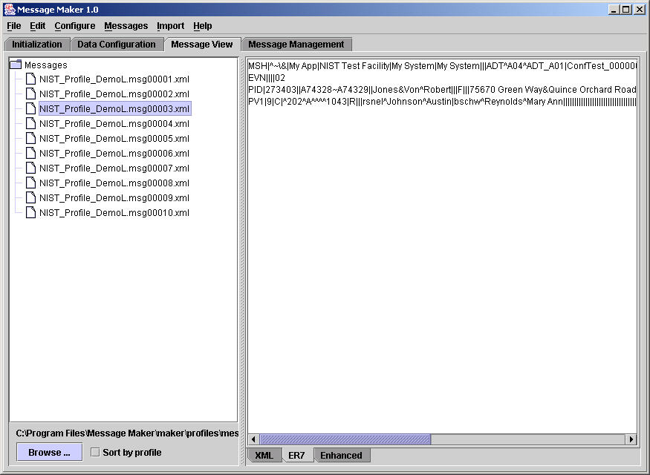
HL7 and Conformance: The Big Picture
HL7
Standard
Tools to build profiles
e.g., MWB (VA)
XML representation
ADT^A01
Message Profile
HL7 Message Structure
Message Profile
MSH
MSH
<?xml version="1.0"?>
<HL7v2xConformanceProfile H
<MetaData Name="CALINX" Or
<Encodings>
<Encoding>ER7</Encoding>
</Encodings>
<DynamicDef AccAck="NE" Ap
<HL7MsgType=“ADT"
EventType=“A01
<MetaData Name="CALINX" >
<Segment Name="MSH" LongN
<Field Name="Field Separator" Us
</Field>
<Field Name="Encoding Characters"
<Reference>2.16.9.2</Reference
</Field>
<Field Name="Sending Application"
EVN
EVN
PID
NK1
NK1
NK1
...
PID
...
NK1
NK1
NK1
NK1
NK1
NK1
NK1
PV1
...
PV1
...
Universal design
Riddled with optionality
Implementation chaos
Interoperability difficult
PV2
PV2
OBX
OBX
AL1
AL1
...
Messaging
Workbench
...
Agreement
Define constraints
Eliminate optionality
HL7 System
Test
System
Many profiles
Need for test messages
Profile
Test
Harness
MSH|^~\&|REGAEVN|A05|199901PID|1||191919^NK1|1|MASSIE^ENK1|2|MASSIE^I…
Message
Maker
Conforms?
Conformance testing needed
Testing Framework
Improves reliability and interoperability
Profile based
Suite of test messages
Suitable for conformance testing
Tools to build messages
Message Maker (NIST)
Automated and adaptable

Slide 3
Message Maker Overview
Need test messages and a testing framework to ensure that applications implement what was agreed upon in the message profiles
Potentially a large number of message profiles
Not practical to handcraft test messages for each message profile
Message Maker is a tool to automatically and dynamically generate test messages for any given HL7 conformance profile
Messages are suitable for conformance testing
Developed by the National Institute of Standards and Technology (NIST)
http://www.nist.gov/messagemaker

Slide 4
Message Maker Design Features
Message Variation
  data content
  constraint attributes (e.g., usage, cardinality)
  validity
  volume
  message density (e.g., maximally populated)
  specific test location and type
Configurable Data Repository
Multiple Encodings (XML, ER7)
Multiple Views (XML, ER7, Enhanced ER7)
  post editing of messages in enhanced view
Test Descriptions of Messages
Supports File and Batch Messages

Slide 5
Message Maker Design
Specification
Tool (e.g., MWB)
Data Sources
HL7
Standard
DB
NIST HL7
Reference
Database
Message
Maker
HL7 V2
Profile (XML)
HL7 Test
Messages
Profile based
Structurally correct
Validated
Varied
Descriptive
Suitable for
conformance testing
Message
Factory
(XSLT)
Data
Repository
(XML)
Table
Values
Example
Values
from Profile
Testing Options
Usage
Cardinality
Volume
Data Content
Length
etc.
Testing
Framework
Default
Values

Slide 6
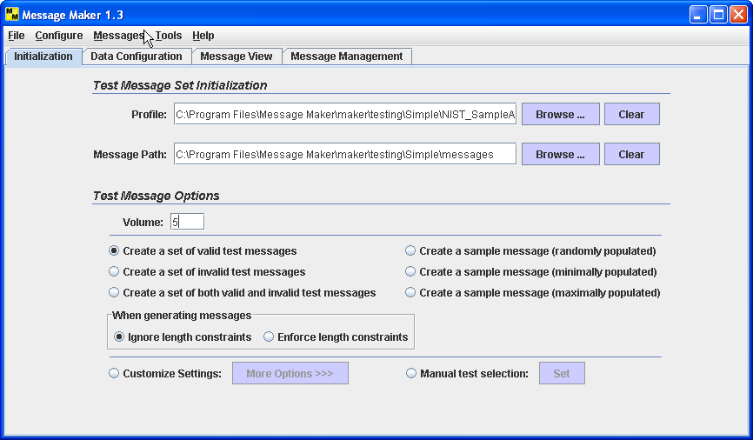
Initial Setup
Load a valid HL7 XML Message Profile
Location to save the messages
Select the type of messages you want to create
Set number of messages to be created
Options to create sample messages
Description: Load the profile you want to create messages for; Set the directory to save the messages in; Select how many messages you want to create; Select the type of messages to create or select one of three sample messages.

Slide 7
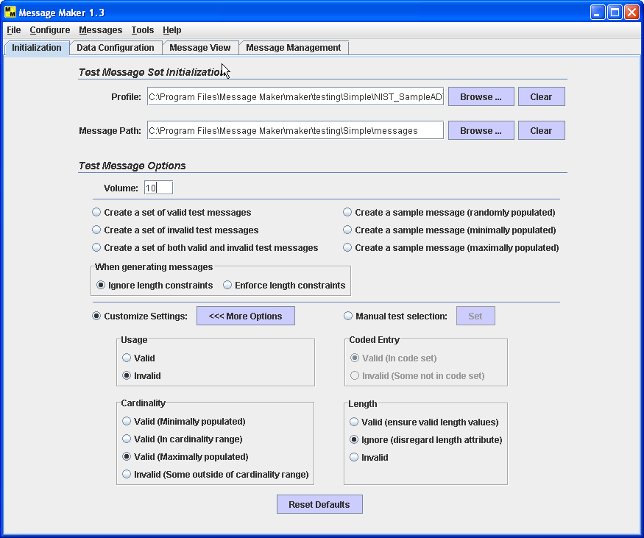
Customize Test Options
Set number of messages to be created
Set preferences for Usage
Set preferences for Cardinality
Set preferences for Length
Description: The Customize Settings allows you to set general preferences for message creation. For example, by setting the Usage option to Invalid, some messages will be created with usage errors.

Slide 8
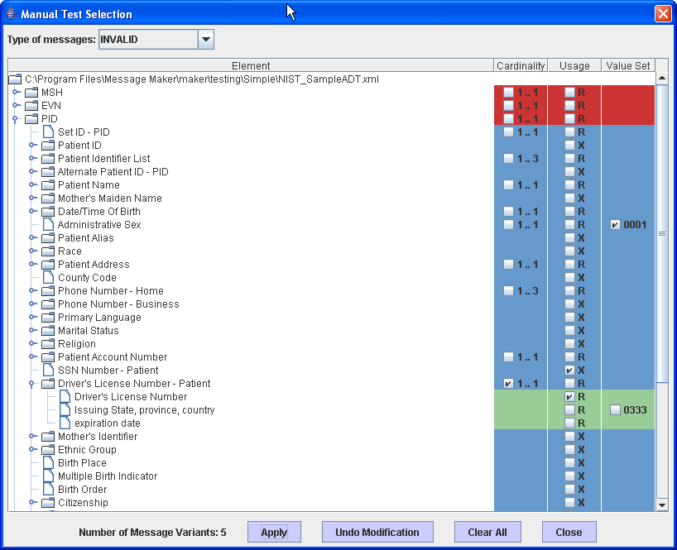
Define Specific Test Location and Type
Request either valid or invalid
Element is populated with value that is NOT in the code set
Navigate to specific location in the profile
Not supported element is populated with a value
Required element is NOT populated with a value
Vary the cardinality of this element such that it is outside the valid cardinality range
Description: The Manual Test Selection allows you to pick a specific location in the profile and the type of test you’d like. Tests can be valid or invalid. A number of error messages have been requested above.

Slide 9
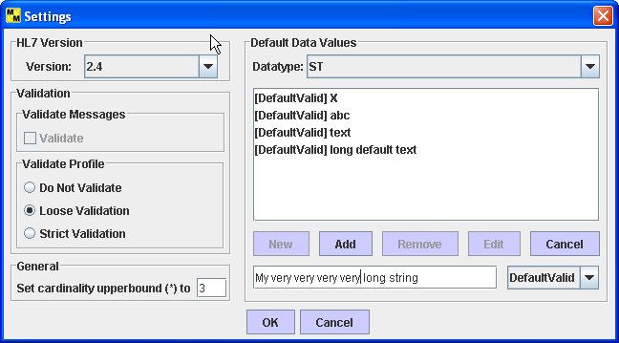
Settings
Select a primitive data type to set
When a value is not available in the repository default values are used.
Sets the upper bound to the minimum plus the chosen value
Description: Set various configuration options.

Slide 10
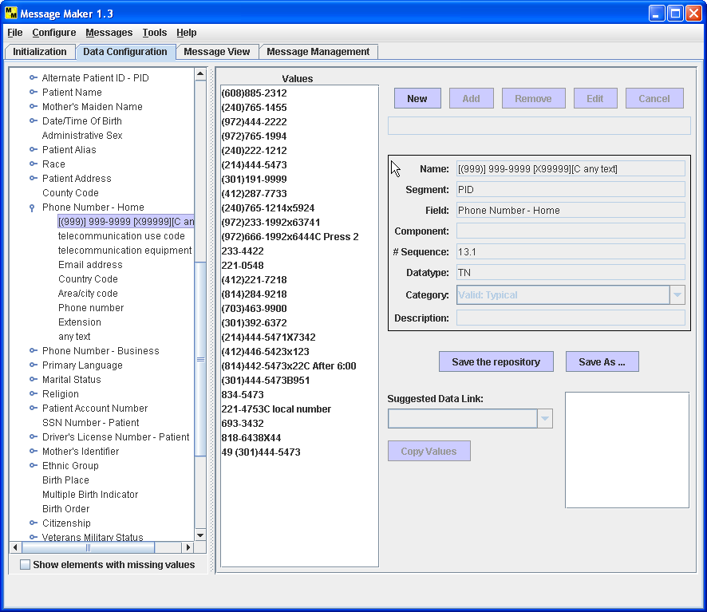
Browse Repository Data
Add values to the repository
Browse the data repository
Description: The Data Repository is a collection of data items for each HL7 primitive element. Users can browse and edit the values in the repository.

Slide 11
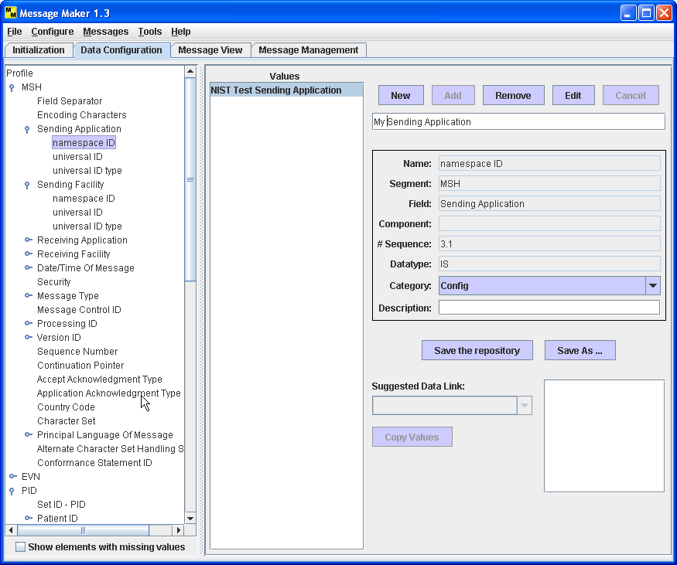
Edit Repository Data
Edit repository data value
Select the item to modify
Description: Data values can be modified. Values can be tagged as configuration; these values are always included in the message (e.g., the name of the Sending Application).

Slide 12
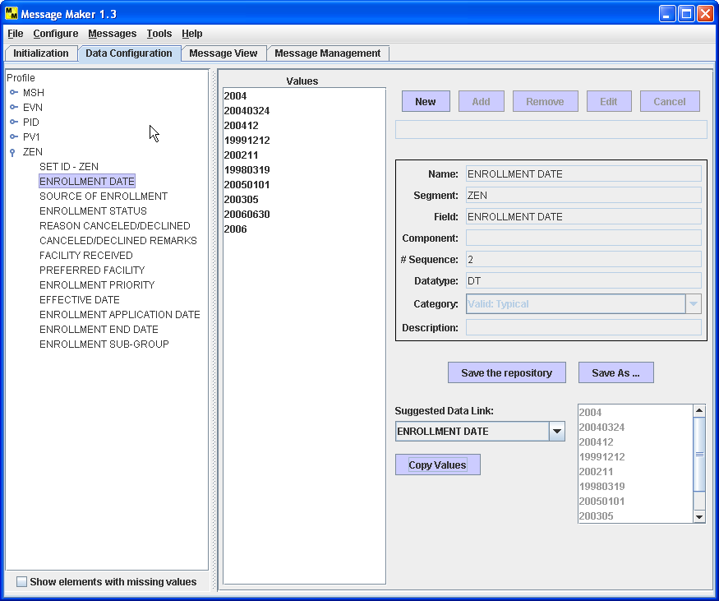
Data for Localization
Browse the suggested links
Select the element to link data
Copy the values to the repository and link to the element
Description: Data values can be linked to elements that are not included in the repository such as those defined by Z-segments. Suggestions of data values are given and can be copied to the repository and linked to the element. The user can also add data values for Z segment elements.

Slide 13
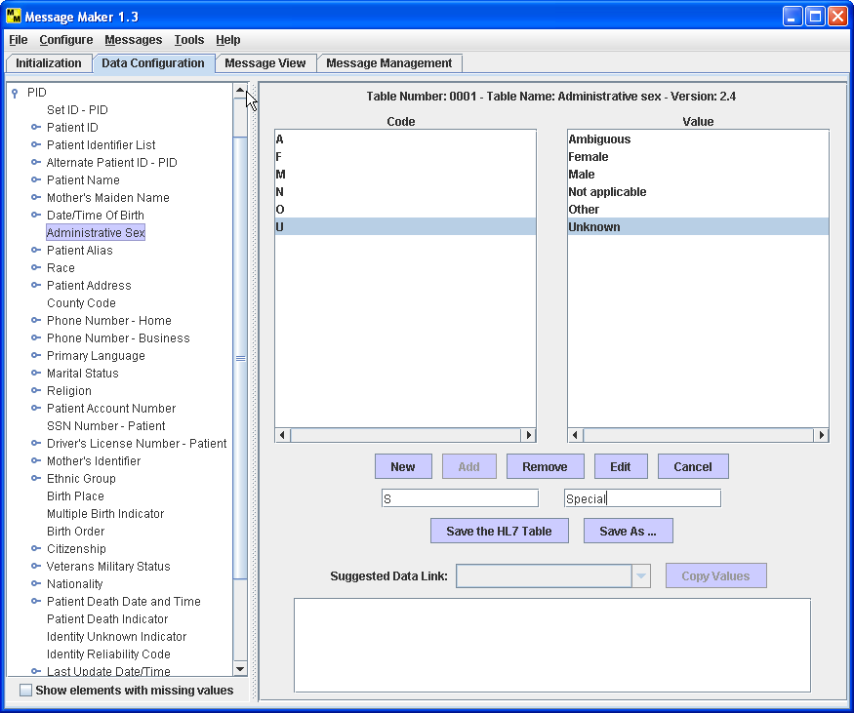
Table Data
Add values to the table
Edit existing values
Select the table
Description: Table data can be browsed and edited. Tables can also be viewed from a table centric view by selecting Table Viewer item under the Configure menu.

Slide 14
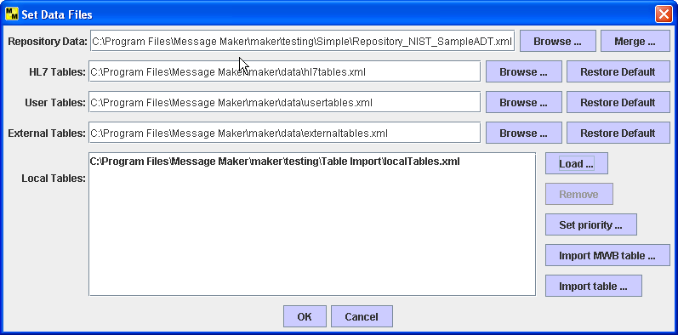
Data Files
Indicates the data repository file
Indicates that a local table has been loaded
Description: This dialog shows the data files that are used for obtaining data values during message generation. The dialog is also used to set the data files, e.g., importing a local table. Local table data can be provided in the Message Maker format, MWB format, or in a local format that needs to be converted with the utility provided.

Slide 15
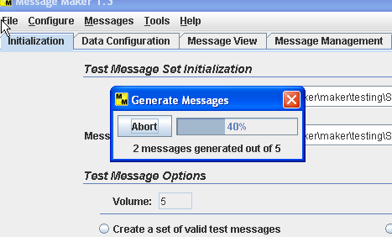
Generate Messages
Select Generate under Messages Menu
Generate messages and view progress
Description: Once initialization has been completed messages can be generated.

Slide 16
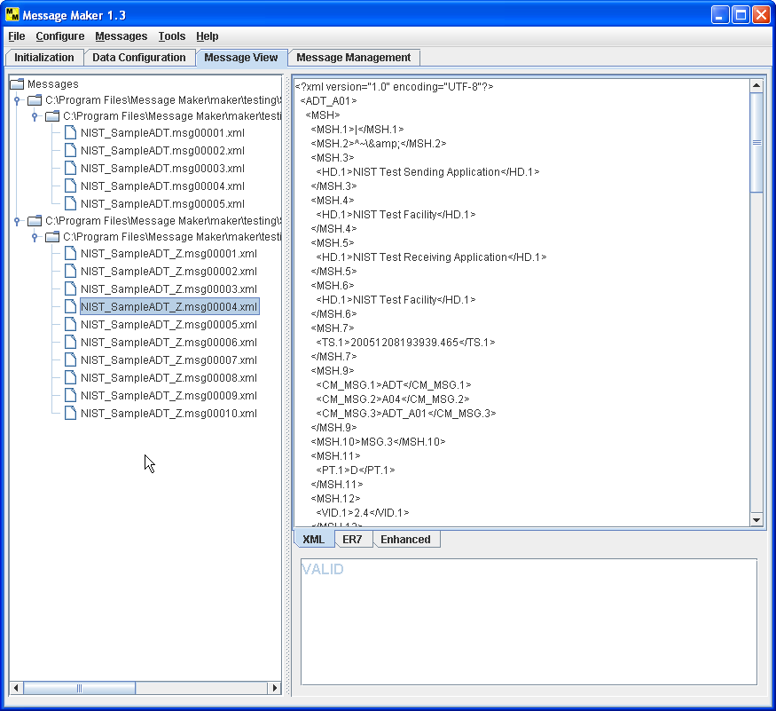
XML Message View
Change the
View
Select a message to view
Test Description
Description: Message Maker provides three views of the messages (XML, ER7 and Enhanced ER7). For each message a Test Description is given that describes the purpose of the test message.

Slide 17
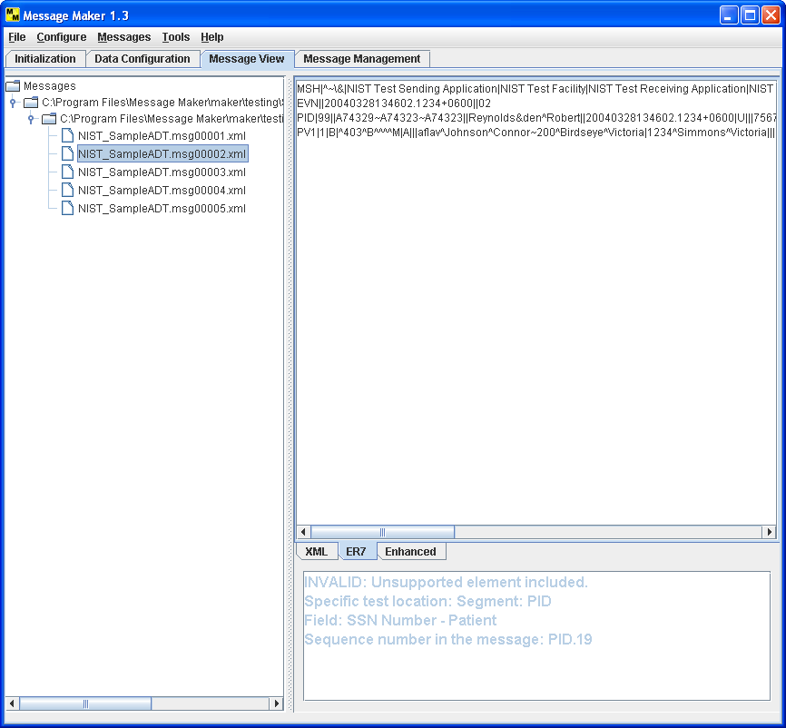
ER7 Message View
ER7 Encoding
Test Description describes the purpose of the test message
Description: ER7 view with a detailed test description.

Slide 18
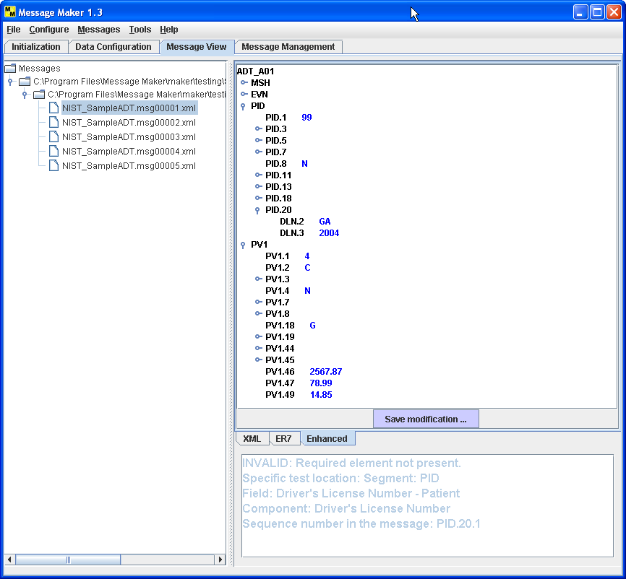
Enhanced Message View
Missing data element PID.20.1
Required element error injected at location PID.20.1
Description: The enhanced ER7 view presents the message in a tree structure that can be navigated. The above call outs shows the injected error description and the location in the message.

Slide 19
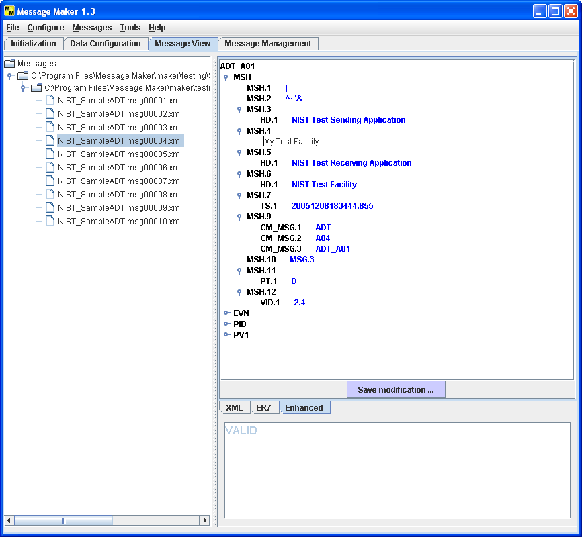
Post Edit Message
Edit the message contents
Description: The enhanced ER7 view allows messages to be edited and saved.

Slide 20
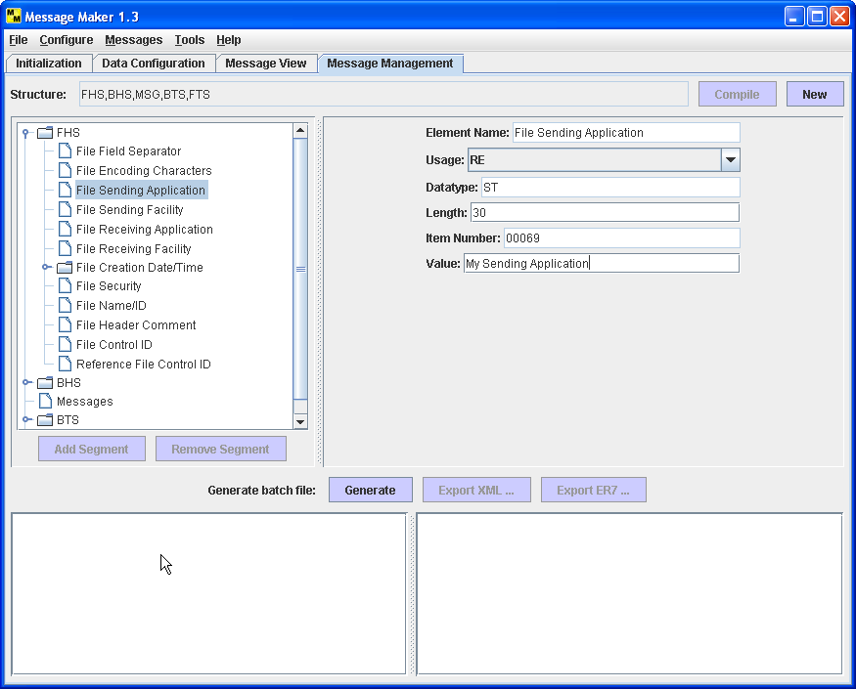
Batching Messages
Define the batch structure
Defines location for messages
Compile the structure
Define the field attributes
Description: A batch of messages can be created using this utility. Define the batch structure; populate the field attributes for the FHS, BHS, BTS, and FTS segments; and compile. MSG is a placeholder for the messages.

Slide 21
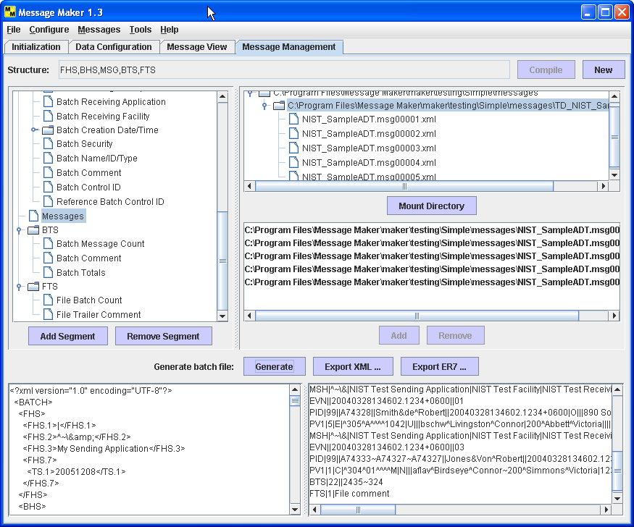
Batching Messages (Cont.)
List of messages
Add messages to the batch
Save XML or ER7 batch file
Description: Add messages to the batch. Select Generate to create the batch file. The batch is created in both the XML and ER7 encodings.

