Slide 1
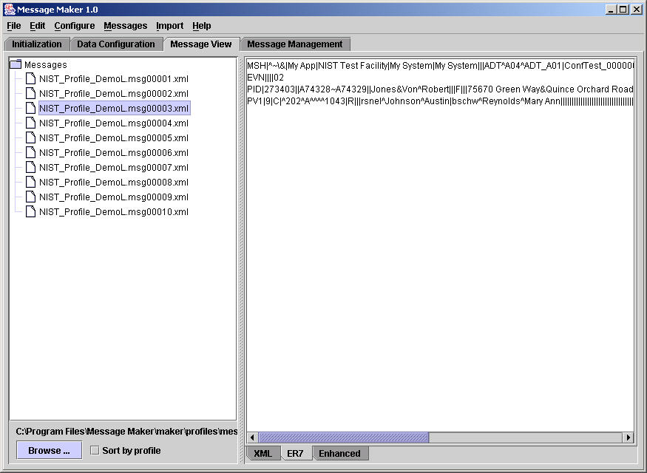
Message Maker: The Need for Dynamic Test Creation
Message
Types
Message
Events
Message Profile
ADT^A01
-
ACK
ADR
ADT
BAR
CRM
CSU
DFT
DOC
DSR
EAC
EAN
EAR
EDR
EQQ
ERP
ESR
ESU
INR
INU
LSR
LSU
MCF
MDM
MFD
MFK
MFN
MFQ
MFR
NMD
NMQ
NMR
OMD
OMG
OML
OMN
OMP
OMS
ORD
ORF
ORG
ORL
ORM
ORN
ORP
ORR
ORS
ORU
OSQ
OSR
OUL
PEX
PGL
PIN
PMU
PPG
PPP
PPR
PPT
PPV
PRM
PRR
PTR
QBP
QCK
QCN
QRY
QSB
QSX
QVR
RAR
RAS
RCI
RCL
RDE
RDR
RDS
RDY
REF
RER
RGV
ROR
RPA
RPI
RPL
RPR
RQA
RQC
RQI
RQP
RQQ
RRA
RRD
RRE
RRG
RRI
RSP
SIU
SPQ
SQM
SRM
SSR
SSU
SUR
TBR
TCR
TCU
UDM
VQQ
VXQ
VXR
VXU
VXX
A01
A02
A03
A04
A05
A06
A07
A08
A09
A10
A11
A12
A13
A14
A15
A16
A17
A18
A19
A20
A21
A22
A23
A24
A25
A26
A27
A28
A29
A30
A31
A32
A33
A34
A35
A36
A37
A38
A38
A39
A40
A41
A42
A43
A44
A45
A46
A47
A48
A49
A50
A51
HL7 Message Structure
Message Profile
MSH
MSH
EVN
EVN
Segments/Segment Groups:
PID
...
PID
-
Cardinality (min, max)
NK1
NK1
NK1
NK1
NK1
NK1
NK1
NK1
NK1
NK1
...
PV1
PV1
...
...
Fields/Components:
(
-
Field Usage
PV2
PV2
Optionality
)
-
(R, RE, C, CE, X)
OBX
OBX
repeats)
Cardinality (max
AL1
AL1
-
Value Sets/Coding
...
...
system
14
-
Descriptions
Use VA’s MWB or Orion’s
Symphonia to create
XML profiles.
Test Messages
<?xml version="1.0"?>
<HL7v2xConformanceProfile H
<MetaData Name="CALINX" Or
<Encodings>
<Encoding>ER7</Encoding>
</Encodings>
<DynamicDef AccAck="NE" Ap
<HL7MsgType=“ADT"
EventType=“A01
<MetaData Name="CALINX" >
<Segment Name="MSH" LongN
<Field Name="Field Separator" Us
</Field>
<Field Name="Encoding Characters"
<Reference>2.16.9.2</Reference
</Field>
<Field Name="Sending Application"
<Component Name="namespace ID"
Usage="X</Component>
Message Maker
MSH|^~\&|REGAEVN|A05|199901PID|1||191919^NK1|1|MASSIE^ENK1|2|MASSIE^I…
Any
Profile

Slide 2
Message Maker: HL7 V2 Conformance Testing
Specification
Tool (e.g., MWB)
Data Sources
HL7
Standard
DB
NIST HL7
Reference
Database
HL7 V2
Profile (XML)
Message
Maker
HL7 Test
Messages
Profile based
Structurally correct
Validated
Varied
Descriptive
Suitable basis for
conformance testing
NIST
Reference
Data (XML)
Message
Factory
(XSLT)
Site-Specific
Database
Interface
Module
Testing Options
Usage
Cardinality
Volume
Data Content
Length
etc.
Testing
Framework

Slide 3
Robert Snelick, NIST May 24, 2004
Input
Data
Sources
Message
Maker
Output
Testing
Framework
System
Under
Test (SUT)
MWB
Table Data
HL7 Tables
User (HL7)
User (Local)
External
HL7
Test
Application
Prime
Database
Control
Send
Message(s)
HL7
Message
Profile
(XML)
Tool
Management
NIST
Reference
Data
Query
SUT
Configuration
API
(Future)
Receive
Message(s)
Testing
Options:
Structure
Cardinality
Usage
Code Sets
Data Type
Length
Boundary
Out-of-Range
Encoding
Volume
Invalid
Escape
Etc.
Site
Database
View
Test Messages
Validate
Message(s)
Message
Factory
Message
Management
Storage
Retrieval
Logging
Dynamic
Match Pattern
Range
Log
Log
XSL
Transformations
Analyze
Coded Data
SNOMED
LONIC
etc.
Message
Management
Reports

Slide 4
NIST HL7 Message Maker
Message
Workbench
Site DB
Enables site specific data to be imported
~10000 Elements
(~1400 Unique)
Interface
Module
Data Sources
Site Data (XML)
NIST HL7
Element DB
(MS Access)
[Static: Fixture Data]
[Dynamic: Patterns]
[Dynamic: Range]
[Configuration: Site
Specific]
HL7 V2
Profile (XML)
Message
Maker
Partially Populated for ADT Messages
HL7 Test
Messages
Profile based
Structurally correct
Validated
Varied
Descriptive
Suitable basis for
conformance testing
NIST Ref.
Data (XML)
Message
Factory
(XSLT)
HL7
Standard
DB
HL7 Tables
(XML)
Table Data
HL7
HL7 User
User (Local)
External
User Tables
(XML)
Testing Options
Usage
Cardinality
Volume
Data Content
Length
etc.
Testing
Framework
External Tables
(XML)
NIST Created
(Configurable)
Coded Data
SNOMED
LONIC
etc.
Interface
Module
Robert Snelick
September 2004

