Slide 1
Towards Interoperable Healthcare Information Systems: The HL7 Conformance Profile Approach
Robert Snelick, Len Gebase, Lisa Carnahan
National Institute of Standards and Technology (NIST)
Pete Rontey, U.S. Veterans Administration (VA)
rsnelick@nist.gov
http://www.nist.gov/messagemaker
Notes:
Today I will discuss interoperability problems that persists in healthcare information systems worldwide and present the concept of conformance profiles to address these problems. This is joint work between the National Institute of Standards and Technology, the U.S. Veterans Administration, and industry participates on the HL7 conformance special interest group.

Slide 2
Outline
Overview the HL7 Standard
HL7 Message Structure
Problems with the HL7 Standard
Using conformance profiles to improve interoperability
Tools to support conformance profiles
Conformance profiles in practice
Summary
Notes:
First I’ll give an overview the HL7 standard and the details of how an HL7 message is constructed. I’ll discuss the shortcoming of the standard and how this presents interface implementation problems. I’ll offer a solution using conformance profiles and describe a set of tools that we have developed to support conformance profiles. Finally I’ll provide some examples of how conformance profiles are being using in practice to improve interoperability.

Slide 3
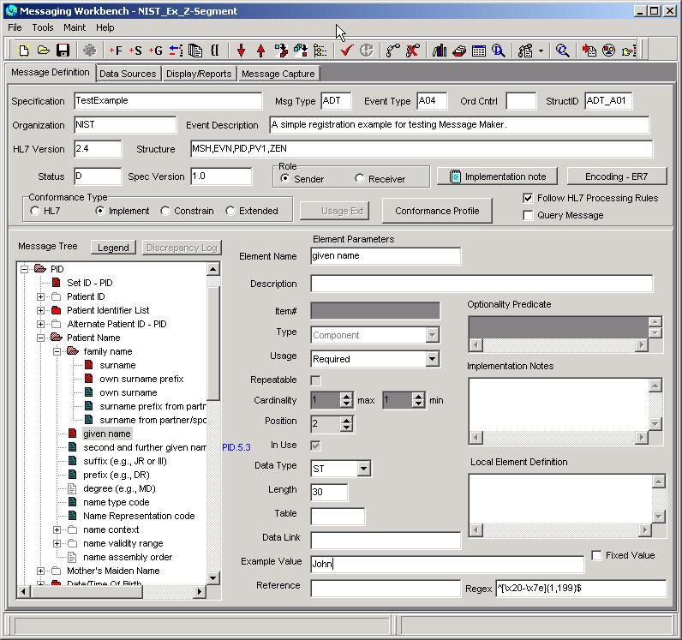
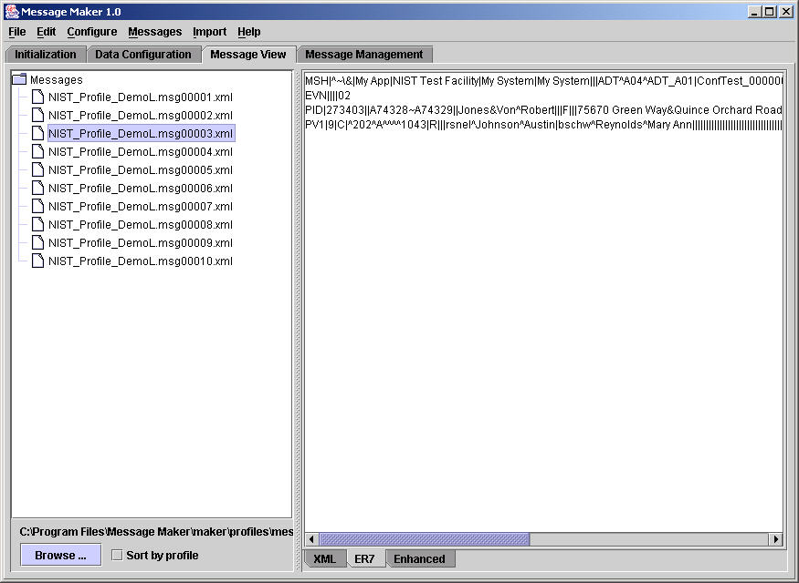
HL7 and Conformance: The Big Picture
HL7
Standard
Tools to build profiles
e.g., MWB (VA)
XML representation
ADT^A01
Message Profile
HL7 Message Structure
Message Profile
MSH
MSH
<?xml version="1.0"?>
<HL7v2xConformanceProfile H
<MetaData Name="CALINX" Or
<Encodings>
<Encoding>ER7</Encoding>
</Encodings>
<DynamicDef AccAck="NE" Ap
<HL7MsgType=“ADT"
EventType=“A01
<MetaData Name="CALINX" >
<Segment Name="MSH" LongN
<Field Name="Field Separator" Us
</Field>
<Field Name="Encoding Characters"
<Reference>2.16.9.2</Reference
</Field>
<Field Name="Sending Application"
EVN
EVN
PID
NK1
NK1
NK1
...
PID
...
NK1
NK1
NK1
NK1
NK1
NK1
NK1
PV1
...
PV1
...
Universal design
Riddled with optionality
Implementation chaos
Interoperability difficult
PV2
PV2
OBX
OBX
AL1
AL1
...
Messaging
Workbench
...
Agreement
Define constraints
HL7 System
Test
System
Need for test messages
Profile
Test
Harness
MSH|^~\&|REGAEVN|A05|199901PID|1||191919^NK1|1|MASSIE^ENK1|2|MASSIE^I…
Message
Maker
Conforms?
Conformance testing needed
Improves reliability and interoperability
Testing Framework
Profile based
Suite of test messages
Suitable for conformance testing
Tools to build messages
Message Maker (NIST)
Automated and adaptable
Notes:
This pictures shows an overview of our approach. When originally design the HL7 standard wanted to accommodate as many as possible business use cases. This left the standard riddled with many optional components which lead to implementation difficulties. Conformance profiles were introduced to help with these problems. Tools such as the messaging workbench were developed to build profiles. An important outcome from tools like these is a standard representation of the profile as an XML document. The XML profile directly supports testing activities such as automatic test generation of and message validation. Ensuring that systems adhere to the conformance profiles agreements will lead to interoperability.

Slide 4
HL7 and Healthcare Integration
R1
R2
R3
DICOM
RIS
Scheduling
Cardiology
HL7
HL7
NCPDP
X12
HL7
HL7
Rx
Billing
HIS
HL7
HL7
HL7
HL7
Diet
HL7
Nursing
LAB
Hospital
Domain
HL7
ASTM
L1
L2
L3
L4
HL7 (Health Level Seven) Messaging Standard (Application level) – Version 2
Standards for the exchange, management, and integration of data for clinical care
  Messages model real world events
  e.g., Messages for registering a patient or requesting a lab order
HL7 provides a flexible framework to build messages
Widely used; 90% of hospitals
Notes:
Here we see a typical healthcare environment that consists of a number of best-of-breed applications that need to exchange clinical data. Multiple standards can be used for a particular domain, one of which is the HL7 messaging standard. HL7 models real world events such as registering a patient or requesting a lab order.
HL7 offers a a flexible framework to build messages and is widely used.

Slide 5
HL7 Message Framework
Hierarchy of Message Elements
  Groups, Segments, Fields, Components, and Sub-Components
  Groups and Segments can contain additional elements
  Fields and Components can contain additional elements or are primitive elements
  Sub-components are primitive elements (i.e., can data values)
Many Message Events
Model Real World Events, such as
Admit/Discharge/Transfer (ADT)
  ADT A04 (Register Patient)
  ADT A08 (Update Patient Data)
  Etc.
Lab Orders (ORM)
  ORM O01 (Order Message)
Lab Results (ORR)
  ORR O02 (Order Response)
Etc.
Hundreds of message events
HL7 Message
Segments
Groups
Fields
Groups
Segments
Component
Sub-Component
Notes:
An HL7 message has a hierarchal structure of message elements. The elements can be container elements or be primitive elements. There are many message events that model real world events. For each event there is an associated message type. For example, the message type to register a patient is ADT A04.

Slide 6
Anatomy of an HL7 Message
PID Segment
ADT^A04^ADT_A01
MSH
EVN
PID
[ PD1 ]
[{ ROL }]
[{ NK1 }]
PV1
[ PV2 ] . . .
[{ GT1 } ]
[{
IN1
[ IN2 ]
[{ IN3 }]
[{ ROL }]
}]
[ ACC ]
[ UB1 ]
[ UB2 ]
[ PDA ]
SEQ | LEN | DT | OPT | RP/# | TBL# | ITEM# | ELEMENT NAME
1 | 4 | SI | O |  |  | 00104 | Set ID - PID
2 | 20 | CX | B |  |  | 00105 | Patient ID
3 | 250 | CX | R | Y |  | 00106 | Patient Identifier List
4 | 20 | CX | B | Y |  | 00107 | Alternate Patient ID - PID
5 | 250 | XPN | R | Y |  | 00108 | Patient Name
6 | 250 | XPN | O | Y |  | 00109 | Mother’s Maiden Name
7 | 26 | TS | O |  |  | 00110 | Date/Time of Birth
8 | 1 | IS | O |  | 0001 | 00111 | Administrative Sex
…
37 | 80 | ST | O |  |  | 01541 | Strain
38 | 250 | CE | O | 2 | 0429 | 01542 | Production Class Code
Components: <family name (FN)> ^ <given name (ST)> ^
<second and further given names or initials thereof (ST)> ^ <suffix (e.g., JR or III) (ST)> ^
<prefix (e.g., DR) (ST)> ^ <degree (e.g., MD) (IS)> ^ <name type code (ID) > ^
<name representation code (ID)> ^ <name context (CE)> ^
<name validity range (DR)> ^ <name assembly order (ID)>
Subcomponents of family name: <surname (ST)> ^ <own surname prefix (ST)> ^
<own surname (ST)> ^ <surname prefix from partner/spouse (ST)> ^ <surname from partner/spouse (ST)>
Subcomponents of name context: <identifier (ST)> & <text (ST)> &
<name of coding system (IS)> & <alternate identifier (ST)> & <alternate text (ST)> &
<name of alternate coding system (IS)>
Subcomponents of name validity range: <date range start date/time (TS)> &
<date range end date/time (TS)>
HL7 0001 - Admin Sex
A | Ambiguous
F | Female
M | Male
U | Unknown
Notes:
A message event has an associated message structure that gives a basic template for the message. The message structure consists of a list of segments. Segments can be required or optional and may or may not repeat. Each segment is made up of a list of fields. Here is an example of a Patient Identifier segment or PID. The PID segment list each field and associated attributes for each field. These include the length, datatype, optionality, a table association and other information. A field may be further decompose into components and sub-components that also have associated attributes.

Slide 7
Problem with HL7 Base Standard
APP X
User Interface
Order Entry
Application
System
DB
Program Module
Order Entry
Application
System
Lab Order
Transaction
Message
Creation
Message
Parsing
Lab Result
Transaction
HL7
X to Y
Mapping
Y to X
Mapping
HL7
Laboratory
Application
System
Message
Parsing
Message
Creation
Laboratory
Application
System
Program Module
DB
User Interface
APP Y
Overwhelmingly large with many optional features
  Framework for negotiations, but still need to work out the details
  Lacks a standard methodology for establishing trading partner agreements
  Local Extensions (e.g., Z-segments) complicate matters further
Interoperability Issues – “HL7 Flavors”
  Two systems could be HL7 compliant but not interoperable
  e.g., a sending system could support 10 repetitions of a field while the receiving systems may only support 5.
Notes:
This picture shows a typically message exchange scenario where one system wants to exchange information with another system. Here we want to send a request for a lab test and get back results. The order system constructs a message from user input and information stored in a database and sends it to the lab system. However, before these systems can exchange information there is a mapping that needs to take place between to account for the differences in the HL7 implementations.
These implementation issues arise because the HL7 standard is a framework for negotiations and lacks a common methodology for establishing precise interface requirements. So different systems develop their own flavor of hl7-so-to-speak. Matter are further complicated because the standard allows for local extensions in the form of Z segments. In practice, vendors will claim HL7 compliant but that means little for making systems work together. For example, a sending system could support 10 repetitions a field for maintaining allergies while the receiving system may only support 5.

Slide 8
Why Conformance Profiles are needed
Billing
HIS
RIS
State-of-the-Art Today
  Ad hoc build-as-you-go solutions
  Interface Engines (Message Mapping)
HL7 Version 3 (Object Technology)
  Explicit conformance model
  Design based on consensus Reference Information Model
  Many good ideas to support interoperability…
  …but too complex and many years from practical deployment
HL7 Version 2 Conformance (or Message) Profiles
  Applies implementation specific constraints to the standard
  Principles drawn from HL7 V3 development efforts
  The solution for today
IE
LAB
Rx
Diet
Notes:
What happens today is the scenario I just described or more commonly interface engines are deployed. An interface engine sits in between the applications and acts as a message broker. It does translations to account for the different flavors of HL7 that are connected to a healthcare information system. Performing the transformation of one message format to another message format can get very complex and information may be lost or misconstrued in the translation.
V3: HL7 recognized the problems with version 2 of the standard and set out to develop version 3 to address the problems over 10 years ago. V3 has plenty of good ideas but is mired in too much abstraction and complexity and therefore has gained little traction in the community and likely will not make significant in-roads for many years to come.
V2 has borrowed many of the conformance ideas of V3 that has resulted in the concept of conformance profiles. Conformance profiles applies implementation constrains to the standard in a common format.
Extra Text
Ad hoc: One large hospital determines requirements by giving vendors a set of messages and instructs them to build an interface to handle the messages. Current practices are often ad hoc and debugging and testing is on the fly.
Interface Engines:
As users enter patient data on the HIS, message events are triggered in the HIS’ data export routine. In response, the HIS sends a corresponding message to the interface engine. Since most healthcare systems typically want data in their own flavor of HL7, the interface engine sends a custom copy of the HL7 message to each ancillary system configured to receive the HL7 message. IE works but can become very complex and are error prone.

Slide 9
The Message Profile Approach
Refinement of the HL7 Standard (applies implementation constraints)
Agreement between Trading Partners
Profiled at each level in the message structure (.i.e., segment, field, etc.)
Each element attribute is constrained (e.g., usage)
Specification can be directly implemented
Building a Message Profile
ADT^A01
HL7 Message Structure
Message Profile
MSH
MSH
Segments/Segment Groups:
EVN
EVN
Usage (optionality)
Cardinality (min, max)
PID
...
PID
NK1
NK1
NK1
NK1
NK1
NK1
NK1
NK1
NK1
NK1
...
PV1
PV1
...
...
Fields/Components:
Field Usage (Optinality: R, RE, C, CE, X)
PV2
PV2
Cardinality (min, max)
Value Sets/Coding system
OBX
OBX
Descriptions
Length
AL1
AL1
...
...
Notes:
The conformance or message profile approach is an agreement between trading partners and this agreement is documented in a common format. Each message element in the message structure is constrained in a message profile. On the left we see a message template for an ADT A01 message. On the right the pictures depicts that the message is constrained. Here we see in blue the elements that are supported and for each of these elements, their associated attributes are constrained, such as the usage, coding systems, and cardinality.

Slide 10
Example Profiling: Field Level
SEQ | LEN | Min Len | Max Len | DT | OPT | OPT | RP/# | RP# Min | RP# Max | TBL# | ITEM# | ELEMENT NAME
1 | 4 | 1 | 4 | SI | O | R |  |  |  |  | 00104 | Set ID - PID
2 | 20 |  |  | CX | B | X |  |  |  |  | 00105 | Patient ID
3 | 250 | 1 | 150 | CX | R | R | Y | 1 | 3 |  | 00106 | Patient Identifier List
4 | 20 |  |  | CX | B | X | Y |  |  |  | 00107 | Alternate Patient ID - PID
5 | 250 | 10 | 200 | XPN | R | R | Y | 1 | 3 |  | 00108 | Patient Name
6 | 250 |  |  | XPN | O | X | Y |  |  |  | 00109 | Mother’s Maiden Name
7 | 26 | 4 | 26 | TS | O | R |  |  |  |  | 00110 | Date/Time of Birth
8 | 1 | 1 | 1 | IS | O | R |  |  |  | 0001 | 00111 | Administrative Sex
9 | 250 |  |  | XPN | B | X | Y |  |  |  | 00112 | Patient Alias
10 | 250 | 3 | 20 | CE | O | RE | Y | 0 | 8 | 0005 | 00113 | Race
11 | 250 | 1 | 300 | XAD | O | R | Y | 1 | 3 |  | 00114 | Patient Address
12 | 4 |  |  | IS | B | X |  |  |  | 0289 | 00115 | County Code
13 | 250 | 10 | 30 | XTN | O | RE | Y | 1 | 3 |  | 00116 | Phone Number - Home
14 | 250 | 10 | 30 | XTN | O | RE | Y | 1 | 3 |  | 00117 | Phone Number - Business
…
37 | 80 |  |  | ST | O | X |  |  |  |  | 01541 | Strain
38 | 250 |  |  | CE | O | X | 2 |  |  | 0429 | 01542 | Production Class Code
Each table
reference
contains the
allowed
values
* Also regular expressions to constrain data content of primitive elements
Notes:
Profiling occurs at all levels of the message structure. This table shows an example of how a message structure can be profiled at the field level. The attributes shown in yellow is what is specified by the standard; the red shows how they are specified in the profile. For example, if we look at the optionality column we see that the standard typically declares most fields as optional. In the profile we can constrain these to usage codes such as required or not supported. As another example, specific code values can be specified for elements that referenced tables.

Slide 11
Benefits of Conformance Profiles
Agreement between trading partners
Eliminates the potential ambiguities that the standard allows as implementation alternatives
Provides a better way to conduct and document interface negotiations
Standardized XML representation
  Profile Registries
    Reuse
    Comparison
  Enables interoperability among tools
  Automated message validation
  Automated message generation
  Can expose vendors’ value added product features
Provides a clear method to document localizations
Facilitates conformance and interoperability testing
Notes:
There are many benefits of conformance profiles; one of the most important is a standard way to document the message specification. This allows for profiles to be registered which promotes reusability. The common XML representation of the profile also allows for automated message generation and message validation. In addition, local extensions of the standard can be clearly document. Profiles facilities conformance and interoperability testing, next I’ll present some tools that we have built to support the use of profiles.

Slide 12
Tools to Support Conformance Profiles
Profile Builder
  VA Messaging Workbench (MWB)
Test Generation
  NIST Message Maker
Test Administration and Analysis
  NIST Testing Framework
  NIST Web Services
    Message Generation and Message Validation
  VA MWB Validation Server
Notes:
These tools include a productivity tool for building profiles called the Messaging Workbench. A message generation tool called Message Maker and tools administer and analyze test results.

Slide 13
Messaging Workbench (MWB)
Created by Pete Rontey at the U.S. Veterans Administration (VA)
Productivity tool to build message profiles
Incorporates all HL7 Version 2.x artifacts as MWB libraries
Reverse engineering from sample message
Multiple reports (profile, tables, etc.)
Multiple reports formats (html, xml, etc.)
Supports localizations
Notes:
Artifacts for:
Message Structures
Segment Definitions
Data Type definitions
Elements Attributes
Pre-defined HL7 table definitions
This is for each version (2.1 through 2.5)

Slide 14
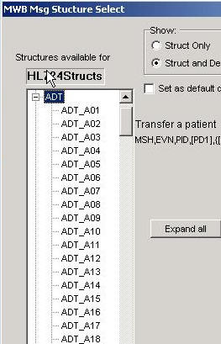
Select Message Type and Apply Constraints

Slide 15
Message Profile Example (XML)
License is required and must appear exactly one time
Snippet from PID segment
SSN not supported
Value needs to be in table 0333
<Field Name="SSN Number - Patient" Usage="X" Min="0" Max="*" Datatype="ST" Length="16" ItemNo="00122">
<Reference>3.4.2.19</Reference>
</Field>
<Field Name="Driver's License Number - Patient" Usage="R" Min="1" Max="1" Datatype="DLN" Length="250" ItemNo="00123">
<Reference>3.4.2.20</Reference>
<Component Name="Driver's License Number" Usage="R" Datatype="ST" Length="100">
</Component>
<Component Name="Issuing State, province, country" Usage="R" Datatype="IS" Length="10" Table="0333">
</Component>
<Component Name="expiration date" Usage="R" Datatype="DT" Length="30">
</Component>
</Field>
<Field Name="Mother's Identifier" Usage=“X" Min="0" Max="*" Datatype="CX" Length="250" ItemNo="00124">
<Reference>3.4.2.21</Reference>
<Component Name="ID" Usage="X" Datatype="ST" Length="3">
</Component>
<Component Name="Check digit" Usage="X" Datatype="ST">
</Component>
<Component Name="code identifying the check digit scheme employed" Usage="X" Datatype="ID" Length="3" Table="0061">
</Component>
Value must be a valid date
Provides impetus for conformance and interoperability;
e.g., message creation, validation, etc.

Slide 16
NIST Testing Services
Message Management
Profile Validation
Message Validation
Message Generation
Encoding Transformation
Logging
HL7 Actors (Simulations)
Communication
Test Framework
Provided as a set of Java APIs which can be used to develop applications, web services, and web applications
Notes:
At NIST we are developing a number of services to support HL7 testing. These services are provided as a set of Java APIs that can be used to build tools, web services, and web applications. I’ll give an overview of our work on message validation, message generation, and a test service.

Slide 17
Message Validation
Validated
XML Message Profile
HL7 Message Source
ER7 Encoded Message
Profile Schema Generator
(XSLT)
ER7 to XML Transformer
Message Profile Validation Schema
HL7 Message
Source
XML Encoded Message
Schematron Rules
XML Schema Validator
Message Validation Reports
XML Message
Validation Report
Schema Violation Interpreter
Notes:
Profile specific schemas are employed for operational message validation. Using an XSL transformation a profile is converted into an XML schema that encapsulates the constraints placed on message instances. Messages are validated against the resultant schema and schema violations are interpreted as message validation failures. The methodology is depicted in the diagram shown. The profile is first validated against the HL7 standard for the specific message type and against the HL7 conformance schema. Validating the profile ensures that basic message construction and conformance rules are adhered to in the message profile. A valid profile provides the baseline upon which message instances can be assessed. That is, the profile is now the governing instrument for determining the validity of a message. Once the profile schema is created, common XML validation processors can be used to produce an XML validation report. This data can be interpreted as needed to produce human readable reports.

Slide 18
The Need for Dynamic Message Creation
Message
Types
Message
Events
Message Profile
explicitly defines message components at each level
implementable specification
still sites defined their own profiles (many)
nature of the beast
Message Profile
Message Profile
explicitly defines message components at each level
implementable specification
still sites defined their own profiles (many)
nature of the beast
ADT^A01
Message Profile
explicitly defines message components at each level
implementable specification
still sites defined their own profiles (many)
nature of the beast
Message Profile
explicitly defines message components at each level
implementable specification
still sites defined their own profiles (many)
nature of the beast
ACK
ADR
ADT
BAR
CRM
CSU
DFT
DOC
DSR
EAC
EAN
EAR
EDR
EQQ
ERP
ESR
ESU
INR
INU
LSR
LSU
MCF
MDM
MFD
MFK
MFN
MFQ
MFR
NMD
NMQ
NMR
OMD
OMG
OML
OMN
OMP
OMS
ORD
ORF
ORG
ORL
ORM
ORN
ORP
ORR
ORS
ORU
OSQ
OSR
OUL
PEX
PGL
PIN
PMU
PPG
PPP
PPR
PPT
PPV
PRM
PRR
PTR
QBP
QCK
QCN
QRY
QSB
QSX
QVR
RAR
RAS
RCI
RCL
RDE
RDR
RDS
RDY
REF
RER
RGV
ROR
RPA
RPI
RPL
RPR
RQA
RQC
RQI
RQP
RQQ
RRA
RRD
RRE
RRG
RRI
RSP
SIU
SPQ
SQM
SRM
SSR
SSU
SUR
TBR
TCR
TCU
UDM
VQQ
VXQ
VXR
VXU
VXX
A01
A02
A03
A04
A05
A06
A07
A08
A09
A10
A11
A12
A13
A14
A15
A16
A17
A18
A19
A20
A21
A22
A23
A24
A25
A26
A27
A28
A29
A30
A31
A32
A33
A34
A35
A36
A37
A38
A38
A39
A40
A41
A42
A43
A44
A45
A46
A47
A48
A49
A50
A51
HL7 Message Structure
Message Profile
Message Profile
explicitly defines message components at each level
implementable specification
still sites defined their own profiles (many)
nature of the beast
MSH
Profile N
EVN
MSH
PID
EVN
<?xml version="1.0"?>
<HL7v2xConformanceProfile H
<MetaData Name="CALINX" Or
<Encodings>
<Encoding>ER7</Encoding>
</Encodings>
<DynamicDef AccAck="NE" Ap
<HL7MsgType=“ADT"
EventType=“A01
<MetaData Name="CALINX" >
<Segment Name="MSH" LongN
<Field Name="Field Separator" Us
</Field>
NK1
NK1
NK1
NK1
NK1
...
PID
NK1
NK1
NK1
NK1
...
PV1
NK1
...
PV1
...
PV2
PV2
OBX
OBX
AL1
AL1
...
...
MSH|^~\&|REGAEVN|A05|199901PID|1||191919^NK1|1|MASSIE^ENK1|2|MASSIE^I…
MSH|^~\&|REGAEVN|A05|199901PID|1||191919^NK1|1|MASSIE^ENK1|2|MASSIE^I…
MSH|^~\&|REGAEVN|A05|199901PID|1||191919^NK1|1|MASSIE^ENK1|2|MASSIE^I…
Need many test messages for each profile and a testing framework to ensure that applications implement what was agreed upon in the message profiles
Notes:
Conformance profiles better enables the automated creation of test messages. However we had a technical problem in that the universe of potential profiles in unbounded given that many message types and events exist and that for a given message event, profile definitions often will differ from site-to-site. To solve this we developed a methodology and tool called Message Maker to dynamically build messages for any given profile.

Slide 19
NIST Message Maker
Specification
Tool (e.g., MWB)
Data Sources
HL7
Standard
DB
NIST HL7
Reference
Database
Message
Maker
HL7 V2
Profile (XML)
HL7 Test
Messages
Profile based
Structurally correct
Validated
Varied
Descriptive
Suitable basis for
conformance testing
Message
Generation
Engine
NIST Data
Repository
(XML)
Table
Values
Example
Values
from Profile
Testing Options
Usage
Cardinality
Volume
Data Content
Length
etc.
Testing
Framework
Default
Values
Notes:
Approach to Message Generation
XSLT Engine
Create base message
Combines XML Profile, Rules, Data
Modify the profile
Message Structure
Element attributes (e.g., cardinality, usage)
Modify existing message content
XPath expression and data value
Element content (length, data, value set)
Used in combination

Slide 20
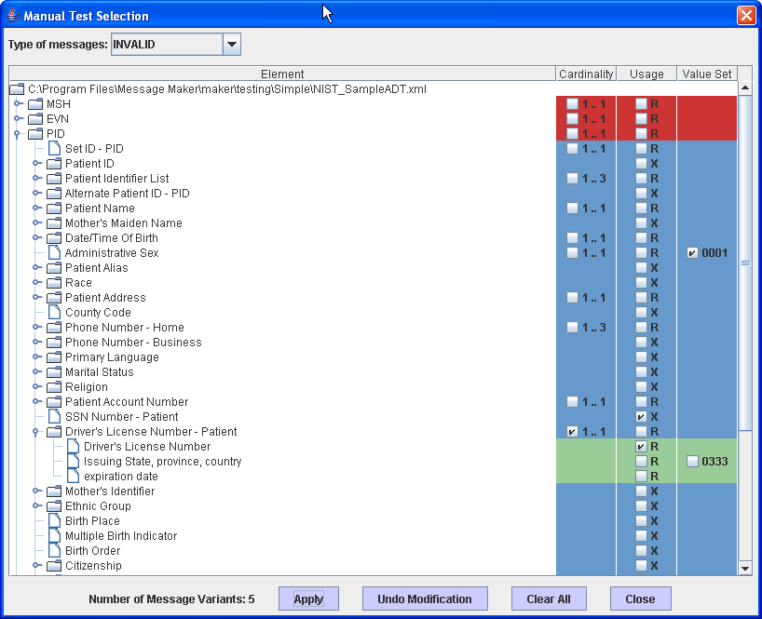
Message Maker: Select Tests
Request either valid or invalid
Element is populated with value that is NOT in the code set
Navigate to specific location in the profile
Not supported element is populated with a value
Required element is NOT populated with a value
Vary the cardinality of this element such that it is outside the valid cardinality range
Description: The Manual Test Selection allows you to pick a specific location in the profile and the type of test you’d like. Tests can be valid or invalid. A number of error messages have been requested above.

Slide 21
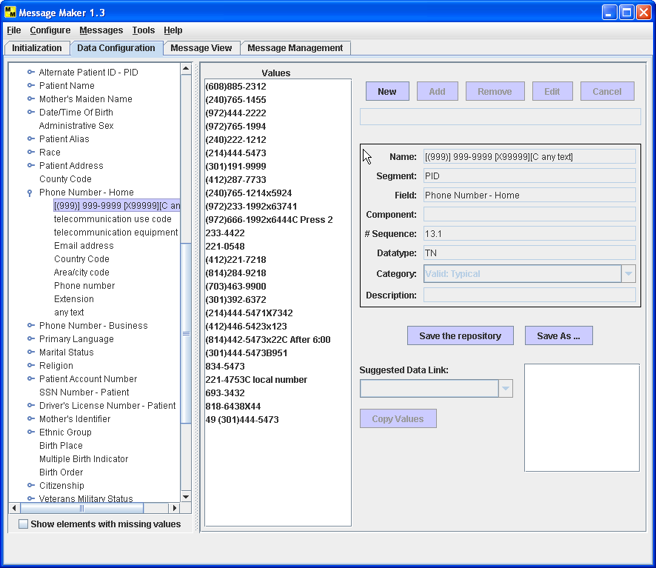
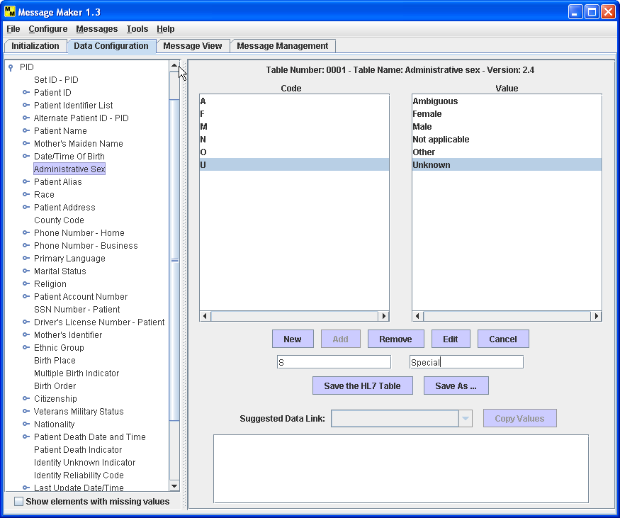
Message Maker: Browse and Edit Data
Notes:
You can also browse the data repository to set various configuration data or to set the content of a particular element to a specific value. This also includes setting table data.

Slide 22
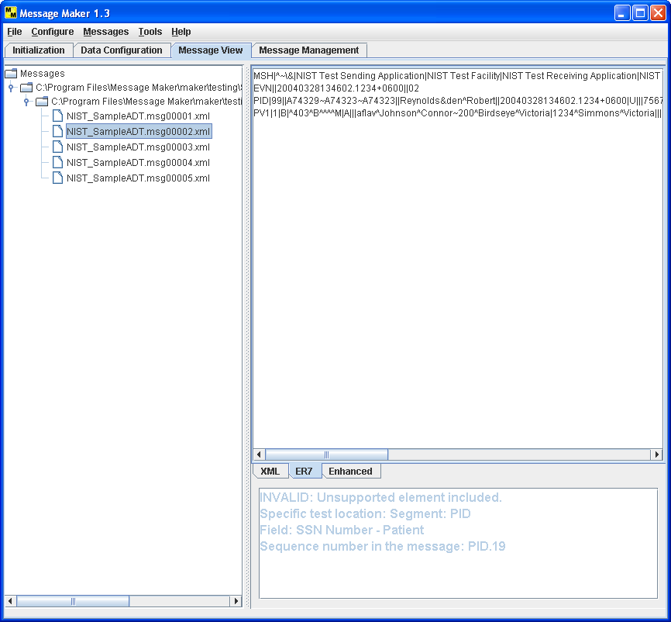
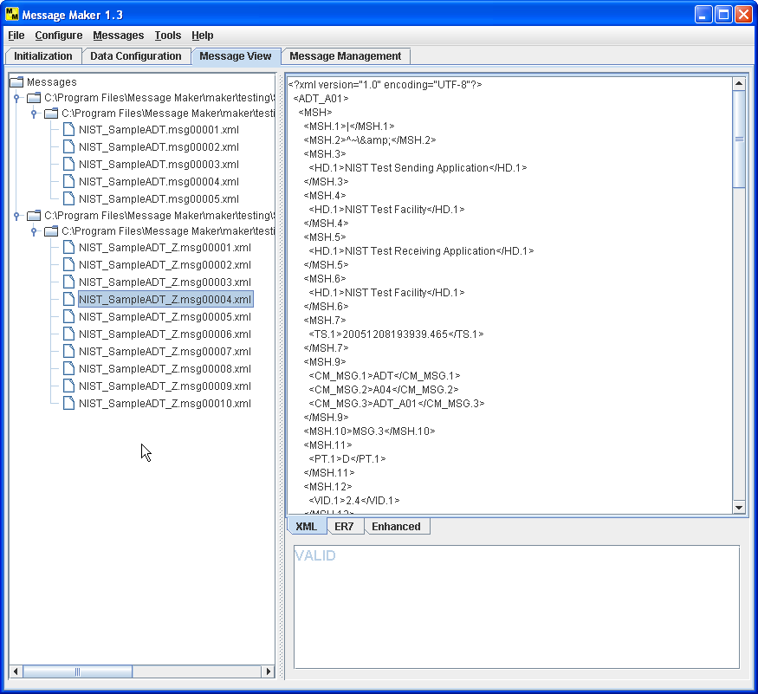
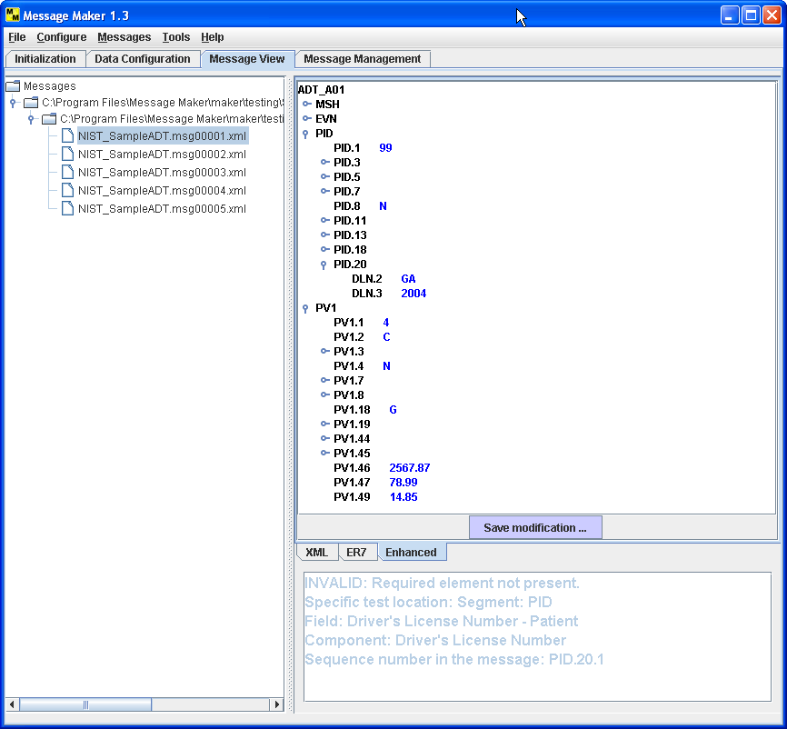
Message Maker: Message Views
ER7 Encoding
XML Encoding
Enhanced View
Test Description describes the purpose of the test message
Notes:
Messages can be displayed and saved in multiple formats. The messages can be posted edited in the enhanced view. Another important aspect is that for each message there is associated meta data describing the test; this information is useful during testing phase of a project.

Slide 23
NIST HL7 Test Framework
Order Placer
IUT
1: ADT_A01
2: ACK
4: ACK
5: ORR_O02 (APP ACK)
3: ORM_O01
6: SIU_S12
ADT
Actor
Order Filler Actor
Image Manager Actor
7: ACK
Test Service
Profile
Repository
Message
Manager
Actor
Manager
Communication
Data
Manager
Test Script (XML)
Actor(s) Config
Messages
Validation Requirements
Simulation
Message
Repository
Logging
Validation
Services
Data
Repository
Message
Encoding
Message
Generation
HL7 Test Services
Notes:
Conformance profiles are useful in scenario testing. We have begun to develop a framework based on the core testing services that we have already built. Here actors can be used to test the behavior of HL7 systems.

Slide 24
Conformance Profiles in Practice
Adoption of conformance profiles is gaining momentum
Example Installations
  U.S. Veterans Administration
  IHE: Integrating the Healthcare Enterprises
  ELINCS: The EHR-Lab Interoperability and connectivity specification
  HITSP: Healthcare Information Technology Standards Panel
Anticipated increase usage adoption as latest versions of HL7 make it into implementations (conformance added in HL7 Version 2.5)
Support from vendors increasing
Notes:
VA: The U.S. Veterans Administration (VA) has used conformance profiles internally for years. Much of the original and advancement has come for the experiences gain within the VA. The MWB is the main tool for interface development in the VA.
IHE: Is an organization that seeks to promote the integration of healthcare standards through the process of use case and prototype implementations. Vendors test their implementations at periodic connectathons. Conformance profiles are used to describe specifications for the HL7 aspects of the use cases.
ELIINCS:
HITSP:

Slide 25
Summary
Data exchange among healthcare systems is problematic due to inadequate messaging standards
Conformance profile approach provides a roadmap
Approach:
  Incorporate and refine conformance concepts into standards
  Provide tools that support the conformance concepts
    Profile Builder
    Message Generation
    Profile and Message Validation
    Testing Framework and Support Utilities
  Work with industry to demonstrate the feasibility and benefits of the methodology with use case example implementations supported by organizations such as IHE and HITSP
End result is improved interoperability of healthcare information systems
Notes:
Healthcare interoperability issues persist
Using Conformance Profiles helps
Our approach is to incorporate solid conformance ideas into the standard and to provide support of the concepts by developing a set of testing tools.
We also work with industry to demonstrate the feasibility and benefits of the methodology.
In the end interoperability will improve.

