Slide 1
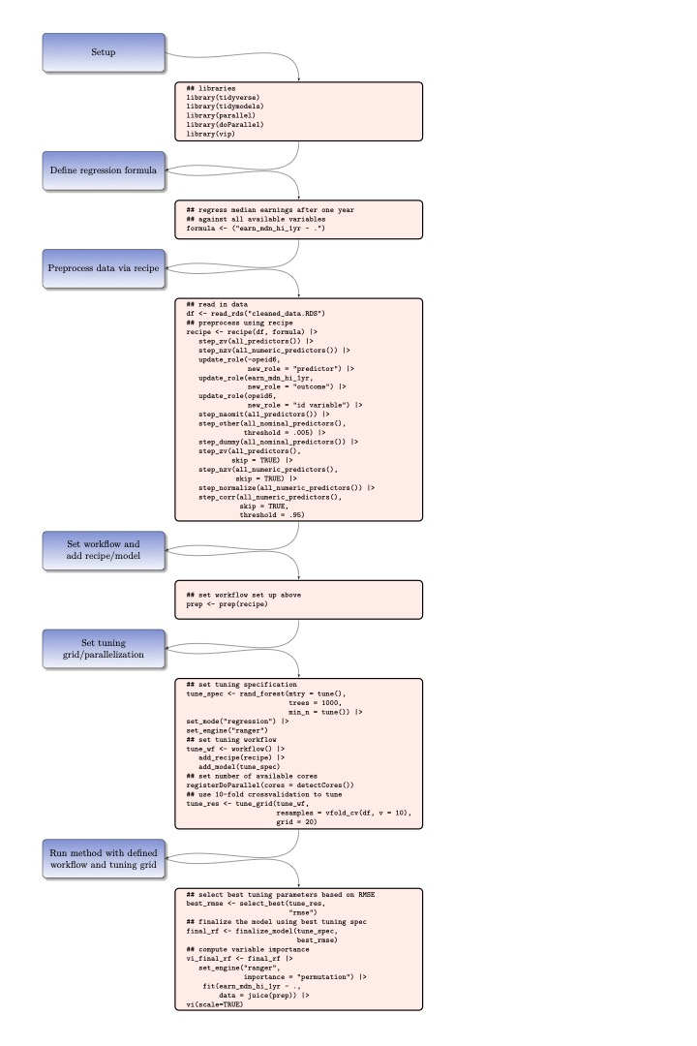
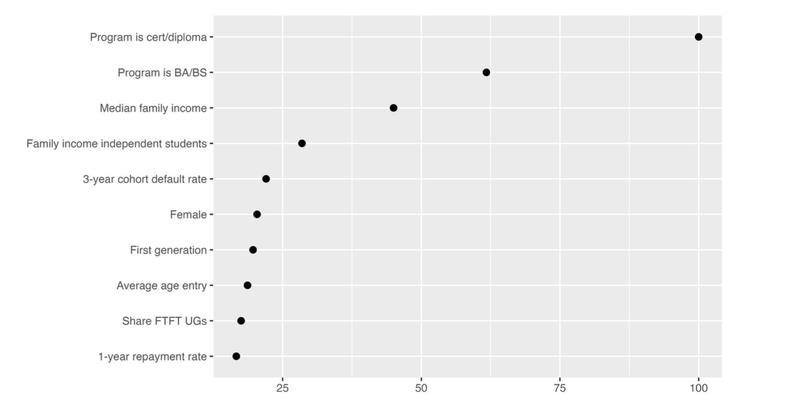
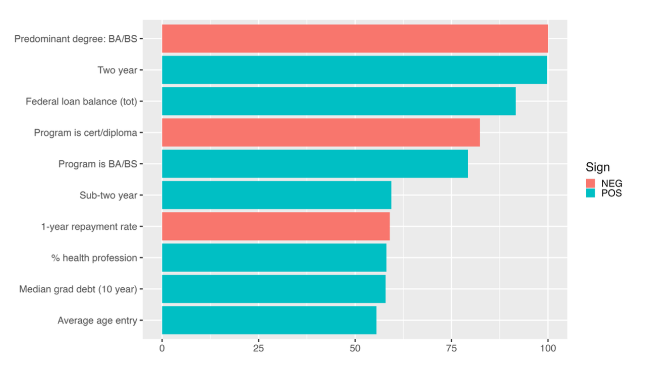

Employing Machine Learning Methods in Predicting Incomes of Recent College Graduates
WORKFLOW
MODELS
Using a Tidymodels workflow (Kuhn and Silge, 2022) in the R language, we preprocess our data and perform analyses following a standardized recipe structure that allows for transparent parameter tuning and model adjustments. Below is example code for our random forest model.
Elastic net regularization (Zou & Hastie, 2005)
Combines LASSO/ridge regression penalties to mitigate issues of bias and variance introduction in your statistical model
Random forest
Randomly samples covariates in a regression model, splits observations on covariates to maximize reduction of RMSE
Using a principled machine-learning approach, we predict recent college graduates' earnings using data from the College Scorecard. These predictions are estimated using elastic net regularization and the random forest algorithm, regression-based methods adept at producing parsimonious statistical models and reducing bias. Our results support the predictive capabilities of institutional characteristics like school classification, overall debt repayment rates and family income on recent graduate earnings.
RESULTS
RQ1 (Variable Importance)
QUESTIONS
What institutional/program level variables are most predictive of median first-year earnings?
What are the patterns of association (positive/negative) for these variables?
DATA
RQ2 (Elastic Net Model)
College Scorecard
2019–2020
Includes over 2,000 variables for 6,700 accredited higher education institutions (HEIs) in the U.S.
Significant portions of the data are privacy suppressed
American Community Survey
2015–2019
Geography of interest: County level (using FIPS)
Matching HEIs with unique county FIPS codes
Helps recover information lost from missing data in the Scorecard
Authors
Olivia Morales, University of Florida
Benjamin Skinner, University of Florida
William Doyle, Vanderbilt University

